Slide 1

Data Visualization
ADTA 5250
Pharmacy Rx Routes Insights Summary
Looking into Dropping Rx Route to Focus on Higher Profiting Routes
Trevor Khan
Fall 8W1 2022

Slide 2

Executive Summary
Looking into reduce company expenses by no longer selling Extended-Release routes
Focus on our larger profiting routes instead
Units Sold & Profit Comparisons:
Extended Release had the second highest of units sold out of all the Rx routes
Looking into the gross profits sold, Extended Released performed the worst out of all the other Rx routes
Location, Drug Reps, & Competitors:
None of the competitors had any success with extended-release drugs….so it is not only our company that is under profiting from the extended-release drugs
Comparing all the drug reps, the extended release is the worst performing in sales
There weren’t any states that were showing substantial success with extended-release drugs
The Top Two Routes:
The IV(Infusion) and Intramuscular routes are the top two in performance in our company
Executive Summary

Slide 3
Extended-Release drugs had the 2nd Highest Units Sold… But the Lowest Gross Profits
The profits being generated from Extended-Release drugs are incredibly low for being the 2nd highest in units sold.
Top Units Sold: Iv (Infusion)
Extended-Release: 2nd Highest
Top Gross Profits: Iv(Infusion)
Extended-Release: Last
Units Sold vs Profits

Slide 4
Extended-Release has only a $5 average in profits…
…The lowest of all the Rx Routes
$191 Average in Profits
$5 average in profits
Wholesale Cost vs Retail Price

Slide 5
Extended-Release drugs are in drastic decline…
…Profits and Units Sold have been in decline since 2008
2% Decrease
8% Decrease
Time Trend of Profits & Units Sold

Slide 6
The top selling extended-release drug barely made the top 100 in profits made…
$178K difference between the highest overall drug and the highest extended-release drug in profits
Extended-Release Drug Profits

Slide 7
In all other competitor companies, extended-release performed the worse overall…
Since extended-release performed the worse in all companies… It is not an internal issue on why profits are so low
Competitor Gross Profits Comparison

Slide 8
Extended-Release was the lowest for all reps…
… Iv infusion was the top profiting drug
54K difference
280K difference
*Note: Wally Wasserman had Intramuscular as their highest profiting
Most Profitable Drug Reps

Slide 9
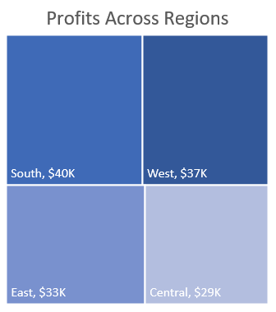
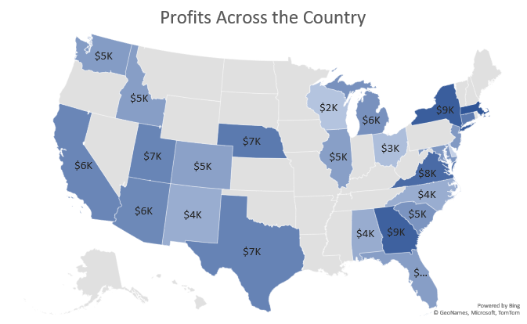
The profits from extended-release drugs seemed to be consistent across the country…
0 of the states are profiting over 10K from Extended-Release Drugs
Gross Profits Across the Country

Slide 10
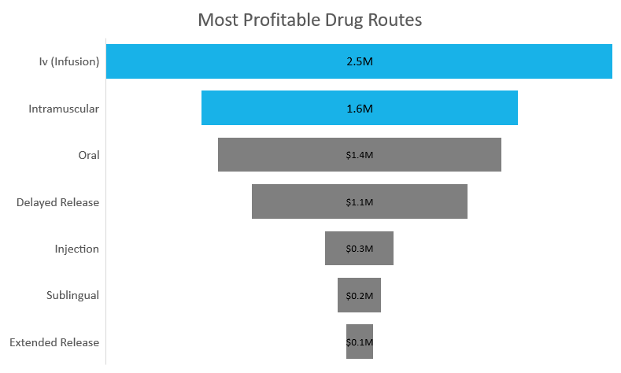
Looking at the Stronger Performing Drug Reps….
… Iv(Infusion) and Intramuscular are the top 2 routes
Iv Infusion & Intramuscular are showing an increase in profits
Strong Performing Drug Routes

Slide 11
The Issue:
The company’s expenses are too high and need to find a way to reduces expenses
The Solution:
Removing the Extended-Release Drugs from our company is the recommendation to reduce expenses
Focus on the more profiting drug routes of IV(Infusion) and Intramuscular
The Evidence:
Looking into an overview of Profits and Units Sold… Extended-Release Drugs are our lowest profiting drug route
Are we just failing at marketing this drug? No, it is showing that all our competitors as well have Extended-Release drugs as their lowest performer
Does Location make a difference? No, across the country the Extended-Release Drugs are not profiting over 10K anywhere
Looking into our Drug Reps, It is the lowest performing route for everyone.
Then looking into the specific extended-release drugs…. 0 were in the top 50 of the profits by specific drugs in our company
The Recommendation

