Slide 1


DATAMBULANCE QR CODE BASED SYSTEM
THE AMBULANCE FOR DATA EXCHANGE

Slide 2


OUR BIG IDEA
The spread of diseases through touch has now become a new normal nowadays. Hence, paperless and contactless, are THE need of the hour. The age-old method of carrying medical files whenever you visit a doctor results in it going through different hands and if the patient forgets to carry his medical file along with him then the doctor has no prior information to move forward with. DATAMBULANCE is here to CHANGE this. With DATAMBULANCE, the patient can have the entirety of medical information right in the palm of his hand as a QR CODE, without having any physical contact.

Slide 3
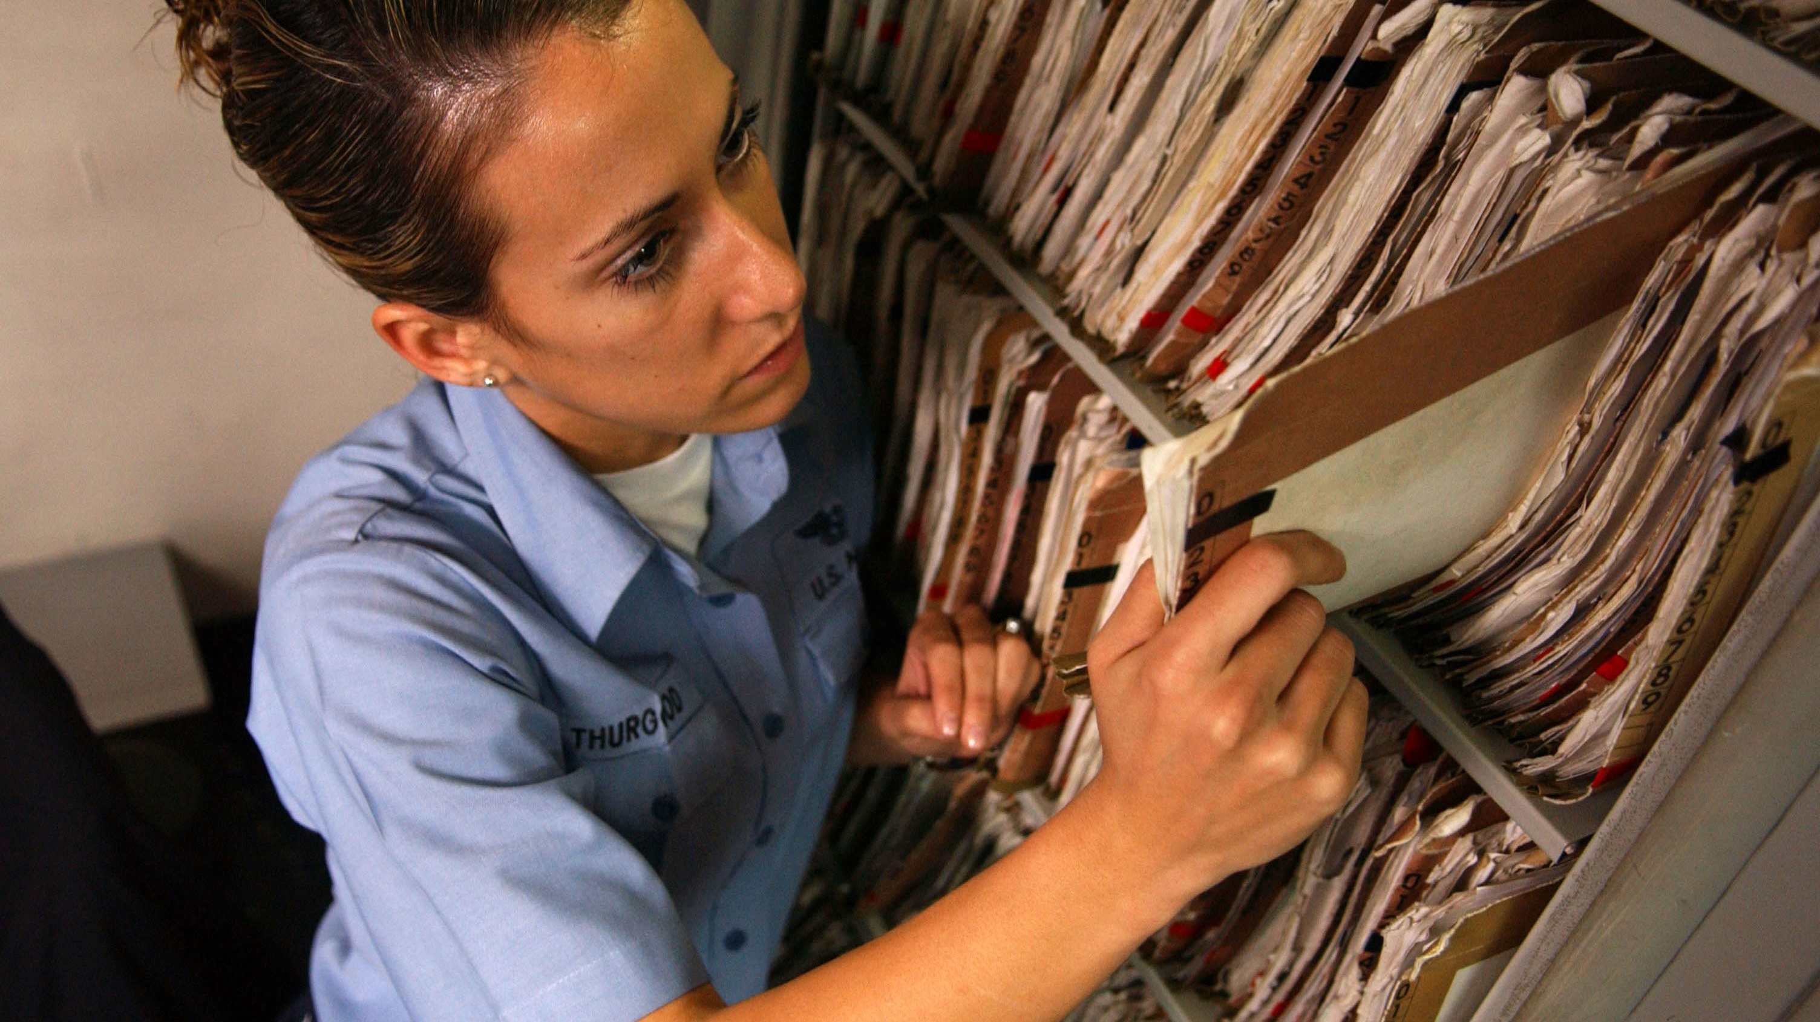
COMMON ISSUES WITH CURRENT PRACTICE
1. Patient forgetting to carry his file or losing it
Struggling with inhouse hospital scanning
Medical Record Libraries Taking up Space
4. Retrieving Records Sent Off Site
DATAMBULANCE IS THE SOLUTION TO THESE PROBLEMS

Slide 4
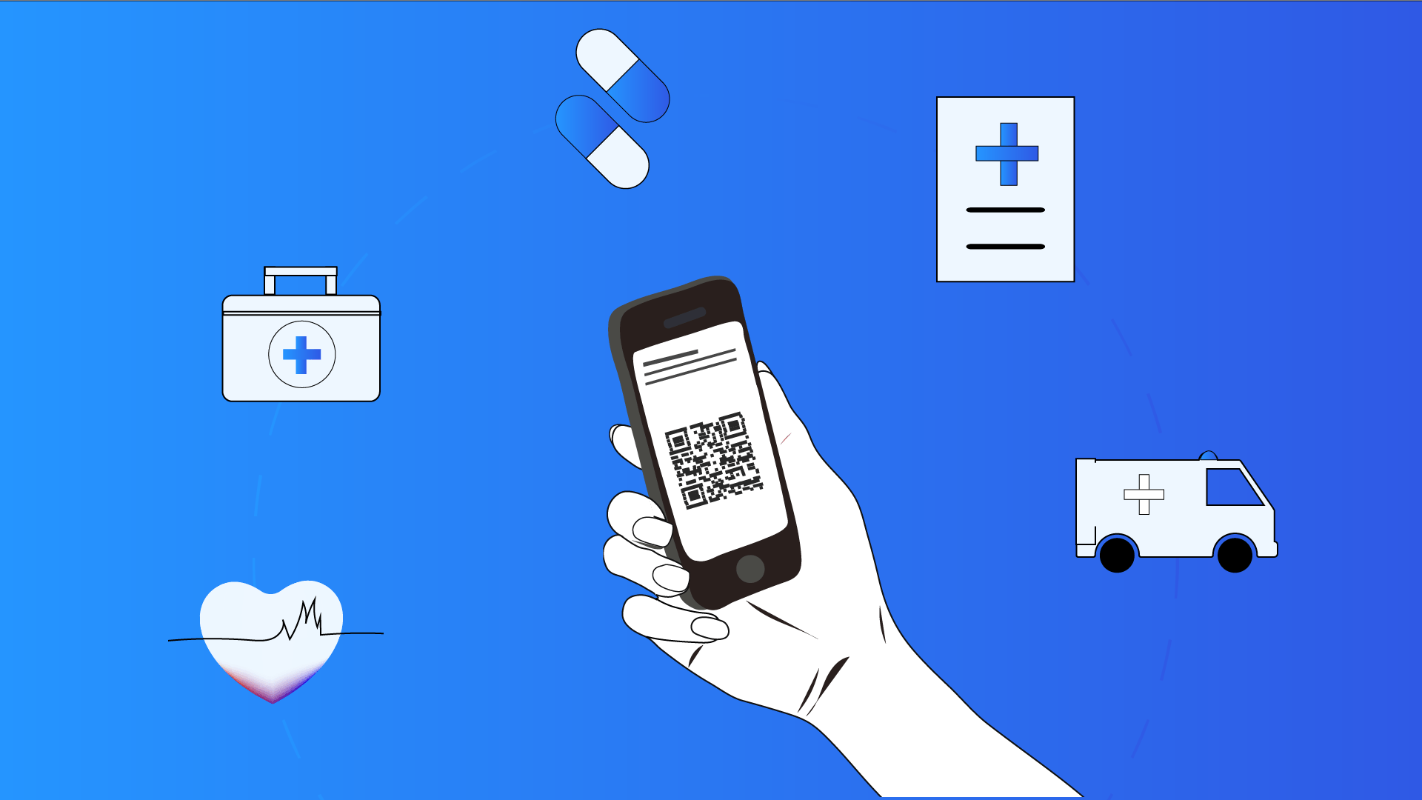
SOLUTION
QR BASED DATA STORAGE

Slide 5




OUR SERVICES
QR Code For Retrieving Entire Information of a patient
Database Management Service
Scanning QR Code by the hospital or the doctor will display all the medical information
Hospital can sign in to view the records of patients
Call-in General Physician Consultation Available
Personal Medical Assistant :
Our AI powered Chatbot will assistant the Patient in providing quick help to the patient
Answers to questions not given by personal medical assistant can be forwarded via call to a general physician

Slide 6








1.HOW It WORKS : QR CODE
Patient carries his QR Code in his phone
Hospital Staff scan the QR Code
DATAMBULANCE then displays the data to the doctor

Slide 7



2.HOW IT WORKS : DATABASE MANAGEMENT
For Hospitals
Data will be displayed for all patients
Personal Information and QR code will be displayed
For Patients

Slide 8






3 & 4.HOW IT WORKS : PERSONAL MEDICAL ASSISTANT
3.
4.
DATAMBULANCE has a AI powered Personalized Chatbot assistant which helps to predict the disease and suggest some home remedies. In healthcare, they could take off the burden on medical professionals regarding easily diagnosable health concerns or quickly solvable health management issues 24/7.
If the chatbot is not able to answer some question the patient will be provided with an option to have an on-call discussion with the general physician

Slide 9
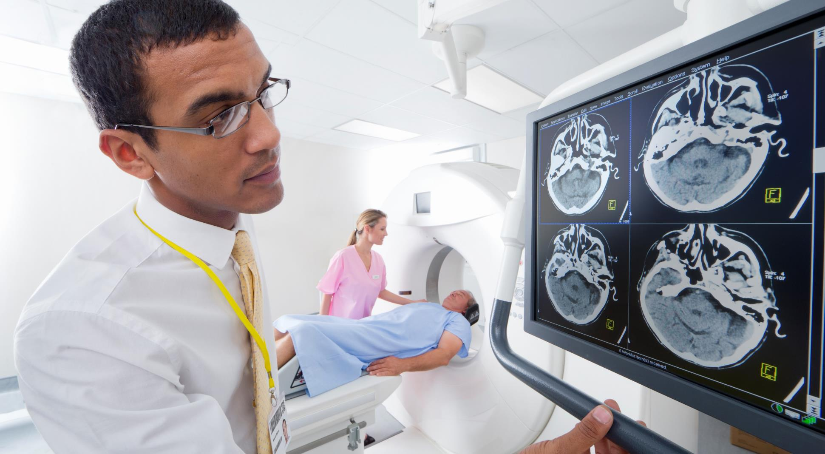





ADVANTAGES OF DATAMBULAnCE QR SYSTEM :
No Contact Data transfer between patient and doctor reducing risk of virus transmission
More reliable than traditional data storage practices
Faster to retrieve older records of patients
QR can be printed and pasted on your bag , purse etc for viewing by Emergency Respondents
Cost Effective
DATAMBULANCE

Slide 10





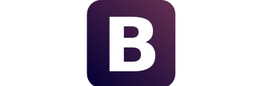

TECH STACK USED :
HTML
CHATBOT
PYTHON
CSS
BOOTSTRAP
SQLite

Slide 11





THE TEAM
Abhirup Singh
Utkarsh Gaikwad
Backend Developer
Database Developer
Paresh Meher
Harsh Khedwal
Front End Developer
Chatbot and ML/AI Developer

Slide 12

Thank you
DATAMBULANCE
SERVICE REPRESENTATIVE
contact@datambulance.com
678-555-0100

