Slide 1
Assessing the Fed Rate Target: Too High, Too Low, or Just Right?
By Shaun Levenson
ECON 531: Macroeconomic Theory 2
Matthew Fienup
Summer 2025
Master of Science in Quantitative Economics

Slide 2

Introduction
Setting the Scene
Notes:
In 2025, following a rapid tightening cycle, the Fed has held the federal funds rate steady at 4.33%, despite a sharp decline in inflation from over 9% in 2022.
This presentation examines whether that rate is appropriate by:
Reviewing current economic conditions
Exploring expert views on the drivers of the 2022 inflation spike
Weighing arguments for adjusting or maintaining current rate levels

Slide 3
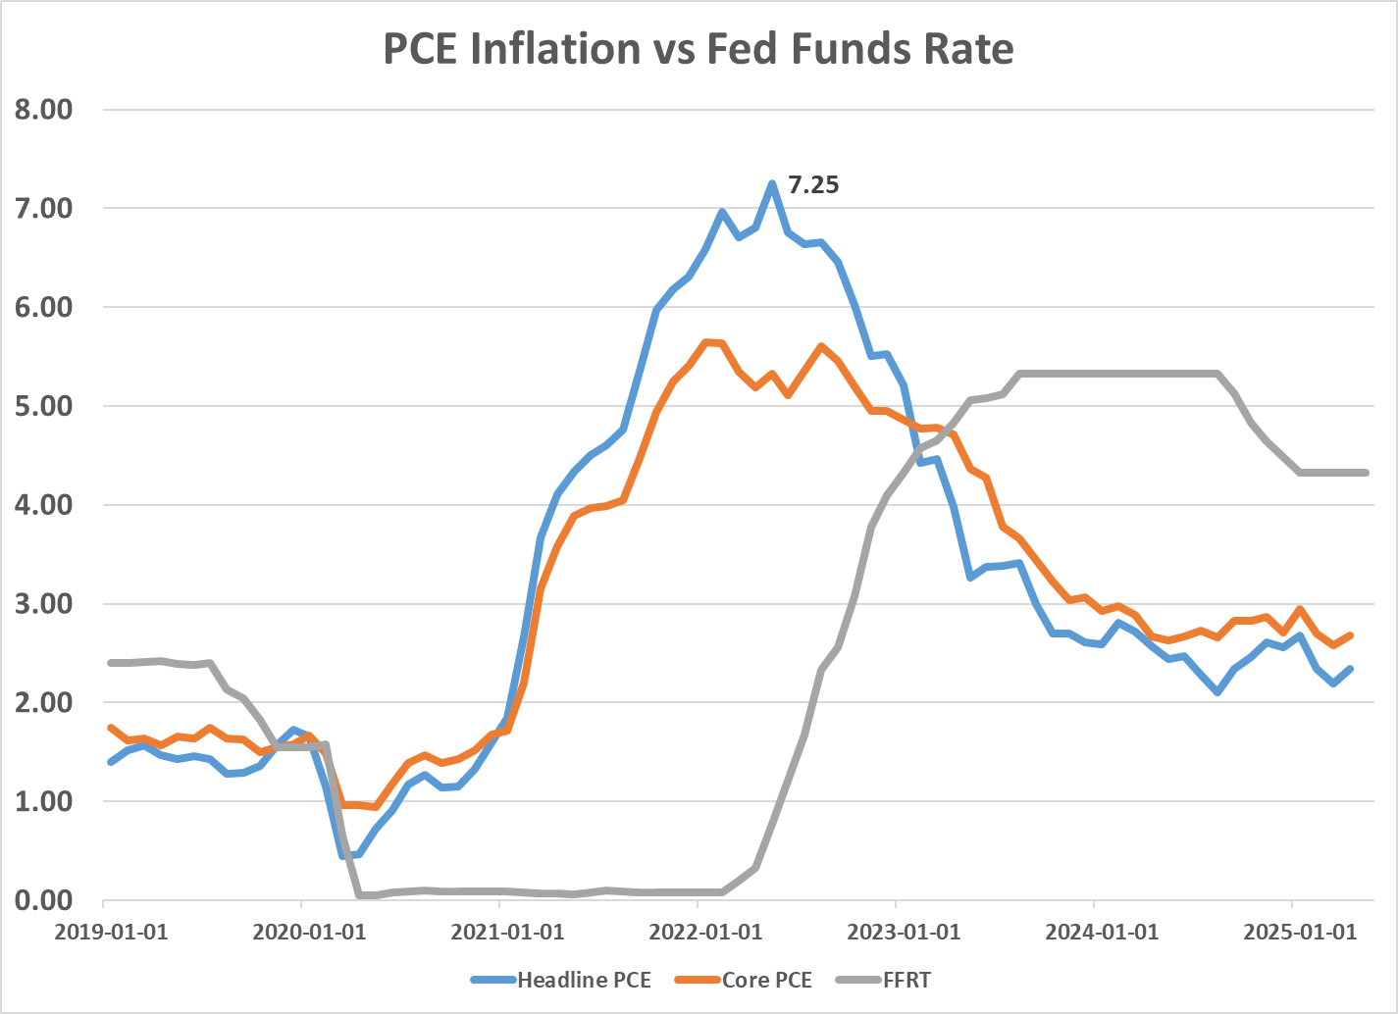
Introduction
Economic Snapshot
Monetary Policy
Fed Funds Rate Target: Between 4.25% and 4.50%
Money Supply (M2): $21.9 trillion (as of May 2025)
Inflation Rates:
Core: 2.7%
Headline: 2.3%
Unemployment Rate:
4.2%
Economic Growth
2024 Annual: 2.9%
2025 Q1: -0.5%
Data Source: https://fred.stlouisfed.org/series/PCEPILFE
https://fred.stlouisfed.org/series/fedfunds
Notes:
In mid-2025, the federal funds rate remains relatively tight at 4.25%-4.50%, above pre-pandemic levels.
Inflation has eased: headline at 2.3%, core at 2.7%—both near the Fed’s 2% goal.
Unemployment rose to 4.2%, signaling a softer labor market.
Q1 2025 GDP contracted by 0.5% after 2.9% growth in 2024.
M2 money supply stands at $21.9 trillion, still high but growth has slowed.
Overall, inflation is down, but growth is weakening and unemployment is increasing, posing a challenge for Fed policy.

Slide 4
Introduction
“I would like to conclude by saying that in this environment of heightened uncertainty, it is increasingly important to comprehend what is driving uncertainty and how monetary policy might play a role in limiting the negative impact of uncertainty on businesses, households, and financial markets.” – Phillip Jefferson, Vice Chair of the Federal Reserve Board, April 16, 2024
Notes:
DON’T READ THE QUOTE THIS TIME
Although this quote is from over a year ago, its message remains highly relevant today. It underscores that in times of economic uncertainty, analyzing monetary policy is vital for understanding how the Fed can help cushion businesses, households, and markets from adverse effects. The federal funds rate, as a key policy tool, continues to play a central role in managing economic stability amid ongoing challenges.

Slide 5
Motivation
Why should we care about what the Fed Funds Rate is?
Notes:
The federal funds rate matters because it shapes borrowing costs for everyone—not just banks or investors. When the Fed changes this rate, it affects interest rates on loans, credit cards, and savings accounts, influencing how much people and businesses choose to spend, borrow, or save. In short, it’s a key lever for guiding the overall economy.

Slide 6
Motivation
Good Monetary Policy Makes a Difference
The Fed uses the federal funds rate to influence borrowing costs, shaping overall financial conditions.
Lower rates encourage spending and investment, boosting demand, employment, and inflation.
Higher rates help cool the economy and control inflation.
Monetary policy impacts inflation and employment indirectly and with a lag.
Notes:
When the Fed lowers rates, borrowing becomes cheaper, encouraging households and businesses to spend and invest more. This boosts demand, raising employment and pushing inflation toward the Fed’s target, especially during recessions or slowdowns. Conversely, raising rates makes borrowing more expensive, slowing demand and helping to reduce inflation and prevent overheating. However, monetary policy works with a lag—its full effects often take months to materialize—so the Fed acts based on forecasts to anticipate economic trends rather than reacting solely to current conditions.

Slide 7
Background
How does the Fed impact the Fed Funds Rate?
Notes:
So how does the Fed actually change the federal funds rate? Indirectly through its tools for managing the supply of money in the banking system.
The target federal funds rate is set by the Federal Open Market Committee (FOMC) by using tools to guide the rate toward that target.

Slide 8
Background
Pre-2008 Financial Crisis Tools
Open Market Operations (OMO)
Buying and Selling short term, small denomination bonds to change the money supply (M2)
Reserve Requirement
Required banks to hold at least 10% of their deposits as cash, incentivized banks to ONLY hold 10% (or near 10%)
Discount Rate
Interest rate the Federal Reserve charges commercial banks and other financial institutions for short term loans
Notes:
Before 2008, the Fed mainly used three tools to influence the federal funds rate:
Open Market Operations (OMO): The Fed bought or sold short-term Treasury securities to add or drain reserves from the banking system, moving the fed funds rate up or down.
Reserve Requirement: Banks were required to keep about 10% of deposits in reserve, ensuring liquidity, but earning no interest, so they kept minimal excess reserves.
Discount Rate: The interest rate banks paid to borrow directly from the Fed; it acted as a ceiling for the fed funds rate, providing banks with a backup funding source.
OMO was the primary tool, with reserve requirements and the discount rate serving as supporting mechanisms for managing liquidity and stability.

Slide 9
Background
Post-2008 Financial Crisis Tools
Open Market Operations (OMO):
The Fed buys or sells short-term, small-denomination Treasury securities to adjust the money supply (M2) and influence the federal funds rate.
Quantitative Easing (QE):
A type of OMO, but on a much larger scale—focused on purchasing long-term securities to inject liquidity and lower long-term interest rates.
Interest on Reserves (IOR):
Post-2008 tool that became essential in an abundant reserves environment. The Fed pays interest on reserves that banks hold, allowing it to set a floor on the federal funds rate even when excess reserves are high.
Notes:
After 2008, the Fed shifted from mainly using small-scale Open Market Operations to manage the federal funds rate to a new strategy shaped by Quantitative Easing (QE) and Interest on Reserves (IOR):
Quantitative Easing (QE): The Fed bought massive quantities of long-term securities, injecting trillions into the banking system and making reserves abundant. Unlike traditional OMO, the Fed does not sell these securities to drain reserves but allows them to mature and roll off the balance sheet.
Impact of Abundant Reserves: With plentiful reserves in the banking system, small tweaks to supply no longer influenced rates as they once did. The old system, which relied on reserve scarcity, became ineffective.
Interest on Reserves (IOR): The Fed began paying interest on reserves held by banks, which established a floor under the fed funds rate. Banks wouldn’t lend at rates below what they could earn risk-free from the Fed, allowing the central bank to maintain control over short-term rates even with high reserve levels.

Slide 10
Background
What is the cause of the current inflation rate?
Notes:
Now that we have a solid background on the Fed’s traditional policy tools, let’s shift our focus to the current economic environment — specifically, what’s driving today’s inflation.
While inflation has come down significantly from its peak in 2022 — when it surged above 9% — it’s still not fully back to where the Fed wants it.
As of now, inflation is hovering between 2.3% and 2.7%, depending on the measure. That’s still above the Fed’s 2% target, and it’s one of the main reasons why interest rates remain elevated.

Slide 11
Background
Monetary Policy on Current Inflation
Zero Interest Rate Policy (ZIRP)
The Federal Reserve set its target interest rate at 0% to stimulate economic activity during the pandemic.
The Fed initially projected that inflation would remain contained under ZIRP, but underestimated the inflationary impact of a rapidly expanding money supply.
Notes:
One of the reasons why inflation spiked so high and our current interest rates are elevated is because of the Fed’s response during the pandemic.
To stimulate economic activity amid unprecedented uncertainty, the Fed set its target interest rate close to zero percent — a policy called the Zero Interest Rate Policy (ZIRP).
The idea was to make borrowing extremely cheap to encourage spending and investment, helping to support the economy through the crisis.
At the time, the Fed expected inflation would remain contained under this policy. But they underestimated how rapidly the money supply would expand and how other factors—like supply chain issues and strong fiscal stimulus—would amplify inflationary pressures.

Slide 12
Background
Monetary Policy on Current Inflation
Quantitative Easing and Money Supply Growth
Aggressive quantitative easing measures led to a significant increase in the M2 money supply—about $7 trillion, representing a 47% growth since the start of COVID-19.
The end of this surge in money supply coincided with a peak inflation rate of approximately 9%.
Notes:
Following the implementation of Zero Interest Rate Policy, the Fed also engaged in aggressive quantitative easing to inject liquidity directly into the financial system.
This massive asset purchasing drove a dramatic increase in the M2 money supply — which includes cash, checking deposits, and other liquid assets. Since the start of the COVID-19 pandemic, M2 grew by roughly $7 trillion, representing about a 47% increase.
This rapid expansion in the money supply contributed to excess liquidity in the economy, fueling higher spending and investment.
Importantly, the peak of this money supply surge aligned closely with the highest inflation rate observed — around 9% in mid-2022.
As the Fed began to taper its asset purchase, the money supply growth slowed, which helped bring inflation down — but as we saw earlier, inflation remains above target.

Slide 13
Background
Monetary Policy on Current Inflation
Delayed Response to Inflation
The Fed’s economic forecasts underestimated the persistence of inflation.
As a result, the Federal Reserve was late in raising the federal funds rate to address rising inflation pressures.
Notes:
One important factor in the recent inflation story is the Fed’s delayed response to rising price pressures.
Early in the recovery, the Fed’s economic forecasts underestimated how persistent inflation would be. They expected inflation to be more temporary — driven mainly by supply disruptions and pandemic-related factors.
Because of this, the Fed was relatively slow to raise the federal funds rate. They kept rates low longer than they probably should have, hoping inflation would moderate on its own.
This delay allowed inflationary pressures to build and become more entrenched in the economy, making the Fed’s job much harder when they finally began tightening policy.
This experience highlights the challenges the Fed faces in responding quickly to complex economic conditions.

Slide 14
Literature
What do the professionals say?
Notes:
Now that we have a background on the current economic climate, tools, and causes, lets look at what professional opinions are regarding causes of inflation, causes of 2023 bank failures, and arguments in favor and against lowering rates.

Slide 15
Literature
Professional Opinions on 9% Inflation
Professional Opinions on what caused the 9% inflation rate in 2022 come down to several opinions
Fiscal deficit spending and monetary accommodation caused inflation (Cochrane 2025; Vereckey 2024; Greenwood and Hanke 2021)
Demand-side factors are the root cause of persistent inflation (Sumner 2024; Vereckey 2024)
Money supply growth drives inflation following the Quantity Theory (Greenwood and Hanke 2021; Cochrane 2025)
Supply side Inflation persists only with policy accommodation (Cochrane 2025; Sumner 2024)
Supply-side disruptions caused the inflation spike (Maddock 2024)
Notes:
Professional opinions on what caused the 9% inflation rate in 2022 come down to several views, most of which emphasize demand-side factors but also recognize the role of supply-side disruptions.
Many economists like Cochrane, Kritzman, Greenwood, and Hanke point to fiscal deficit spending and monetary accommodation as key drivers. They argue that large government spending programs combined with loose monetary policy flooded the economy with excess demand, pushing prices higher.
Others, including Scott Sumner and again Vereckey, emphasize that demand-side factors are central to persistent inflation. This includes strong consumer spending fueled by stimulus payments and low interest rates.
The money supply growth perspective, rooted in the Quantity Theory of Money, highlights that sustained inflation follows when the money supply expands faster than real output, a view supported by Greenwood, Hanke, and Cochrane.
Some, like Cochrane and Sumner, acknowledge supply-side disruptions—such as supply chain bottlenecks and labor shortages—but stress that inflation only persists when these disruptions are met with accommodative monetary policy. Without it, supply shocks would cause temporary price changes rather than prolonged inflation.
On the other hand, analysts like Maddock focus more heavily on supply-side disruptions as the initial cause of the inflation spike, pointing to pandemic-related bottlenecks and logistical challenges as the main drivers.

Slide 16
Literature
Arguments Against Lowering the Interest Rates
Persistent inflation above target requires steady rates to avoid further price pressures (Wolf 2025)
Elevated inflation expectations need anchoring through consistent monetary policy (Wolf 2025)
Ongoing trade and fiscal policy uncertainty calls for cautious, flexible approach (Wolf 2025)
Stable rates help maintain financial market stability and support the dollar (Wolf 2025)
Premature rate cuts risk reigniting inflation and undermining Fed credibility (Wolf 2025)
Notes:
Michael Wolf offers several strong arguments for why the Fed should not rush to cut interest rates, even though inflation has cooled from its peak.
First, Wolf stresses that inflation is still above target, and persistent inflation requires stable or restrictive rates. Lowering rates prematurely risks undoing progress and stoking renewed price pressures.
Second, he points out that inflation expectations remain fragile. If the Fed sends mixed signals by easing too soon, expectations could become unanchored — making inflation harder to control in the long run. Credibility matters.
Third, uncertainty in trade and fiscal policy means the Fed needs to tread carefully. Fiscal deficits remain large, and ongoing global trade tensions could easily reintroduce supply-side pressures. Wolf advises a cautious, flexible approach in response.
Fourth, stable interest rates help support the U.S. dollar and broader financial market stability. Rapid rate cuts might spark volatility or weaken capital inflows, especially from abroad.
And finally, Wolf warns that cutting too soon would undermine the Fed’s credibility. After aggressively raising rates to tame inflation, reversing course before the job is fully done could send the wrong message — that the Fed is backing down under pressure.
So, in Wolf’s view, the risk of cutting too early is greater than the risk of holding steady a bit longer.

Slide 17
Literature
Arguments in Favor of Lowering the Interest Rates
Inflation has dropped sharply, now near target—restrictive rates may no longer be needed (Stoykov 2025)
Current federal funds rate is historically high and already restraining growth (Stoykov 2025)
Lagged effects of past hikes are still working through the economy (Stoykov 2025)
Market inflation expectations remain well-anchored, showing Fed credibility (Stoykov 2025)
Monetary environment remains tight with ongoing balance sheet reduction (Stoykov 2025)
Risk of policy error: waiting too long to cut could trigger unnecessary slowdown (Stoykov 2025)
Notes:
Nikolay Stoykov lays out several arguments that support the idea that the Fed could begin easing interest rates — or at least reconsider how restrictive current policy needs to be.
First, he points out that inflation has dropped sharply, and is now hovering close to the Fed’s 2% target. That weakens the original justification for keeping rates at elevated levels. If inflation is no longer a pressing threat, the need for continued tightening becomes less obvious.
He also notes that the current federal funds rate is historically high. Real interest rates — adjusted for inflation — are well into restrictive territory, and are already placing downward pressure on growth and investment.
Stoykov argues that the lagged effects of past rate hikes are still working through the economy. Monetary policy doesn’t work instantly — so even without further hikes, the current level of tightness may already be enough to continue slowing demand.
Importantly, he points to well-anchored inflation expectations, which signal that markets and households still believe the Fed will do its job. This supports the idea that a modest rate cut wouldn’t necessarily lead to runaway inflation or damage the Fed’s credibility.
Another factor he raises is that balance sheet reduction — the ongoing process of quantitative tightening — continues to drain liquidity from the system. That’s a form of passive tightening that adds to the overall restrictive environment, even without changes to the fed funds rate.
Finally, Stoykov warns of the risk of a policy error — that by holding rates too high for too long, the Fed could overcorrect and trigger an unnecessarily deep slowdown. In other words, there’s a cost to being overly cautious.

Slide 18
Conclusion
So is the FFRT too low, too high, or just right?
Notes:
So in conclusions, what do I think the fed should do about the fed funds rate?

Slide 19
Conclusion
The Fed Should NOT Cut Rates
Notes:
I believe the fed shouldn’t cut rates, at least not yet, and here’s why:

Slide 20
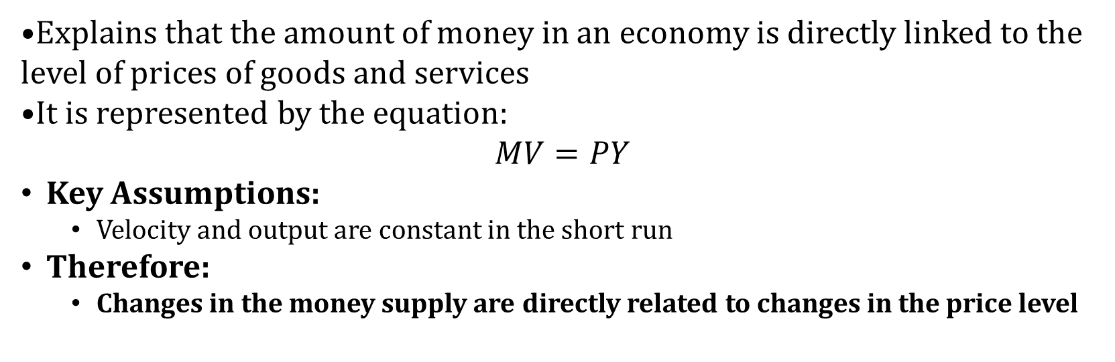
Conclusion
Quantity Theory of Money
Explains that the amount of money in an economy is directly linked to the level of prices of goods and services
It is represented by the equation:
$$MV=PY$$
Key Assumptions:
Velocity and output are constant in the short run
Therefore:
Changes in the money supply are directly related to changes in the price level
Notes:
This theory links the money supply directly to the price level in an economy.
It is expressed as: M × V = P × Y where M = money supply, V = velocity, P = price level, Y = real output.
Key assumptions: velocity (V) and output (Y) are constant short-term.
Therefore, changes in money supply (M) lead directly to proportional changes in prices (P).
In brief, more money with steady output and velocity means higher prices (inflation), and less money means lower prices (deflation).
Central banks watch money supply closely to maintain price stability.

Slide 21
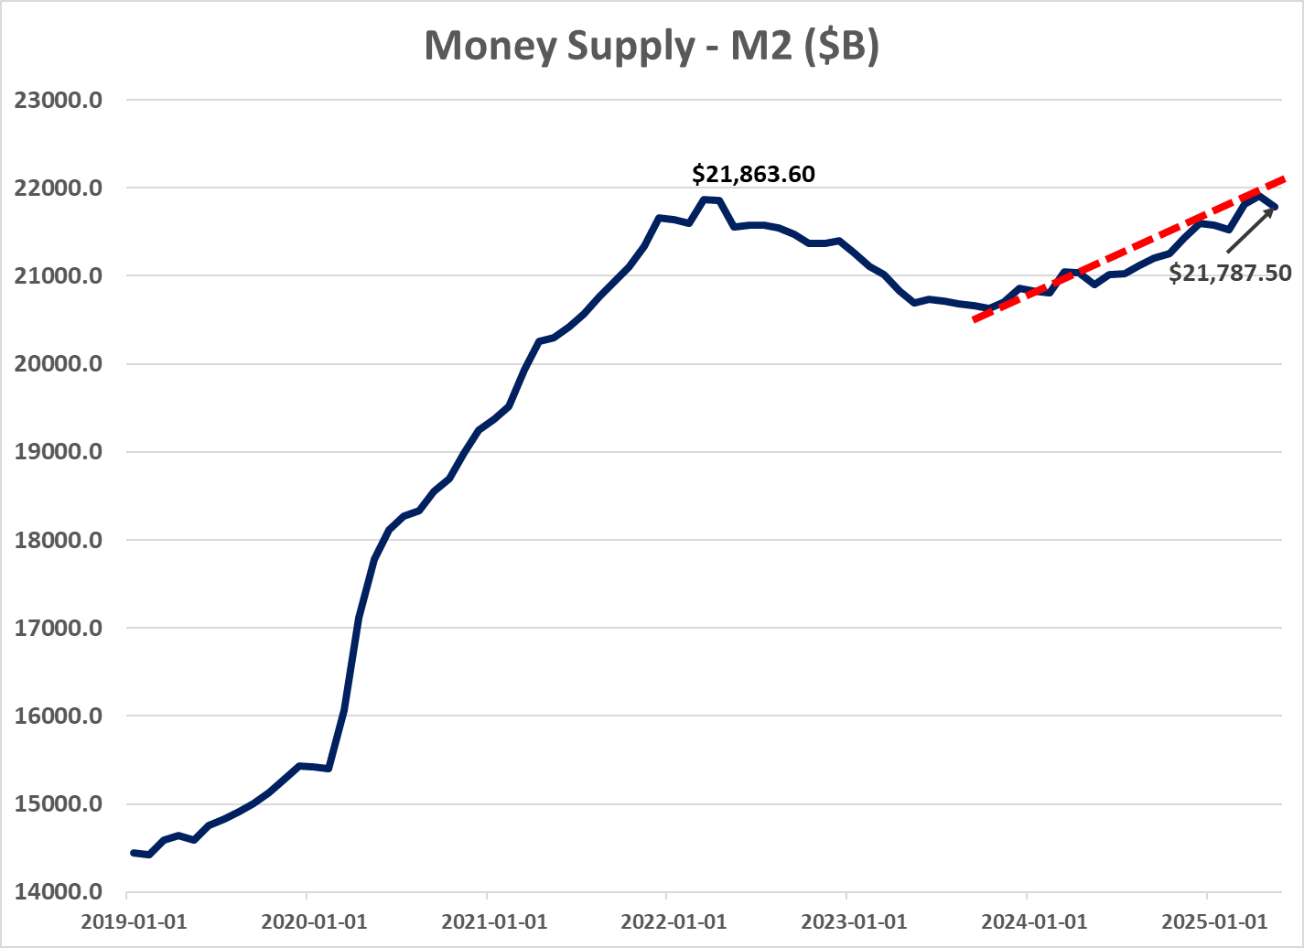
Conclusion
Data Source: FRED
Notes:
As we see in this graph, the current money supply is trending upwards since mid 2023, with the most recent datapoint being the start of May. The current money supply is almost back up to the peak in 2022, indicating that we should see rising prices according to the quantity theory of money.

Slide 22
Conclusion
Fiscal Theory of the Price Level
Strong FTPL:
Fiscal authority commits to a path of extremely high deficits
Inflation Expectations Change
Prices rise before any monetary policy is put in place
Fed is forced to drop rates to improve solvency
Notes:
Under the strong version of FTPL, if fiscal policy sets a course of persistently high deficits—regardless of monetary policy—markets anticipate that the government will have to manage its debt, even if it means higher inflation.
As a result, inflation expectations shift upward before any actual monetary policy response, because people begin to doubt that future surpluses will cover the debt.
This change in expectations alone can cause prices to rise, even if the central bank hasn’t changed policy yet.
In this scenario, the Fed might be forced to lower rates—not to fight inflation, but to help the government’s solvency by reducing debt service costs.
The key message: with very loose fiscal policy, inflation can get out of control purely from expectations and solvency concerns, limiting the central bank’s ability to keep prices stable.

Slide 23
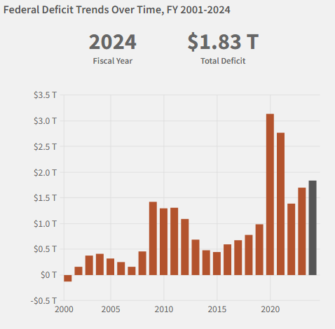
Conclusion
Rising Fiscal Deficits
Chart Source: https://fiscaldata.treasury.gov/americas-finance-guide/national-deficit/
Notes:
Here we have a chart of the fiscal deficit, we see that it is much higher than the average historical amount, and it appears to be climbing, with forecasts predicting upwards of $1.86T for 2025.

Slide 24
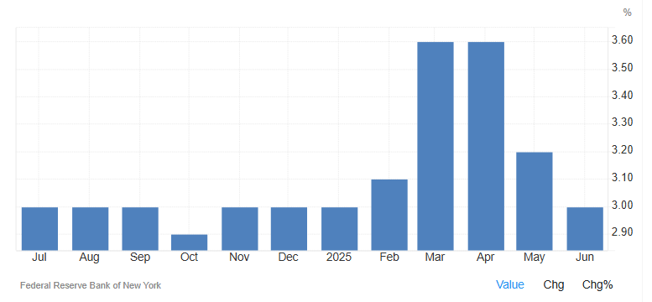
Conclusion
Inflation Expectations Dropping
Notes:
And here we have a chart of inflation expectations. Despite the growing deficit, inflation expectations are dropping steadily, sitting around 3% currently, indicating that the fed is getting some public trust back. Because inflation expectations are falling despite rising fiscal deficits, the immediate risk of the fed being forced into dropping rates due to fiscal pressures is low. If expectations were unanchored, meaning the public expected inflation to rise as a way to deal with deficits, the fed would face pressure to respond with lower rates to ensure solvency. However, because expectations remain above the target rate, the Fed has not fully brought back their trust. As a result, holding the FFRT steady reinforces the message that the Fed should be sending about their seriousness regarding returning to a 2% inflation rate. Choosing to cut rates now would undermine confidence, leading consumers and businesses to expect higher inflation again.

Slide 25
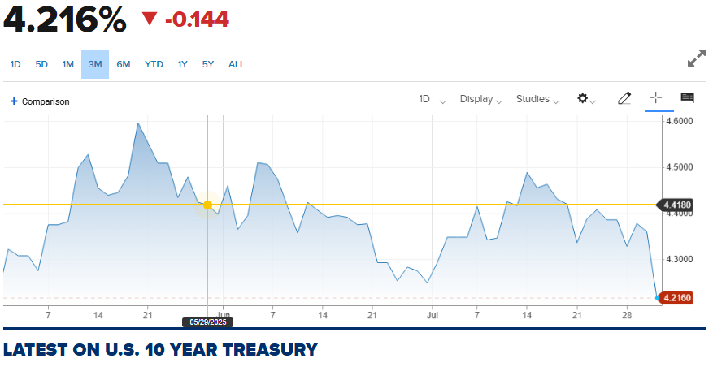
Conclusion
10 Year Treasury Yield Dropping
Chart Source: https://www.cnbc.com/quotes/US10Y
Notes:
As further evidence of falling expectations, the 10 year treasury yield has fallen sharply in response to the Fed’s decision to maintain rates, indicating growing consumer confidence. That being said, a drop in the 10 year treasury yield flags concern regarding cooling of GDP growth, supporting Stoykov’s argument of an unnecessary slowdown.

Slide 26
Conclusion
Money Demand
Notes:
Now lets talk a bit about money demand

Slide 27
Conclusion
Keynesian Money Demand
Money demand depends on income and interest rates
Motives: transactions, precaution, speculation
Higher interest rates lower money demand
Changing money demand influences inflation & Fed policy
Notes:
Keynesian theory divides money demand into three motivations: – Transactions (for everyday purchases) – Precautionary (for unexpected expenses) – Speculative (holding cash rather than assets when rates are low)
Money demand increases when incomes rise, but falls as interest rates go up, since holding cash becomes more costly.
When the Fed raises rates—like now—households and firms hold less money, reducing upward pressure on prices.
If rates drop too soon, people and businesses may demand more money, potentially increasing spending and stoking inflation.
This is why the current high-rate environment is helping to keep money demand—and thus inflation—in check.

Slide 28
Conclusion
Monetarist Money Demand
Money demand is stable in the long run
Inflation results if money supply grows faster than demand
Quantity Theory
Policy priority: align money supply growth with output
Notes:
Monetarists, like Milton Friedman, argue that money demand is fairly predictable and doesn’t change much over time.
Inflation happens when the money supply expands faster than people and businesses want to hold.
The Quantity Theory equation (MV = PY) highlights this stable relationship.
Today’s context: with elevated money supply, if demand isn’t rising fast enough to absorb it, there’s a risk that inflation could rebound if rates are cut too soon.
For monetarists, the policy imperative is to match money supply growth to real economic growth—keeping an eye on overall liquidity to prevent future price spikes.

Slide 29
Conclusion
Neutral Rate
Notes:
Finally, lets talk about the neutral rate.

Slide 30
Conclusion
Wicksellian Theory and the Neutral Rate
The neutral rate is the real interest rate that keeps the economy in balance—neither speeding up nor slowing down growth or inflation.
At the neutral rate, monetary policy is neither restrictive nor stimulative.
Estimated by economists, not directly observable; changes over time with economic fundamentals.
Key drivers include productivity growth, demographics, long-run GDP growth, global savings/investment, and fiscal policy.
Central banks track the neutral rate to judge whether current rate policy is tight, loose, or “just right.”
Notes:
The neutral rate is the real interest rate that keeps the economy running at a steady pace—neither boosting nor slowing growth and inflation.
When rates are at this level, monetary policy isn’t pushing the economy faster or holding it back.
We can’t observe the neutral rate directly; economists estimate it, and it moves over time with changes in fundamentals.
Key factors that shift the neutral rate are productivity growth, demographics, long-term economic growth, global savings versus investment, and fiscal policy.
Central banks track the neutral rate closely to help decide if their current policy is too tight, too loose, or about right for the economy.

Slide 31
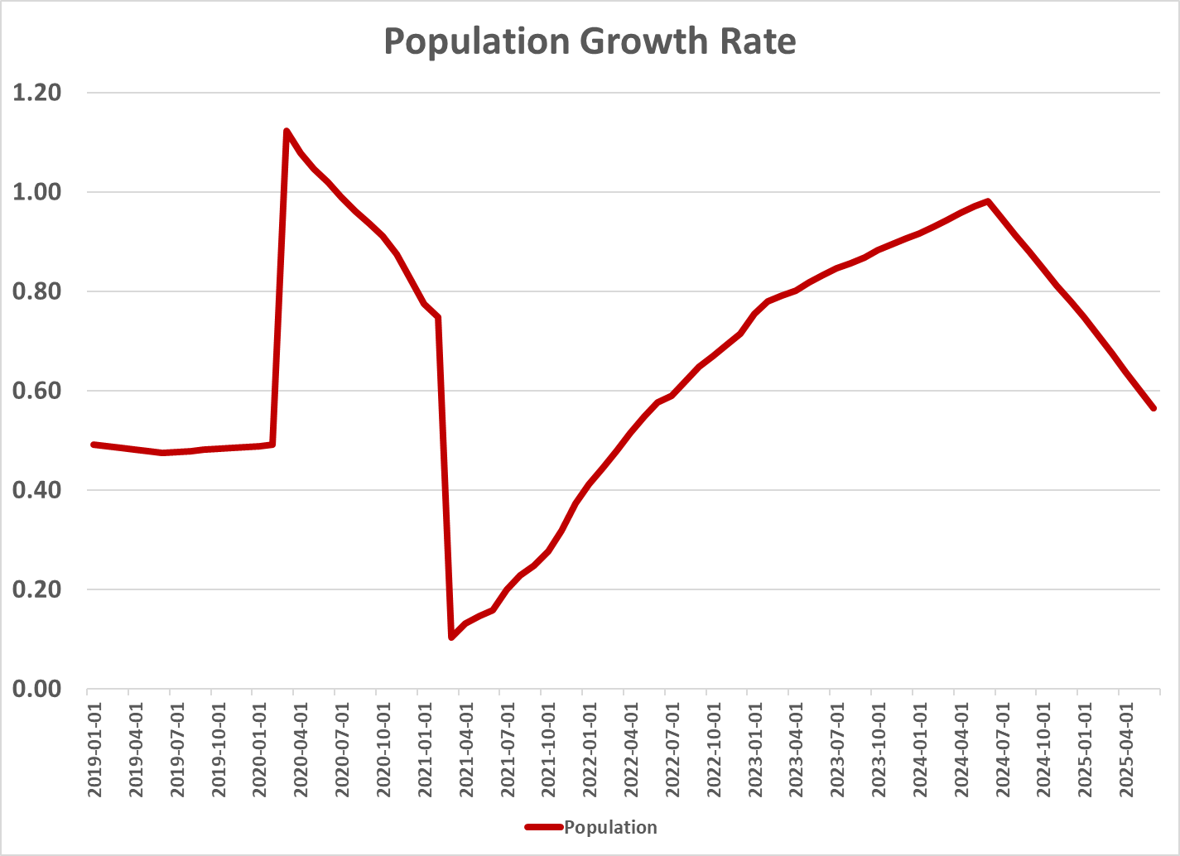
Conclusion
Neutral Rate - Population
Notes:
As for quantitative analysis for the drivers, recent population growth is declining, but remains positive.

Slide 32
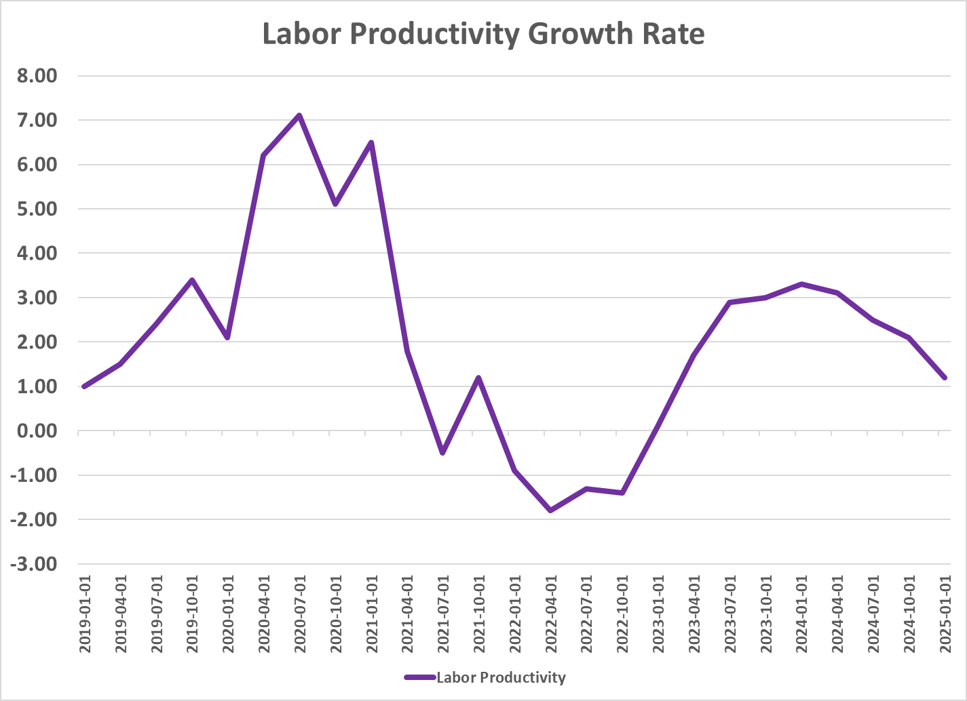
Conclusion
Neutral Rate – Productivity
Notes:
The labor productivity growth rate is declining as well.

Slide 33
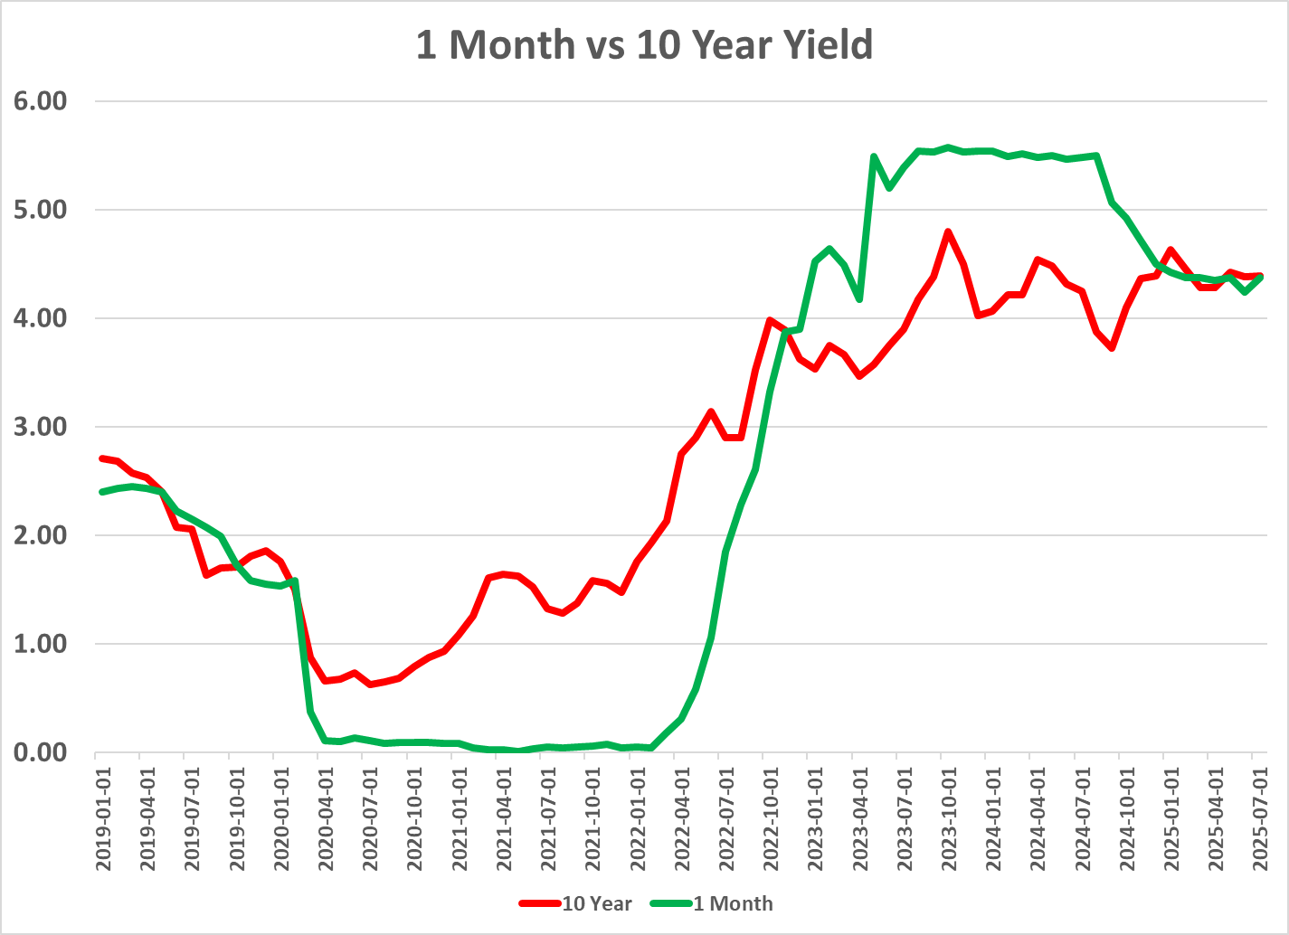
Conclusion
Neutral Rate – Treasury Yields
Notes:
The term structure of interest rates yield curve is fairly flat, if not completely flat, indicating little change in in interest rates or inflation over near and medium term.

Slide 34
Conclusion
Neutral Rate – Treasury Yields
Notes:
And as we saw before, fiscal policy shows a growing deficit, but remains less than the peak of COVID.

Slide 35
Conclusion
Neutral Rate – Summary
Neutral Rate Factor | Impact | Status | Conclusion
Time Preference | Positive Relationship | Uncertain | Uncertain
Population | Positive Relationship | Declining Growth | Neutral Rate Decrease
Productivity | Positive Relationship | Declining Growth | Neutral Rate Decrease
Treasury Yields (Risk Premia) | Positive Relationship | Stable Yields around the FFRT | Neutral Rate Unchanged
Fiscal Policy | Positive Relationship | Increasing government spending | Neutral Rate Increase
Notes:
Time preference’s impact is unclear, but most other drivers point to a lower neutral rate today.
Population and productivity growth are both slowing, pushing the neutral rate down.
Treasury yields are stable and close to the policy rate, suggesting little change to the neutral rate from risk premia lately.
Fiscal deficits are rising, which could raise the neutral rate, but so far, underlying fundamentals keep it stable or falling.
Overall, these factors point to the neutral rate being stable or declining—justifying a moderately restrictive Fed policy.

Slide 36
Conclusion
Too High, Too Low, or Just Right?
Neutral rate is stable or slowly declining—current policy remains aligned with underlying economic fundamentals.
Maintaining the federal funds rate above the neutral rate keeps monetary policy moderately restrictive.
This helps contain inflation risks in an environment of rising money supply and expanding fiscal deficits.
Inflation expectations are still above the 2% target, signaling that inflation pressure has not fully subsided.
A "just right" rate balances restraining inflation with avoiding unnecessary harm to growth, supporting Fed credibility and public confidence.
Notes:
After weighing trends—in productivity, population, yields, and fiscal policy—it’s clear that the neutral rate is not rising, and may even be drifting lower.
By keeping the policy rate above this neutral rate, the Fed is striking a careful balance: restricting inflation without overtightening the economy.
Elevated inflation expectations and continued fiscal expansion mean there's still potential for renewed inflation if policy loosens too soon.
Therefore, holding the federal funds rate steady is the right move at this time—firm, but flexible, to safeguard both price stability and economic momentum.

Slide 37
References
Bennett, R. (2023, May 1). 2023 Banking Crisis: Silicon Valley Bank’s Collapse And A Timeline Of The Financial Fallout That Followed. Bankrate. https://www.bankrate.com/banking/bank-failures-latest-updates-silicon-valley-signature-bank/#failure-fallout
Board of Governors of the Federal Reserve System. (2024, July 19). The Fed - How does monetary policy influence inflation and employment? Board of Governors of the Federal Reserve System. https://www.federalreserve.gov/faqs/money_12856.htm
Board of Governors of the Federal Reserve System (US). (2001, July 31). 1-Month Treasury Constant Maturity Rate. FRED, Federal Reserve Bank of St. Louis. https://fred.stlouisfed.org/series/DGS1MO
CNBC. (2025). US TREASURY-CURRENT 10 YEAR’s stock price (US10Y) in real time. CNBC. https://www.cnbc.com/quotes/US10Y
Cochrane, J. H. (2025, January 4). Inflation and the Macroeconomy. Grumpy-Economist.com; The Grumpy Economist. https://www.grumpy-economist.com/p/inflation-and-the-macroeconomy
Evans, M. (2025, March 31). What Happened to Silicon Valley Bank? Investopedia. https://www.investopedia.com/what-happened-to-silicon-valley-bank-7368676
Fiscal Data. (2025). Fiscal Data Explains the National Deficit. Fiscaldata.treasury.gov. https://fiscaldata.treasury.gov/americas-finance-guide/national-deficit/
FRED. (2020). M2 Money Stock. Stlouisfed.org. https://fred.stlouisfed.org/series/M2SL
FRED. (2024). Consumer Price Index for All Urban Consumers: All Items. Stlouisfed.org. https://fred.stlouisfed.org/series/CPIAUCSL
FRED. (2025a). 10-Year Treasury Constant Maturity Rate. FRED, Federal Reserve Bank of St. Louis. https://fred.stlouisfed.org/series/DGS10
FRED. (2025b). Effective Federal Funds Rate. Stlouisfed.org. https://fred.stlouisfed.org/series/FEDFUNDS
Greenwood, J., & Hanke, S. H. (2021, July 20). Too Much Money Portends High Inflation. Wall Street Journal. https://www.wsj.com/opinion/money-supply-inflation-friedman-biden-federal-reserve-11626816746
Jefferson, P. N. (2024). Speech by Vice Chair Jefferson on monetary policy during periods of uncertainty. Board of Governors of the Federal Reserve System. https://www.federalreserve.gov/newsevents/speech/jefferson20240416a.htm
Laurion, H., & Bhagat, S. (2024, January 31). Silicon Valley Bank Demise: Causes and the Path Forward. The Harvard Law School Forum on Corporate Governance. https://corpgov.law.harvard.edu/2024/01/31/silicon-valley-bank-demise-causes-and-the-path-forward/

Slide 38
References
Maddock, C. (2024, November 27). An Analysis of Pandemic-Era Inflation – Michigan Journal of Economics. Umich.edu. https://sites.lsa.umich.edu/mje/2024/11/27/an-analysis-of-pandemic-era-inflation/
Stoykov, N. (2025, February 19). Alaric Securities. Alaric Securities. https://alaricsecurities.com/the-fed-funds-rate-increase-history-and-inflation/
Sumner, S. (2024, September 19). Why the Experts are Wrong about Inflation - Econlib. Econlib. https://www.econlib.org/why-the-experts-are-wrong-about-inflation/
U.S. Bureau of Labor Statistics. (1948, January 1). Business Sector: Labor Productivity (Output per Hour) for All Employed Persons. FRED, Federal Reserve Bank of St. Louis. https://fred.stlouisfed.org/series/PRS84006091
Vereckey, B. (2024, July 22). Federal spending was responsible for the 2022 spike in inflation, research shows | MIT Sloan. Mitsloan.mit.edu. https://mitsloan.mit.edu/ideas-made-to-matter/federal-spending-was-responsible-2022-spike-inflation-research-shows
Wolf, M. (2025, March 25). United States Economic Forecast. Deloitte Insights; Deloitte. https://www.deloitte.com/us/en/insights/topics/economy/us-economic-forecast/united-states-outlook-analysis.html
(2019, August 20). Tradingeconomics.com; TRADING ECONOMICS. https://tradingeconomics.com/united-states/inflation-expectations

