Slide 1
Modelling the Technology Industry Production Function
A Production Function Approach
By Shaun Levenson
ECON 513: Econometrics 4 - Modelling
Dan Hamilton
Summer 2025
Master of Science in Quantitative Economics

Slide 2

Motivation
What makes Tech Important?
Notes:
Before we can get into talking about the data, we first must ask the question of what makes technology important?

Slide 3
Motivation
Technology impacts the whole Economy
Broad Economic Impact
Technology drives long-run economic growth by improving productivity, fostering innovation, reducing costs, and enabling sustained increases in output and living standards.
Technology has had incredible impacts on keeping people connected all over the world, moving us towards a tighter global community
Technology is vital for efficiently reducing many externalities, such as pollution that reduce social welfare
Technology harbors increases to long run economic growth by increasing productivity
Notes:
Technology is a key engine of long-run economic growth because it boosts productivity, drives innovation, lowers costs, and supports sustained improvements in output and living standards.
Beyond economic metrics, technology has transformed how people connect globally, fostering a more integrated and interconnected world community.
It also plays a crucial role in addressing societal challenges by helping reduce negative externalities like pollution, thereby improving social welfare efficiently.
Overall, technology’s contributions to productivity and innovation are central to sustaining economic growth over the long term.

Slide 4
Motivation
Technology impacts the whole Economy
Downward Price Pressures
Sectors like computers and electronic products experience persistent relative price deflation, reflecting rapid efficiency gains and faster innovation cycles.
This contributes to keeping overall inflation in the broader economy lower than it might otherwise be.
It increasingly makes advanced technology affordable and accessible for lower-income households over time.
Notes:
Sectors like computers and electronics see persistent relative price deflation due to rapid efficiency improvements and faster innovation cycles.
This technological deflation helps keep overall inflation in the broader economy lower than it would be otherwise by continuously lowering costs across many goods and services.
Additionally, falling prices make advanced technologies increasingly affordable and accessible to lower-income households, expanding their reach and fostering broader economic inclusion.

Slide 5
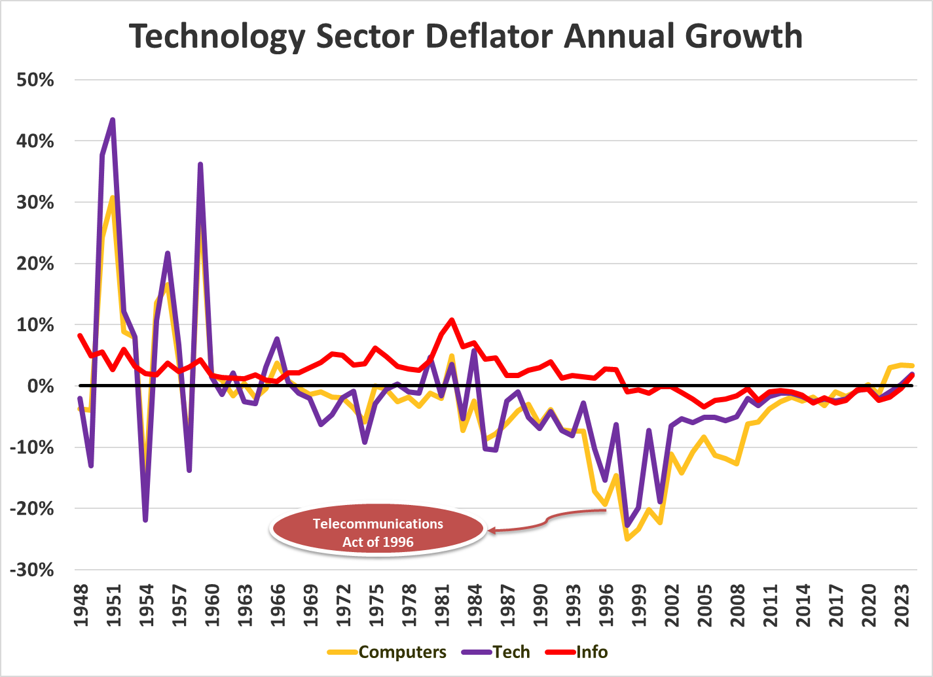
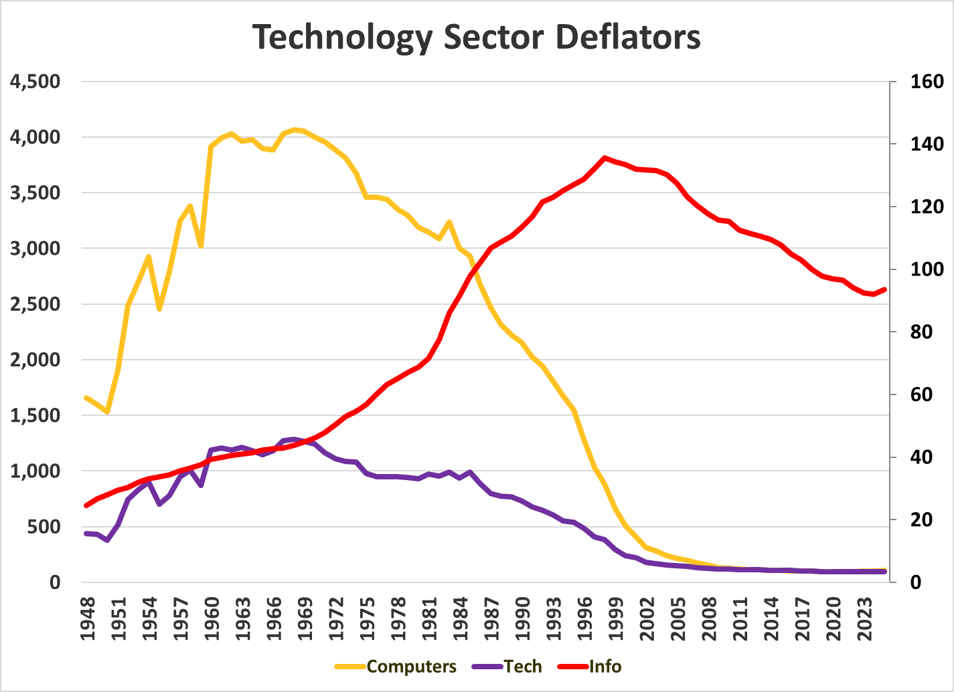
Motivation
Technology Components have seen significant price deflation
Notes:
On the left we see that across the majority of the series, we have seen significant quality adjusted price deflation, with the greatest % reduction shown in the mid 90s. On the right, the left axis is for Computers and Tech, whereas the right is for information. Notice that the price for information has been steadily rising until the mid 90s, and only since then has it started to fall. The magnitude of which is much more subtle.

Slide 6
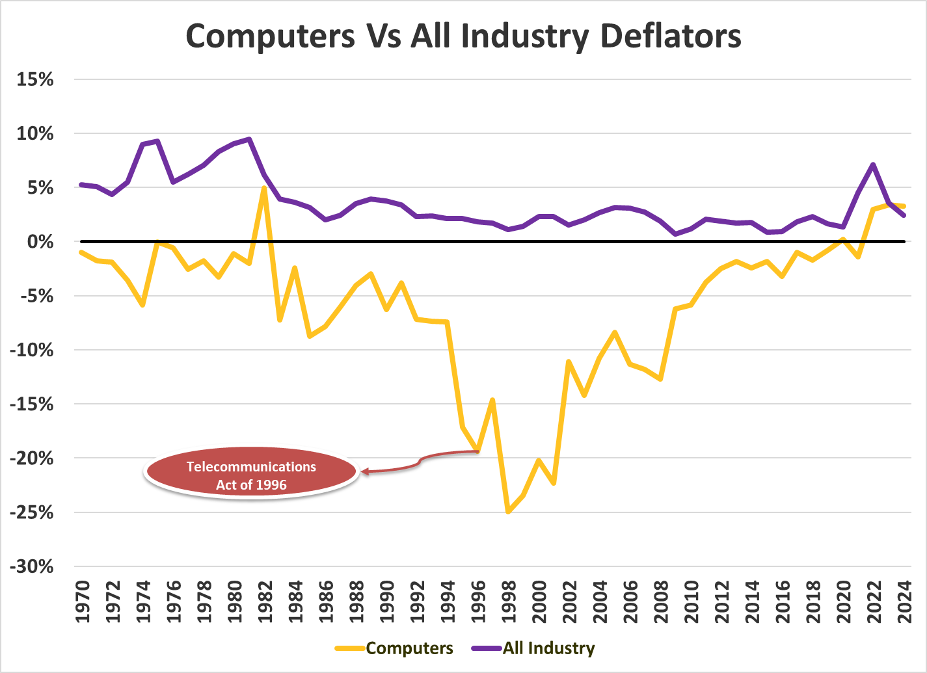
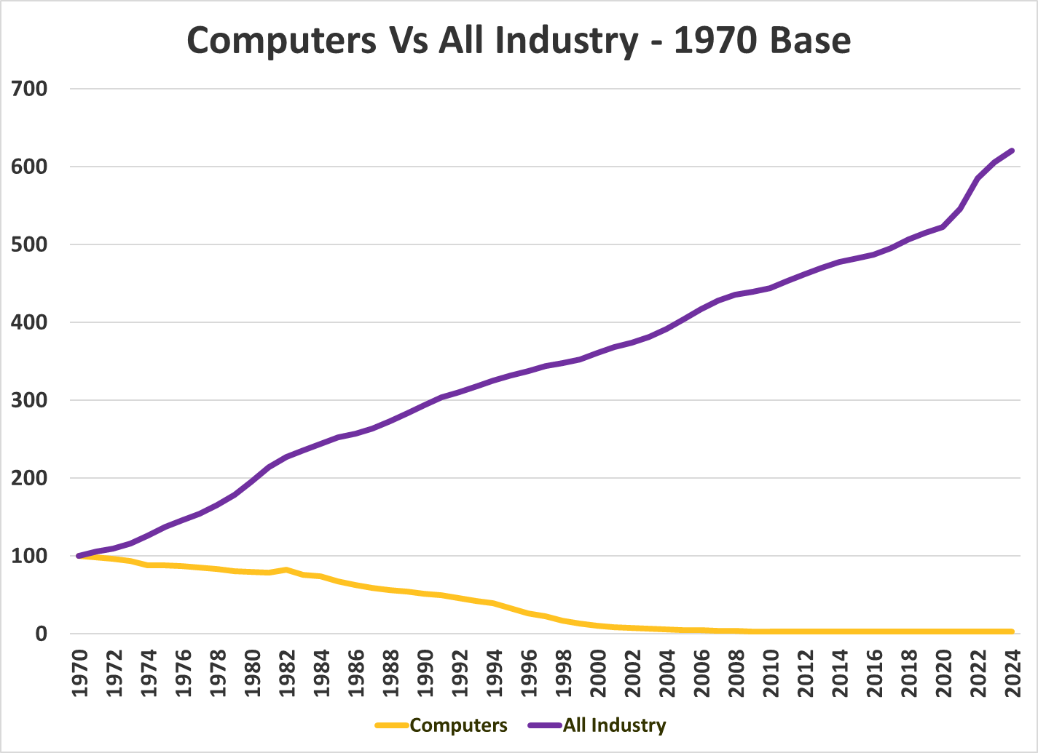
Motivation
Technology Components have seen significant price deflation
Notes:
Now if we compare computers to the whole of the economy, using 1970 as a base, the separation is clearer. The wider economy has steady price growth, ending up a little over 600 in 2024, with computers sitting at a measly 3; a 97% price reduction relative to their 1970s prices.

Slide 7
Motivation
Technology impacts the whole Economy
Broad Economic Impact
Technological innovation raises productivity across the economy—not only in the tech sector—reshaping production processes and cost structures.
Downward Price Pressures
Sectors like computers and electronic products experience persistent relative price deflation, reflecting rapid efficiency gains and faster innovation cycles.
AI Acceleration
Artificial intelligence is amplifying the speed and reach of innovation, intensifying tech’s influence on growth and inflation dynamics.
Notes:
Next, AI is a significant recent contributor to the technology sector and the broader macroeconomy. AI is amplifying the speed and reach of innovation, intensifying tech’s influence on growth.

Slide 8
Motivation
Technology impacts the whole Economy
Broad Economic Impact
Technological innovation raises productivity across the economy—not only in the tech sector—reshaping production processes and cost structures.
Downward Price Pressures
Sectors like computers and electronic products experience persistent relative price deflation, reflecting rapid efficiency gains and faster innovation cycles.
AI Acceleration
Artificial intelligence is amplifying the speed and reach of innovation, intensifying tech’s influence on growth and inflation dynamics.
Policy and Forecasting Relevance
Accurate forecasting of tech-sector GDP helps policymakers and economists interpret structural changes, productivity trends, and sector-specific pricing effects.
Notes:
Lastly, an accurate forecast of technology sector GDP helps policymakers (if they listen to economists) and economists interpret structural changes, productivity trends, and sector specific pricing effects.

Slide 9
Background
Growth and Composition
Notes:
Into the background section, we’ll go into the growth and composition of the main key dependent variable.

Slide 10
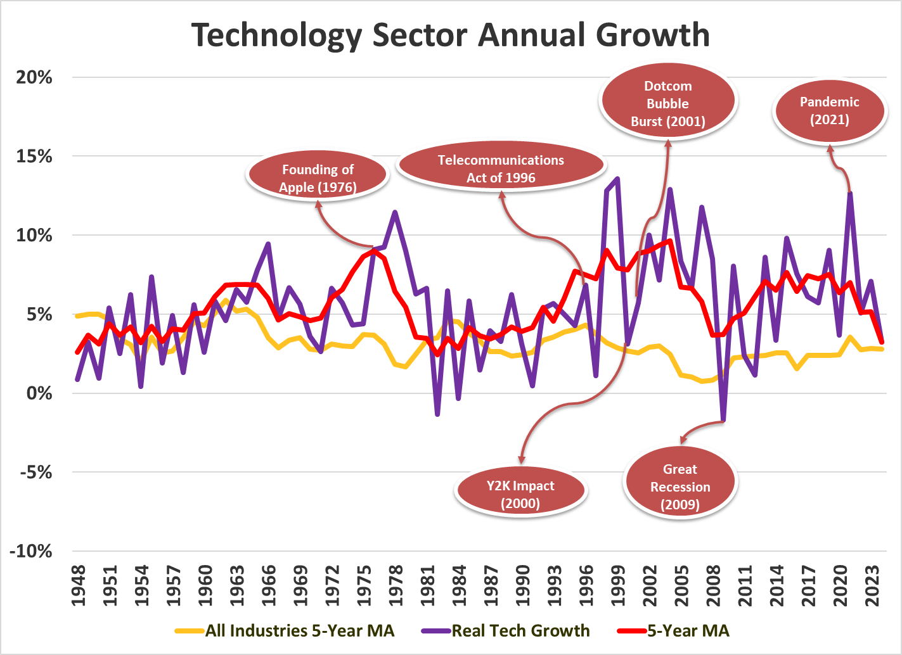
Background
Notes:
This chart provides an illustration of the growth dynamics of the full technology sector and each of its components. As you see, some of the major turning points in technological history are shown here. Noticeably, there are few points where technology growth is negative, with the largest being in the great recession. The pandemic, funnily enough, was a massive positive spike for this sector, likely due to the greater widespread reliance on tech for functioning.

Slide 11
Background
NAICS Composition
Item | Description
Information - 51 | Full Information Sector: Motion Picture, Sound Recording, News and other publishing, Broadcasting, Telecomms, and Web Search, Etc
Computers and Electronics Manufacturing - 334 | A portion of the manufacturing industry: Computers, Communications Equipment, Audio and Video Equipment, Semiconductors, Navigational and Measuring, Etc
Notes:
My KDV, real gdp attributed to technology, is comprised of the entirety of the information sector as well as a portion of the manufacturing sector, namely computers and electronics manufacturing. Some components of each are shown here.

Slide 12
Theory
Production Function
Notes:
Now that we have a background, lets move onto theory. For time constraints reasons, I will keep this brief.

Slide 13

Theory
Production Function
The theoretical production function is a function of technology level, capital inputs, and labor inputs:
$$Y=f(A,K,L)$$
Where:
Y = Output
A = Technology
K = Capital Inputs
L = Labor Inputs
This is commonly expressed using the Cobb-Douglas production function:
$$Y=AK^{α}L^{β}$$
This form captures constant returns to scale when $α+β=1$ and allows for estimation of output elasticities by use of logs
Side note:
The 2 most common presumed growth factors in models of long run economic growth are population growth and technology growth (or productivity)
Notes:
The production function used in this forecast uses the cobb-douglas production function. Shown here is the baseline cobb-douglas, but we need more than just the baseline to get a fully specified production function.

Slide 14
Literature
Literature

Slide 15
Literature
Literature Synthesis
Standard Production Function Framework
Most studies use a standard production function framework, incorporating capital and labor as key inputs. Several distinguish between public/private capital and labor to refine models (Hamilton, 2001; Lynde & Richmond, 1993; UK Government, n.d.).
Role of Intermediate Goods
Some literature emphasizes the importance of intermediate goods (such as oil or energy) as critical for production capacity and sectoral output, extending the basic inputs (Hahn & Skudelny, 2008; Lynde & Richmond, 1993).
Notes:
Many studies use a standard production function framework, focusing on capital and labor as main inputs.
Some distinguish between public and private forms of these inputs to better capture production nuances.
Intermediate goods like oil and energy are important additional factors influencing production capacity, extending basic models.

Slide 16
Literature
Growth, Modeling, and Empirical Insights
Technological Change as a Growth Driver
Theoretical models often include technological change, but few empirical studies incorporate it explicitly. Lynde & Richmond (1993) directly account for technological change, while Hamilton (2001) uses human capital and R&D as proxies.
Functional Forms Employed
Cobb-Douglas production functions dominate the empirical literature, occasionally supplanted by Translog specifications to capture more flexible substitution (Olley & Pakes, 1992).
Empirical Challenges and Extensions
There is an increased focus on adding detailed inputs (public/private capital and labor, intermediate goods, R&D) to resolve omitted variable bias (Hamilton, 2001; Lynde & Richmond, 1993).
Notes:
Technological change is widely recognized as a growth driver, but few empirical studies include it directly.
Some use proxies like human capital and R&D to capture its effect on output.
The Cobb-Douglas functional form is most common, with Translog models applied for more flexibility.
Empirical work focuses on including more detailed inputs and addressing econometric challenges like serial correlation and unobservable factors to improve accuracy.

Slide 17
Data Section
Metadata
Notes:
After theory we have the metadata, which I will brush by quickly and give a quick summary of the important variables at the end.

Slide 18
Data Section
Data Summary
Most Important from Data Table:
KDVs:
GDP_CEP$, GDP_Info$, GDP_Tech$
Deflators:
I_P_CEP, I_P_Info, I_P_Tech
Real Industry Capital Investment
K_Info$, K_IndEq$
Industry Labor Force
L_Info, L_CEP
Technological Progress
RnD$, K_IP$, Hk, MFP, PatGrant
Public Capital
Pk$
Prices
P_Oil, P_Semi, P_E_C, P_Cop_Prod, P_Cop_Brass, P_B_T_C
Notes:
So the most important variables I’m including here are my KDVs, real gdp for computers and electronics, real gdp for info, and real gdp for tech. I have deflators for all 3 as well. Capital inputs for info and industrial equipment. Industry labor force for info and computers and electronics. Technological progress variables such as rnd, intellectual property capital stock, human capital, multifactor productivity, and patent grants. Then we have real public capital investment and lastly prices that will be used as robustness checks.

Slide 19
Data Section
Stochastic Properties
Notes:
Next the descriptive statistic.

Slide 20
Data Section
Stochastic Properties
 | ACF(1) & ACF(2) | ADF Unit Root Test Statistic | DF-GLS Test Statistic | KPSS Unit Root Test Statistic | Conclusion
D(log(GDP_CEP$)) | 0.614, 0.727 | -2.114 | -2.034 | 0.165 | I(1)
D(log(GDP_Info$)) | -0.059, 0.209 | -9.294 | -1.763 | 0.302 | I(1)
D(I_P_CEP) | 0.171, 0.128 | -4.968 | -4.882 | 0.255 | I(1)
D(I_P_Info) | 0.852, 0.744 | -2.446 | -2.335 | 0.248 | I(1)
GDP_CEP$ |  | GDP_Info$ |  | I_P_CEP |  | I_P_Info
Year | Shock | Year | Shock | Year | Shock | Year | Shock
2000 | 3.37 | 2009 | -2.32 | 1959 | 4.81 | 1982 | 3.12
1995 | 2.33 | 2021 | 2.26 | 1951 | 3.18 | 1984 | 2.317
1996 | 2.05 | 2000 | -2.07 | 1956 | 2.53 | 2005 | -2.215
1997 | 2.01 | 1982 | -1.95 | 1954 | -2.34 | 1981 | 2.162
1959 | -1.89 | 1999 | 1.93 | 1950 | 2.06 | 1983 | 1.918
Notes:
The three stochastic properties I checked are GDP_CEP$, GDP_Info$, and I_P_CEP and found that each are I(1) with GDP_CEP$ and GDP_Info$ needing to be logged. As for shocks, I found that GDP_CEP$ had a significant shock at year 2000, consistent with the dotcom bubble. GDP_Info$ didn’t have any significant shocks. I_P_CEP seemed to, but all of those shocks occurred at the beginning of the series, so I deemed modelling them as unnecessary.

Slide 21
Structural Regressions
Statistics
Notes:
Now onto the main meat of the project, starting with structural regressions.

Slide 22
Structural Regressions
Real GDP for Computers and Electronic Products
$$\text{l}\text{n}\left(\frac{{\text{GDP}\text{_}\text{CEP}\text{\$}}_{t}}{{\text{L}\text{_}\text{CEP}}_{t}}\right)=α_{0}+α_{1}\text{l}\text{n}\left(\frac{{\text{K}\text{_}\text{IndEq}\text{\$}}_{t}}{{\text{L}\text{_}\text{CEP}}_{t}}\right)+α_{2}\text{l}\text{n}\left(\frac{{\text{Hk}\text{\$}}_{t}}{{\text{L}\text{_}\text{CEP}}_{t}}\right)+α_{3}\text{l}\text{n}\left(\frac{{\text{RND}\text{\$}}_{t}}{{\text{Pk}}_{t−5}}\right)+α_{4}\text{ITV}\text{_}\text{CEP}+ε_{t}$$
Coefficients: 0.37 1.45 0.83 0.26
T-Statistics: 1.70 4.19 3.65 2.74
Estimation Technique | Fully Modified Least Squares (FMOLS)
Data Frequency | Annual
Estimation Range | 1953 to 2024 (72 Observations)
Net D.F. | 67 (i.e. 72-5)
Residual Unit Root Test | -4.396 Stationary at 10% Significance
Residual ACF(1) | 0.560
Seasonal Dummies | N/A
Notes:
For both GDP structural regs, I found using a per capita basis ended up with the best performing models. Both equations were constrained to FMOLS due to theory dictating them be estimated in levels rather than growth rates.. GDP_CEP$ has a very good coefficient for capital stock, as it is widely accepted for it to be between 0.2 and 0.4. That being said, it has a really large human capital coefficient. Additionally, this regression required an intervention for 2000 and 2001 and it was found to be highly significant.

Slide 23
Structural Regressions
Causality Statements
Private Capital (K_IndEq$):
More or better machinery, equipment, and buildings raise productive capacity and boost output.
Private Labor (L_CEP):
More workers expand production and management, increasing industry output.
Human Capital (Hk):
A more educated and skilled workforce enables higher-value contributions and greater output.
R&D Investment (RnD$):
More spending on R&D drives innovation, efficiency, and long-term output growth.
Public Capital (Pk$):
Improved public infrastructure helps firms move goods and inputs efficiently, supporting higher output.
Notes:
Private Capital (K_Info$, K_IndEq$):
More or better machinery, equipment, and buildings raise productive capacity and boost output.
Private Labor (L_Info, L_CEP):
More information-sector workers expand production and management, increasing industry output.
Human Capital (Hk):
A more educated and skilled workforce enables higher-value contributions and greater output.
R&D Investment (RnD$):
More spending on R&D drives innovation, efficiency, and long-term output growth.
Public Capital (Pk$):
Improved public infrastructure helps firms move goods and inputs efficiently, supporting higher output.

Slide 24
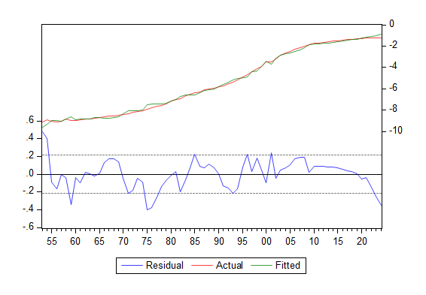
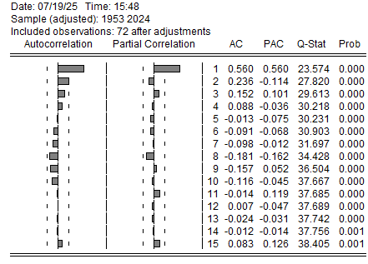
Structural Regressions
Real GDP for Computers and Electronic Products

Slide 25
Structural Regressions
Real GDP for Information
$$\text{l}\text{n}\left(\frac{{\text{GDP}\text{_}\text{Info}\text{\$}}_{t}}{{\text{L}\text{_}\text{Info}}_{t−3}}\right)=α_{0}+α_{1}\text{l}\text{n}\left(\frac{{\text{K}\text{_}\text{Info}\text{\$}}_{t−5}}{{\text{L}\text{_}\text{Info}}_{t−3}}\right)+α_{2}\text{l}\text{n}\left(\frac{{\text{Pk}\text{\$}}_{t−2}}{{\text{L}\text{_}\text{Info}}_{t−3}}\right)+ℰ_{t}$$
Coefficients: 0.18 1.16
T-Statistics: 31.61 36.12
Estimation Technique | Fully Modified Least Squares (FMOLS)
Data Frequency | Annual
Estimation Range | 1957 to 2024 (68 Observations)
Net D.F. | 65 (i.e. 68-3)
Residual Unit Root Test | -3.299 Stationary at 15% Significance
Residual ACF(1) | 0.844
Seasonal Dummies | N/A
Notes:
Real GDP for info found only capital stock for info and public capital to be significant with the right sign with the regressions I tested, however the coefficient on capital stock is a little bit lower than the widely empirically tested expectation of 0.2 to 0.4, not to mention that coefficient for PK is very high, overall indicating some omitted variable bias.

Slide 26
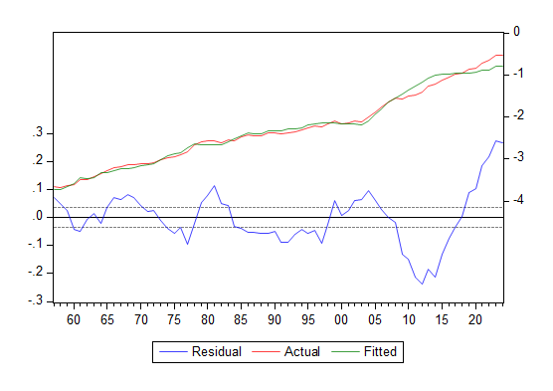
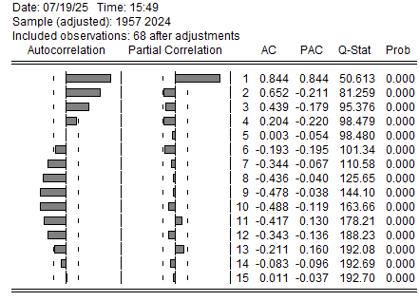
Structural Regressions
Real GDP for Information

Slide 27
Structural Regressions
Computers and Electronic Products Deflator
$$Δ\ln\left(\frac{\text{I}\text{_}\text{P}\text{_}\text{CEP}}{\text{RND}\text{\$}}\right)=α_{0}+α_{1}Δ\ln\left({\text{MFP}}_{t−3}\right)+α_{2}Δ\ln\left({\text{PatGrant}}_{t}\right)+α_{3}Δ\ln\left({\text{K}\text{_}\text{IP}\text{\$}}_{t−2}\right)+α_{4}Δ\ln\left({\text{RND}}_{t−4}\right)+u_{t}$$
Coefficients: -1.13 -0.24 -0.68 -0.51
T-Statistics: -1.77 -2.06 -3.39 -2.80
Estimation Technique | Ordinary Least Squares (OLS)
Data Frequency | Annual
Estimation Range | 1956 to 2024 (69 Observations)
Net D.F. | 64 (i.e. 69-5)
Residual Unit Root Test | N/A
Residual ACF(1) | 0.421
Seasonal Dummies | N/A
Notes:
Both industry price regressions have the same variable structure and similar lag structures. Shown here is the industry price for computers and electronics. MFP has a large negative coefficient, while the rest look reasonable.

Slide 28
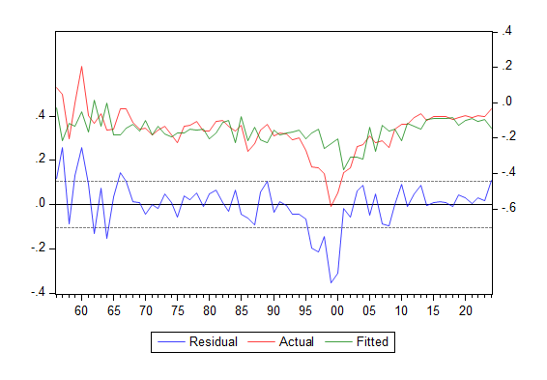
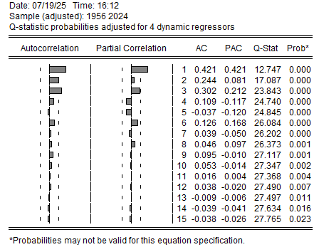
Structural Regressions
Computers and Electronic Products Deflator

Slide 29
Multi-Equation Model
Descriptions and Flow

Slide 30

Multi-Equation Model
Mathematically Typeset
$$\text{GDP}\text{_}\text{CEP}\text{\$}=f\left(\text{K}\text{_}\text{IndEq}\text{\$}, \text{L}\text{_}\text{CEP}, \text{Hk}, \text{RnD}\text{\$}, \text{Pk}\text{\$}\right)+ε_{t}$$
$$\text{GDP}\text{_}\text{Info}\text{\$}=f\left(\text{K}\text{_}\text{Info}\text{\$}, \text{L}\text{_}\text{Info}, \text{Pk}\text{\$}\right)+ℰ_{t}$$
$$\text{I}\text{_}\text{P}\text{_}\text{CEP}=f\left(\text{MFP}, \text{PatGrant}, \text{K}\text{_}\text{IP}\text{\$}, \text{RnD}\text{\$}\right)+u_{t}$$
$$\text{I}\text{_}\text{P}\text{_}\text{Info}=f\left(\text{MFP}, \text{PatGrant}, \text{K}\text{_}\text{IP}\text{\$}, \text{RnD}\text{\$}\right)+v_{t}$$
$$\text{I}\text{_}\text{P}\text{_}\text{Tech}=f\left(\text{I}\text{_}\text{P}\text{_}\text{Info}\text{, }\text{I}\text{_}\text{P}\text{_}\text{CEP}\right)+η_{t}$$
$$\text{GDP}\text{_}\text{Tech}\text{\$}=\text{GDP}\text{_}\text{CEP}\text{\$}+\text{GDP}\text{_}\text{Info}\text{\$}$$
$$\text{GDP}\text{_}\text{Tech}=\text{GDP}\text{_}\text{Tech}\text{\$}∗\left(\frac{\text{I}\text{_}\text{P}\text{_}\text{Tech}}{100}\right)$$
$$\text{GDP}\text{_}\text{Info}=\text{GDP}\text{_}\text{Info}\text{\$}∗\left(\frac{\text{I}\text{_}\text{P}\text{_}\text{Info}}{100}\right)$$
$$\text{GDP}\text{_}\text{CEP}=\text{GDP}\text{_}\text{CEP}\text{\$}∗\left(\frac{\text{I}\text{_}\text{P}\text{_}\text{CEP}}{100}\right)$$
$$\text{GDP}\text{_}\text{Tech}\text{2}=\text{GDP}\text{_}\text{Info}+\text{GDP}\text{_}\text{CEP}$$
$$\text{GDP}\text{_}\text{Tech}\text{_}\text{SD}=\text{GDP}\text{_}\text{Tech}−\text{GDP}\text{_}\text{Tech}\text{2}$$
Notes:
Here is the typeset MEM. Changes from last time include reflating the individual components of GDP_Info and GDP_CEP, then using those to compute an additional nominal GDP_Tech variable, and finding the difference between the two for a statistical discrepancy.

Slide 31
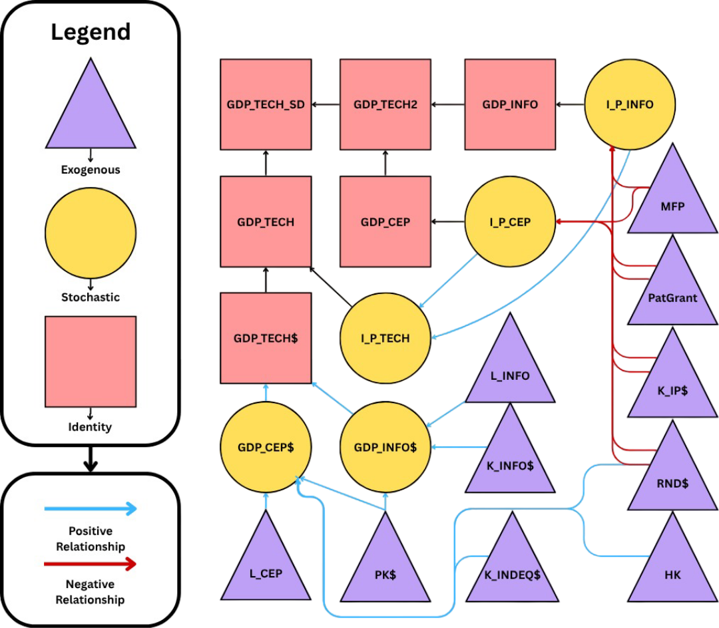
Multi-Equation Model
Flowchart
Notes:
Improved flowchart! Positive relationships are shown with blue arrows and negative relationships are shown with red arrows. Black arrows just indicate use in an identity.

Slide 32
Forecasting
Assumptions
Notes:
Now onto exogenous assumption forecasts. All assumptions are made using growth factors, as technological growth is the key for determining output growth for all GDP variables, but especially for computers and electronics.

Slide 33
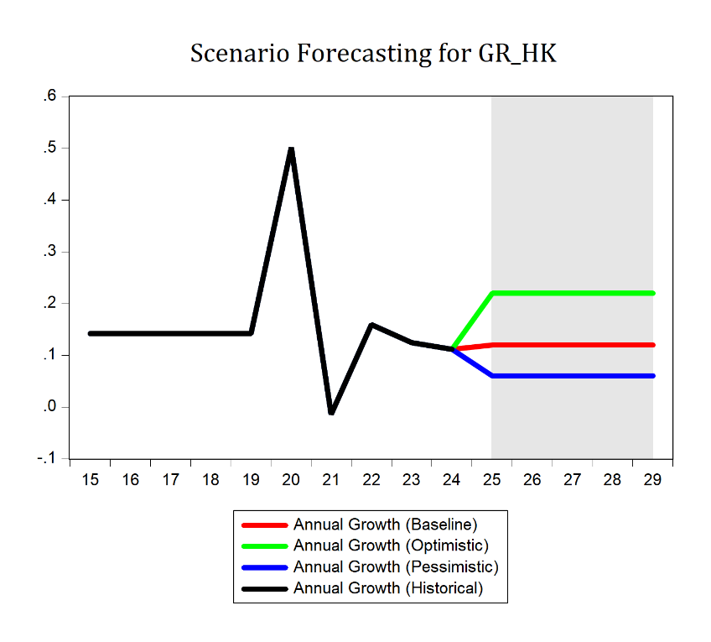
Forecasting
Hk
Human Capital Growth Assumptions
Year | Baseline | Optimistic | Pessimistic
2025 | 0.12 | 0.22 | 0.06
2026 | 0.12 | 0.22 | 0.06
2027 | 0.12 | 0.22 | 0.06
2028 | 0.12 | 0.22 | 0.06
2029 | 0.12 | 0.22 | 0.06
Notes:
HK has Assumed Stability across the forecasted range for each scenario, just higher or lower depending on scenario.

Slide 34
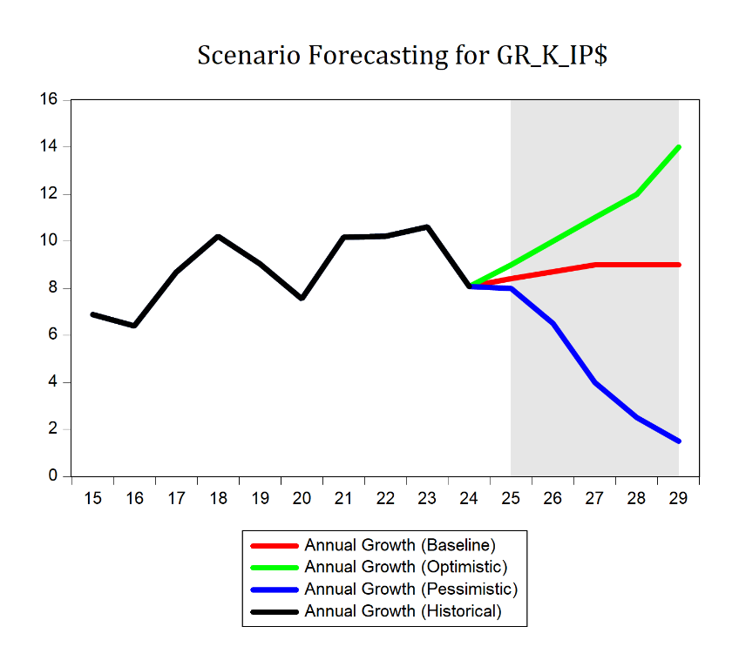
Forecasting
K_IP$
Intellectual Property Capital Investment
Year | Baseline | Optimistic | Pessimistic
2025 | 8.40 | 9.00 | 7.00
2026 | 8.70 | 10.00 | 6.50
2027 | 9.00 | 11.00 | 5.50
2028 | 9.00 | 12.00 | 4.50
2029 | 9.00 | 14.00 | 3.50
Notes:
K_IP has a stable baseline with growing optimistic and falling pessimistic growth rates.

Slide 35
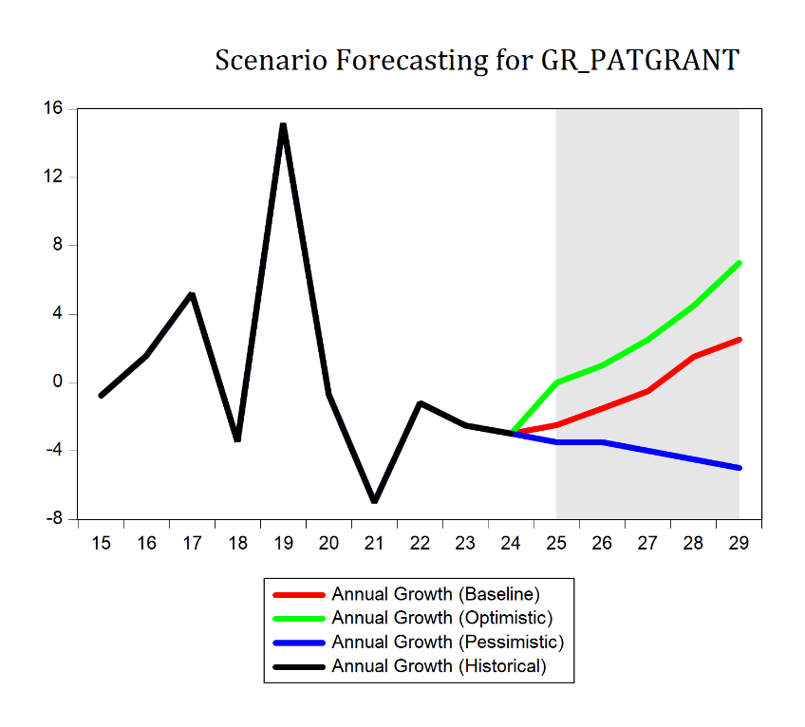
Forecasting
PatGrant
Patent Grants
Year | Baseline | Optimistic | Pessimistic
2025 | -2.50 | 0.00 | -2.50
2026 | -1.50 | 1.00 | -3.00
2027 | -0.50 | 2.50 | -3.50
2028 | 1.50 | 4.50 | -4.00
2029 | 2.50 | 7.00 | -4.50
Notes:
Patent grants are assumed to rebound their growth in baseline, with optimistic having a greater initial growth, with pessimistic having further decline.

Slide 36
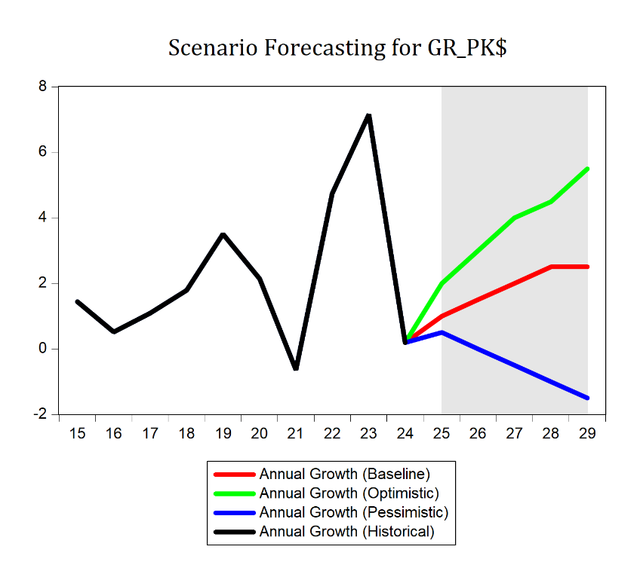
Forecasting
PK$
Public Capital Investment
Year | Baseline | Optimistic | Pessimistic
2025 | 1.00 | 2.00 | 0.50
2026 | 1.50 | 3.00 | 0.00
2027 | 2.00 | 4.00 | -0.50
2028 | 2.50 | 4.50 | -1.00
2029 | 2.50 | 5.50 | -1.50
Notes:
Similar to patent grants, public capital has slight growth for baseline, increased growth for optimistic, and decline for pessimistic.

Slide 37
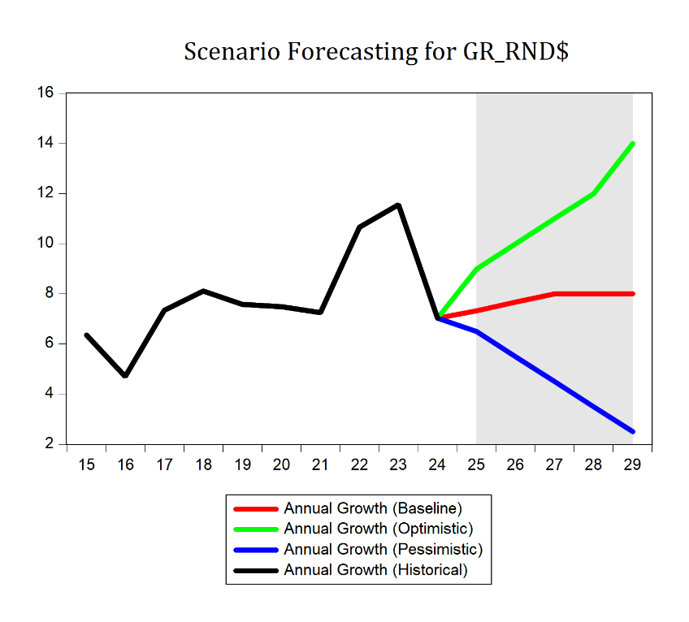
Forecasting
RnD$
Research and Development Investment
Year | Baseline | Optimistic | Pessimistic
2025 | 7.33 | 9.00 | 6.00
2026 | 7.68 | 10.00 | 5.00
2027 | 8.00 | 11.00 | 4.00
2028 | 8.00 | 12.00 | 3.00
2029 | 8.00 | 14.00 | 2.00
Notes:
And again the same for rnd capital

Slide 38
Forecasting
GDP_CEP$
Notes:
Now for the scenario forecasts, focusing on GDP_CEP$.

Slide 39
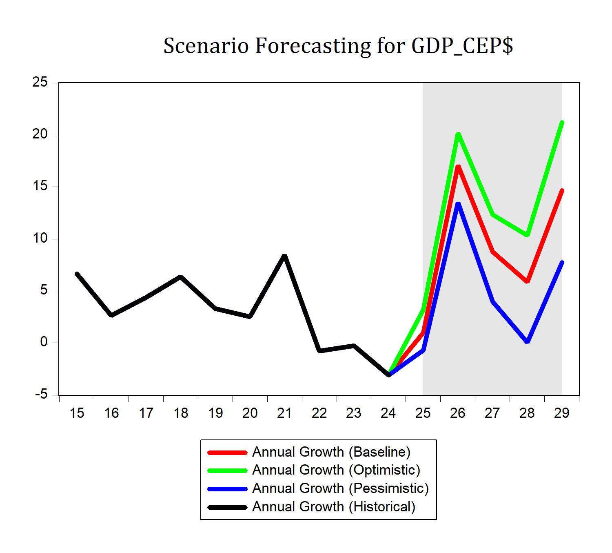
Forecasting
GDP_CEP$
Real GDP Computers and Electronic Products
Year | Baseline | Optimistic | Pessimistic
2025 | 1.00 | 3.21 | -0.71
2026 | 17.08 | 20.2 | 13.51
2027 | 8.76 | 12.33 | 3.97
2028 | 5.84 | 10.32 | 0.06
2029 | 14.66 | 21.23 | 7.76
Notes:
We see massive growth across the board across all 3 scenarios, just with slightly different magnitudes. The peak forecasted growth in 2026 ranges from 13.51% in the pessimistic case to 20.2% in the optimistic case.

Slide 40
Forecasting
Competitor VARs

Slide 41
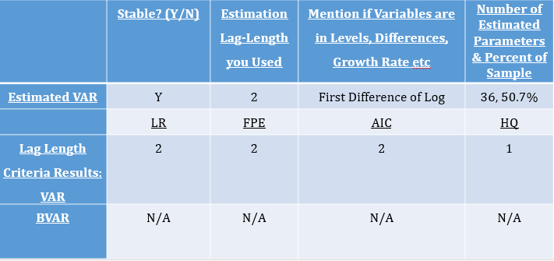
Forecasting
Variable Set 1 – Technological Growth
Endogenous Variables: GDP_Info$, RnD$, MFP, GDP_CEP$
Exogenous Variables: Intercept
Notes:
In selecting growth factors of R&D investment and multifactor productivity for the VAR alongside the key dependent variables, the economic logic is rooted in their direct impact on technological progress and productivity growth. Including RnD$ captures the role of innovation and new knowledge in driving output expansion, while MFP measures the overall efficiency with which labor and capital are transformed into output—reflecting technological and organizational improvements. By jointly modeling these variables, the VAR effectively captures the dynamic interplay between technological inputs and sectoral economic performance, mirroring how advances in R&D and productivity diffuse through and propel technology industries. This VAR set uses 2 lags, so 50% of percent of sample of estimated parameters.

Slide 42

Forecasting
Variable Set 2 – Capital Accumulation
Endogenous Variables: GDP_Info$, K_Info$, K_IndEq$, GDP_CEP$
Exogenous Variables: Intercept
Notes:
Including each industry’s specific capital stock directly captures the role of physical investment in expanding output capacity and supporting long-term productivity within each sector. By matching capital stock to its respective industry, the model accurately reflects how new machinery, equipment, or infrastructure additions drive sectoral growth and output. This approach ensures the VAR can trace industry-level capital accumulation effects on real GDP, providing clear insight into how investment shapes production and economic performance in information and electronics manufacturing. This VAR setuses 3 lags so 74% percent of sample of estimated parameters

Slide 43
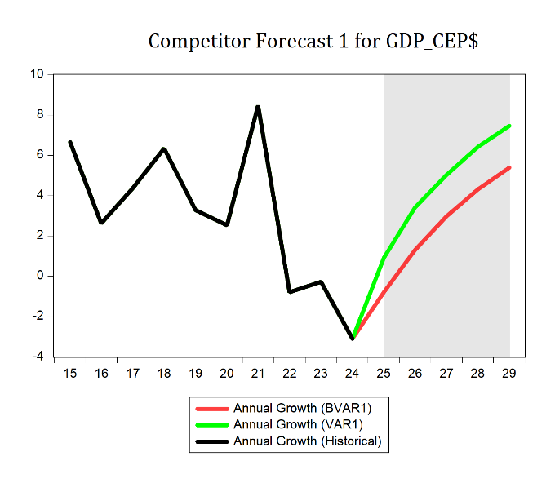
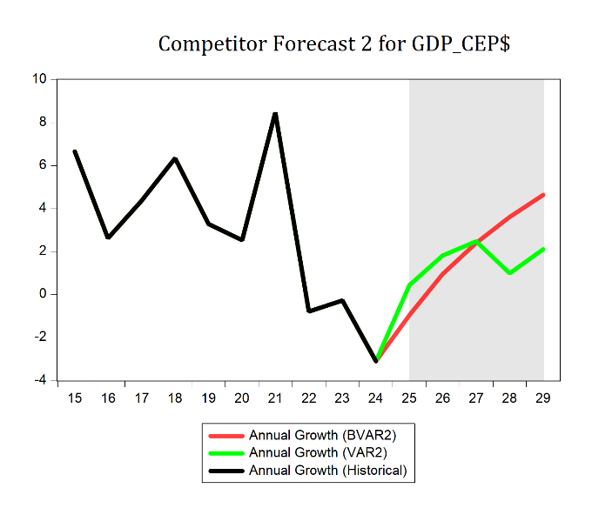
Forecasting
Forecast Comparison – GDP_CEP$
Notes:
And here we have a comparison of how the two performed. Relatively similar for the most part, except capital accumulation VAR ended up with a little bit of volatility towards the end of the forecast.

Slide 44
Forecasting
Competitor ARIMA
Notes:
Quickly looking at the competitor ARIMA Forecast…

Slide 45
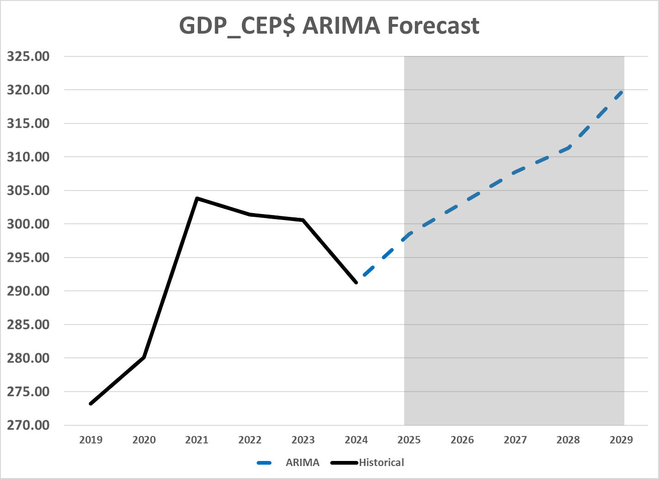
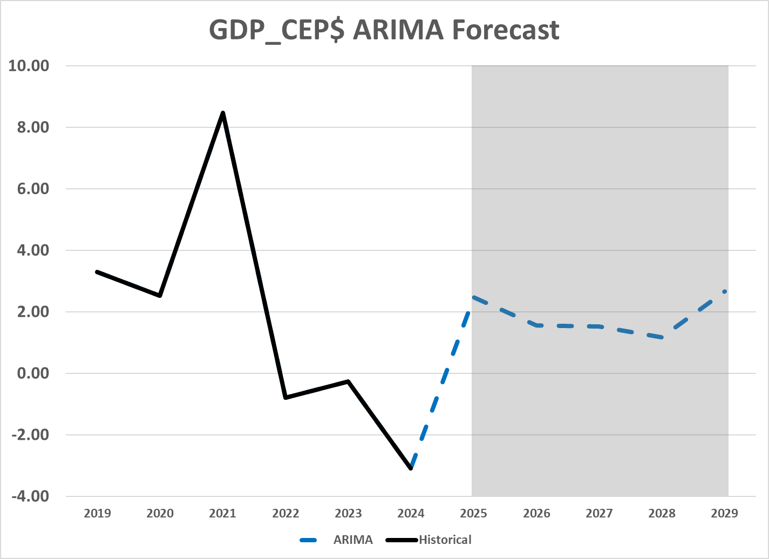
Forecasting
ARIMA Model for Variable GDP_CEP$: (4,1,0) with 1999-2001 Intervention
Notes:
The ARIMA for GDP_CEP$ is a 4, 1, 0 with the intervention used in the structural reg. It forecasts a fairly stable growth of about 2%.

Slide 46
Forecasting
Model OOS Forecasting

Slide 47
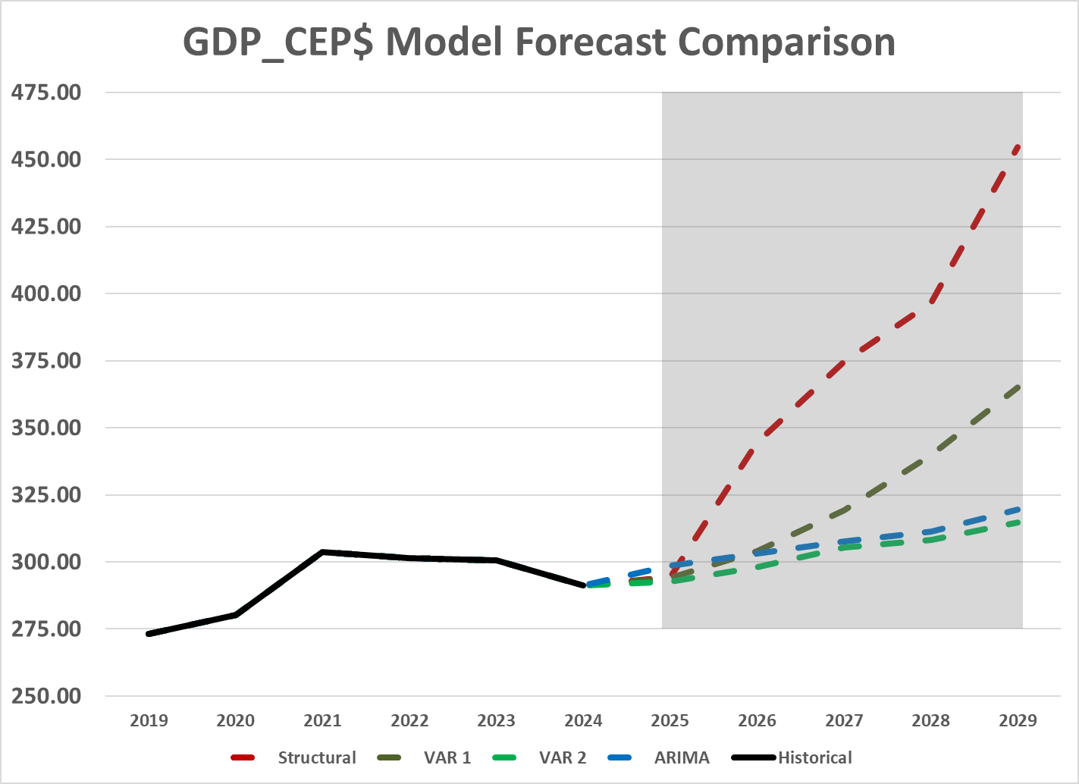
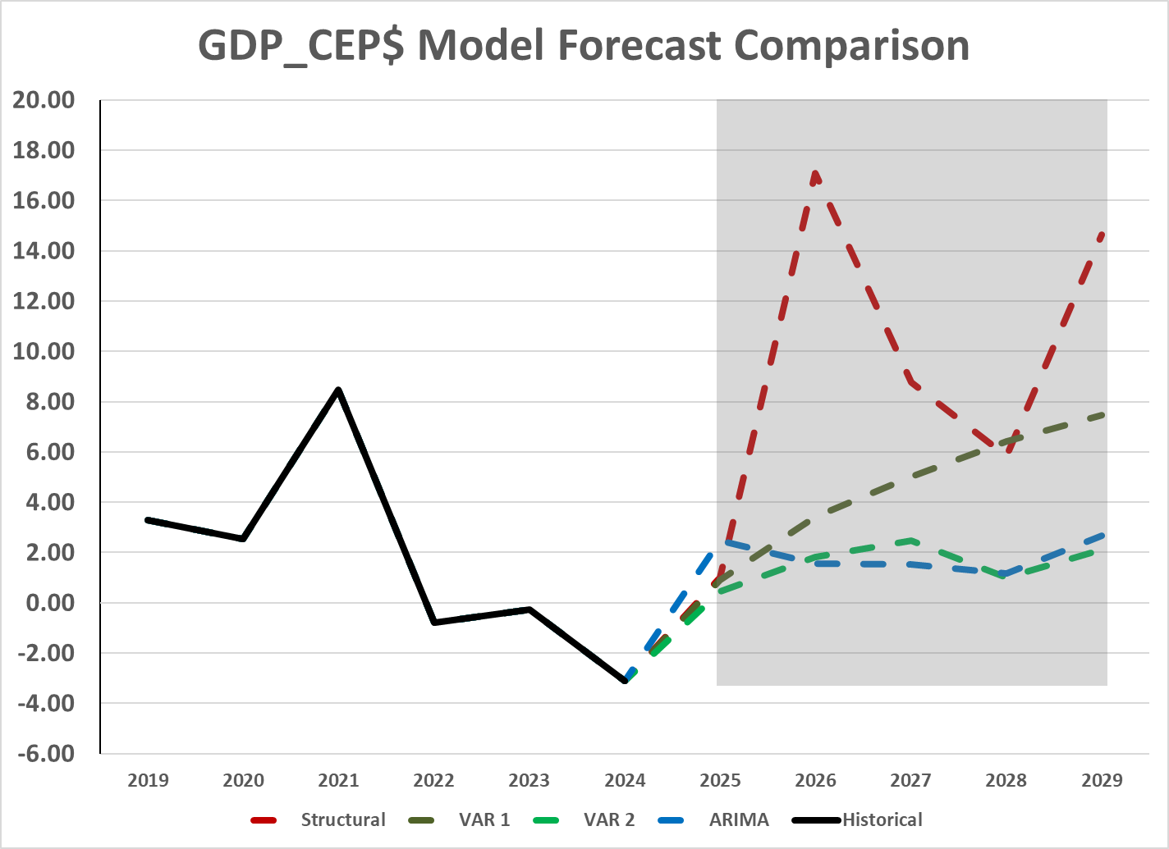
Forecasting
Models
Notes:
Comparing the different model structures, I have the structural, Technological progress VAR1, Capital Accumulation VAR2, and ARIMA forecasts for GDP CEP$. Each model has the same relative trajectory, all having positive growth across the forecast range. Capital accumulation and ARIMA show a very similar path, with minimal deviation in growth and levels. Technological progress VAR shows increasing but decelerating growth, with the structural model showing the greatest growth overall, with the most growth volatility.

Slide 48
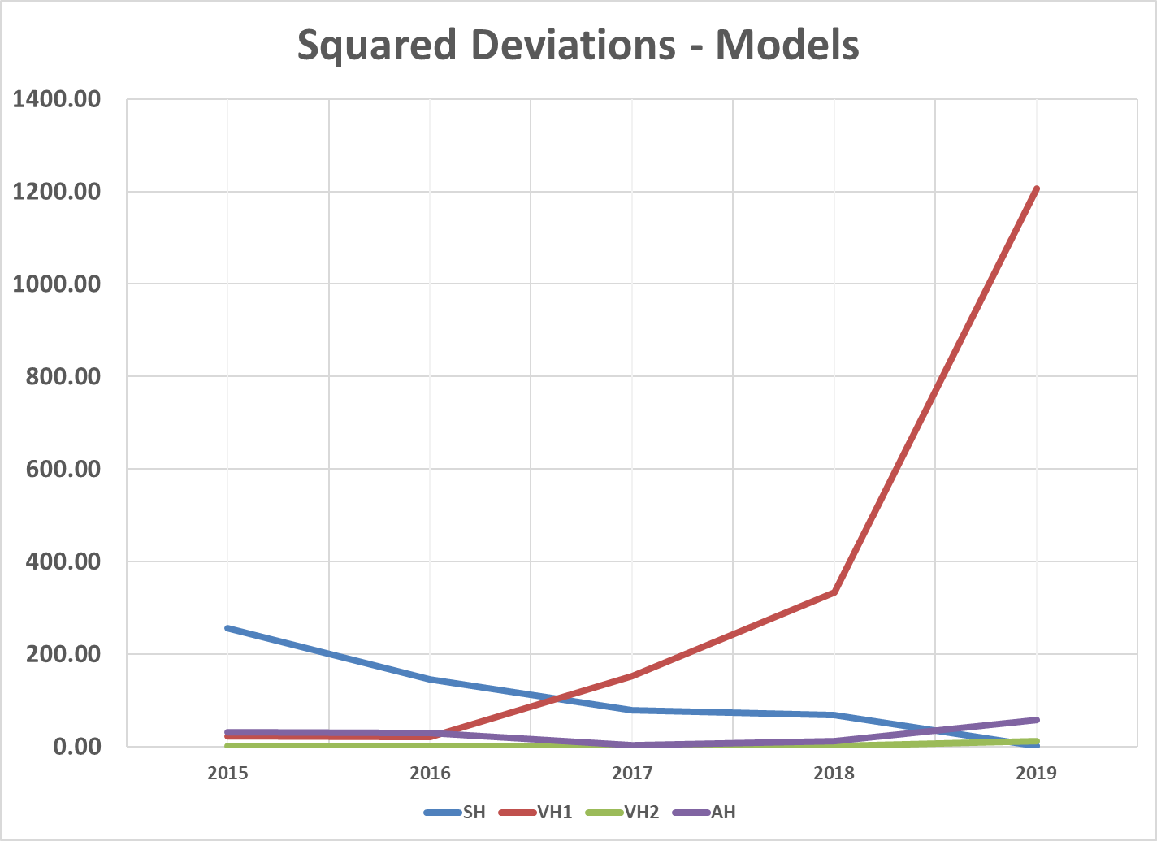
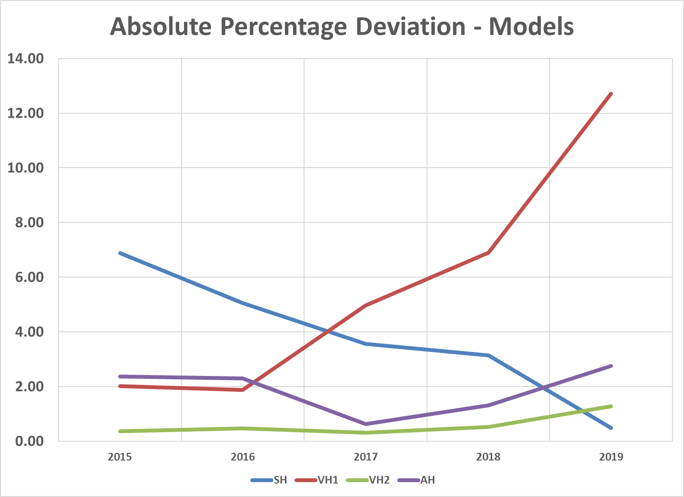
Forecasting
Model Error Comparison
Notes:
The error charts show in-sample model performance for all approaches: Structural, VAR1 (Technological Progress), VAR2 (Capital Accumulation), and ARIMA.
Early on, all models perform similarly, with the structural model having errors notably higher than the rest, but errors for VAR1 rise quickly and remain high, while structural and ARIMA models show moderate, stable errors.
VAR2 stands out with the lowest RMSE and MAPE across most years, indicating it consistently produces the most accurate forecasts overall.

Slide 49
Forecasting
Combination Forecasting

Slide 50
Forecasting
Combination Algorithms
 | METHOD | RMSE | MAPE | Equal | Inv MAPE | Inv MSE | RMSE Adj.
Models | Structural | 10.48 | 3.82 | 25% | 9.8% | 2.6% | 20.9%
 | VAR1 | 18.62 | 5.69 | 25% | 6.6% | 0.8% | -1.7%
 | VAR2 | 1.82 | 0.58 | 25% | 63.7% | 85.6% | 44.9%
 | ARIMA | 5.13 | 1.87 | 25% | 20% | 10.8% | 35.8%
Combos | Equal | 5.86 | 1.61 | - | - | - | -
 | Inv MAPE | 3.12 | 0.87 | - | - | - | -
 | Inv MSE | 2.13 | 0.66 | - | - | - | -
 | RMSE Adj. | 3.60 | 1.31 | - | - | - | -
 | Combo Combo | 4.68 | 1.26 | 25% | 25% | 25% | 25%
Notes:
The combinations I am using are equal weighting, inverse MSE optimized, inverse MAPE optimized, Dan’s RMSE adjusted weighting, and then a combination of all combinations. Equal Weights
Each model is assigned an equal share of the weight, regardless of its past performance. With four models, this implies a weight of 25% per model. This serves as a benchmark against which other performance-based weighting methods are evaluated.
Inverse-MAPE Weights
These weights assign more importance to models with lower Mean Absolute Percentage Error (MAPE). The inverse of each model’s MAPE is calculated, and then the values are normalized so they sum to 1.This approach assumes that models that, on average, deviate less from the actual values (in percentage terms) should contribute more to the forecast.
Inverse-MSE Weights
Here, the focus is on minimizing the influence of models with high mean squared error (MSE). The inverse of each model’s MSE is taken, so lower-error models are given higher weight. After normalization, models with lower MSEs get proportionally larger contributions to the final forecast. This method penalizes large deviations more severely than MAPE due to squaring the error term.
Adjusted RMSE Share Weights – Dan’s Method
The equal weights are revised based on each method’s contribution to the sum of all RMSE values. If a method contributes more than 25% of the total RMSE (i.e., it performs worse than average), its weight is reduced below 25% by the excess share amount. For example, if a model contributes 43% of the total RMSE, it exceeds its “fair share” by 18 percentage points. Its equal weight of 25% is then adjusted down to 7%, while better-performing models receive proportionally higher weights. This method retains interpretability by directly tying weights to error shares and adjusts weights symmetrically around the equal benchmark.

Slide 51
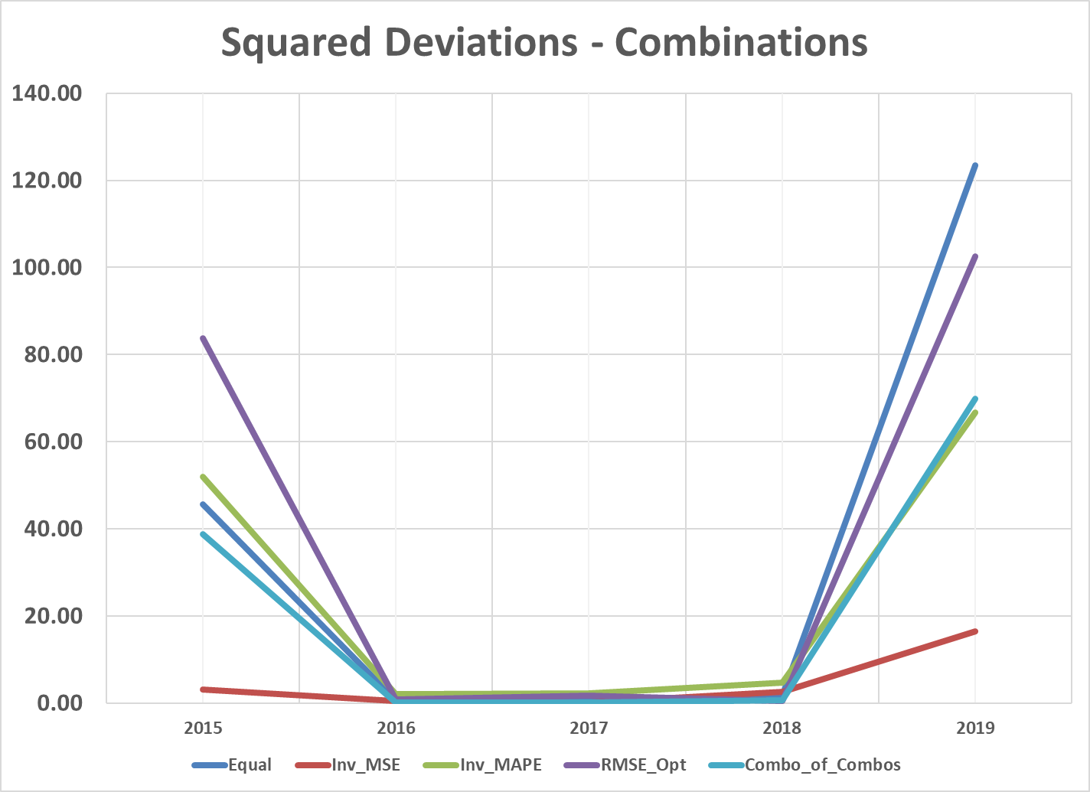
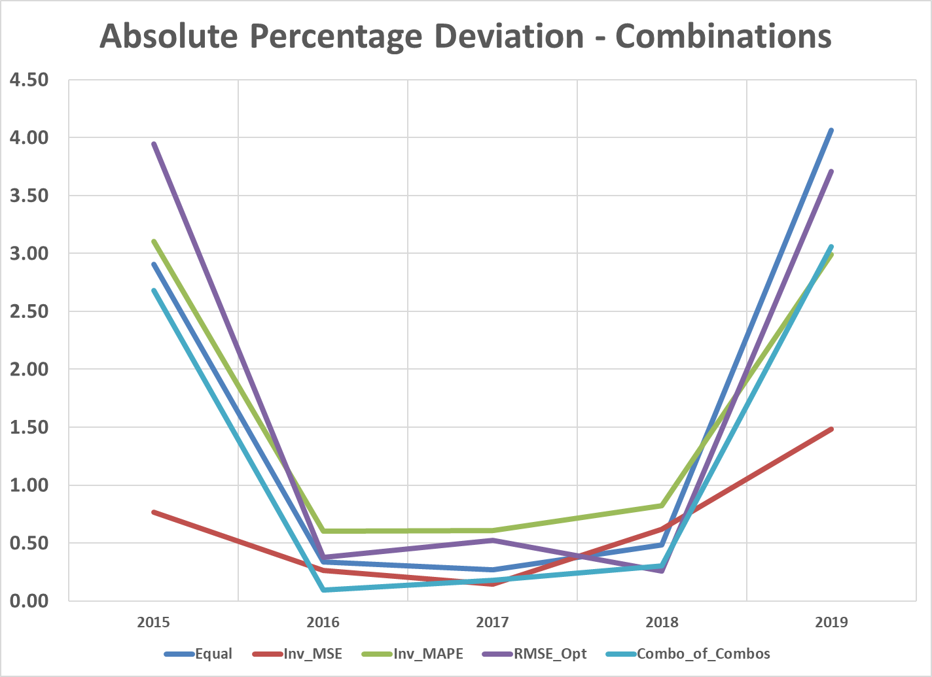
Forecasting
Combination Algorithms - Errors
Notes:
Contrasting the model based in sample forecast errors, most of the combination perform very similarly, with inverse Mean Squared Error weights being notably different. All combinations show higher errors in 2015 and 2019, with very low errors from 2016 to 2018, inverse MSE being the best across the board.

Slide 52
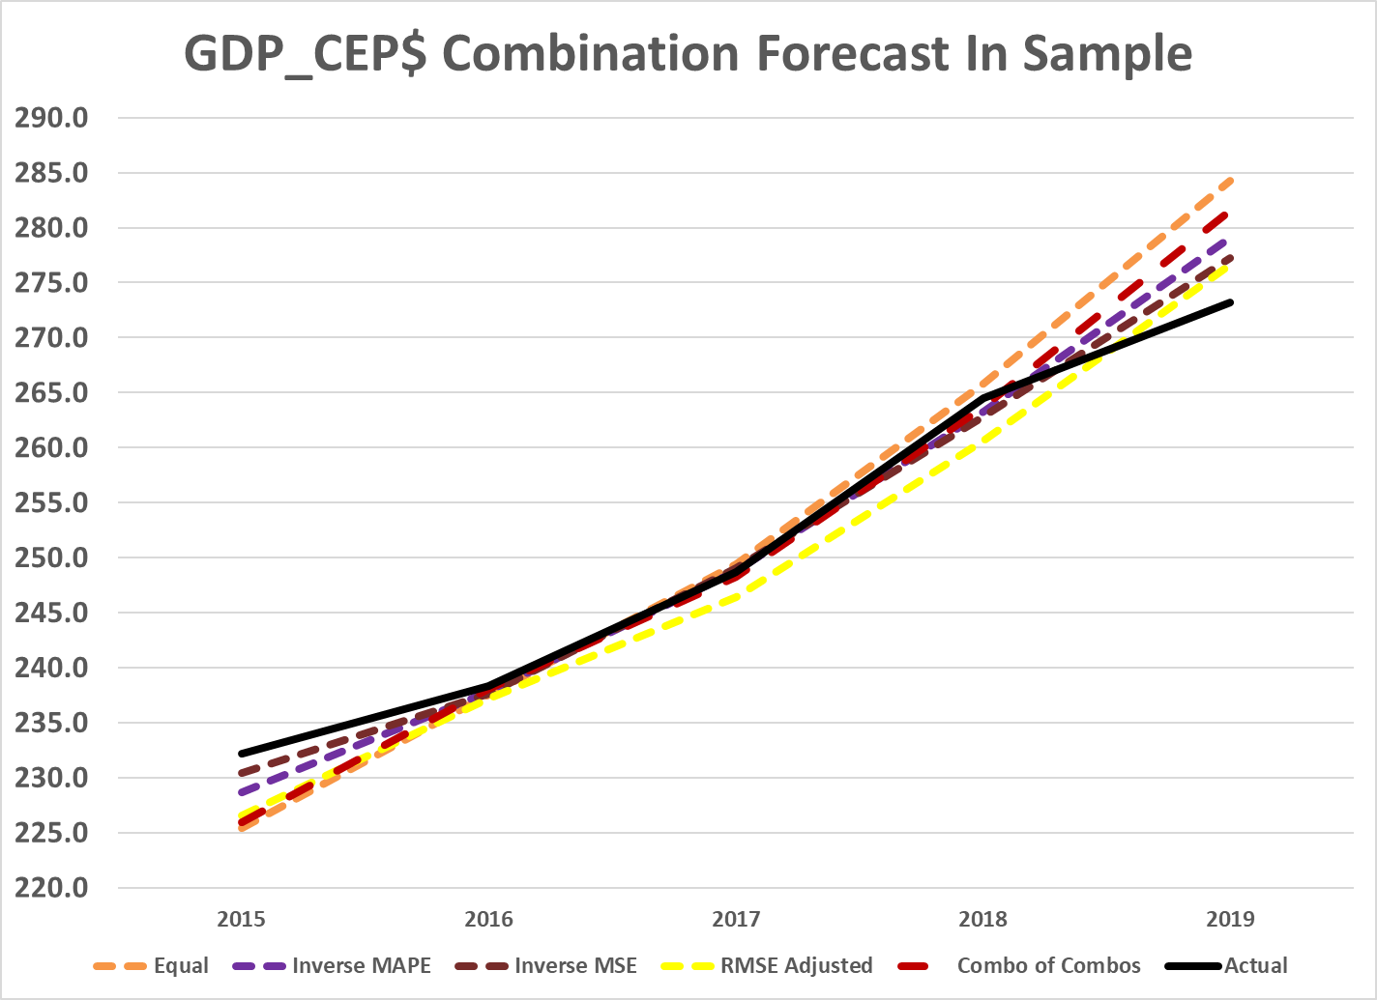
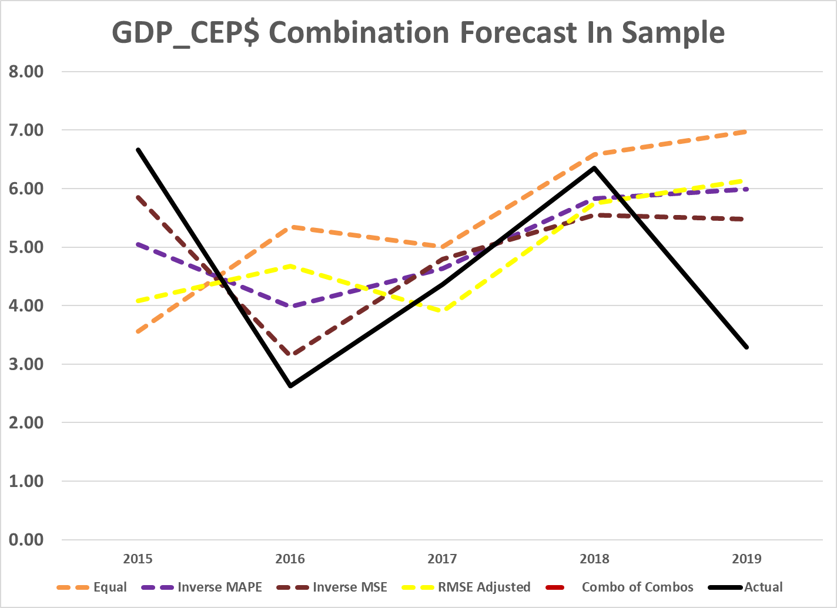
Forecasting
Combination Algorithms – In sample
Notes:
Here we have the in sample forecasts for levels and growth rates, more clearly showing the divergence of forecasted and actual data. All combinations under-forecast in 2015, then converge for the middle 3 years near the actual values, then over forecast 2019. The combination that does the best at maintaining dynamics is inverse MSE, showing minimal divergence in growth rates, and maintaining the same dynamics as the actual growth rates across the range.

Slide 53
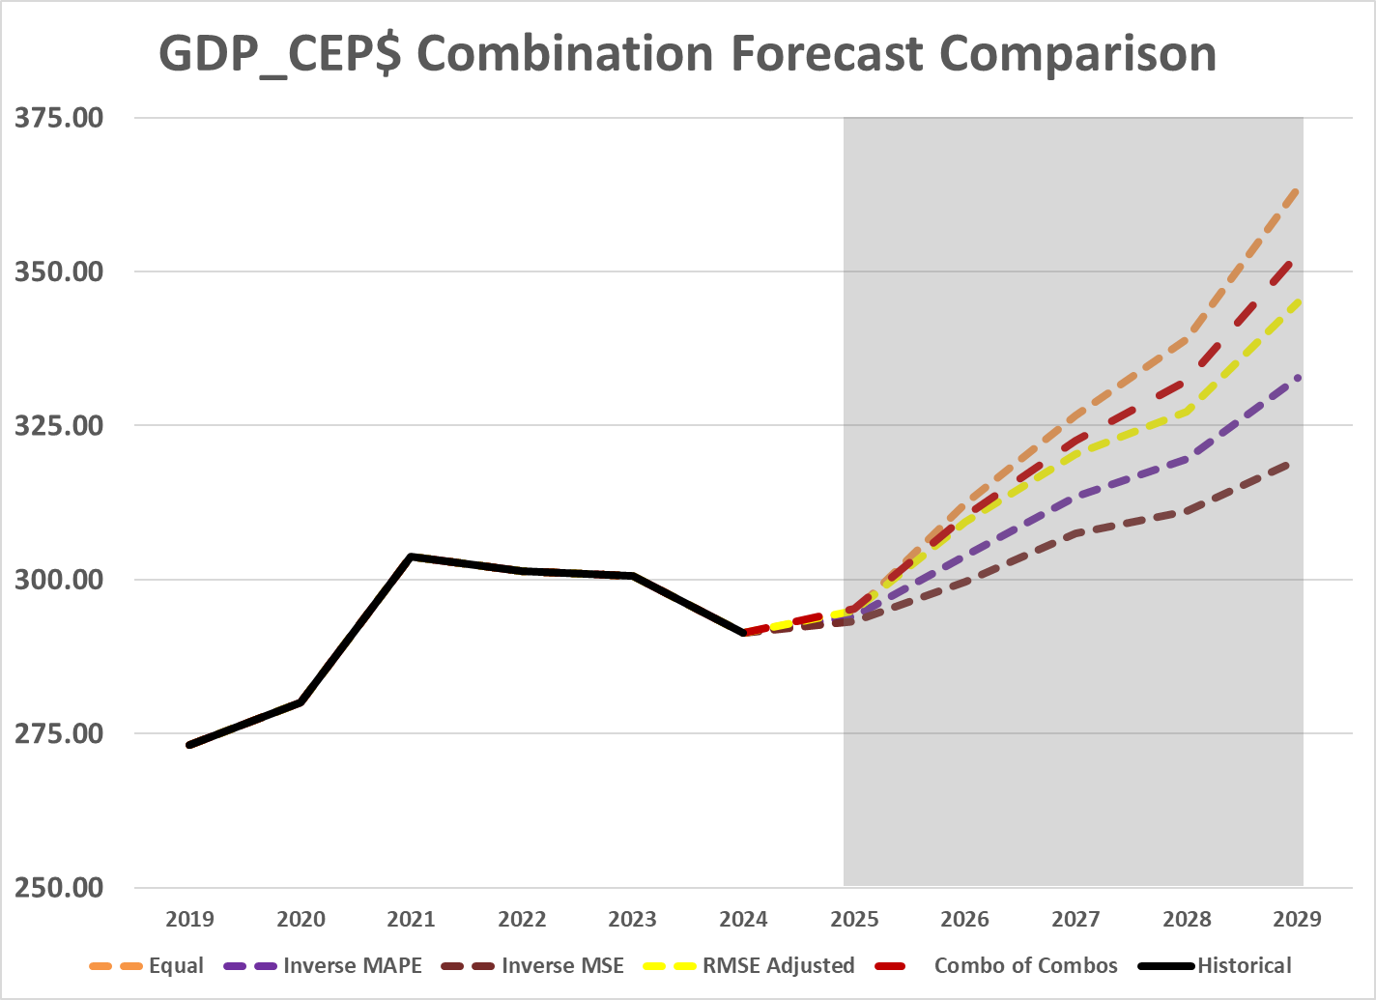
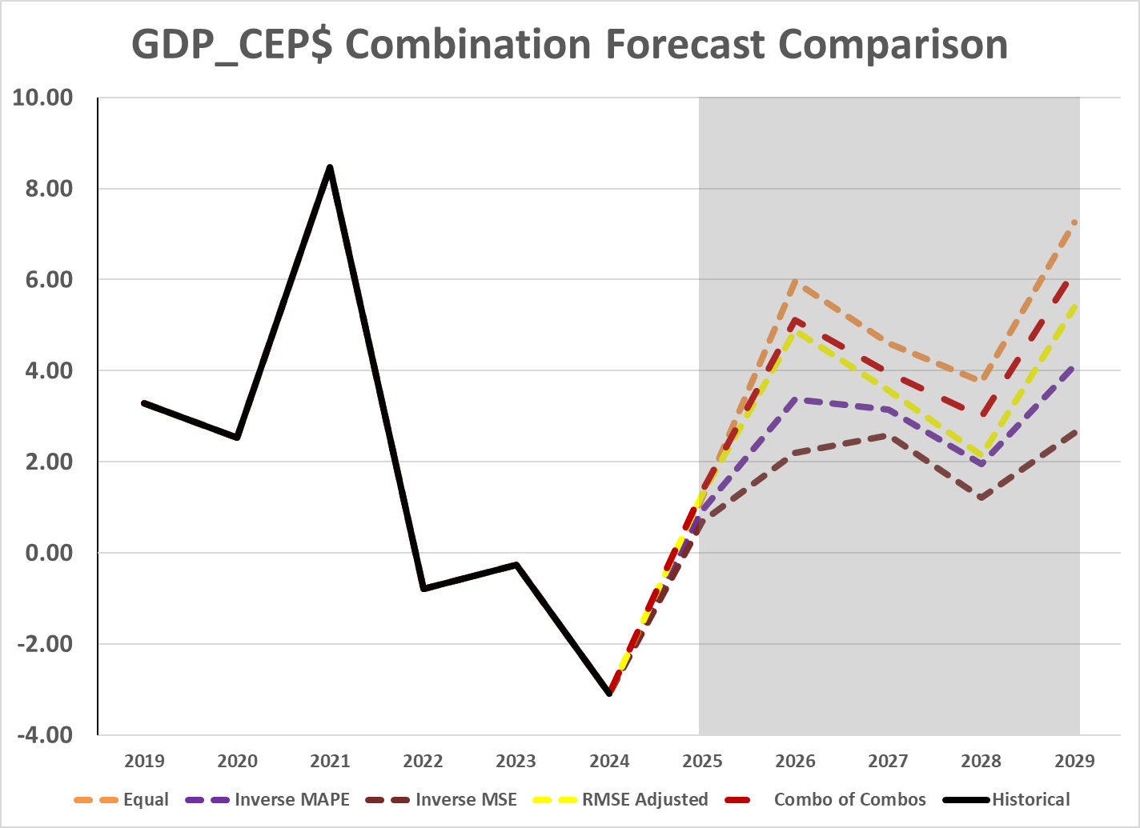
Forecasting
Combination Algorithms – Out of Sample
Notes:
Here we see the out-of-sample forecasts generated from the various model combinations. What stands out is how heavily the final forecast is influenced by either the structural model or VAR 2, depending on the weighting method used.
The baseline forecast from the structural model (CEP) was relatively high. As a result, even a modest increase in its weighting leads to a noticeable increase in the overall forecasted growth. On the other hand, VAR 2 consistently forecasted lower growth and also had the lowest error, making it the most accurate model in this set.
This performance dynamic is reflected in the weighting schemes:
Equal weighting gives all models 25%, which keeps the structural model’s influence relatively strong.
In contrast, inverse MSE weighting gives VAR 2 as much as 85% of the total weight due to its superior error performance.
The optimal adjusted weighting (based on RMSE shares) also systematically pulls down the influence of the structural model while boosting the contribution from VAR 2.
In short, the better a model performs out-of-sample, the more it drives the forecast, and VAR 2’s strong performance makes it the dominant influence under most optimized schemes.

Slide 54
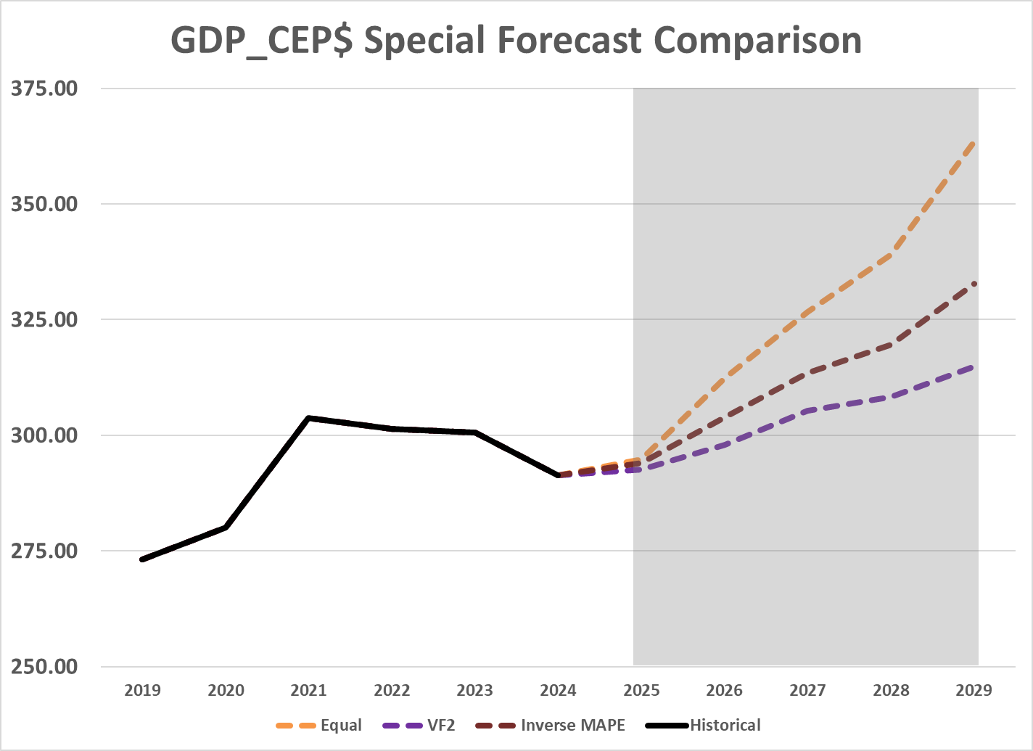
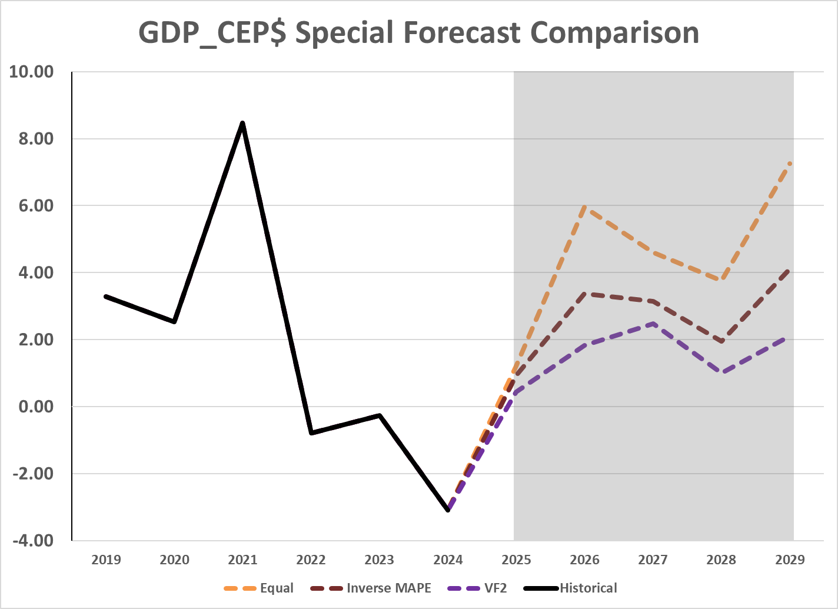
Forecasting
Combination Algorithms
Notes:
Here we compare out-of-sample forecasts from equal weighting, VAR 2, and the inverse MAPE combination.
I excluded inverse MSE from this comparison because it placed an extremely high weight on VAR 2—so high that the resulting forecast was virtually identical to the VAR 2 forecast itself. For that reason, I included VAR 2 individually here for contrast.
The forecasts form a clear bracketing set:
Equal weighting leads to the highest projected growth rates, as it gives more influence to the structural model, which had a more optimistic forecast.
VAR 2 produces the lowest growth forecast, consistent with its more conservative outlook and stronger in-sample performance.
The inverse MAPE combination strikes a balance between the two, moderating extreme weightings while still adjusting for forecast error quality.
This comparison helps show how different weighting schemes influence the overall growth trajectory.

Slide 55
End
Looking Forward

Slide 56
End
Looking Forward
1 Week
Robustness Checks with Prices
Automated Weighting System
Use the BVARs as well
Time Varying Weights
3 Months
Regression Respecification
Trying more combinations of variables and transformations
More model layers
Using structural Regs for capital and labor
Full Code Cleanup
Reducing redundancy and ease of adjustment
Improving generalizability for future projects/additions
Notes:
Over the next week, the focus will be on conducting robustness checks using alternative price variables, implementing an automated weighting system for model combinations, expanding the modeling toolbox by adding Bayesian VARs (BVARs), and exploring time-varying model weights for greater flexibility.
Over the following three months, the plan would be to respecify the regressions by experimenting with additional variable and transformation combinations, introduce extra model layers (including new structural models for capital and labor), and carry out a comprehensive code cleanup to minimize redundancy and improve adaptability for future enhancements.

