Slide 1
Targeting Emissions: Comparing US Climate Policy Effectiveness
By Shaun Levenson
ECON 555: Environmental Economics
Matthew Fienup
Summer 2025
Master of Science in Quantitative Economics

Slide 2

Motivation
Why do we care?
Notes:
Greenhouse gas emissions create significant negative externalities, harming ecosystems, health, agriculture, and economic stability. These social costs aren’t reflected in market prices, causing over-pollution and heightened climate-related damages. Economists and policymakers must understand these costs to fairly assess and design effective environmental policies.

Slide 3
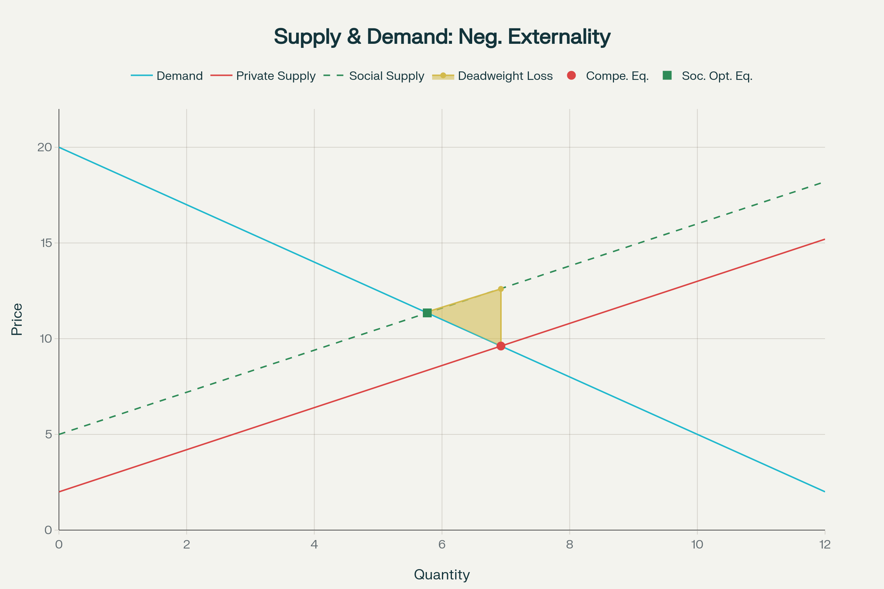
Motivation
Production of Greenhouse Gases Creates Externalities
Definition: An externality is a cost or benefit from an economic activity that affects third parties who did not choose to incur that effect.
Types:
Negative externalities (e.g., pollution, noise) impose costs on others.
Positive externalities (e.g., vaccination, education) create benefits beyond the individual or business.
Market Failure: When externalities are present, the market price does not reflect the true social cost or benefit, leading to inefficient outcomes.
Policy Solutions: Governments may intervene with taxes, subsidies, regulations, or property rights to internalize externalities—aligning private incentives with social welfare.
Notes:
When we say externalities, we mean costs or benefits from economic activities that affect people not directly involved.
There are two main types: Negative externalities create costs for others, like air pollution or construction noise. Positive externalities provide broader benefits, such as vaccination protecting not just the individual but the community too.
These external effects cause market failure because market prices don’t capture these spillover costs or benefits. As a result:
Goods with negative externalities tend to be overproduced (like pollution-heavy goods), and
Goods with positive externalities tend to be underproduced (like education or public health measures).
Looking at this chart, the competitive equilibrium (where supply meets demand) ignores external costs, leading to too high a quantity. When we factor in the social cost (the full cost to society), the supply curve shifts left, lowering the equilibrium quantity and raising the price leading to the socially optimal equilibrium.
The deadweight loss area illustrates the welfare loss from this gap—society bears unnecessary harm or forgone benefits because the market outcome is inefficient.
To fix this, policies are necessary to align private incentives with social costs. While many mechanisms exist, this presentation focuses on three key approaches:
Renewable Portfolio Standards,
Low Carbon Fuel Standards, and
Carbon Cap-and-Trade systems.

Slide 4
Motivation
Environmental Damage and the Policy Puzzle
High Social Costs
Greenhouse gases impose estimated social costs of $190 (CO₂), $1,600 (CH₄), and $54,000 (N₂O) per metric ton (2020 dollars, 2% discount rate).
By 2025, these costs are projected to rise to $210, $2,000, and $60,000, respectively. By 2080, these per-ton costs will nearly double.
Based on projected U.S. emissions, this translates to an estimated $900 billion to $1.3 trillion in annual climate-related damages for 2025.
Graph Cost Data: https://www.epa.gov/system/files/documents/2023-12/epa_scghg_2023_report_final.pdf
Graph Emissions Data: https://www.epa.gov/system/files/documents/2025-01/2024-btr-summary.pdf
Notes:
Building on our understanding of externalities—the unpriced costs that lead to over-pollution—we can now put a dollar value on those costs. The Social Cost of Greenhouse Gases quantifies the estimated global damages caused by emitting one additional ton of these gases, capturing the very harms we discussed earlier like health impacts, property damage, and ecosystem losses. This economic valuation makes the consequences of externalities tangible and underscores why policy interventions are both necessary and urgent.

Slide 5
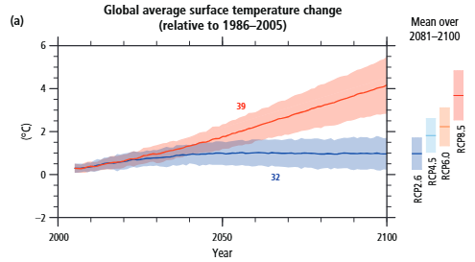
Motivation
Representative Concentration Pathways (RCP)
Chart Source: IPCC Fifth Assessment Report
Notes:
This chart shows projected global average temperature changes through 2100 under four RCP scenarios—from strong climate action (RCP2.6, blue) to very high emissions (RCP8.5, red).
RCP2.6 shows the least warming, likely staying under 2°C if strong mitigation continues.
RCP8.5 projects severe warming—over 4°C by 2100—if emissions keep rising.
Intermediate scenarios (RCP4.5, RCP6.0) fall between these extremes.
Shaded areas represent uncertainty in model projections. The bars on the right summarize average warming at century’s end for each scenario.

Slide 6
Motivation
Environmental Damage and the Policy Puzzle
Why Evaluate Environmental Policy Effectiveness?
Not all policies are equally effective
Costs can vary dramatically
Policy design informs future action
Balancing Tradeoffs
Notes:
Environmental damage from greenhouse gas emissions is extremely costly—not only in economic terms but also through impacts on public health, infrastructure resilience, and long-term economic stability.
Since public resources are limited, simply reducing emissions isn’t enough; we need to reduce them efficiently—maximizing benefits while minimizing costs.
Evaluating the effectiveness (real emissions reductions achieved) and efficiency (cost per unit of reduction) of policies like Renewable Portfolio Standards (RPS), Low Carbon Fuel Standards (LCFS), and Carbon Cap-and-Trade systems is essential.
This evaluation helps decision-makers prioritize policies that deliver the greatest social benefits for each dollar spent, and guides the refinement or combination of tools needed to best approach the socially optimal emissions level.
Ultimately, this ensures climate action is not only impactful but also economically sound, improving welfare while addressing greenhouse gas externalities.

Slide 7
Background
Greenhouse Gas Effect
Notes:
Before we can analyze the effectiveness of emissions policies, we need to understand two key things:
First, what greenhouse gases actually do - the basic science behind how they trap heat and contribute to climate change.
And second, where they come from — the major sources of these emissions across the economy.

Slide 8
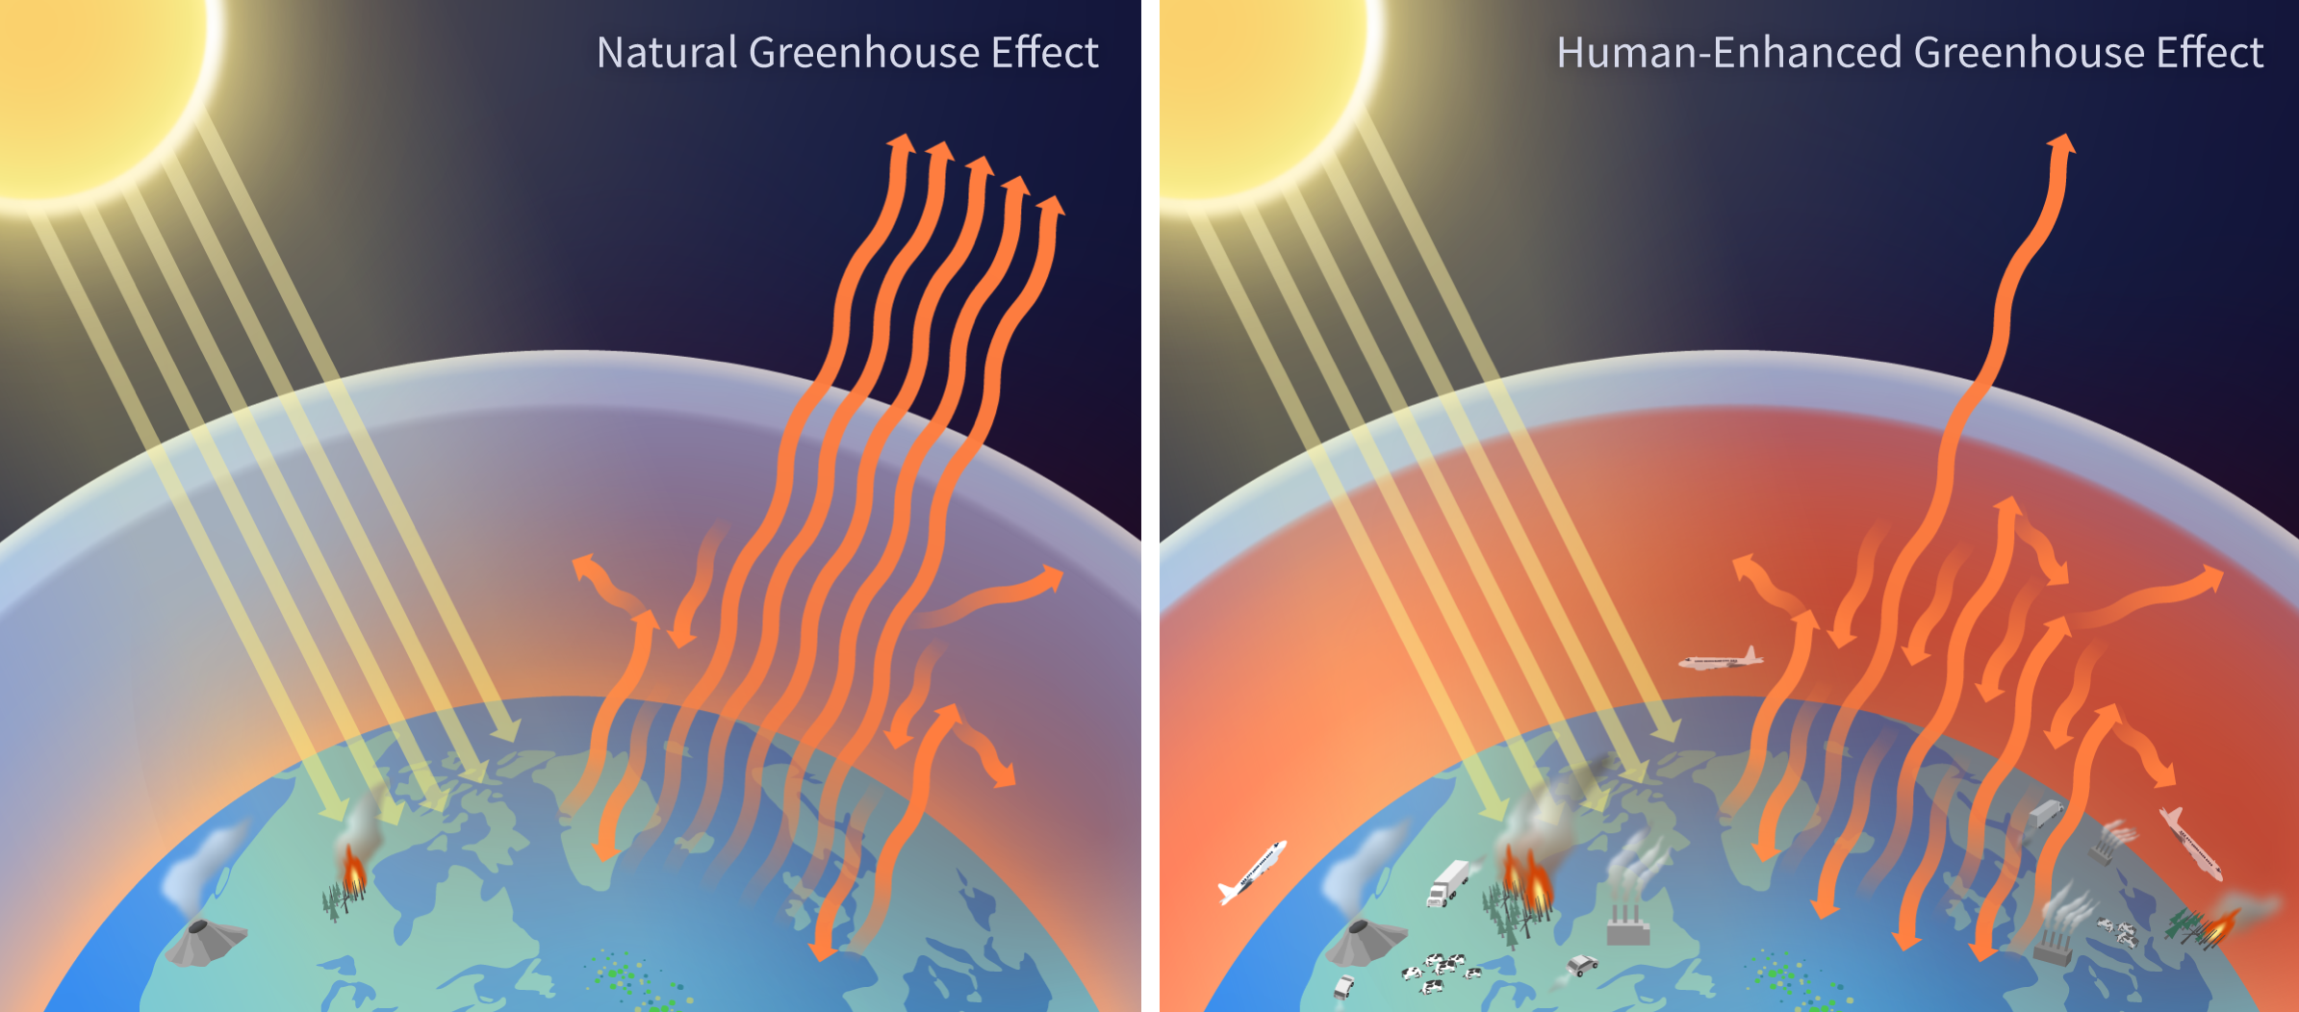
Background
Climate Change and the Policy Puzzle
Image Source: https://www.climate.gov/media/16408
Notes:
Greenhouse gases are gases in the atmosphere that trap heat by absorbing and re-emitting infrared radiation.
This is what’s known as the greenhouse effect.
During the day, sunlight passes through the atmosphere and heats Earth’s surface.
At night, the Earth cools down by releasing that energy as infrared radiation — a form of heat.
But greenhouse gases — like carbon dioxide, methane, and nitrous oxide — absorb much of that outgoing infrared radiation.
Gases like oxygen and nitrogen don’t absorb infrared, but greenhouse gases do.
And once they absorb it, they radiate some of it back down to the surface, effectively trapping heat in the atmosphere.
This warming cycle is natural and necessary because it allows for life to thrive on Earth — but when human activity increases greenhouse gas levels too much, too much heat is trapped, which leads to global warming and broader climate disruption.

Slide 9
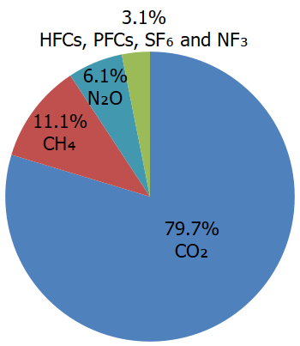
Background
Major sources of each greenhouse gas (2022 Data)
CO2 (79.7% of all GHG emissions)
35% Transportation, 30% Electricity, 16% Industrial, 12% Residential and Commercial, 5% Other, 2% Non-Energy Use of Fuels
CH4 (11.1% of all GHG emissions)
28% Natural Gas and Petroleum Systems, 25% Enteric Fermentation, 16% Landfills, 9% Manure Management, 6% Coal Mining, 6% Flooded Land, 9% Other, 2% Land Use, Land Use Change, and Forestry
N2O (6.1% of all GHG emissions)
75% Agricultural Soil Management, 6% Stationary Combustion, 6% Wastewater Treatment, 4% Manure Management, 4% Transportation, 2% Land Use, Land Use Change, and Forestry, 2% Other
Fluorinated Gases - HFCs, PFCs, SF6, and NF3 (3.1% of all GHG emissions)
90% Substitution of Ozone Depleting Substances, 4% Fluorochemical Production, 3% Electrical Equipment, 2% Electronics Industry, 1% Production and Processing of Aluminum and Magnesium
Chart Source: https://www.epa.gov/ghgemissions/overview-greenhouse-gases
Notes:
Carbon dioxide (CO₂): ~80% of U.S. emissions; mostly from burning fossil fuels.
Biggest sources: transportation (~⅓), electricity (~30%), and the rest from industry, buildings, and other fuel uses.
Methane (CH₄): ~11%.
Main contributors: oil and gas industry, then agriculture (especially livestock), and landfills.
Nitrous oxide (N₂O): ~6%.
Almost three-quarters from agricultural soils (mainly fertilizers), plus some from combustion and waste.
Fluorinated gases: ~3%, but highly potent.
Mostly from replacing ozone-depleting substances; also from refrigerants and industry.

Slide 10
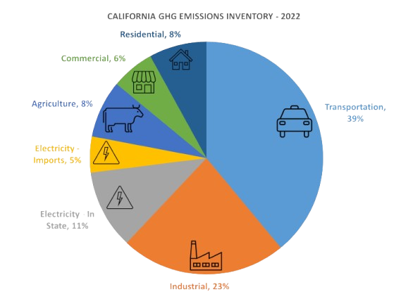
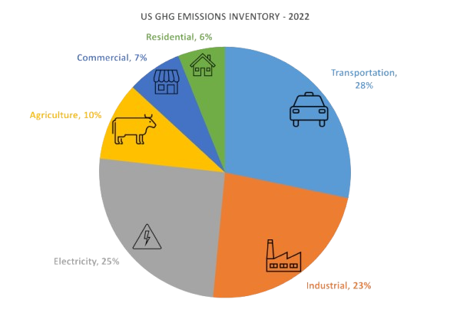
Background
Major sources of each greenhouse gas (2022 Data)
CA Source: https://ww2.arb.ca.gov/ghg-inventory-graphs
US Source: https://www.epa.gov/ghgemissions/inventory-us-greenhouse-gas-emissions-and-sinks
Notes:
These charts break down greenhouse gas emissions by sector for 2022, with California on the left and the entire U.S. on the right.
California’s emissions profile is dominated by transportation, which accounts for about 39% of the state’s total emissions—much higher than the national share. Industry comes next, at about 23%. Electric power is a smaller portion of California’s emissions compared to the U.S. average because California’s electricity grid is much cleaner.
For the U.S., the largest sectors are transportation (about 28%) and electric power (around 25%), followed by industry (23%). Commercial and residential buildings together make up about 13%, and agriculture is roughly 10%.

Slide 11
Background
Policy Tools
Notes:
Now that we have the scientific background and greenhouse gas source information, we can start looking at the tools we are analyzing.

Slide 12
Background
Tool | What It Does
Renewable Portfolio Standards (RPS) | Requires that a minimum percentage of electricity sold by utilities comes from renewable sources, such as wind, solar, or hydroelectric.
Low Carbon Fuel Standards (LCFS) | Sets a declining annual standard for the carbon intensity of transportation fuels, requiring fuel providers to lower the average emissions per unit of energy produced
Carbon Cap-and-Trade | Sets an overall limit (cap) on emissions and distributes (often through auction or free allocation) emission allowances. Emitters must hold enough allowances to cover their emissions, and they can trade allowances with others
Notes:
These are three of the main policy tools used to reduce emissions in practice.
RPS targets the electricity sector by requiring a growing share from renewables.
LCFS targets transportation fuels and is flexible — allowing any low-carbon fuel to help meet the goal.
Cap-and-Trade works by setting an overall emissions limit, letting companies trade permits so reductions happen where they’re most efficient.

Slide 13
Background
Renewable Portfolio Standard (RPS) – Mechanism Overview
Mandates that a minimum percentage of electricity comes from renewable sources (wind, solar, hydro, etc.).
How it works:
Utilities must source a set share of electricity from renewables.
Compliance is tracked through Renewable Energy Certificates (RECs).
Non-compliant utilities may have to buy RECs or pay penalties.
Notes:
The Renewable Portfolio Standard mandates that a minimum percentage of our electricity comes from renewable sources like wind, solar, and hydro. Utilities are legally required to obtain a specified share of their power from renewables. They prove compliance by acquiring Renewable Energy Certificates, or RECs, each reflecting one megawatt-hour of renewable electricity generated. If a utility falls short of its target, it must either buy extra RECs from others who have a surplus or pay financial penalties. By requiring or incentivizing the use of renewables, RPS forces firms to internalizes some of the external costs, making electricity generation cleaner and aligning private utility decisions with broader social interests.

Slide 14
Background
Low Carbon Fuel Standard (LCFS) – Mechanism Overview
Requires fuel providers to decrease the average carbon intensity (CI) of transportation fuels over time.
How it works:
Sets a declining annual CI target for fuel mix.
Credits are awarded for low-carbon fuels (biofuels, electricity, hydrogen).
Providers of high-carbon fuels must purchase credits or blend cleaner fuels.
Notes:
The Low Carbon Fuel Standard requires fuel providers to decrease the average carbon intensity of transportation fuels over time.
Each year, a lower carbon intensity (CI) target is set, pushing fuel suppliers to use or blend in more low-carbon options like biofuels, electricity, or hydrogen. For every unit of low-carbon fuel sold, credits are earned, while selling fuels above the target incurs deficits. Providers of high-carbon fuels must either blend cleaner alternatives or purchase credits from those who exceed the standard.
By making low-carbon fuels more valuable and high-carbon fuels more costly, LCFS internalizes some of these broader social and environmental costs, providing a direct incentive for private companies to innovate and reduce emissions.

Slide 15
Background
Carbon Cap and Trade – Mechanism Overview
Imposes a firm limit ("cap") on total greenhouse gas emissions from covered entities.
How it works:
Issues a fixed number of emission allowances.
Companies must hold allowances equal to their emissions.
Allowances can be traded, creating a carbon price.
Notes:
The Carbon Cap and Trade program imposes a firm limit, or "cap," on the total greenhouse gas emissions allowed from covered entities, such as power plants and industrial facilities. A set number of emission allowances are issued, each permitting the holder to emit one ton of CO₂ or equivalent greenhouse gases. Companies must hold enough allowances to cover their emissions. If they emit less, they can sell or trade their excess allowances to others who need more. This creates a market price for carbon emissions.
Why this matters: By capping total emissions and making allowances a scarce, tradable commodity, the policy directly puts a price on carbon pollution—the negative externality not accounted for in unregulated markets. This incentivizes companies to reduce emissions where it is most cost-effective, internalizing the societal costs of climate change and pollution.

Slide 16
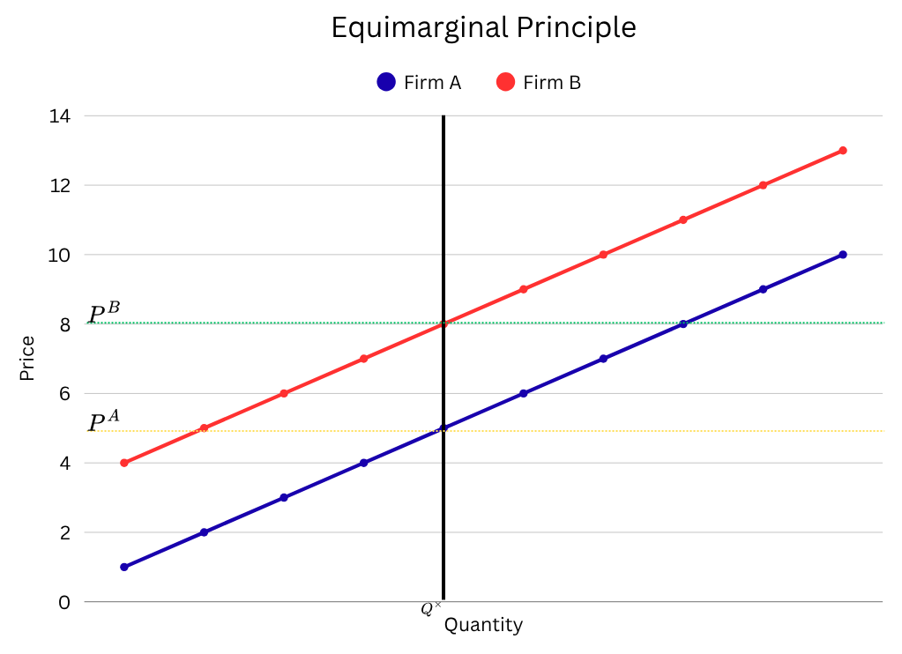
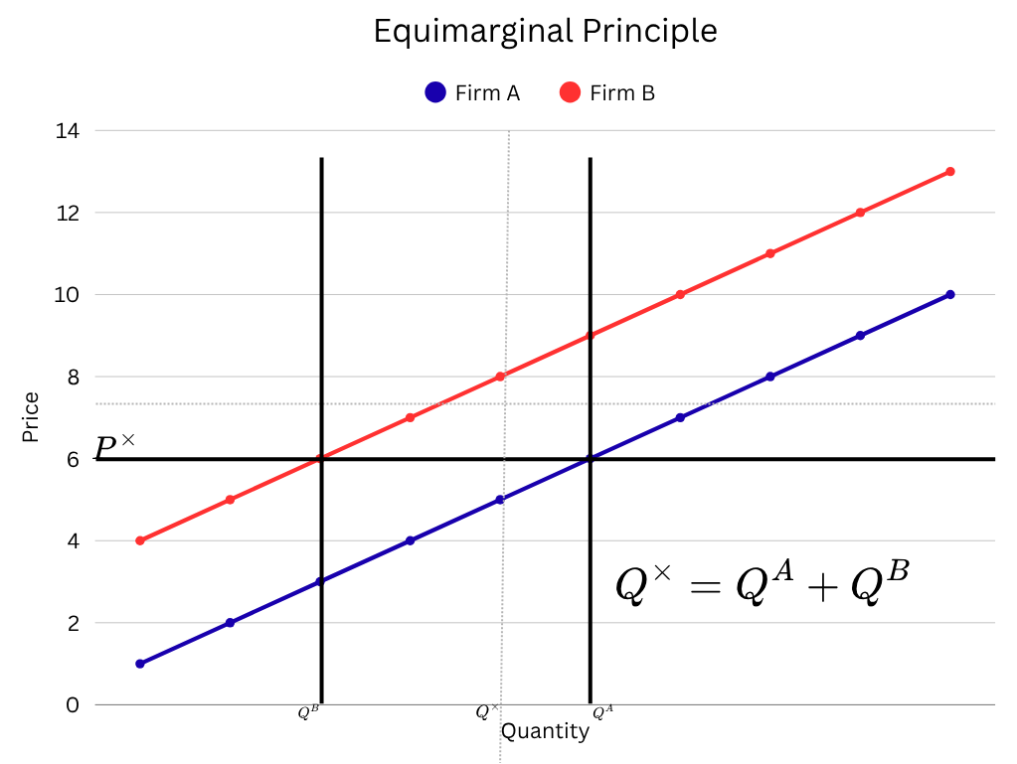
Background
Policy and the Equimarginal Principle
Notes:
The equimarginal principle states that emissions reduction is most efficient when all firms cut pollution until their marginal abatement costs are equal. If firms are forced to reduce the same amount regardless of costs, total costs rise because cheaper reductions aren’t fully utilized. Market-based policies like cap and trade allow firms to adjust abatement levels, achieving emission goals at minimum total cost by equalizing marginal costs. This principle underlies the cost-effectiveness of such policies.

Slide 17
Background
Policy and Equity
Ensures fair distribution of costs and obligations across companies of different sizes and emissions profiles.
RPS: Compliance costs vary by access to renewables; tradable Renewable Energy Creditss help but regional disparities remain.
LCFS: Firms with low-carbon fuel options benefit; trading credits adds flexibility but may favor early movers.
Cap-and-Trade: Equity depends on allowance allocation; free allocation protects some but can disadvantage new or smaller firms.
Fair policies minimize competitive distortions by aligning obligations with emissions and providing balanced compliance options
Notes:
After explaining the equimarginal principle and cost-effectiveness, it’s important to consider fairness between firms—how climate policy costs and obligations are shared.
The Renewable Portfolio Standard (RPS) can advantage firms with better renewable access; tradable RECs help but don’t fully equalize regional differences.
The Low Carbon Fuel Standard (LCFS) favors those able to supply low-carbon fuels; credit trading adds flexibility but benefits some firms more.
In Cap-and-Trade, fairness depends on allowance allocation—free allocation protects some firms but may disadvantage newer or smaller ones; auctions treat emitters equally but impose costs proportional to emissions.
Balancing fairness and efficiency is key to maintaining competitive markets and broad participation. Understanding equity among firms helps us evaluate these policies beyond just emissions and costs.

Slide 18
Literature
Evidence from the Literature
Notes:
We’ve reviewed the science, social costs, and key policy tools and how they address externalities. Now, let’s examine evidence from existing studies on their real-world performance.
Our analysis focuses on three key aspects:
Effectiveness – Has the policy led to measurable emission reductions?
Economic efficiency – What was the cost of achieving those reductions?
Equity – How fairly are costs and obligations distributed among firms affected by the policy?

Slide 19
Literature
Renewable Portfolio Standards – Are they effective?
RPS programs significantly increase renewable energy adoption (Lyon, 2017; Wiser et al., 2017; Greenstone & Nath, 2021)
Coal-fired CO₂ emissions decline most strongly under RPS mandates (Wiser et al., 2017)
Meaningful reductions in total CO₂ emissions have been observed (Wiser et al., 2017; Greenstone & Nath, 2021)
Co-benefits include improved air quality and lower water use (Wiser et al., 2017)
Overlapping or poorly coordinated policies can reduce effectiveness (Lyon, 2017; Goulder & Stavins 2011; Goulder et al, 2012; Moore et al, 2010)
Notes:
Evidence across multiple studies shows that Renewable Portfolio Standards are effective at expanding clean energy generation — particularly wind and solar. This has led to measurable declines in CO₂ emissions, especially from coal-burning sources. Beyond emissions, RPS policies improve air quality and reduce water consumption, which matters in drought-prone regions. However, when RPS overlaps with other poorly designed policies, it can reduce its effectiveness or even backfire by shifting emissions elsewhere. For example, a RPS may have no impact on carbon emissions if implemented in a region with carbon cap and trade system already in place

Slide 20
Literature
Renewable Portfolio Standards – Are they efficient?
Study | Costs | Benefits | Conclusion
Greenstone and Nath, 2021 | $60-$300/ton of CO2 abated; 11-17% increase in retail electricity prices | 10-36% CO2 reduction; structural changes to electricity mix | Emissions drop, but costs are high and uncertain; grid integration is key
Wiser et al, 2017 | Existing Policy: $31b Expanded Policy: $23b-$194b | Existing Policy: $258b Expanded Policy: $1157b | RPS is cost-effective when including externalities, but may not be the lowest-cost option.
Lyon, 2017 | Varies widely; depends on geography, grid needs, and overlaps | Emissions reductions; renewable adoption; innovation | RPS effectiveness and efficiency depend on policy design and local conditions
Notes:
Greenstone and Nath find that RPS programs reduce emissions but can have high, uncertain costs—especially from grid integration and infrastructure. Falling renewable costs don’t guarantee cost-effective emission cuts; grid flexibility investments are crucial.
Wiser et al. find The overall benefits of RPS, including improved air quality and avoided climate damages, outweigh the costs. While not always the most cost-efficient compared to carbon pricing, RPS is still societally cost-effective.
Lyon finds RPS effectiveness and cost-efficiency vary by context, depending on local resources, markets, and policy mix. Tailored, context-specific implementation is key.

Slide 21
Literature
Low Carbon Fuel Standards – Are they effective?
Transportation CO₂ emissions have declined following LCFS implementation (Huseynov, 2022)
The effectiveness of LCFS depends heavily on policy stringency and market responsiveness (Holland, Hughes & Knittel, 2009)
Inelastic demand for high-carbon fuels can reduce or even reverse emissions reductions (Holland, Hughes & Knittel, 2009)
Fuel-switching incentives under LCFS can drive cleaner fuel adoption, but impact varies by region and baseline fuel mix (Huseynov, 2022)
Notes:
Low Carbon Fuel Standards (LCFS) aim to reduce the carbon intensity of transportation fuels by incentivizing cleaner alternatives like biofuels and electricity.
Evidence from California, as shown in Huseynov (2022), indicates that LCFS policies can reduce transportation-sector emissions. But the scale of these reductions depends on how stringent the standard is and how fuel producers and consumers respond.
Holland, Hughes, and Knittel (2009) caution that LCFS policies don’t always lead to lower emissions. If demand for high-carbon fuels is inelastic, the policy can unintentionally raise emissions. This means that if consumers and producers do not significantly decrease their use of high carbon fuels even as regulations make these fuels more expensive, then the policy may not achieve much, if anything. Under certain scenarios, it may make emissions worse. If demand remains inelastic for high carbon fuels, firms can comply with regulations by increasing production of low carbon fuels rather than reducing production of high carbon fuels, leading to an overall increase in emissions.

Slide 22
Literature
Carbon Cap and Trades – Are they effective?
Costs of carbon cap and trade systems are insignificant (Peace and Juliani, 2009; Holland et al, 2015)
Well designed carbon markets are vital for lowering costs and driving innovation (Peace and Juliani, 2009; Holland et al, 2015; Schmalensee and Stavins, 2015)
Cap and Trade systems provide reduced errors in assigning emissions rates and provides greater incentives to innovate compared to the alternatives of RPS and LCFS (Holland et al., 2015)
Carbon Cap and Trade does not suffer the same land use intensification drawback that RPS and LCFS do (Holland et al., 2015)
Cap and Trade systems lead to not only more efficient emissions reductions, but also quicker emissions reductions than the alternatives (Schmalensee and Stavins, 2015)
Notes:
Cap-and-trade systems have proven to be both cost-effective and efficient. Peace and Juliani, along with Holland et al., find that the overall costs are minimal, especially compared to alternatives.
Well-designed carbon markets also drive innovation by giving firms the flexibility to reduce emissions in the most efficient way.
Compared to RPS and LCFS, cap-and-trade offers greater accuracy in emissions assignment and avoids unintended impacts like land-use intensification.
Finally, studies like Schmalensee and Stavins (2015) show that cap-and-trade leads to faster and more efficient emissions reductions than other major policies.

Slide 23
Literature
Carbon Cap and Trades – Not all that they seem to be?
Cap-and-trade can create allowance price volatility, especially if program rules are unclear, markets are thin, or banking is not allowed (Schmalensee & Stavins, 2015).
Limited coverage or regional boundaries risk emissions "leakage," where pollution shifts to unregulated sectors or locations (Schmalensee & Stavins, 2015)
Political pressures often lead to free allocation of allowances, which can cause windfall profits for some firms and reduce perceived fairness (Schmalensee & Stavins, 2015; Grainger & Costello, 2015)
Overlapping regulations under the cap can undermine market efficiency, raising costs without further reducing emissions (Schmalensee & Stavins 2015)
High administrative needs for monitoring, reporting, and enforcement are crucial to prevent gaming or non-compliance (Breetz et al, 2005; Schmalensee & Stavins, 2015)
Notes:
Cap-and-trade systems, while effective in many cases, come with several commonly recognized challenges:
The market can experience allowance price volatility, especially if program rules are unclear or trading activity is low—making planning difficult for firms.
When the program’s scope is limited, emissions can “leak” to unregulated sectors or regions, reducing environmental gains.
Political compromises often lead to free allocation of allowances, resulting in windfall profits for some companies and concerns about fairness among competitors.
Overlapping regulations, such as mandated renewables or efficiency rules, can drive up costs without achieving additional emissions reductions.
Finally, these systems require extensive administration and enforcement to ensure accurate reporting and prevent gaming or non-compliance, which adds complexity and cost.

Slide 24
Comparison of Policies
Efficiency and Equity
Notes:
The results of the analysis comes down to two main concepts, determining if a policy is efficient and determining if a policy is equitable.

Slide 25
Comparison of Policies
Efficiency and Equity
Definitions
Efficiency
Achieving abatement at the lowest possible cost to society
Equity
How fairly costs and benefits are distributed
Notes:
Heres how each is defined. A policy is deemed efficient when it achieves emissions reductions at the lowest possible social cost, whereas equity is about how fairly costs and benefits are distributed.

Slide 26
Comparison of Policies
Direct Comparison - Efficiency
Policy | Pros | Cons
RPS | Drives measurable renewables growth Can reduce emissions in the electricity sector Monitoring costs are fairly low | Costly to achieve the equimarginal principle Reduces incentives to innovate Can be inefficient if renewables are expensive locally
LCFS | Incentivizes innovation and cleaner fuels Flexible compliance via credit trading | Effectiveness is limited depending on market conditions Can unintentionally raise fuel emissions Cost effectiveness is highly variable
CnT | Frequently satisfies the equimarginal principle when implemented well Drives rapid innovation | Allowance price volatility if not designed well Overlapping policies can dilute returns
Notes:
This table summarizes the main efficiency pros and cons of these three key climate policies.
RPS drives renewable energy growth and reduces emissions in electricity, with relatively low monitoring costs. However, it can be costly and inefficient because it doesn’t ensure reductions where cheapest and may limit innovation.
LCFS encourages cleaner fuels and innovation through flexible credit trading, but its effectiveness depends on market responses, and it can sometimes unintentionally increase emissions. Costs vary widely.
Cap-and-Trade often achieves cost-effective reductions by equalizing marginal abatement costs and driving innovation, but allowance price volatility and overlapping policies can reduce efficiency if not carefully managed.
Overall, each policy has advantages, but their efficiency and effectiveness strongly depend on design and implementation.

Slide 27
Comparison of Policies
Direct Comparison - Equity
Policy | Pros | Cons
RPS | Tradable Renewable Energy Credits add some level of compliance flexibility | Firms in regions with poor renewables pay more Regressive, particularly burdensome on low income users
LCFS | Providers with early/cheap access to low carbon intensity fuels benefit | Traditional fuel providers and regions dependent on fossil fuels face higher costs
CnT | Auctions can distribute obligations fairly among emitters Permit revenue enables compensation for abatement | Free allocation can favor incumbents and disadvantage new/small firms, especially when allocation is based on history Cost burden falls disproportionately on sectors with high emissions
Notes:
This table highlights key equity advantages and challenges of the three policies.
RPS: Tradable credits help with flexibility, but firms in areas with poor renewables face higher costs. Costs can disproportionately hit low-income consumers through higher rates.
LCFS: Firms with early low-carbon fuel access benefit; traditional fuel providers and fossil-fuel–dependent regions bear higher costs.
Cap-and-Trade: Auctions distribute obligations fairly, and revenues can support compensation. However, free allocations favor incumbents, while high-emission sectors bear more costs.

Slide 28
Comparison of Policies
Direct Comparison - Conclusion
Most Economically Efficient?
Cap and Trade systems
Most Equitable?
Also cap and trade… but with stipulations:
Notes:
Now based on theory, what do I conclude to be the most efficient and most equitable. I believe that Cap-and-Trade is the best of both worlds. Using markets for emissions permits allows for firms to decide for themselves where and how to cut emissions, and incentivizes firms to cut sooner and to greater degrees to extract all the value from their permits that they can. And because firms can choose when and where to cut, it inherently leverages the equimarginal principle to result in the lowest total cost of abatement. Furthermore, unlike RPS and LCFS, cap and trade systems do not require specific technologies or actions. They can innovate or choose the best solutions that fit their circumstances best, decreasing the cost of compliance.
Cap-and-trade offers strong potential for fairness among firms, but actual equity depends on how emission permits are allocated. Auctioning allowances ensures all firms pay the same carbon price, creating a level playing field. Conversely, freely giving permits—especially based on past emissions—can benefit large, established firms and disadvantage newcomers or smaller companies. The fairest systems use clear, performance-based allocation methods to treat similar firms equally and avoid locking in existing market advantages. Proper permit allocation is essential to ensure fair competition and broad participation.

Slide 29
AB-32
Policy Comparison to AB 32
Notes:
How do theoretical policies compare to what is currently being used as a part of Assembly Bill 32?

Slide 30
AB-32
What is AB-32?
AB-32 is the first ever enacted long term approach to addressing climate change
Core of AB-32
Uses Carbon Cap and Trade authorized under the California Air Resources Board (CARB)
Requires mandatory monitoring and reporting of emissions
Enacts strict penalties for violators
Establishes declining limit on major source of GHG emissions throughout California
Provides a portion of free allowances and an additional set left for auction
Notes:
AB-32 established California’s comprehensive, long-term approach to addressing climate change and set a pioneering example in climate policy. The law centers around a carbon cap-and-trade program administered by the California Air Resources Board, which introduced a steadily declining statewide emissions cap for all major sources of greenhouse gases.
AB-32 requires all covered entities to monitor and report their emissions in a standardized manner, supporting robust data collection and transparent tracking of progress. The law includes mechanisms for enforcement through strict compliance procedures and defined penalties.
Allowance allocation under AB-32 is a balanced mix: a portion of permits is distributed for free to support key sectors, and the remaining allowances are auctioned to participants. This structure facilitates a market for carbon pricing and continuous emissions reductions in line with the state’s targets.

Slide 31
AB-32
How does AB-32 fare regarding efficiency and equitability?
AB-32’s cap-and-trade cut power sector emissions by nearly 50% compared to a no-policy scenario but did not reduce industrial emissions. (Lessman, 2024).
Complementary policies like RPS aided power sector reductions but may have shifted emissions to industry, reducing overall efficiency. (Lessman, 2024).
Free permit allocation favored incumbents, weakening incentives for broader emission cuts and equity. (Lessman, 2024).
Despite statewide emission declines, many low-income and minority communities near polluters saw increased emissions, raising environmental justice concerns.(Lessman, 2024; Boyce 2018).
Efficiency and equity outcomes depend strongly on policy design, especially permit allocation and coordination of overlapping policies. (Lessman, 2024; Boyce, 2018).
Notes:
This slide summarizes key research findings on AB-32’s cap-and-trade program and related policies.
AB-32 significantly reduced power sector emissions—about 48% below a no-policy scenario—but industrial emissions did not decline. Complementary policies like the RPS helped cut power emissions but may have shifted emissions to industry, limiting overall efficiency.
Free permit allocation to incumbent firms reduced incentives for broader emissions cuts and impacted equity. Despite statewide reductions, many low-income and minority communities near polluters experienced increased emissions, raising environmental justice concerns.
Finally, efficiency and equity outcomes depend heavily on policy design, especially permit allocation and how overlapping policies interact. These factors shape whether emission reductions are broad, cost-effective, and fairly distributed. So overall, AB-32 seems to have been relatively favorable for reducing emissions reductions in the power sector, but its overall efficiency and equity outcomes are mixed at best.

Slide 32
California Policy
Recommendations

Slide 33
AB-32
Policy Adjustment Recommendations
Problem: Current system applies a uniform cap statewide, ignoring regional pollution burdens
Impact: Dilutes environmental and equity outcomes—hotspot communities still face high exposure
Proposal: Introduce nested regional sub-caps within the existing statewide market
Design:
Total GHG cap remains unchanged
Some allowances reserved for specific regions, tradable only within those zones
Benefits:
Targets reductions where harm is greatest
Preserves market efficiency and administrative structure
Enhances local air quality and equity outcomes
Notes:
A significant issue with AB-32 is the broad, uniform reach of its cap-and-trade program. As it stands, the system applies a “one-size-fits-all” carbon market across the entire state, without regard for the vast differences in regional pollution burdens, industrial composition, and community vulnerability. While this statewide scope makes administrative sense and ensures market liquidity, it also dilutes the program’s impact in areas where environmental harm is concentrated—such as the Central Valley or parts of the South Coast air basin.
To improve both the equity and effectiveness of the program, I propose a shift toward a nested market system within the current AB-32 framework.
Under this design, the total statewide emissions cap would remain intact, but a portion of allowances would be allocated into regional sub-caps. These sub-caps would apply to areas with particularly high industrial emissions or vulnerable populations. Allowances within each sub-cap would be tradable only within that region, while the rest of the market would remain fully statewide.
This hybrid approach would:
Allow regions with large industrial footprints to feel a stronger price signal, encouraging localized mitigation.
Create space for more place-based environmental justice solutions, without fragmenting the entire market.
Preserve the core strengths of AB-32—cost-effectiveness, statewide coordination, and administrative efficiency.
Admittedly, setting up regional sub-caps would introduce some additional complexity and cost, especially in emissions tracking and allowance administration. But these costs could be minimized by building on the existing CARB infrastructure and emissions reporting system. And importantly, the benefits—more targeted pollution reduction, stronger local air quality improvements, and greater fairness—could make California’s climate policy a more equitable and scalable model for others to follow.

Slide 34
References
2024 U.S. Emissions and Energy System Baselines. (n.d.). Retrieved July 11, 2025, from https://www.epa.gov/system/files/documents/2025-01/2024-btr-summary.pdf
Axsen, J., & Wolinetz, M. (2023). What does a low-carbon fuel standard contribute to a policy mix? An interdisciplinary review of evidence and research gaps. Transport Policy, 133, 54–63. https://doi.org/10.1016/j.tranpol.2023.01.008
Berck, P., & Helfand, G. E. (2011). The Economics of the Environment. Pearson.
Boyce, J. K., & Ash, M. (2018). Carbon pricing, co-pollutants, and climate policy: Evidence from California. PLOS Medicine, 15(7), e1002610. https://doi.org/10.1371/journal.pmed.1002610
Bracmort, K. (2021). A Low Carbon Fuel Standard: In Brief. Congressional Research Service.
California Air Resources Board. (2018). AB 32 Global Warming Solutions Act of 2006 | California Air Resources Board. Ww2.Arb.ca.gov. https://ww2.arb.ca.gov/resources/fact-sheets/ab-32-global-warming-solutions-act-2006
CLG-P2-ES3-Greenhouse Effect Diagram. (2024). NOAA Climate.gov. https://www.climate.gov/media/16408
EPA Energy and Environment Guide to Action Renewable Portfolio Standards Policy Description and Objective Summary. (n.d.).
GHG Emission Inventory Graphs | California Air Resources Board. (n.d.). Ww2.Arb.ca.gov. https://ww2.arb.ca.gov/ghg-inventory-graphs
Goulder, L. H., Jacobsen, M. R., & van Benthem, A. A. (2012). Unintended consequences from nested state and federal regulations: The case of the Pavley greenhouse-gas-per-mile limits. Journal of Environmental Economics and Management, 63(2), 187–207. https://doi.org/10.1016/j.jeem.2011.07.003
Goulder, L. H., & Stavins, R. N. (2011). Challenges from State-Federal Interactions in US Climate Change Policy. American Economic Review, 101(3), 253–257. https://doi.org/10.1257/aer.101.3.253
Greenstone, M., & Nath, I. (2019). Do Renewable Portfolio Standards Deliver? SSRN Electronic Journal. https://doi.org/10.2139/ssrn.3374942
Holland, S. P., Knittel, C. R., & Hughes, J. E. (2007). Greenhouse Gas Reductions Under Low Carbon Fuel Standards? SSRN Electronic Journal. https://doi.org/10.2139/ssrn.987759
Holland, S., Hughes, J., Knittel, C., & Parker, N. (2015). Unintended Consequences of Carbon Policies: Transportation Fuels, Land-Use, Emissions, and Innovation. Source: The Energy Journal, 36(3), 35–74. https://doi.org/10.5547/01956574.36.3.sho!

Slide 35
References
Huseynov, S., & Palma, M. (2017). Does California’s Low Carbon Fuel Standards reduce carbon dioxide emissions?
Lee, H. (2023). CLIMATE CHANGE 2023 Synthesis Report A Report of the Intergovernmental Panel on Climate Change.
Lessmann, C., & Kramer, N. (2024). The effect of cap-and-trade on sectoral emissions: Evidence from California. Energy Policy, 188, 114066–114066. https://doi.org/10.1016/j.enpol.2024.114066
Lyon, T. P. (2016). Drivers and Impacts of Renewable Portfolio Standards. Annual Review of Resource Economics, 8(1), 141–155. https://doi.org/10.1146/annurev-resource-100815-095432
Mandegari, M., Ebadian, M., & Saddler, J. (John). (2023). The need for effective life cycle assessment (LCA) to enhance the effectiveness of policies such as low carbon fuel standards (LCFS’s). Energy Policy, 181, 113723. https://doi.org/10.1016/j.enpol.2023.113723
Moore, M. R., Lewis, G. McD., & Cepela, D. J. (2010). Markets for renewable energy and pollution emissions: Environmental claims, emission-reduction accounting, and product decoupling. Energy Policy, 38(10), 5956–5966. https://doi.org/10.1016/j.enpol.2010.05.051
Peace, J., & Juliani, T. (2009). The coming carbon market and its impact on the American economy. Policy and Society, 27(4), 305–316. https://doi.org/10.1016/j.polsoc.2009.01.002
Schmalensee, R., & Stavins, R. N. (2015). Lessons Learned from Three Decades of Experience with Cap-and-Trade. SSRN Electronic Journal. https://doi.org/10.2139/ssrn.2690441
Supplementary Material for the Regulatory Impact Analysis for the Final Rulemaking, “Standards of Performance for New, Reconstructed, and Modified Sources and Emissions Guidelines for Existing Sources: Oil and Natural Gas Sector Climate Review” EPA Report on the Social Cost of Greenhouse Gases: Estimates Incorporating Recent Scientific Advances. (2023). https://www.epa.gov/system/files/documents/2023-12/epa_scghg_2023_report_final.pdf
United States Environmental Protection Agency. (2025a, January 15). Inventory of U.S. Greenhouse Gas Emissions and Sinks. US EPA. https://www.epa.gov/ghgemissions/inventory-us-greenhouse-gas-emissions-and-sinks
United States Environmental Protection Agency. (2025b, January 16). Overview of Greenhouse Gases. US EPA. https://www.epa.gov/ghgemissions/overview-greenhouse-gases
Wiser et al., R. (2017). LETTER • OPEN ACCESS Research on novel hybrid structure AACMM based on 3-RPS parallel mechanism Can Active Galactic Nuclei Activity Be Enhanced by Ram Pressure Stripping?-X-Ray Perspective Assessing the costs and benefits of US renewable portfolio standards. Environ. Res. Lett, 12, 94023. https://doi.org/10.1088/1748-9326/aa87bd
(2023). Report on the Social Cost of Greenhouse Gases: Estimates Incorporating Recent Scientific Advances. US EPA.

