Slide 1
General Description of Platinum (Q5)
Pt Line graphs of actual price and index

Slide 2
General Description of All metals (Q6)
All metals line graphs of price, index and daily return

Slide 3
Pt Analysis (Q4)
Index Line graphs and CC between Pt&Au and Pt&Cu

Slide 4
Pt Analysis (Q4)
Index Line graphs and CC between Pt&Au and Pt&Cu
In different time frame

Slide 5
Pt Analysis (Q4)
Index Line graphs and CC between Pt&Au and Pt&Cu
In different time frame

Slide 6
Pt Analysis (Q4)
Index Line graphs and CC between Pt&Au and Pt&Cu
In different time frame

Slide 7
Pt Cu Hedging (Q4)
Line graphs of Index and Daily return between Pt & Cu

Slide 8
Events Impact(Q4)
Line graphs of Index of all metals in different time frame

Slide 9
Conclusion(Q1 & Q2)
What tools are used
And what insights are important
Q2: Invest in pt… Cu not good hedge for pt
 | Platinum | Palladium | Gold | Copper
Mean | 1642.192618 | 692.3474249 | 1610.662961 | 3.832682403
Standard Deviation | 145.8421816 | 75.75192861 | 126.5564182 | 0.380663673
Co-Varariance | 0.088809425 | 0.109413173 | 0.078574116 | 0.099320432

Slide 10
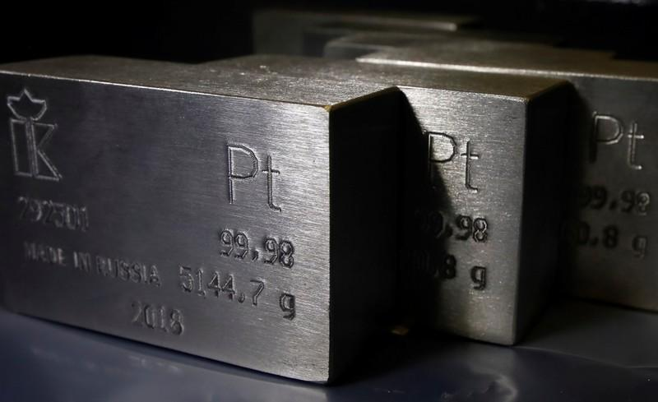
BARCLAYS’
METAL & MINING
Case Study
Chaitanya Varma Mudundi
Goutham Bommu
Hemanchal Joshi
Jasmeet Singh
Jiye Wang
Saranjyot Singh

Slide 11
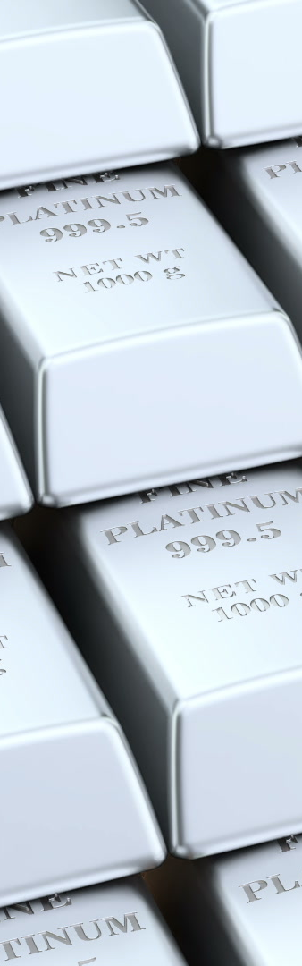
Pt
General Introduction
Pd
Platinum
Palladium
Platinum and palladium follow the similar trend over the period of time.
Palladium falls under PGA and serves as an alloy of platinum

Slide 12
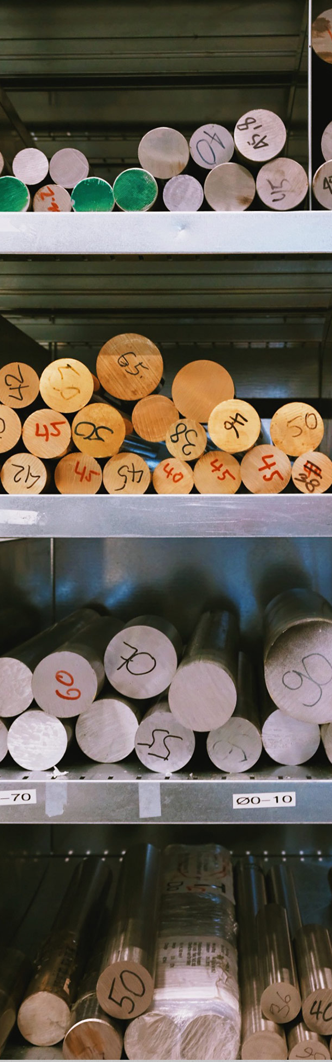
Pt
General Introduction
Pd
Au
Cu
Platinum and gold are correlated (precious metal)
Price of platinum dropped, gold increased.
Copper is an industrial metal but it seems to match the change in trends with palladium over the period of time.

Slide 13
Pt
General Introduction
Pd
Au
Platinum
Palladium
Gold
Copper
Cu
Gold has significant increase in value.
Rest follow a similar decremental trend

Slide 14
Pt
General Introduction
Pd
Au
Cu

Slide 15
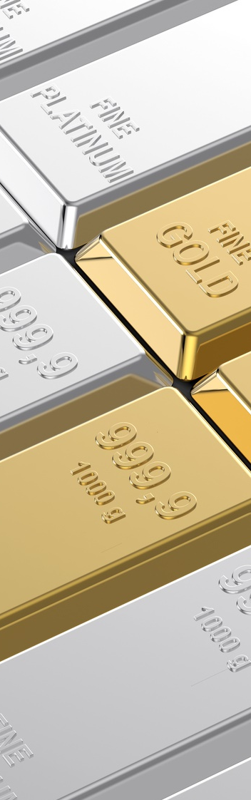
Pt
Platinum Analysis
Au
Increasing trend in the daily prices of gold over the period of two years.
Decline in prices of platinum over the same period.

Slide 16
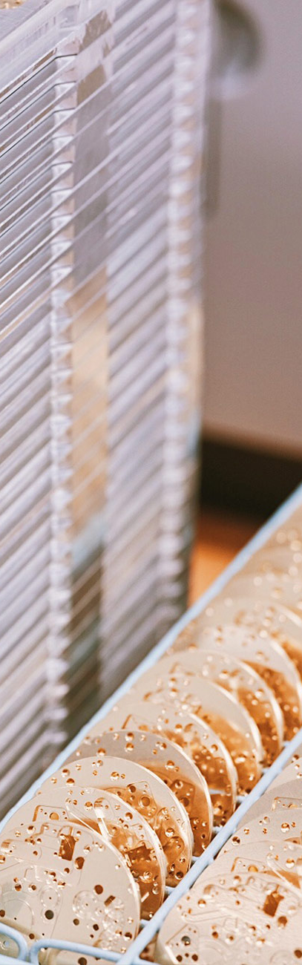
Pt
Platinum Analysis
Cu
Both of these metals follow a similar downward trend over the course of time.

Slide 17
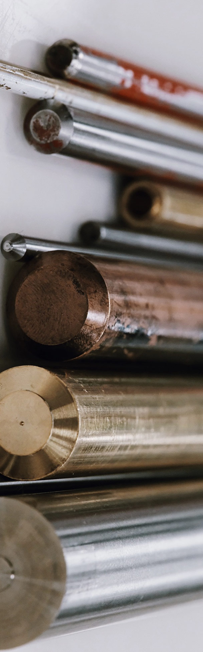
Pt
Platinum Analysis
Cu
Au
Correlation coefficient for Platinum & Copper is much closer to 1 as compared to the negative value for Platinum & Gold.

Slide 18
Pt
Platinum Analysis
Cu
Au
Platinum & Gold were highly unrelated in the first time frame with a correlation coefficient value of -0.18
There has been an exponential increase in the trend as we move towards the last time frame, in short Platinum has a strong relationship with Gold as compared to that of Platinum & Copper.

Slide 19
Pt
Hedging Analysis
Cu
 | Platinum | Palladium | Gold | Copper
Mean | 1642.192618 | 692.3474249 | 1610.662961 | 3.832682403
Standard Deviation | 145.8421816 | 75.75192861 | 126.5564182 | 0.380663673
Co-Variance | 0.088809425 | 0.109413173 | 0.078574116 | 0.099320432
A lot of variation in the daily returns for Copper can be seen where as the variation was much stable in case of Platinum.
Platinum has a smaller covariance value of 0.088 as compared to that of Copper which is 0.099, so we can say that there is a low level of risk associated with Platinum.

Slide 20
Pt
Turmoil Impact
Pd
Au
Cu

Slide 21
Pt
Turmoil Impact
Pd
Au
Cu

Slide 22
Pt
Turmoil Impact
Pd
Au
Cu

Slide 23
Pt
Turmoil Impact
Pd
Au
Cu

Slide 24
Effect of Greece debt on metal prices
Pt
Turmoil Impact
Pd
Au
Cu

Slide 25
Pt
Turmoil Impact
Pd
Au
Cu

Slide 26
Pt
Conclusion
Pd
Insights which are important to the clients
Platinum is more viewed as industrial metal. However, the relation between Platinum and precious metal increased over time.
Copper investment is unable to be used as hedging against Platinum investment.
Debt downgrade drove the rocket-up of gold price while prices of other metals were experiencing downtrend.
The unrest in South Africa led to the increase of all metal prices.
There shows stable trend in all metal prices through 2012.
Tools which Pach can use to analyze the data
Prices over time to see the changes and change patterns
Co-relation Co-efficient to distinguish the relation between two metal prices
Returns to see the fluctuation in prices in daily frame
Index to compare the change patterns based on particular events on particular dates
Au
Cu

Slide 27
Thank You !
Questions ?

