Slide 1

Titanic Case Study
Women and Children First
Chaitanya Varma Mudundi
Goutham Bommu
Hemanchal Joshi
Jasmeet Singh
Jiye Wang
Saranjyot Singh

Slide 2
Case Study Analysis:
An analysis has been conducted to identify if the following attributes played any factor in survival of individuals
During the titanic incident:
Gender
Child or Adult
Age group in adults
Passenger Class
Port of Embarking
Techniques used:
The following are the Techniques & tools that have been used to conduct the analysis:
Techniques:
Chi-Square test/Contingency table
Post-Hoc analysis
Introduction

Slide 3
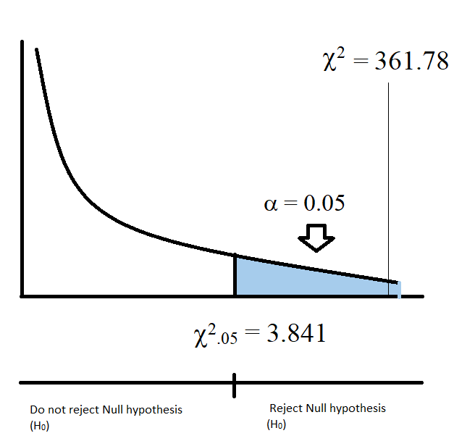
H₀: Gender was not a factor in survival.
H_{A}: Gender was a factor in survival.
d.f=1
SURVIVAL
 | YES | NO
FEMALE | Observed: 338 Expected: 177.61 | Observed: 127 Expected: 287.38 | 465
MALE | Observed: 162 Expected: 322.38 | Observed: 682 Expected: 521.61 | 844
 | 500 | 809 | 1309
GENDER
GENDER
Since χ² value is greater than 3.841, therefore we can say that with a confidence level of 95%, we will reject the null hypothesis.
Women First

Slide 4
This clearly signifies that females were more likely to survive than males.
Women First

Slide 5
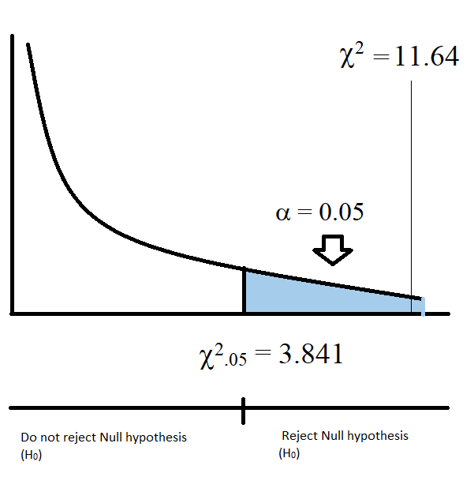
H₀: Children were less likely to survive than adults.
H_{A}: Children were more likely to survive than adults.
d.f.=1
SURVIVAL
 | YES | NO
CHILD | Observed: 95 Expected: 73.72 | Observed: 98 Expected: 119.27 | 193
ADULT | Observed: 405 Expected: 426.27 | Observed: 711 Expected: 689.72 | 1116
 | 500 | 809 | 1309
AGE CATEGORY
Since χ² value i.e. 11.64 is greater than 3.841, therefore we can say that with a confidence level of 95%, we will reject the null hypothesis.
Children First

Slide 6
Therefore, we can say that children were more likely to survive than adults.
Children First

Slide 7
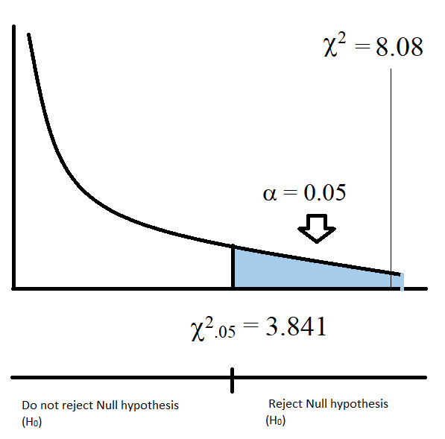
H₀: Age among adults was not a factor in survival.
H_{A}: Age among adults was a factor in survival.
d.f.=2
1.69
SURVIVAL
 | YES | NO
Adult (19 yrs – 39 yrs) | Observed: 236 Expected: 236.30 | Observed: 369 Expected: 368.69 | 605
Adult (40 yrs – 59 yrs) | Observed: 84 Expected: 80.07 | Observed: 121 Expected: 124.92 | 205
Adult (60+ yrs) | Observed: 12 Expected: 15.62 | Observed: 28 Expected: 24.37 | 40
 | 332 | 518 | 850
AGE CATEGORY
1.69
Since χ² value is less than 3.841, therefore we can stay with a the null hypothesis i.e. Age among adults was not a factor for survival.
Age Factor

Slide 8
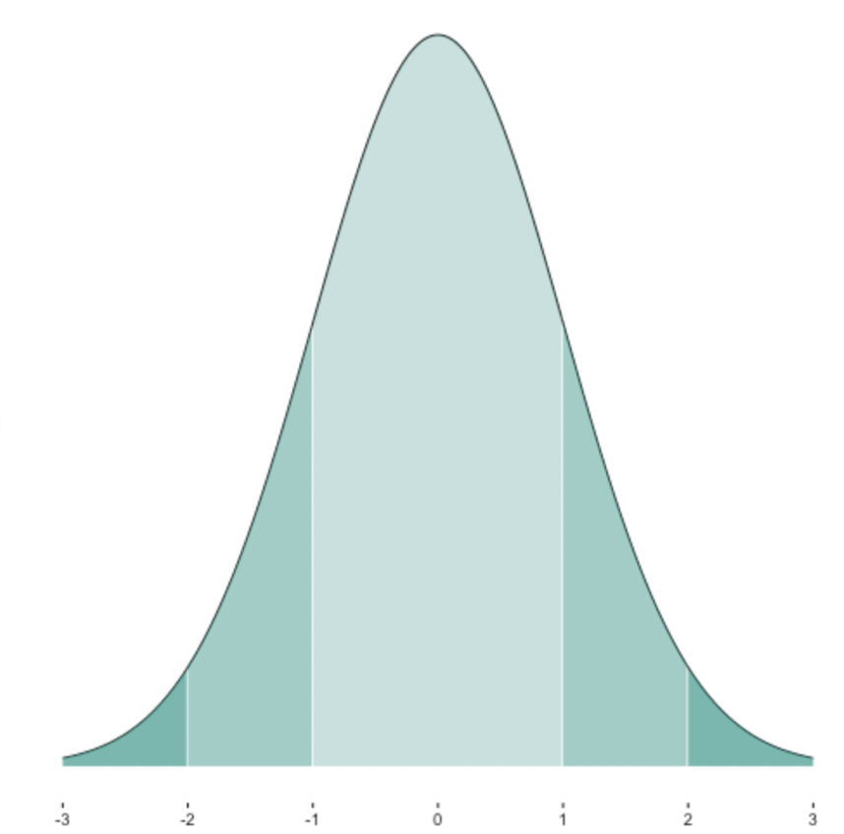
0.99
-0.99
Adjusted Residual
SURVIVAL
 | YES | NO
Adult (19yrs – 39yrs) | -0.997 | 0.997
Adult (40yrs – 59yrs) | 0.692 | -0.692
Adult (60+yrs) | -1.185 | 1.185
Critical = | 2.638 |
AGE CATEGORY
-0.69
-1.18
0.69
1.18
0.58
Conclusion:
As non of the age categories in adults are not significant we stay with the null hypothesis.
This means that the Age group in adults was not a factor for survival .
Age Factor

Slide 9
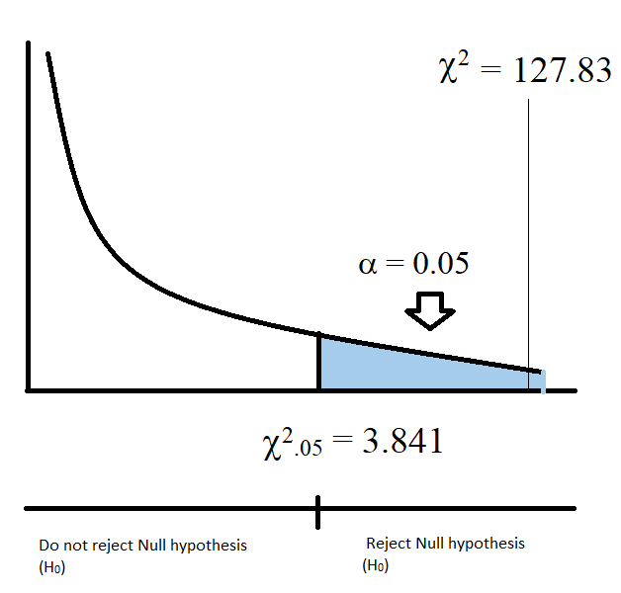
H₀: Passenger class was not a factor in survival.
H_{A}: Passenger class was a factor in survival.
SURVIVAL
 | YES | NO
1st Class | Observed: 200 Expected: 123.37 | Observed: 123 Expected: 199.62 | 323
2nd Class | Observed: 119 Expected: 105.80 | Observed: 158 Expected: 171.19 | 277
3rd Class | Observed: 181 Expected: 270.81 | Observed: 528 Expected: 438.18 | 709
 | 500 | 809 | 1309
d.f.=2
PASSENGER CLASS
Since χ² value is much greater than 3.841, therefore we can say that with a confidence level of 95%, we will reject the null hypothesis.
Passenger Class Factor

Slide 10
Adjusted Residual
SURVIVAL
 | YES | NO
1st Class | 10.11 | -10.11
2nd Class | 1.84 | -1.84
3rd Class | -10.25 | 10.25
Critical = | 2.638 |
PASSENGER CLASS
-10.25
-10.11
-1.84
0.58
1.84
10.11
10.25
Conclusion:
The 1st and the 3rd class passengers are statistically significant. As, their values are present in the critical region.
Thus these passenger class(1st and 3rd ) give statistical evidence that passenger class and survival are dependent.
Passenger Class Factor

Slide 11
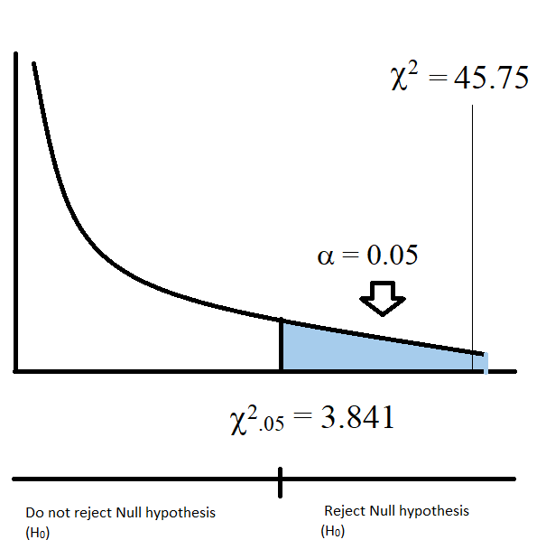
H₀: Port of embarkation was not a factor in survival.
H_{A}: Port of embarkation was a factor in survival.
SURVIVAL
 | YES | NO
Cherbourg | Observed: 152 Expected: 103.89 | Observed: 120 Expected: 168.10 | 272
Queenstown | Observed: 44 Expected: 46.98 | Observed: 79 Expected: 76.01 | 123
Southampton | Observed: 304 Expected: 349.12 | Observed: 610 Expected: 564.87 | 914
 | 500 | 809 | 1309
d.f.=2
PORT OF EMBARKATION
Since χ² value is much greater than 3.841, therefore we can say that with a confidence level of 95%, we will reject the null hypothesis.
Port of Embarkation Factor

Slide 12
Adjusted Residual
SURVIVAL
 | YES | NO
Cherbourg | -6.74 | 6.74
Queenstown | -0.58 | 0.58
Southampton | -5.59 | 5.59
Critical = | 2.638 |
PORT OF EMBARKATION
-6.74
-5.59
-0.58
0.58
5.59
6.74
0.58
Conclusion:
Cherbourg and Southampton are statistically significant. As, their values lie in the critical region.
Thus these group of ports(Cherbourg and Southampton ) give statistical evidence that port of embarkation and survival are dependent.
Port of Embarkation Factor

Slide 13
Out of total people that survived 67% are Female and 33% are Male
Out of people who survived 60% of the people boarded at Southampton
Major proportion of people who have survived are from class 1 and 2 which constitutes to 61% of survivals.
On a whole females who have boarded at Southampton constituted 40% of survivals.
Females from class1 and Class2 constitute 45% of the survivals.
Summary

Slide 14
Thank You
Questions?

