Slide 1
Problem - Quantum Threat
Modern digital systems rely on cryptographic techniques such as RSA and Elliptic Curve Cryptography to secure communication and protect sensitive data. However, with the advancement of quantum computing, these methods are expected to become vulnerable. Quantum algorithms, particularly Shor’s algorithm, can efficiently break these cryptographic schemes once large-scale quantum computers are available.
A major concern is the “harvest now, decrypt later” threat, where attackers can capture encrypted data today and decrypt it in the future using quantum capabilities. This puts long-term sensitive data, such as healthcare records, financial information, and government data, at significant risk.

Slide 2
Quantum Risk-Aware Context-Adaptive Post-Quantum Cryptographic Framework for Smart Digital Systems
Progress Update and Prototype

Slide 3
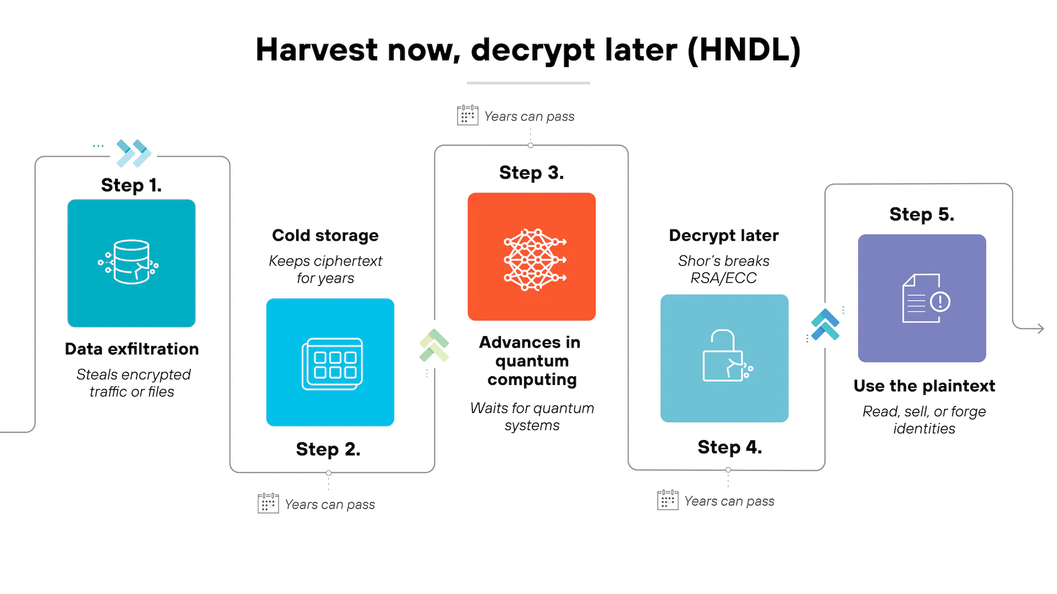
Problem - Quantum Threat
link🔗

Slide 4
Why Current Solutions Are Incomplete
Current efforts in post-quantum cryptography mainly focus on developing and standardizing new algorithms such as CRYSTALS Kyber and Dilithium. While these algorithms are essential, they do not address the practical challenge of deploying them across real-world systems.
Different systems have very different requirements. For example, IoT devices have limited computational power, while servers can handle more complex operations. Applying the same cryptographic solution across all systems can lead to inefficiencies and performance issues. Therefore, simply having strong algorithms is not enough without a structured deployment strategy.

Slide 5
GAP - Missing Deployment Framework
There is currently no widely adopted framework that guides how heterogeneous systems should transition to post-quantum cryptography in a practical and efficient manner.
Organizations lack a method to evaluate which systems are most at risk and how to prioritize migration. Without such a framework, migration can either be delayed or done inefficiently, leading to unnecessary overhead or security gaps. This creates a clear need for a system that can guide decision-making based on risk and system context.

Slide 6
Proposed Idea
We propose an intelligent and practical migration framework that enables risk-driven and context-aware adoption of post-quantum cryptography.
Instead of applying uniform security upgrades across all devices, the system evaluates the risk associated with each system and determines the appropriate level of cryptographic protection required. This ensures that critical systems receive stronger protection, while less critical systems are not overloaded with unnecessary computational costs.

Slide 7
Architecture Overview
The proposed framework is based on a two-layer architecture designed to separate risk evaluation from decision-making.
The first layer evaluates the level of quantum risk associated with each system, while the second layer uses this information to decide the most suitable cryptographic configuration. This separation makes the system modular, scalable, and easier to adapt to different environments.

Slide 8
Architecture Layer Details
The first layer, called the Quantum Risk Evaluation Engine, computes a Quantum Risk Index using factors such as data sensitivity, system exposure, data lifetime, threat window, and device capability. This index provides a measurable representation of risk.
The second layer, called the Context-Aware Cryptographic Decision Engine, uses this risk score along with system constraints to select appropriate cryptographic methods. This layer ensures that security decisions are tailored to the needs of each system rather than being fixed.

Slide 9
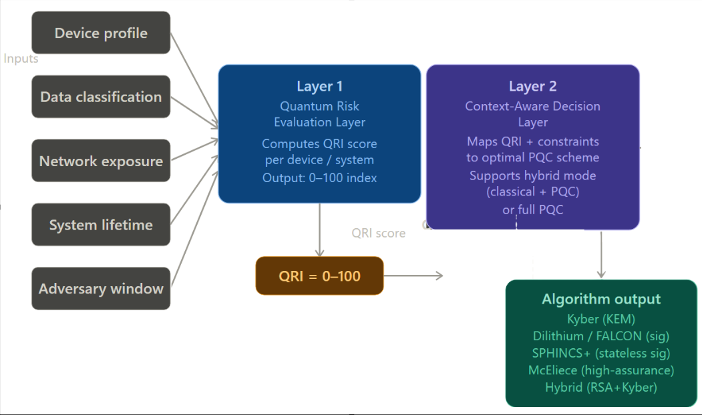
Architecture Layer Details

Slide 10
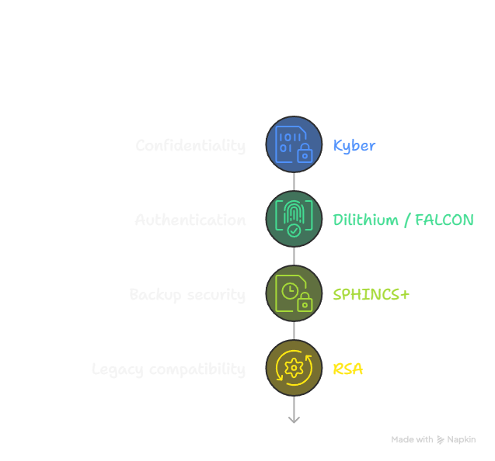
Brief overview of PQC algorithms
TLS Step | What happens | PQC Implementation
ClientHello | Client proposes crypto | Kyber (512/768/1024)
Server Certificate | Identity proof | Dilithium / FALCON
Key Exchange | Shared secret setup | Kyber (512/768/1024)
Verification | Check server identity | Dilithium / FALCON
Session Keys | Derived from secret | (Symmetric crypto)

Slide 11
Brief overview of PQC algorithms
Key Exchange (KEM)
These are used to establish a shared secret between two parties.
Algorithm | Where used
Kyber-512 | Constrained / low capability devices
Kyber-768 | Default for moderate–high systems
Kyber-1024 | High / critical risk systems
Implemented as:
kyber512_constrained
kyber768_*
kyber1024_*

Slide 12
Digital Signatures
Used to prove identity and ensure authenticity.
Primary signature verification:
Algorithm | Where used
Dilithium-3 | Moderate to high systems
Dilithium-5 | High / critical risk systems
Implemented as:
kyber768_dilithium3
kyber1024_dilithium5

Slide 13
Digital Signatures
Used to prove identity and ensure authenticity.
More compact version
Algorithm | Where used
FALCON-512 | Moderate capability devices
Implemented as:
kyber768_falcon512
kyber512_constrained

Slide 14
Digital Signatures
Used to prove identity and ensure authenticity.
Maximum assurance signature
Algorithm | Where used
SPHINCS+ | Critical risk (top tier systems)
Implemented as:
kyber1024_dilithium5_sphincs

Slide 15
QRI Range | Risk Level | Device Capability | Selected Algorithm | Notes
< 30 | LOW | Any | hybrid_kyber512 | Hybrid (RSA + Kyber-512), backward compatible
30–50 | MODERATE | ≤ 3 | kyber512_constrained (+ FALCON-512) | Lightweight PQC for weak devices
30–50 | MODERATE | > 3 | kyber768_dilithium3 | Balanced PQC (Level 3)
50–70 | ELEVATED | ≤ 3 | kyber512_constrained | Under-secured, upgrade needed
50–70 | ELEVATED | 4–5 | kyber768_falcon512 | Compact signatures

Slide 16
70–85 | HIGH | ≤ 3 | kyber512_constrained | Critical gap
70–85 | HIGH | 4–6 | kyber768_dilithium3 | Interim solution
70–85 | HIGH | > 6 | kyber1024_dilithium5 | Full Level 5 security
≥ 85 | CRITICAL | ≤ 3 | kyber512_constrained | Replace/isolate device
≥ 85 | CRITICAL | 4–7 | kyber1024_dilithium5 | Strong primary config
≥ 85 | CRITICAL | > 7 | kyber1024_dilithium5 + SPHINCS+ | Maximum assurance (dual crypto)

Slide 17
Tech Stack and implementation
Frontend | React / Next.js | Dashboard
Backend | FastAPI (Python) | Orchestration
Decision Engine | Python | Select PQC config (QRI + capability)
Risk Engine | Python | Compute QRI from device data
Device Data | JSON | Device profiles
PQC Library | liboqs (oqs) | Kyber, Dilithium, FALCON, SPHINCS+
Classical Crypto | cryptography | RSA (hybrid mode)
Simulation | Python module | Keygen, sign, encapsulation
Storage (optional) | SQLite / PostgreSQL | Store results/logs
Deployment | Docker + Uvicorn | Backend hosting

Slide 18
How it works?
Consider a smart campus environment with different types of systems. A CCTV camera may have moderate sensitivity and limited computational power, while a research database may contain highly sensitive data and run on powerful servers.
The system assigns a risk score to each device based on its characteristics. For example, the CCTV system may receive a medium risk score and use a hybrid approach, while the research database may receive a high risk score and use stronger post-quantum cryptography. This demonstrates how the system adapts security based on actual requirements.

Slide 19
Implementation Plan
The project will be implemented using a simulated environment representing different types of devices such as IoT devices, workstations, and servers.
We will develop a risk scoring model to compute the Quantum Risk Index and a decision engine that maps this score to appropriate cryptographic configurations. Post-quantum algorithms such as Kyber and Dilithium will be implemented using existing libraries to demonstrate practical feasibility. The system may also include a simple interface to visualize decisions and system behavior.

Slide 20
Novelty
The novelty of this work lies in shifting the focus from creating new cryptographic algorithms to designing a structured way to deploy them.
The framework introduces a measurable risk model and combines it with context-aware decision-making. This approach allows adaptive selection of cryptographic methods instead of static configurations, making the system more practical for real-world deployment.

Slide 21
Conclusion
In conclusion, quantum computing introduces a significant threat to existing cryptographic systems, and there is an urgent need for structured migration strategies.
This project presents a practical and adaptive framework that evaluates risk and selects appropriate post-quantum cryptographic methods based on system context. By bridging the gap between research and real-world deployment, the framework contributes toward building secure and future-ready digital systems.

