Slide 1
FIT5202 (Volume I)
Week 1c – Introduction to Parallel Databases

Slide 2
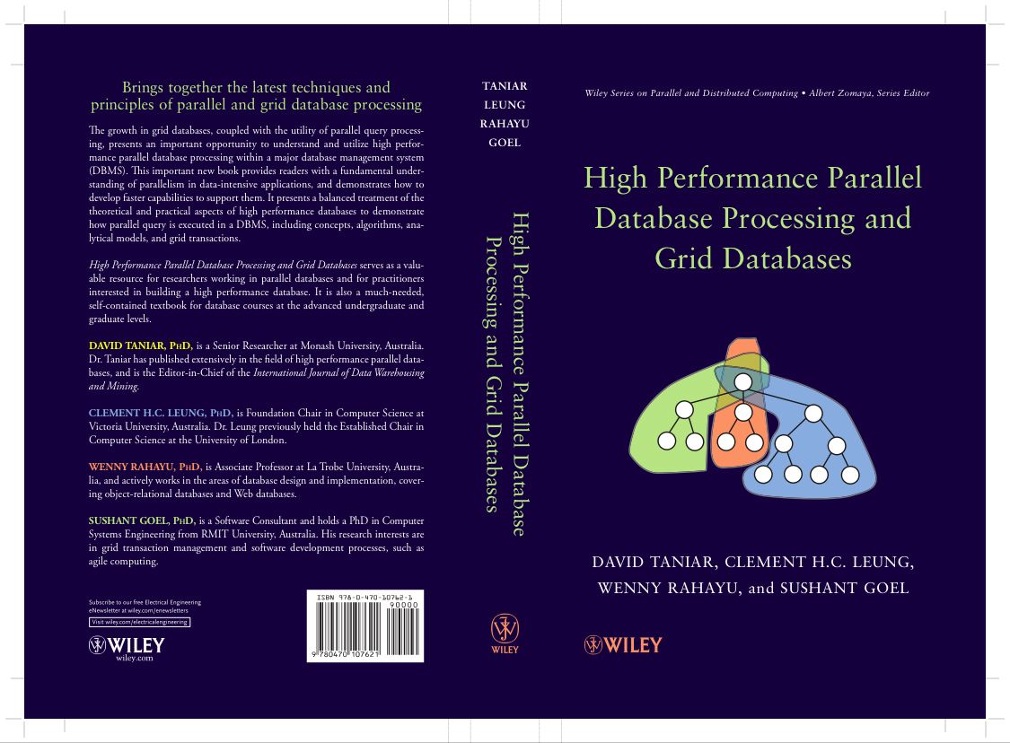
Chapter 1 Introduction
1.1 A Brief Overview - Parallel Databases and Grid Databases
1.2 Parallel Query Processing: Motivations
1.3 Parallel Query Processing: Objectives
1.4 Forms of Parallelism
1.5 Parallel Database Architectures
1.6 Grid Database Architecture
1.7 Structure of this Book
1.8 Summary
1.9 Bibliographical Notes
1.10 Exercises

Slide 3
1.1/1.2. A Brief Overview, and Motivations
An example:
If we have 1 petabyte of data, and the processing speed is 1GB/sec
How long does it take to process 1 PB of data?

Slide 4
1.1/1.2. A Brief Overview, and Motivations (cont’d)
What is parallel processing, and why not just use a faster computer ?
Even fast computers have speed limitations
Limited by speed of light
Other hardware limitations
Parallel processing divides a large task into smaller subtasks
Database processing works well with parallelism (coarse-grained parallelism)
Lesser complexity but need to work with a large volume of data

Slide 5
1.1/1.2. A Brief Overview, and Motivations (cont’d)
Moore’s Law: number of processors will double every 18-24 months
CPU performance would increase by 50-60% per year
Disk access time or disk throughput increases by 8-10% only
Disk capacity also increases at a much higher rate
I/O becomes a bottleneck
Hence, motivates parallel database processing
And parallel database processing is the foundation of Big Data Processing

Slide 6
1.3. Objectives
The primary objective of parallel database processing is to gain performance improvement
Two main measures:
Throughput: the number of tasks that can be completed within a given time interval
Response time: the amount of time it takes to complete a single task from the time it is submitted
Metrics:
Speed up
Scale up

Slide 7
Exercise 1 (FLUX Quiz)
Using the freeway analogy, number of cars that can pass through the freeway (M1: Monash Freeway) during the morning peak hour from 7 to 9am is called:
A. Throughput
B. Response Time
C. None of the above
D. A and B

Slide 8
Exercise 2 (FLUX Quiz)
Using the freeway analogy, the duration I take to drive my car to go to work on a freeway (say M1 Monash Freeway) from the Burke Road entrance to the Blackburn Road exit is called:
A. Throughput
B. Response Time
C. None of the above
D. A and B

Slide 9
1.3. Objectives
The primary objective of parallel database processing is to gain performance improvement
Two main measures:
Throughput: the number of tasks that can be completed within a given time interval
Response time: the amount of time it takes to complete a single task from the time it is submitted
Metrics:
Speed up
Scale up

Slide 10
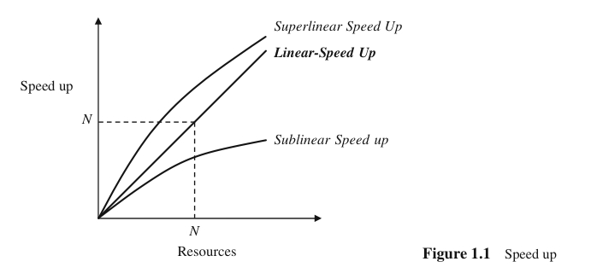

1.3. Objectives (cont’d)
Speed up
Performance improvement gained because of extra processing elements added
Running a given task in less time by increasing the degree of parallelism
Linear speed up: performance improvement growing linearly with additional resources
Superlinear speed up
Sublinear speed up

Slide 11
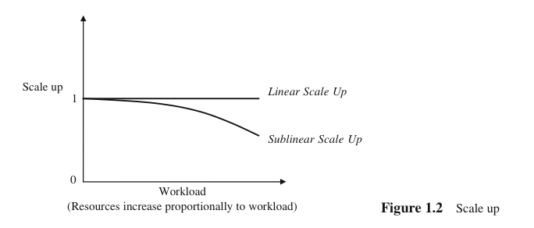

1.3. Objectives (cont’d)
Scale up
Handling of larger tasks by increasing the degree of parallelism
The ability to process larger tasks in the same amount of time by providing more resources.
Linear scale up: the ability to maintain the same level of performance when both the workload and the resources are proportionally added
Transactional scale up
Data scale up

Slide 12
1.3. Objectives (cont’d)
Transaction scale up
The increase in the rate at which the transactions are processed
The size of the database may also increase proportionally to the transactions’ arrival rate
N-times as many users are submitting N-times as many requests or transactions against an N-times larger database
Relevant to transaction processing systems where the transactions are small updates
Data scale up
The increase in size of the database, and the task is a large job who runtime depends on the size of the database (e.g. sorting)
Typically found in online analytical processing (OLAP)

Slide 13
Exercise 3 (FLUX Quiz)
Using the current processing resources, we can finish processing 1TB (one terabyte) of data in 1 hour. Recently the volume of data has increased to 2TB and the management has decided to double up the processing resources. Using the new processing resources, we can finish processing the 2TB in 60 minutes. Is this speed up or scale up? (5 Minutes)
A. Scale Up
B. Speed Up

Slide 14
1.8. Summary
Why, What, and How of parallel query processing:
Why is parallelism necessary in database processing?
What can be achieved by parallelism in database processing?
How parallelism performed in database processing?
What facilities of parallel computing can be used?

Slide 15
Remember…
There is only one question:
Do you really want to pass this unit?
Homework: Read Chapter 1 and Chapter 3 for next week

