Slide 1
FIT5196 Data Wrangling
Assessment 1
Exploratory Data Analysis
Name: Adrian Leong Tat Wei
Student ID: 27030768
Group 35

Slide 2
Metadata Wrangling
Wrangling:
Parse and merge data
Rename columns
Clean invalid values and duplicates
Scope:
Identifiers & metadata: PostID, UserID, secret, server, farm
Access flags: ispublic, isfriend, isfamily

Slide 3
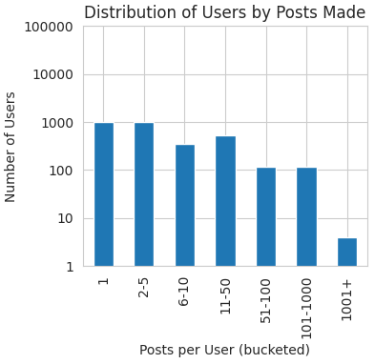
User Post Distribution
Log distribution
Most users barely post
A few users post vast amounts

Slide 4
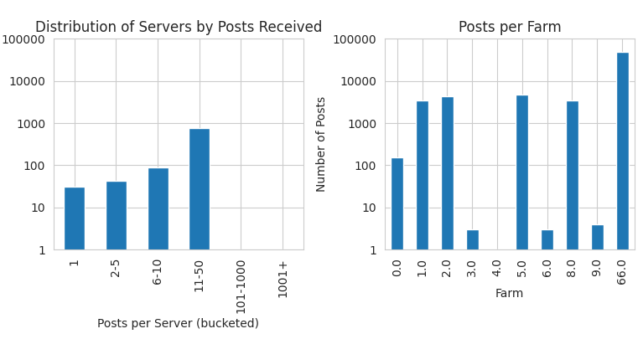
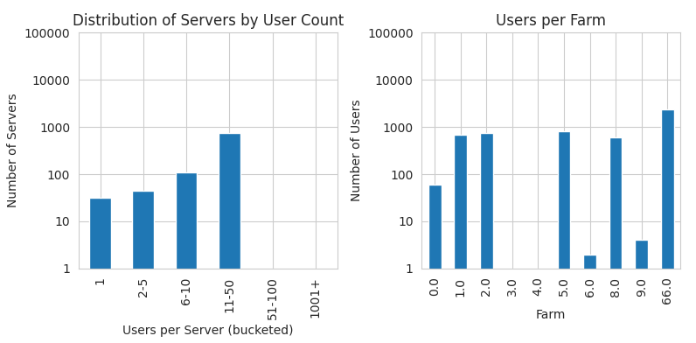
Server distribution
Servers relatively balanced
Farms very lopsided

Slide 5
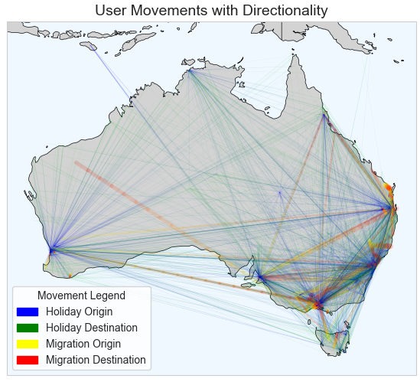
User Movement
Most holidays away from cities
Most migrations to cities

Slide 6
Future Work
ML Research Questions
Who posts a lot, and what are they like?
How do we better distribute server load?
Where are people moving to/away from?

