Slide 1
FIT5202 (Volume I - Introduction)
Week 2a – Introduction to Parallel Databases

Slide 2
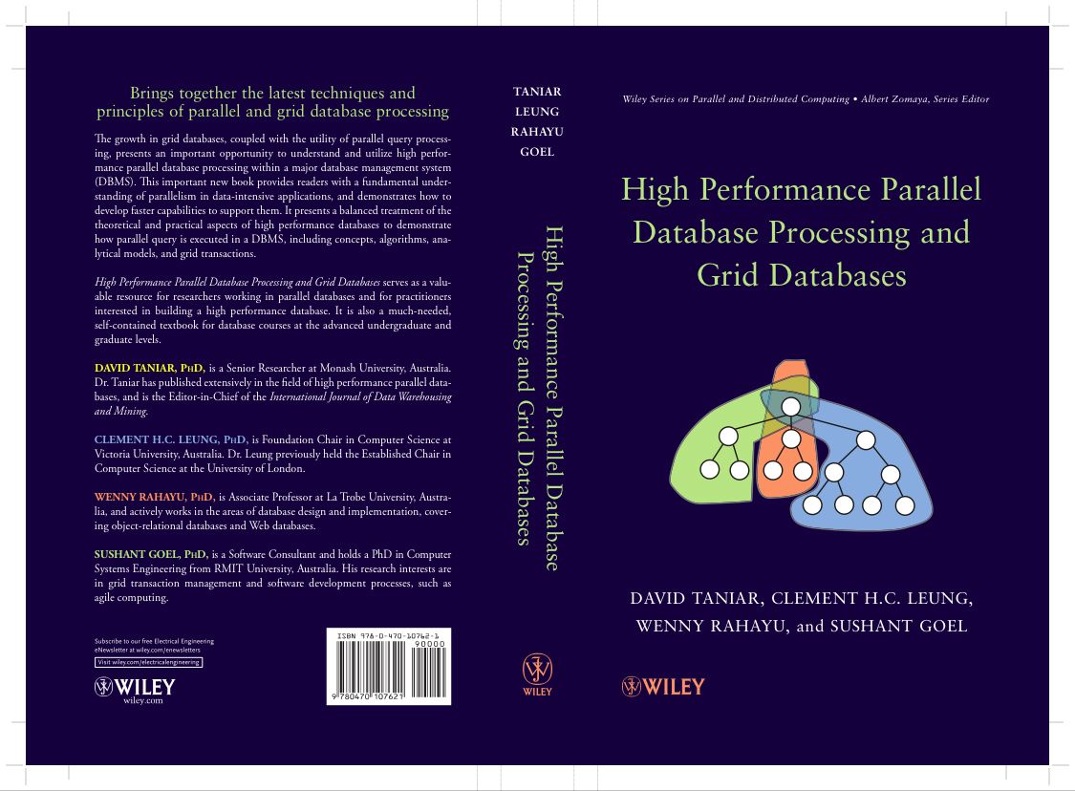
Chapter 1 Introduction
1.1 A Brief Overview - Parallel Databases and Grid Databases
1.2 Parallel Query Processing: Motivations
1.3 Parallel Query Processing: Objectives
1.4 Forms of Parallelism
1.5 Parallel Database Architectures
1.6 Grid Database Architecture
1.7 Structure of this Book
1.8 Summary
1.9 Bibliographical Notes
1.10 Exercises

Slide 3
Revision
Exercise 1 (FLUX Quiz)
Using the freeway analogy, number of cars that can pass through the freeway (M1: Monash Freeway) during the morning peak hour from 7 to 9am is called:
A. Throughput
B. Response Time
C. None of the above
D. A and B

Slide 4
Revision
Exercise 2 (FLUX Quiz)
Using the freeway analogy, the duration I take to drive my car to go to work on a freeway (say M1 Monash Freeway) from the Burke Road entrance to the Blackburn Road exit is called:
A. Throughput
B. Response Time
C. None of the above
D. A and B

Slide 5
1.3. Objectives (cont’d)
Parallel Obstacles
Start-up and Consolidation costs,
Interference and Communication, and
Skew

Slide 6
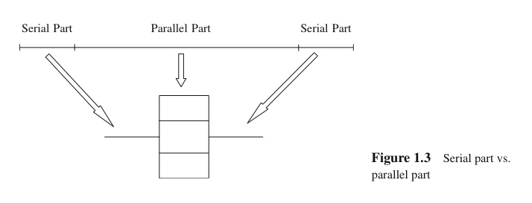
1.3. Objectives (cont’d)
Start-up and Consolidation
Start up: initiation of multiple processes
Consolidation: the cost for collecting results obtained from each processor by a host processor

Slide 7
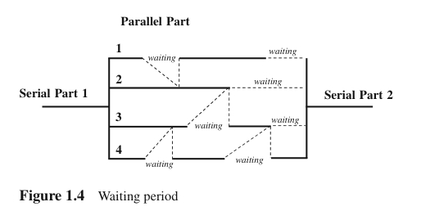
1.3. Objectives (cont’d)
Interference and Communication
Interference: competing to access shared resources
Communication: one process communicating with other processes, and often one has to wait for others to be ready for communication (i.e. waiting time).

Slide 8
Exercise 3 (Flux Quiz)
There is a job that will take 1 hour to complete, if this is done by 1 processor.
The serial part of this job is 10%
There are 4 processors to use in this job, but each processor will have an overhead of 20% due to waiting time, communication time, etc.
What type of speed up do we get?

Slide 9
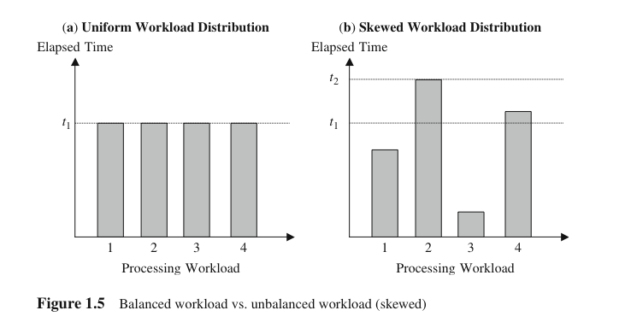
1.3. Objectives (cont’d)
Skew
Unevenness of workload
Load balancing is one of the critical factors to achieve linear speed up

Slide 10
Exercise 4 (FLUX Quiz)
Pick a number (between 1 and 4)
A. 1
B. 2
C. 3
D. 4

Slide 11
Exercise 5 (FLUX Quiz)
Pick a number again (between 1 and 4)
A. 1
B. 2
C. 3
D. 4

Slide 12
Exercise 6 (FLUX Quiz)
Pick a number again (between 1 and 4)
A. 1
B. 2
C. 3
D. 4

Slide 13
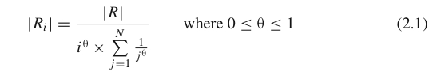
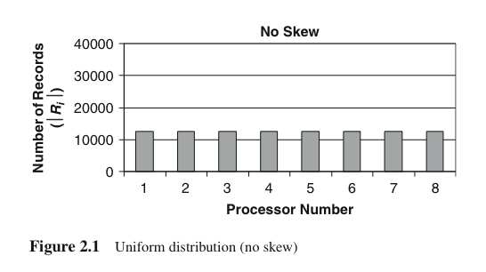
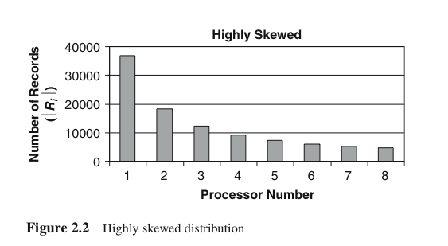
1.3. Objectives (cont’d)
Skew
Zipf distribution model to model skew. Measured in terms of different sizes of fragments allocated to the processors
The symbol θ denotes the degree of skewness, where θ = 0 indicates no skew, and θ = 1 indicates highly skewed
|R| is number of records in the table, |Ri| is number of records in processor i, and N is number of processor (j is a loop counter, starting from 1 to N)
Example: |R|=100,000 records, N=8 processors

Slide 14
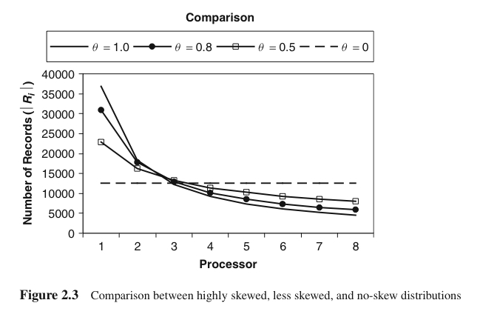
1.3. Objectives (cont’d)
No skew vs. highly skewed

Slide 15
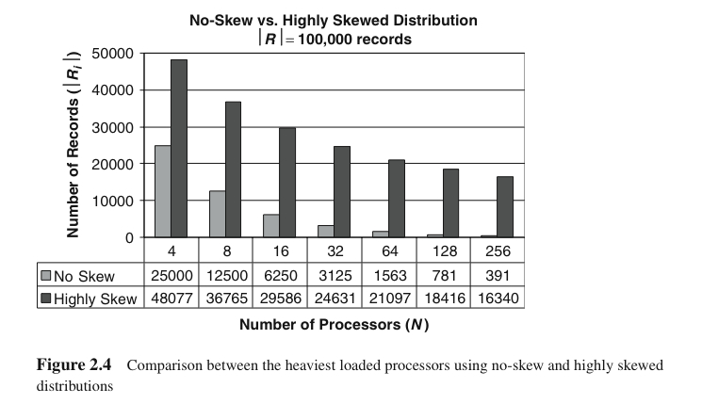
1.3. Objectives (cont’d)
No skew vs. highly skewed

Slide 16
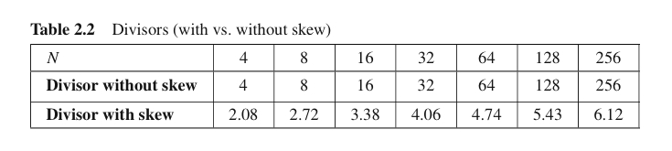
1.3. Objectives (cont’d)
No skew vs. highly skewed

Slide 17
Exercise 7 (FLUX Quiz)
There 100,000 records in the table to be distributed to 32 processors. Assuming that the skewness degree is high (θ = 1), what is the estimated number of records in the heaviest processor?
A. 48,000 records
B. 29,000 records
C. 24,000 records
D. It is not possible to predict

Slide 18
1.4. Forms of Parallelism
Forms of parallelism for database processing:
Interquery parallelism
Intraquery parallelism
Interoperation parallelism
Intraoperation parallelism
Mixed parallelism

Slide 19
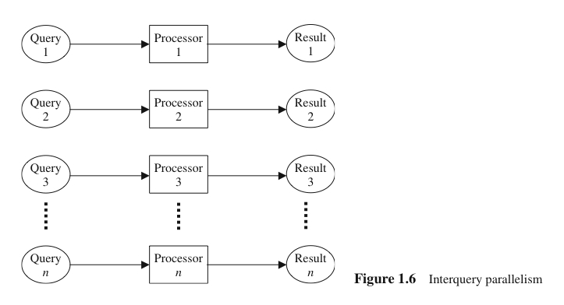
1.4. Forms of Parallelism (cont’d)
Interquery Parallelism
“Parallelism among queries”
Different queries or transactions are executed in parallel with one another
Main aim: scaling up transaction processing systems

Slide 20
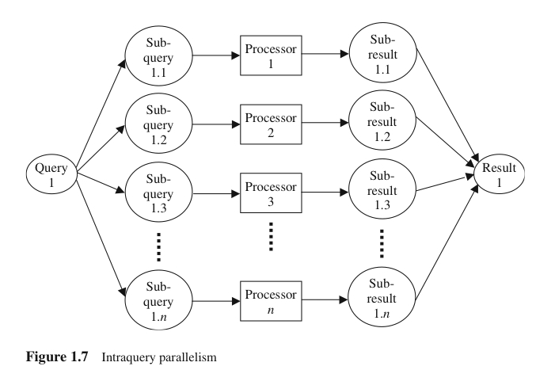
1.4. Forms of Parallelism (cont’d)
Intraquery Parallelism
“Parallelism within a query”
Execution of a single query in parallel on multiple processors and disks
Main aim: speeding up long-running queries

Slide 21
1.4. Forms of Parallelism (cont’d)
Execution of a single query can be parallelized in two ways:
Intraoperation parallelism: Speeding up the processing of a query by parallelizing the execution of each individual operation (e.g. parallel sort, parallel search, etc)
Interoperation parallelism: Speeding up the processing of a query by executing in parallel different operations in a query expression (e.g. simultaneous sorting or searching)

Slide 22
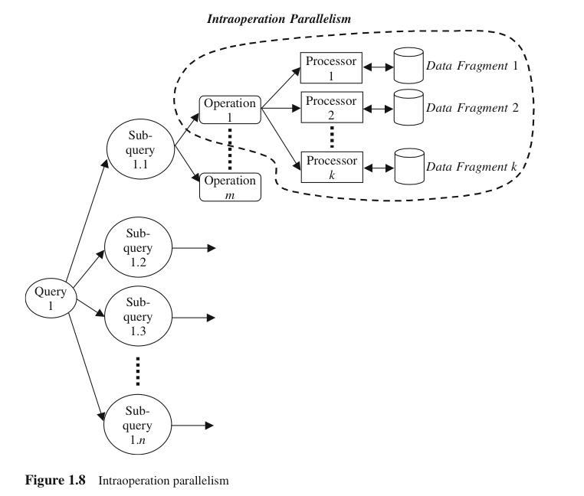
1.4. Forms of Parallelism (cont’d)
Intraoperation Parallelism
“Partitioned parallelism”
Parallelism due to the data being partitioned
Since the number of records in a table can be large, the degree of parallelism is potentially enourmous

Slide 23
1.4. Forms of Parallelism (cont’d)
Interoperation parallelism: Parallelism created by concurrently executing different operations within the same query or transaction
Pipeline parallelism
Independent parallelism

Slide 24
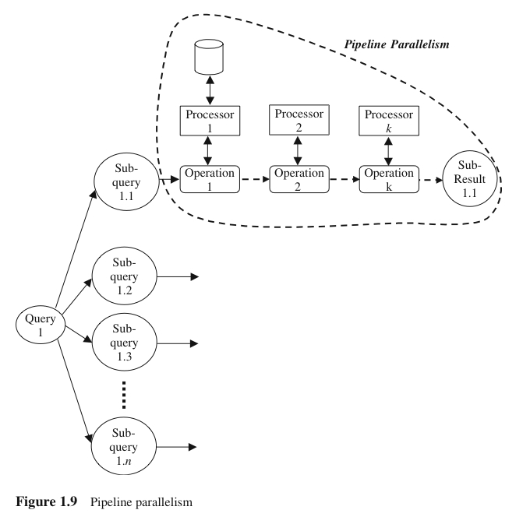
1.4. Forms of Parallelism (cont’d)
Pipeline Parallelism
Output record of one operation A are consumed by a second operation B, even before the first operation has produced the entire set of records in its output
Multiple operations form some sort of assembly line to manufacture the query results
Useful with a small number of processors, but does not scale up well

Slide 25
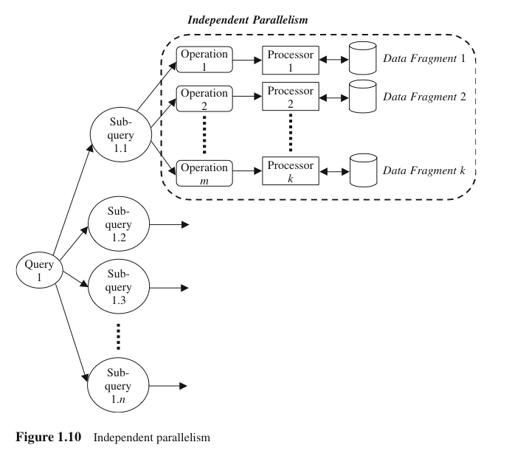
1.4. Forms of Parallelism (cont’d)
Independent Parallelism
Operations in a query that do not depend on one another are executed in parallel
Does not provide a high degree of parallelism

Slide 26
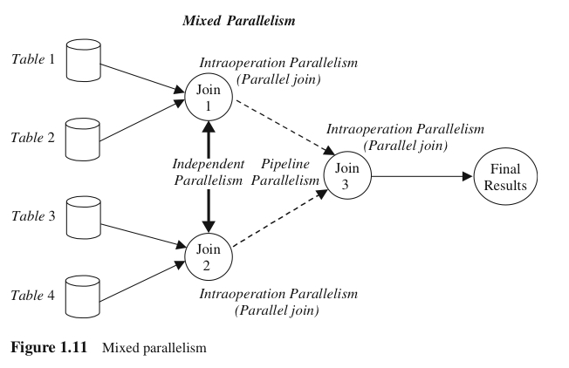
1.4. Forms of Parallelism (cont’d)
Mixed Parallelism
In practice, a mixture of all available parallelism forms is used.

Slide 27
1.5. Parallel Database Architectures
Parallel computers are no longer a monopoly of supercomputers
Parallel computers are available in many forms:
Shared-memory architecture
Shared-disk architecture
Shared-nothing architecture
Shared-something architecture

Slide 28
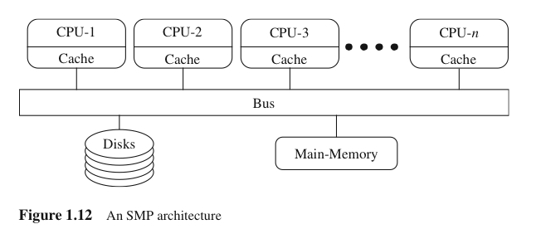
1.5. Parallel Database Architectures (cont’d)
Shared-Memory and Shared-Disk Architectures
Shared-Memory: all processors share a common main memory and secondary memory
Load balancing is relatively easy to achieve, but suffer from memory and bus contention
Shared-Disk: all processors, each of which has its own local main memory, share the disks

Slide 29
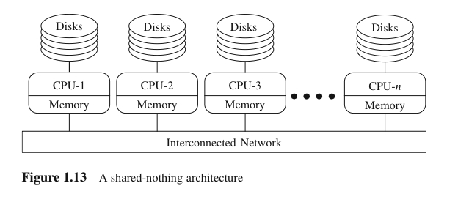
1.5. Parallel Database Architectures (cont’d)
Shared-Nothing Architecture
Each processor has its own local main memory and disks
Load balancing becomes difficult

Slide 30
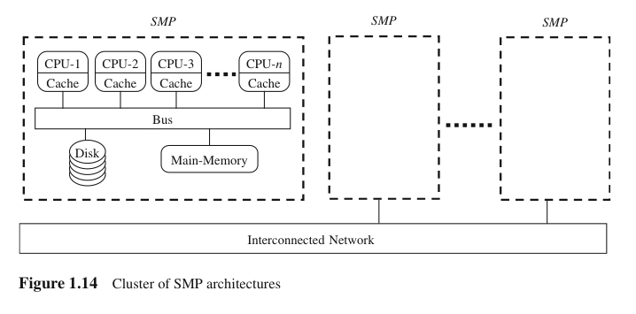
1.5. Parallel Database Architectures (cont’d)
Shared-Something Architecture
A mixture of shared-memory and shared-nothing architectures
Each node is a shared-memory architecture connected to an interconnection network aka shared-nothing architecture

Slide 31
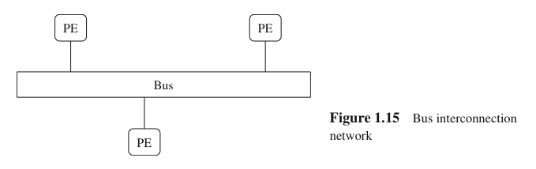
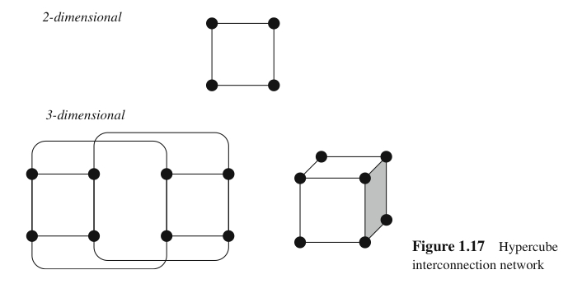

1.5. Parallel Database Architectures (cont’d)
Interconnection Networks
Bus, Mesh, Hypercube

Slide 32
1.7. Exercises (from the textbook)
Q1.3: Highlight the differences between speed up and scale up.
Q1.7: Skewed workload distribution is generally undesirable. Under what conditions that parallelism (i.e. the workload is divided among all processors) is not desirable?

Slide 33
1.8. Summary
Why, What, and How of parallel query processing:
Why is parallelism necessary in database processing?
What can be achieved by parallelism in database processing?
How parallelism performed in database processing?
What facilities of parallel computing can be used?

