Slide 1
FIT5148 (Volume II - Search)
Week 2b – Parallel Search

Slide 2
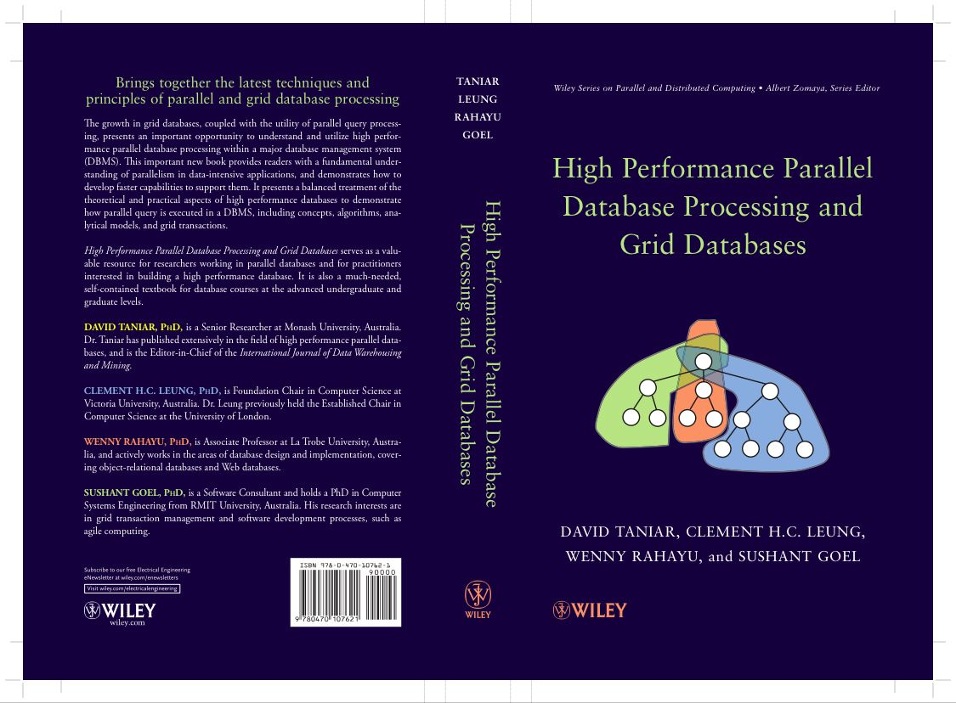
Chapter 3 Parallel Search
3.1 Search Queries
3.2 Data Partitioning
3.3 Search Algorithms
3.4 Summary
3.5 Bibliographical Notes
3.6 Exercises

Slide 3
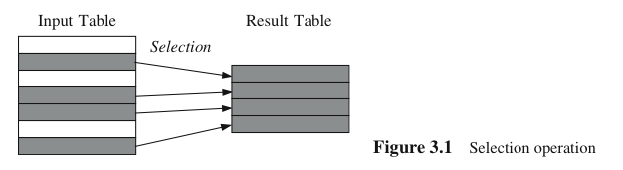
3.1. Search Queries
Search is selection operation in database queries
Selects specified records based on a given criteria
The result is a horizontal subset (records) of the operand
Three kinds of search queries:
Exact-match search
Range search
Multi attribute search

Slide 4

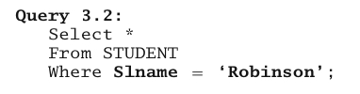
3.1. Search Queries (cont’d)
Exact-Match Search
Selection predicate on an attribute to check for an exact match between a search attribute and a given value
Expressed by the WHERE clause in SQL
Query 3.1 will produce a unique record (if the record is found), whereas Query 3.2 will likely produce multiple records

Slide 5

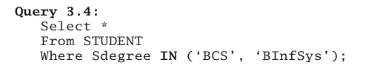
3.1. Search Queries (cont’d)
Range Search Query
The search covers a certain range
Continuous range search query
Discrete range search query

Slide 6
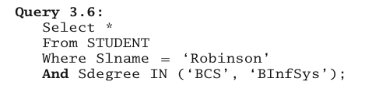
3.1. Search Queries (cont’d)
Multiattribute Search Query
More than attribute is involved in the search
Conjunctive (AND) or Disjunctive (OR)
If both are used, it must be in a form of conjunctive prenex normal form (CPNF)

Slide 7
3.2. Data Partitioning
Distributes data over a number of processing elements
Each processing element is then executed simultaneously with other processing elements, thereby creating parallelism
Can be physical or logical data partitioning
In a shared-nothing architecture, data is placed permanently over several disks
In a shared-everything (shared-memory and shared-disk) architecture, data is assigned logically to each processor
Two kinds of data partitioning:
Basic data partitioning
Complex data partitioning

Slide 8
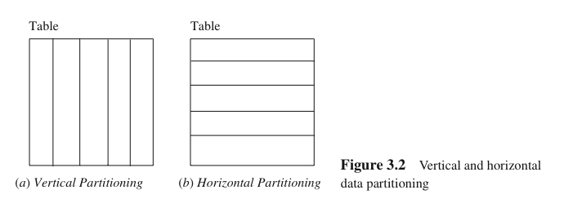
3.2. Data Partitioning (cont’d)
Basic Data Partitioning
Vertical vs. Horizontal data partitioning
Vertical partitioning partitions the data vertically across all processors. Each processor has a full number of records of a particular table. This model is more common in distributed database systems
Horizontal partitioning is a model in which each processor holds a partial number of complete records of a particular table. It is more common in parallel relational database systems

Slide 9
3.2. Data Partitioning (cont’d)
Basic Data Partitioning
Round-robin data partitioning
Hash data partitioning
Range data partitioning
Random-unequal data partitioning

Slide 10
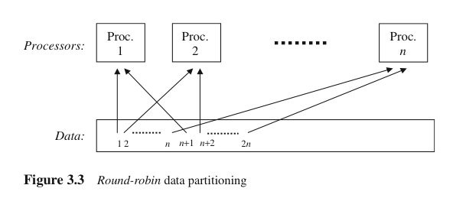
3.2. Data Partitioning (cont’d)
Round-robin data partitioning
Each record in turn is allocated to a processing element in a clockwise manner
“Equal partitioning” or “Random-equal partitioning”
Data evenly distributed, hence supports load balance
But data is not grouped semantically

Slide 11
3.2. Data Partitioning (cont’d)
Round-robin data partitioning
Search U
Search U
Search U
Search U
Search U
Processor 1
Processor 2
Processor 3
Processor 4
nil
U
nil
nil
Data
S
K
F
B
Y
T
V
J
S
B
N
P
L
U
J
S
N
F
R
A

Slide 12
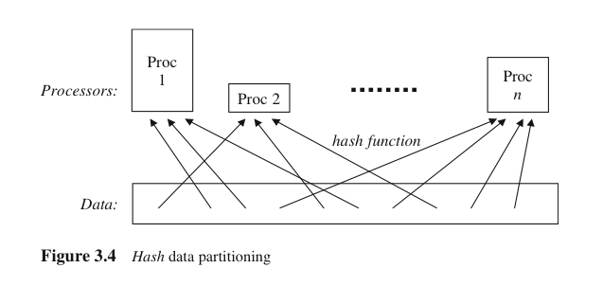
3.2. Data Partitioning (cont’d)
Hash data partitioning
A hash function is used to partition the data
Hence, data is grouped semantically, that is data on the same group shared the same hash value
Selected processors may be identified when processing a search operation (exact-match search), but for range search (especially continuous range), all processors must be used
Initial data allocation is not balanced either

Slide 13
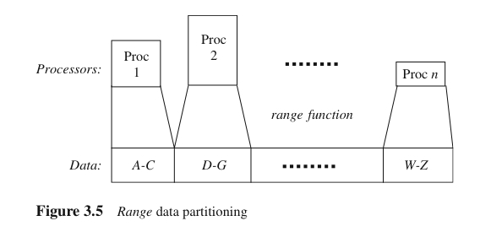
3.2. Data Partitioning (cont’d)
Range data partitioning
Spreads the records based on a given range of the partitioning attribute
Processing records on a specific range can be directed to certain processors only
Initial data allocation is skewed too

Slide 14
3.2. Data Partitioning (cont’d)
Range data partitioning
Search U
Search U
Processor 1
A-F
Processor 2
G-L
Processor 3
M-S
Processor 4
T-Z
nil
nil
nil
U
Data
S
K
F
B
Y
T
V
J
S
B
N
P
L
U
J
S
N
F
R
A

Slide 15
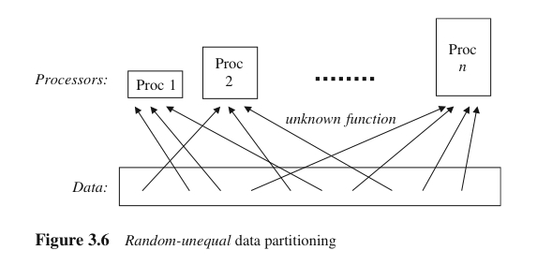
3.2. Data Partitioning (cont’d)
Random-unequal data partitioning
Partitioning is not based on the same attribute as the retrieval processing is based on a non retrieval processing attribute, or the partitioning method is unknown
The size of each partitioning is likely to be unequal
Records within each partition are not grouped semantically
This is common especially when the operation is actually an operation based on temporary results obtained from the previous operations

Slide 16
3.2. Data Partitioning (cont’d)
Random-unequal data partitioning
Search 19
Search 19
Search 19
Search 19
Search 19
Processor 1
A-F
Processor 2
G-L
Processor 3
M-S
Processor 4
T-Z
nil
nil
nil
[U 19]
R 92
N 6
A 15
S 31
F 82
J 72
P 92
U 19
B 42
L 12
N 70
V 9
B 6
J 32
S 56
T 36
F 10
K 5
S 43
Y 88

Slide 17
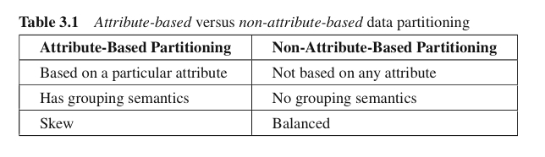
3.2. Data Partitioning (cont’d)
Basic Data Partitioning
Attribute-based data partitioning
Non-attribute-based data partitioning

Slide 18
3.2. Data Partitioning (cont’d)
Exercise 1 (Textbook Q3.6)
Given a data set D = {55; 30; 68; 39; 1; 4; 49; 90; 34; 76; 82; 56; 31; 25; 78; 56; 38; 32; 88; 9; 44; 98; 11; 70; 66; 89; 99; 22; 23; 26}, three processors, and a random-equal data partitioning, illustrate how the parallel searching of data item 78 is carried out.

Slide 19
3.2. Data Partitioning (cont’d)
Exercise 2 (Textbook Q3.7)
Given a data set D = {55; 30; 68; 39; 1; 4; 49; 90; 34; 76; 82; 56; 31; 25; 78; 56; 38; 32; 88; 9; 44; 98; 11; 70; 66; 89; 99; 22; 23; 26}, three processors, and a range data partitioning, illustrate how the parallel searching of data items between 70 and 79 can be carried out.

Slide 20
3.2. Data Partitioning (cont’d)
Exercise 3 (Textbook Q3.8)
Given a data set D = {55; 30; 68; 39; 1; 4; 49; 90; 34; 76; 82; 56; 31; 25; 78; 56; 38; 32; 88; 9; 44; 98; 11; 70; 66; 89; 99; 22; 23; 26}, three processors, and a hash data partitioning, illustrate how the parallel searching of data items 10, 20, 30, …, 90 can be carried out.

Slide 21
3.2. Data Partitioning (cont’d)
Complex Data Partitioning
Basic data partitioning is based on a single attribute (or no attribute)
Complex data partitioning is based on multiple attributes or is based on a single attribute but with multiple partitioning methods
Hybrid-Range Partitioning Strategy (HRPS)
Multiattribute Grid Declustering (MAGIC)
Bubba’s Extended Range Declustering (BERB)

Slide 22

3.2. Data Partitioning (cont’d)
Hybrid-Range Partitioning Strategy (HRPS)
Partitions the table into many fragments using range, and the fragments are distributed to all processors using round-robin
Each fragment contains approx FC records
Where RecordsPerQ_{Ave} is the average number of records retrieved and processed by each query, and M is the number of processors that should participate in the execution of an average query
Each fragment contains a unique range of values of the partitioning attribute
The table must be sorted on the partitioning attribute, then it is partitioned that each fragment contains FC records, and the fragments are distributed in round-robin ensuring that M adjacent fragements assigned to different processors

Slide 23

3.2. Data Partitioning (cont’d)
Hybrid-Range Partitioning Strategy (HRPS)
Example: 10000 student records, and the partitioning attribute is StudentID (PK) that ranges from 1 to 10000. Assume the average query retrieves a range of 500 records (RecordsPerQ=500). Queries access students per year enrolment wth average results of 500 records. Assume the optimal performance is achieved when 5 processors are used (M=5)
The table will be partitioned into 100 fragments
Three cases: M = N, M > N, or M < N (where N is the number of processors in the configuration, and M is the number of processors participating in the query execution

Slide 24
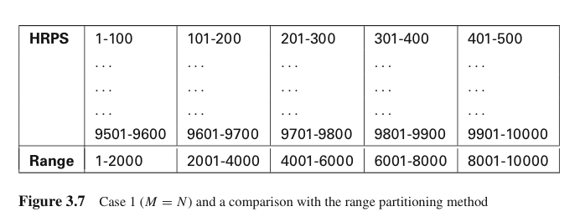
3.2. Data Partitioning (cont’d)
Hybrid-Range Partitioning Strategy (HRPS)
Case 1: M = N
Because the query will overlap with 5-6 fragments, all processors will be used (high degree of parallelism)
Compared with hash partitioning: Hash will also use N processors, since it cannot localize the execution of a range query
Compared with range partitioning: Range will only use 1-2 processors, and hence the degree of parallelism is small

Slide 25
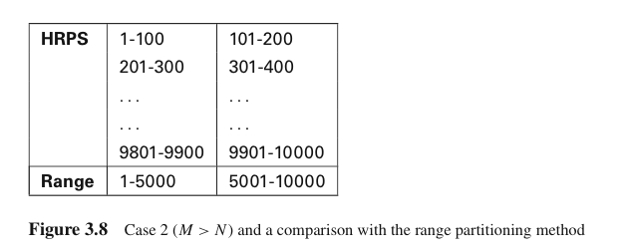
3.2. Data Partitioning (cont’d)
Hybrid-Range Partitioning Strategy (HRPS)
Case 2: M > N (e.g. M=5, and N=2)
HRPS will still use all N processors, because it enforces the constraint that the M adjacent fragments be assigned to different processors whenever possible
Compared with range partitioning: an increased probability that a query will use only one processor (in this example)

Slide 26
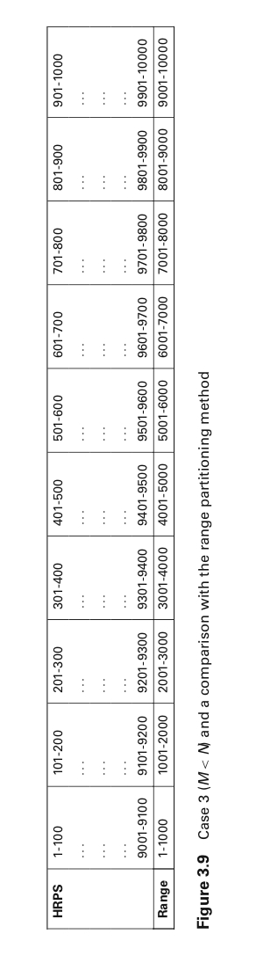
3.2. Data Partitioning (cont’d)
Hybrid-Range Partitioning Strategy (HRPS)
Case 3: M < N (e.g. M=5, and N=10)
HRPS distributes 100 fragments to all N processors. Since the query will overlap with only 5-6 fragments, each individual query is localized to almost the optimal number of processors
Compared with hash partitioning: Hash will use all N processors, and hence less efficient due to start up, communication, and termination overheads
Compared with range partitioning: The query will use 1-2 processors only, and hence less optimal

Slide 27
3.2. Data Partitioning (cont’d)
Hybrid-Range Partitioning Strategy (HRPS)
Support for Small Tables
If the number of fragments of a table is less than the number of processors, then the table will automatically be partitioned across a subset of the processors
Support for Tables with Nonuniform Distributions of the Partitioning Attribute Values
Because the cardinality of each fragment is not based on the value of the partitioning attribute value, once the HRPS determines the cardinality of each fragment, it will partition a table based on that value

Slide 28
3.2. Data Partitioning (cont’d)
Multiattribute Grid Declustering (MAGIC)
Based on multiple attributes - to support search queries based on either of data partitioning attributes
Support range and exact match search on each of the partitioning attributes
Example: Query 1 (one-half of the accesses) Slname=‘Roberts’, and Query 2 (the other half) SID between 98555 and 98600. Assume both queries produce only a few records
Create a two-dim grid with the two partitioning attributes (Slname and SID). The number of cells in the grid equal the number of processing elements
Determine the range value for each column and row, and allocate a processor in each cell in the grid

Slide 29
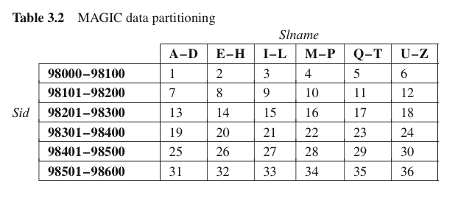
3.2. Data Partitioning (cont’d)
Multiattribute Grid Declustering (MAGIC)
Query 1 (exact match on Slname): Hash partitioning can localize the query processing on one processor. MAGIC will use 6 processors
Query 2 (range on SID): if the hash partitioning uses Slname, whereas the query is on SID, the query must use all 36 processors. MAGIC on the other hand, will only use 6 processors.
Compared with range partitioning, suppose the partitioning is based on SID, then Q1 will use 36 processors whilst Q2 will use 1 processor

Slide 30
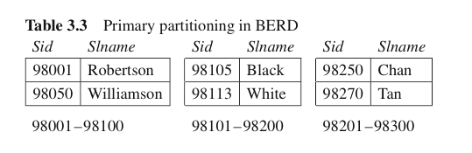
3.2. Data Partitioning (cont’d)
Bubba’s Extended Range Declustering (BERB)
Another multiattribute partitioning method - used in the Bubba Database Machine
Two levels of data partitioning: primary and secondary data partitioning
Step 1: Partition the table based on the primary partitioning attribute and uses a range partitioning method

Slide 31
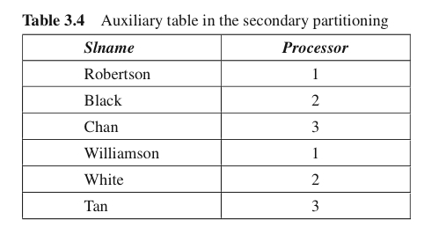
3.2. Data Partitioning (cont’d)
Bubba’s Extended Range Declustering (BERB)
Step 2: Each fragment is scanned and an ‘aux’ table is created from the attribute value of the secondary partitioning attribute and a list of processors containing the original records
Table 3.4 shows the ‘aux’ table (called Table IndexB)

Slide 32
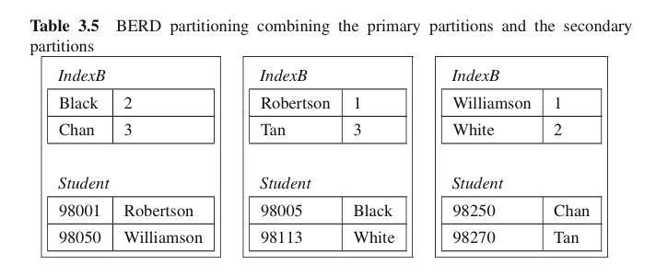
3.2. Data Partitioning (cont’d)
Bubba’s Extended Range Declustering (BERB)
Step 3: The ‘aux’ table is range partitioned on the secondary partitioning attribute (e.g. Slname)
Step 4: Place the fragments from steps 1 and 3 into multiple processors

Slide 33
3.3. Search Algorithms
Serial search algorithms:
Linear search
Binary search
Parallel search algorithms:
Processor activation or involvement
Local searching method
Key comparison

Slide 34
3.3. Search Algorithms (cont’d)
Linear Search
Exhaustive search - search each record one by one until it is found or end of table is reached
Binary Search
Must be pre-sorted
The complexity is O(log₂(n))

Slide 35
3.3. Search Algorithms (cont’d)
Parallel search algorithms:
Processor activation or involvement
Local searching method
Key comparison

Slide 36
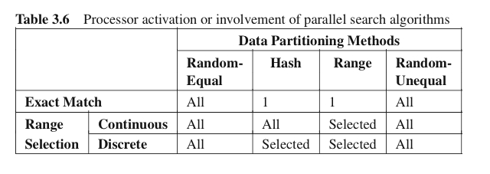
3.3. Search Algorithms (cont’d)
Processor activation or involvement
The number of processors to be used by the algorithm
If we know where the data to be sought are stored, then there is no point in activating all other processors in the searching process
Depends on the data partitioning method used
Also depends on what type of selection query is performed

Slide 37
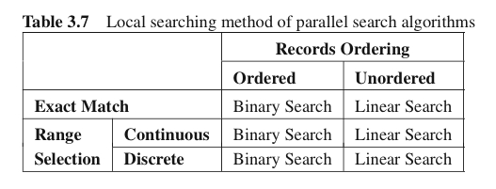
3.3. Search Algorithms (cont’d)
Local searching method
The searching method applied to the processor(s) involved in the searching process
Depends on the data ordering, regarding the type of the search (exact match of range)

Slide 38
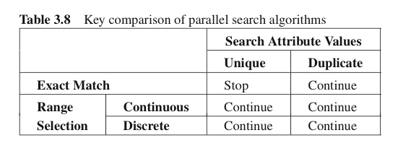
3.3. Search Algorithms (cont’d)
Key comparison
Compares the data from the table with the condition specified by the query
When a match is found: continue to find other matches, or terminate
Depends on whether the data in the table is unique or not

Slide 39
3.4. Summary
Search queries in SQL using the WHERE clause
Search predicates indicates the type of search operation
Exact-match, range (continuous or discrete), or multiattribute search
Data partitioning is a basic mechanism of parallel search
Single attribute-based, no attribute-based, or multiattribute-based partitioning
Parallel search algorithms have three main components
Processor involvement, local searching method, and key comparison
Homework: Read Chapter 5 for next week

