Slide 1
FIT5202 (Volume III - Join)
Week 3b – Parallel Outer Join

Slide 2
Join Queries
Two types of Join Queries
Inner Join
Select R.x, R.a, S.y, S.b
From R, S
Where R.a = S.b;
Outer Join
Select R.x, R.a, S.y, S.b
From R left outer join S on R.a = S.b;

Slide 3
Join Queries
R
S
Results
x | a
0 | 1
1 | 2
2 | 3
y | b
0 | 6
0 | 4
3 | 1
6 | 2
1 | 6
4 | 2
7 | 2
7 | 1
2 | 1
5 | 5
5 | 6
8 | 9
x | a | y | b
0 | 1 | 3 | 1
0 | 1 | 7 | 1
0 | 1 | 2 | 1
1 | 2 | 6 | 2
1 | 2 | 4 | 2
1 | 2 | 7 | 2
Inner Join
Select R.x, R.a, S.y, S.b
From R, S
Where R.a = S.b;

Slide 4
Join Queries
R
S
Results
x | a
0 | 1
1 | 2
2 | 3
y | b
0 | 6
0 | 4
3 | 1
6 | 2
1 | 6
4 | 2
7 | 2
7 | 1
2 | 1
5 | 5
5 | 6
8 | 9
x | a | y | b
0 | 1 | 3 | 1
0 | 1 | 7 | 1
0 | 1 | 2 | 1
1 | 2 | 6 | 2
1 | 2 | 4 | 2
1 | 2 | 7 | 2
2 | 3 | Null | Null
Outer Join
Select R.x, R.a, S.y, S.b
From R left outer join S
On R.a = S.b;

Slide 5
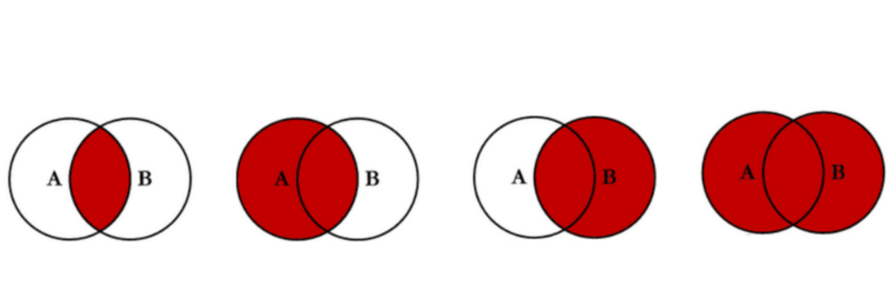
Exercise 1
Identify the LEFT OUTER JOIN?

Slide 6

https://www.codeproject.com/Articles/33052/Visual-Representation-of-SQL-Joins

Slide 7
Parallel Join Query Processing
Parallel Inner Join components
Data Partitioning
Divide and Broadcast
Disjoint Partitioning
Local Join
Nested-Loop Join
Sort-Merge Join
Hash Join
Example of a Parallel Inner Join Algorithm
Divide and Broadcast, plus Hash Join

Slide 8
Parallel Join Query Processing
Parallel Outer Join processing methods
ROJA (Redistribution Outer Join Algorithm)
DOJA (Duplication Outer Join Algorithm)
DER (Duplication & Efficient Redistribution)
Load Balancing
OJSO (Outer Join Skew Optimization)

Slide 9
1. ROJA
Step 1: Distribute or reshuffle data based on join attribute.
Step 2: Each processor performs local outer Join.
SELECT R.x, R.a, S.y, S.b
FROM R left outer join S on R.a = S.b
Eg. Using hash func h(i) = i mod 3 + 1
h(i)= 1
h(i)= 2
h(i)= 3
R |  |  | S
x | a |  | y | b
R |  |  | S
x | a |  | y | b
R |  |  | S
x | a |  | y | b
0
N
6
1
6
2
3
2
1
1
0
N
2
1
0
4
4
2
5
5
3
1
7
2
5
6
6
2
7
1
8
9
Processor 1
Processor 2
Processor 3

Slide 10
2. DOJA
Step 1: Replicate small table.
Step 2: Local Inner Join
Step 3: Hash redistribute inner join result based on attribute x.
SELECT R.x, R.a, S.y, S.b
FROM R left outer join S on R.a = S.b
R |  |  | S
x | a |  | y | b
R |  |  | S
x | a |  | y | b
R |  |  | S
x | a |  | y | b
0
1
0
6
1
2
1
6
2
3
2
1
1
2
0
4
0
1
4
2
1
2
5
5
2
3
3
1
2
3
7
2
0
5
6
1
2
1
6
2
7
1
8
9
Processor 1
Processor 2
Processor 3

Slide 11
2. DOJA
Step 4: Local outer join
SELECT R.x, R.a, S.y, S.b
FROM R left outer join S on R.a = S.b
R
J
R
J
R
J
x
a
x
a
y
b
x
a
x
a
y
b
x
a
x
a
y
b
0
1
0
1
3
1
1
2
1
2
6
2
2
3
N
N
0
1
7
1
1
2
4
2
0
1
2
1
1
2
7
2
Processor 1
Processor 2
Processor 3

Slide 12
3. DER
Step 1: Replicate small table (left)
Step 2: Local Inner Join
Step 3: Select ROW ID of left table with no matches.
Step 4: Redistribute the ROW ID.
Step 5: Store the ROW ID that appears as many times as the number of processors
SELECT R.x, R.a, S.y, S.b
FROM R left outer join S on R.a = S.b
Row ID
R |  |  | S
x | a |  | y | b
Row ID
R |  |  | S
x | a |  | y | b
Row ID
R |  |  | S
x | a |  | y | b
0
0
1
0
6
0
0
1
1
6
0
0
1
2
1
N
1
1
2
0
4
1
1
2
4
2
1
1
2
5
5
1
2
2
2
3
3
1
2
2
3
7
2
2
2
3
5
6
6
2
7
1
8
9
Processor 1
Processor 2
Processor 3

Slide 13
3. DER
Step 6: Inner join
SELECT R.x, R.a, S.y, S.b
FROM R left outer join S on R.a = S.b
R
Row ID
R
Row ID
R
Row ID
x
a
x
a
x
a
x
a
y
b
x
a
y
b
x
a
y
b
0
1
1
2
2
3
2
0
1
3
1
0
1
7
1
0
1
2
1
1
2
6
2
1
2
4
2
x
a
y
b
1
2
7
2
2
3
N
N
Processor 1
Processor 2
Processor 3

Slide 14
Parallel Join Query Processing
Parallel Outer Join processing methods
ROJA (Redistribution Outer Join Algorithm)
DOJA (Duplication Outer Join Algorithm)
DER (Duplication & Efficient Redistribution)
Load Balancing
OJSO (Outer Join Skew Optimization)

Slide 15
 | ROJA | DOJA | DER
Steps | Step 1: Distribute or reshuffle the data based on the join attribute. Step 2: Each processor performs the Local outer Join. | Step 1: Replication. We duplicate the small table. Step 2: Local Inner Join Step 3: Hash redistribute the inner join result based on attribute X. Step 4: Local outer join | Step 1: Replication. We broadcast the left table. Step 2: Local Inner Join Step 3: Select the ROW ID of left table with no matches. Step 4: Redistribute the ROW ID. Step 5: Store the ROW ID that appears as many times as the number of processors. Step 6: Inner join
Pros | fast performance, only two steps | None. ROJA is faster than DOJA. | Redistributes dangling row IDs instead of actual records.
Cons | redistribution of data -> data skew, communication cost | In the replication step, if the table is large, the replication cost is expensive. In the distribution step, data skew and communication cost similar to ROJA | In the replication step, if the table is large, the replication cost is expensive.

Slide 16
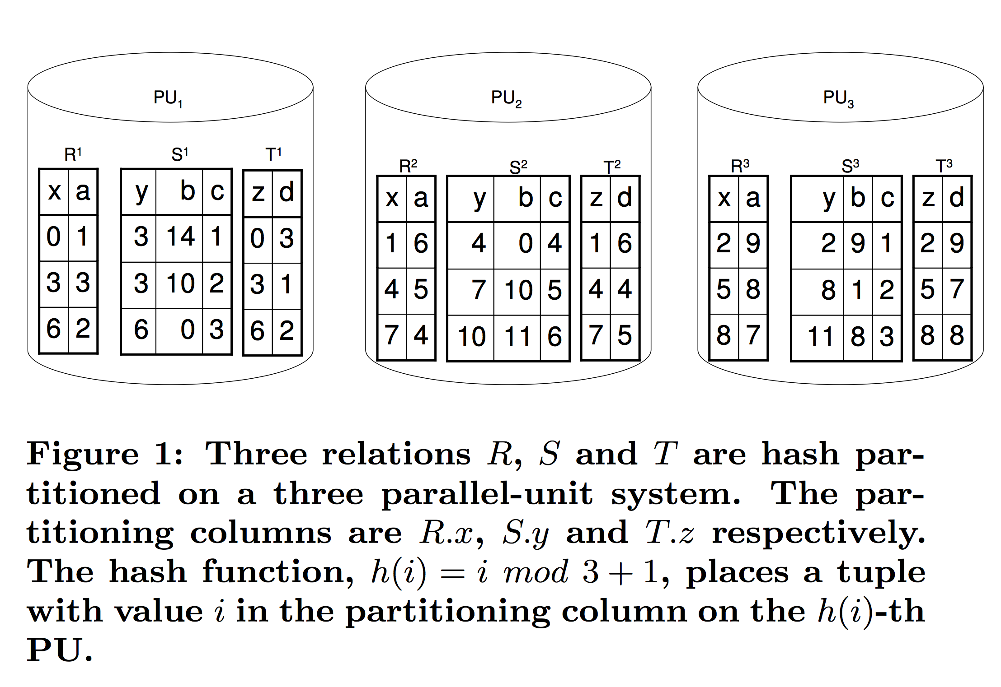
Another example…
Select x, y, z, a, c
From R left outer join S on R.a=S.b
left outer join T on S.c=T.d;
Initial Data Placement

Slide 17
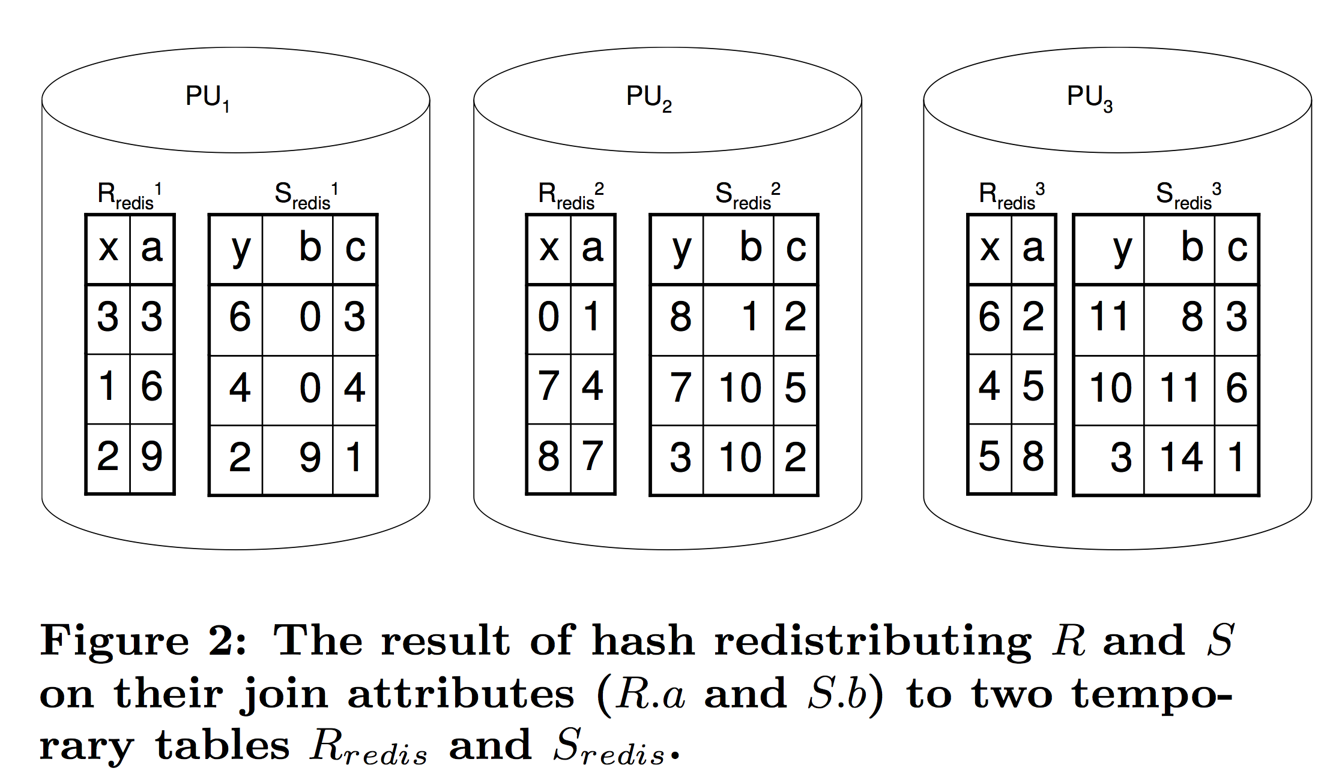
Another example…
Step 1: Redistribution of R and S (why do we need to redistribute?)

Slide 18
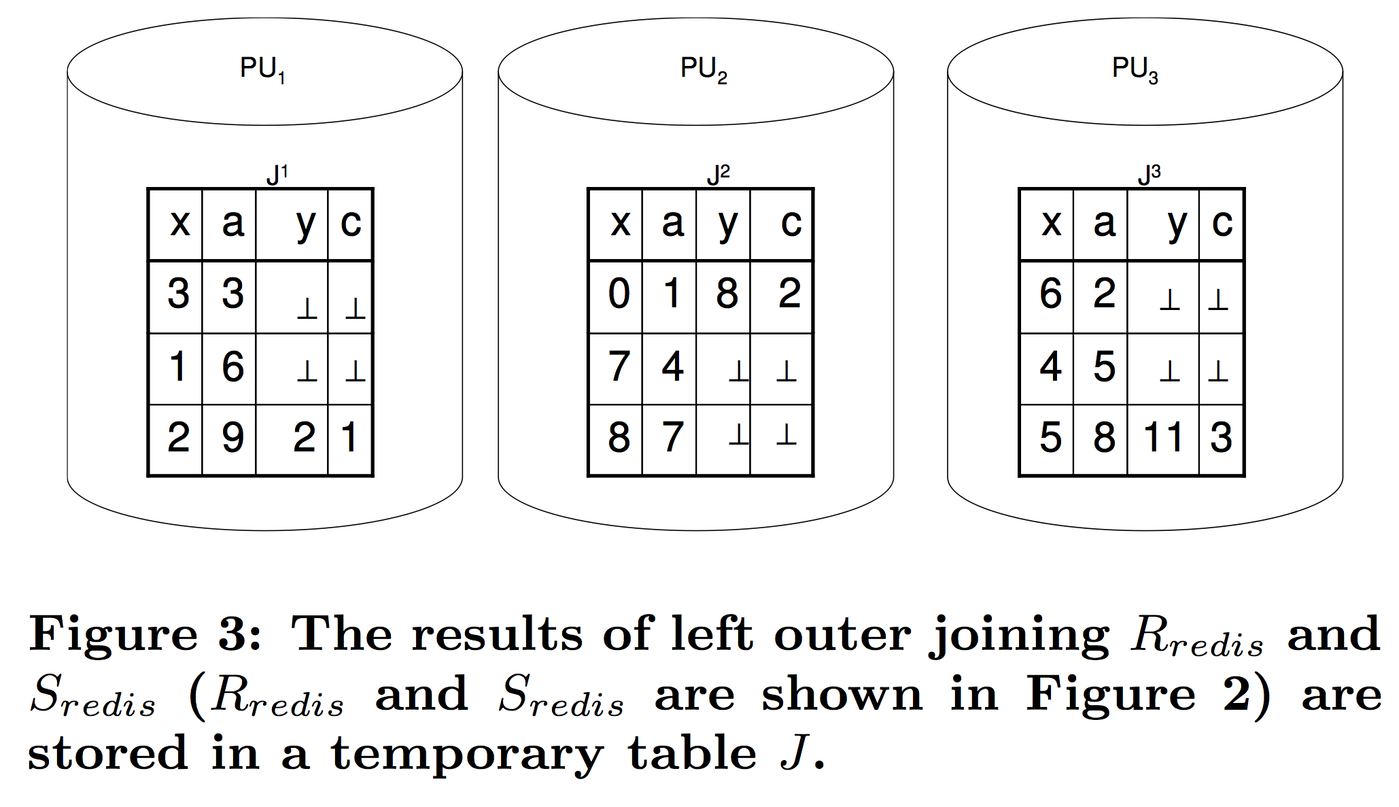
Another example…
Step 2: (a) Outer Join R and S, and store in J

Slide 19
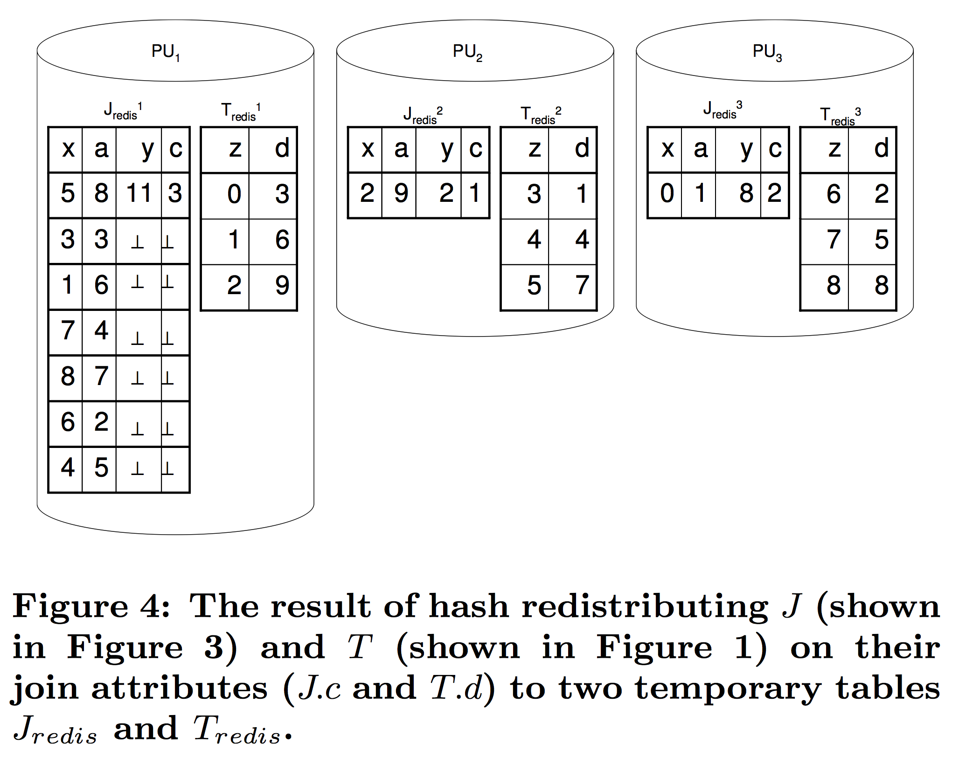
Another example…
Step 2: (b) Redistribute J and T

Slide 20
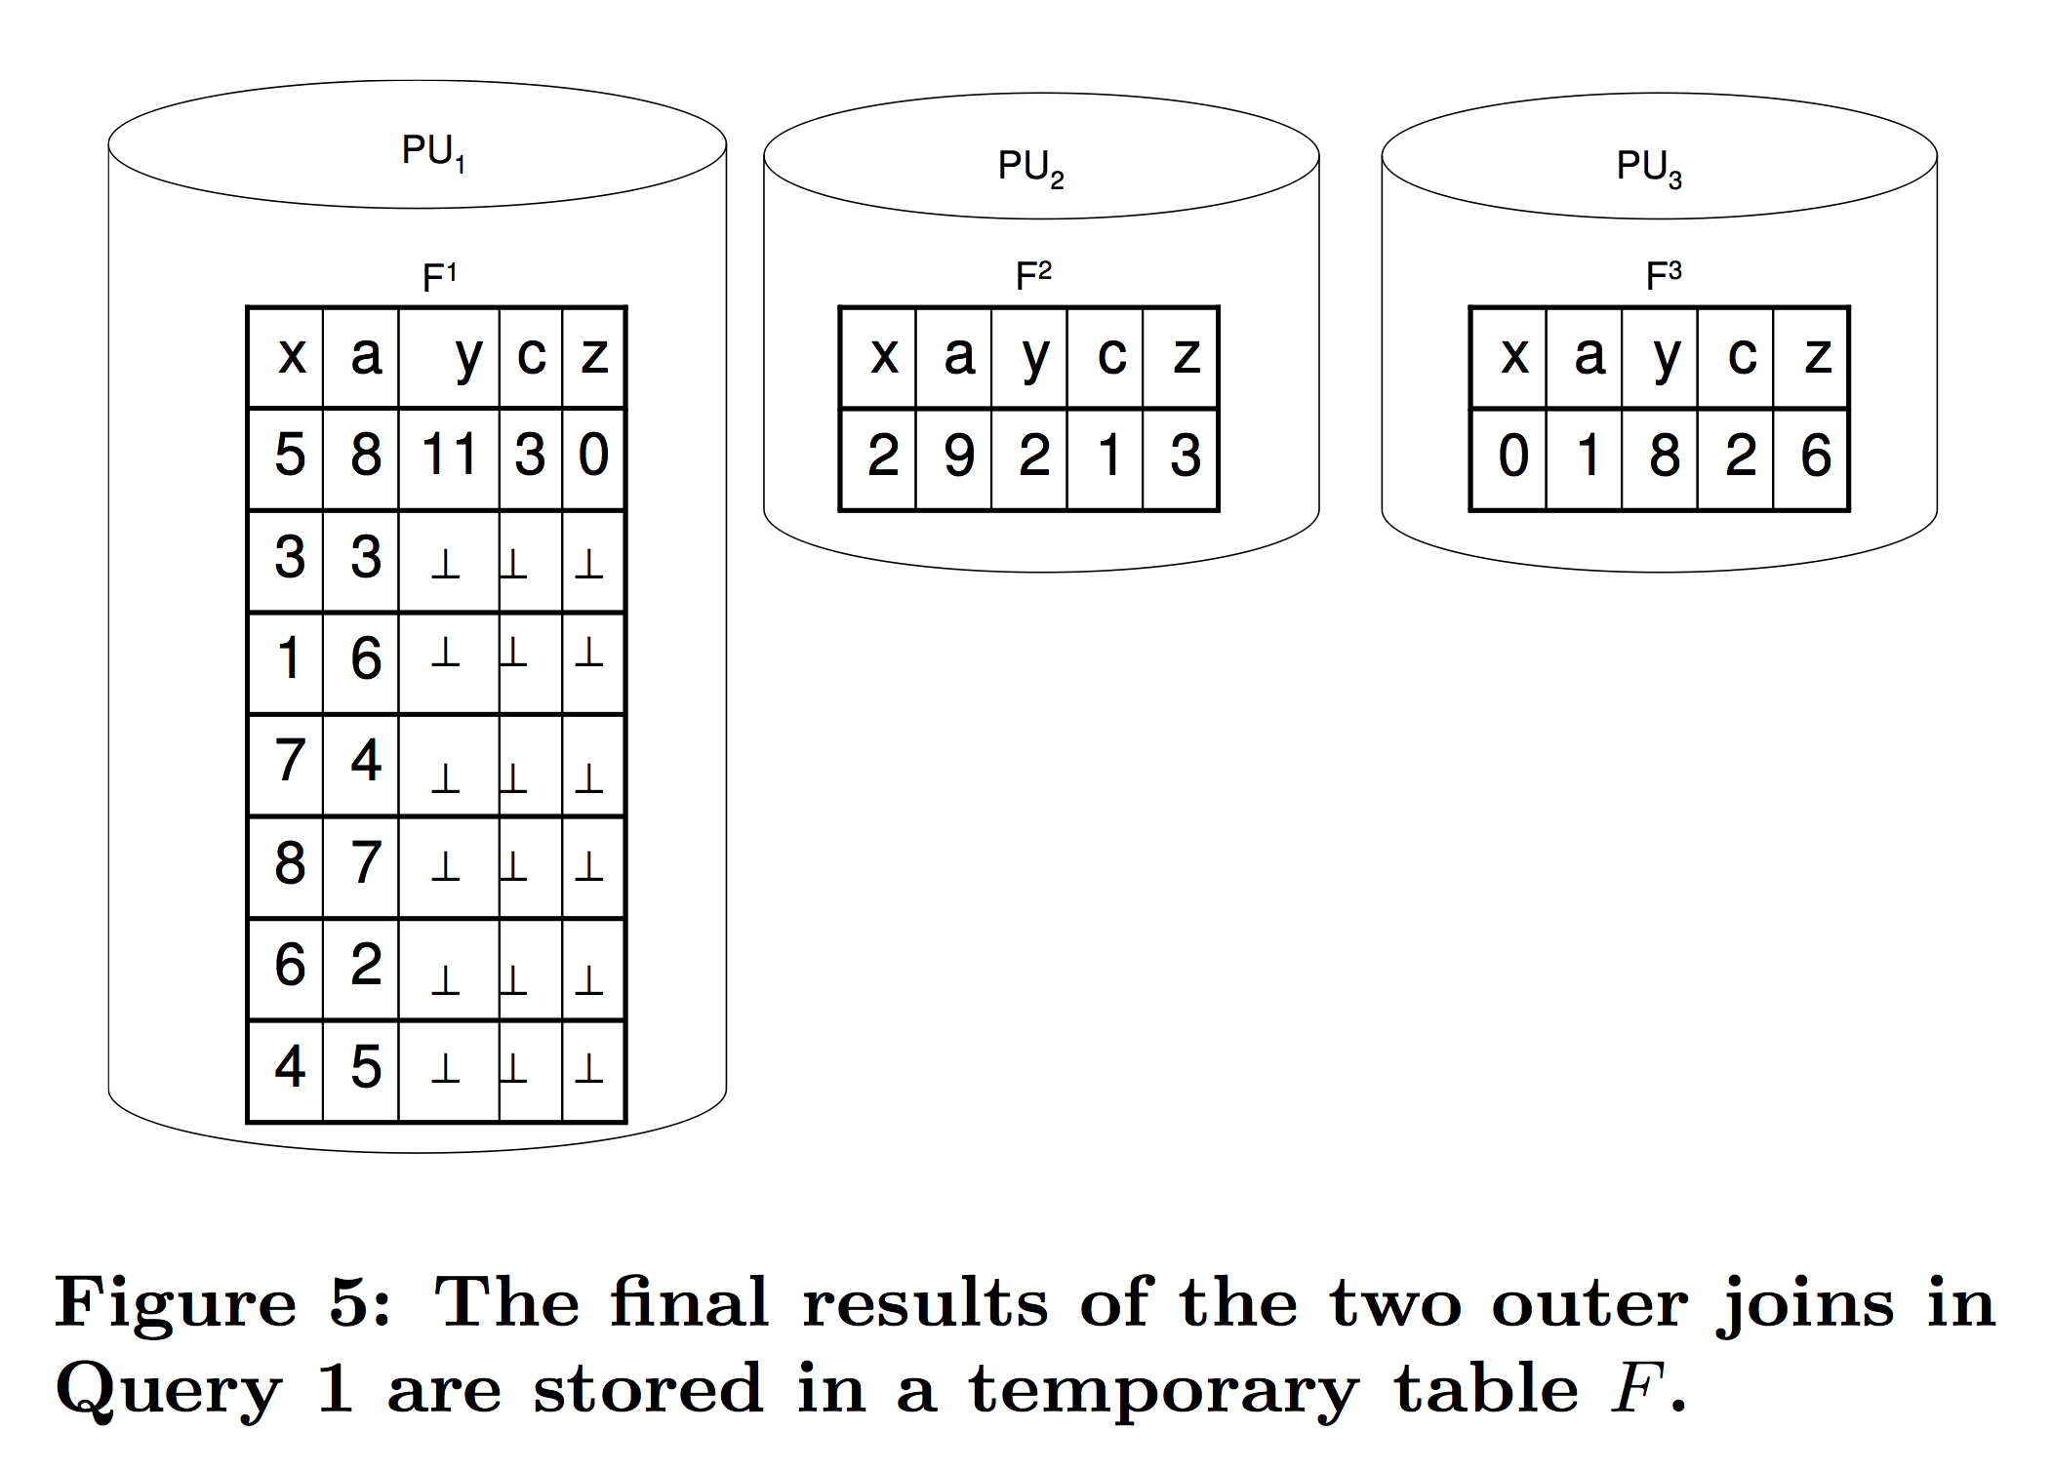
Another example…
Step 3: Outer Join J and T ➔ Final Results

Slide 21
Conclusion…
Skew can easily happen easily in Outer Join queries

Slide 22
Exercise 1 (FLUX Quiz)
In the previous example (R outer join S outer join T), which parallel outer join method was used?
A. ROJA
B. DOJA
C. DER
D. None of the above

Slide 23
A better solution… OJSO
Step 1: Redistribute R and S (same as the previous example)

Slide 24
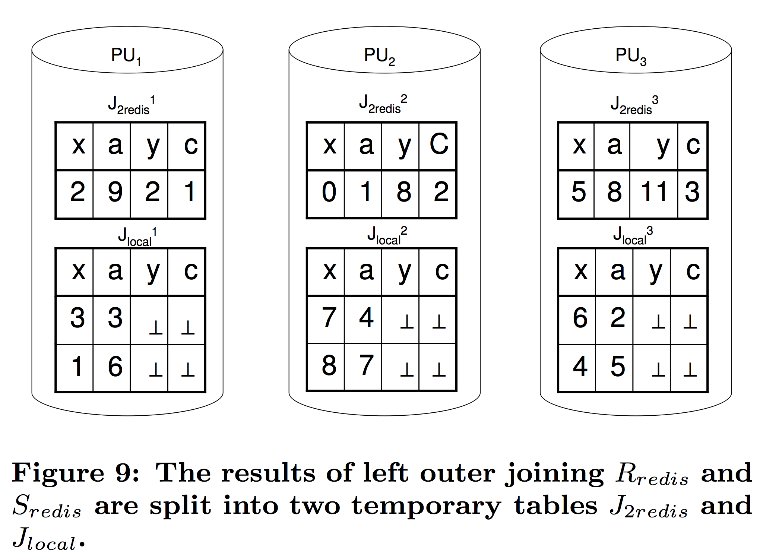
A better solution… OJSO
Step 2: (a) Outer Join R and S, but the results are divided into J_{2redis} and J_{local}

Slide 25
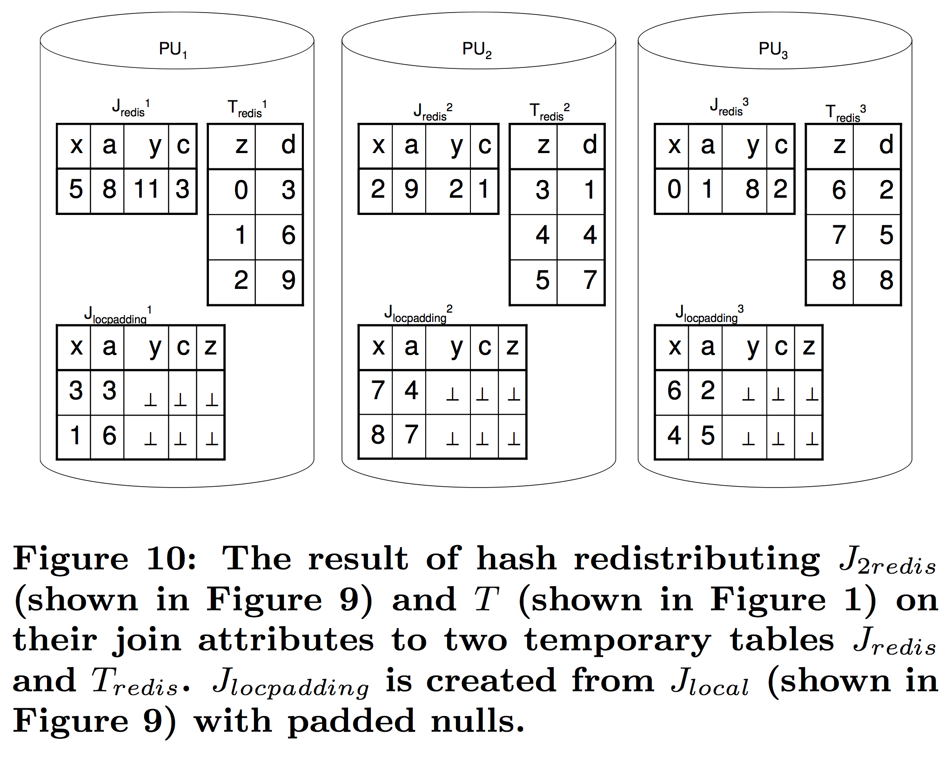
A better solution… OJSO
Step 2: (b) Redistribute J_{2redis} and T; and do an outer join

Slide 26
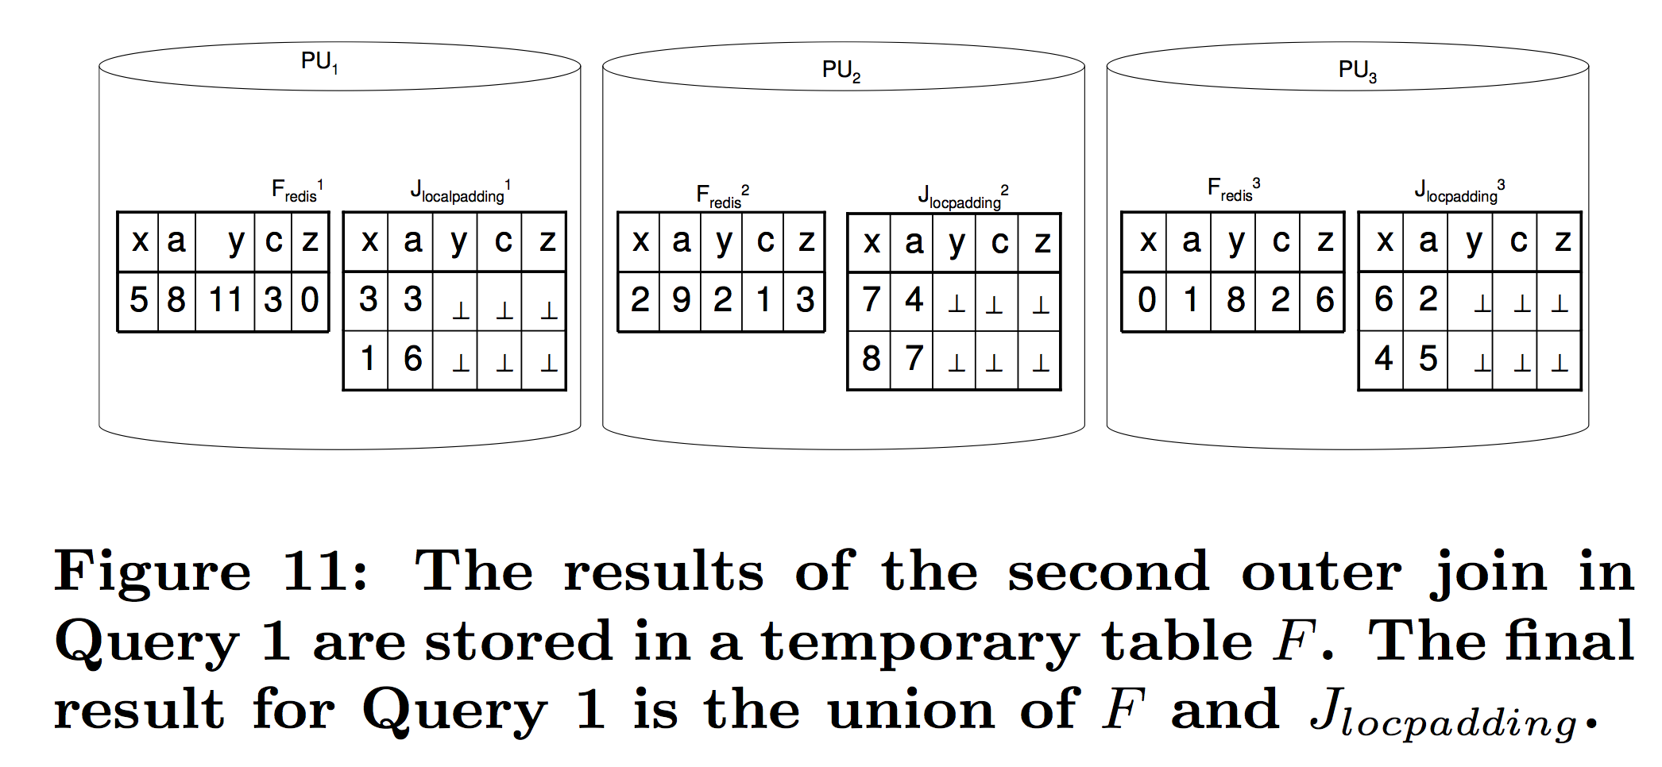
A better solution… OJSO
Step 3: Union the final results in each processor

Slide 27
OJSO Conclusion…
Do not redistribute the dangling records from the previous outer join

Slide 28
Summary…
Parallel Outer Join processing methods
ROJA (Redistribution Outer Join Algorithm)
DOJA (Duplication Outer Join Algorithm)
DER (Duplication & Efficient Redistribution)
Load Balancing
OJSO (Outer Join Skew Optimization)

Slide 29
References
Xu, Y. & Kostamaa, P. (2010). A new algorithm for small-large table outer joins in parallel DBMS. In Proceedings of the 26th Intl Conference on Data Engineering (ICDE’2010) (pp. 1018-1024), IEEE Comp Society Press.
Xu,Y. & Kostamaa, P. (2009). Efficient Outer Join Data Skew Handling in Parallel DBMS. In Proceedings of the 35th International Conference on Very Large Data Bases (VLDB’2009) (pp. 1390-1396), VLDB Endowment.

