Slide 1
FIT5202 (Volume IV – Sort and Group By)
Week 4b – Parallel Group By

Slide 2
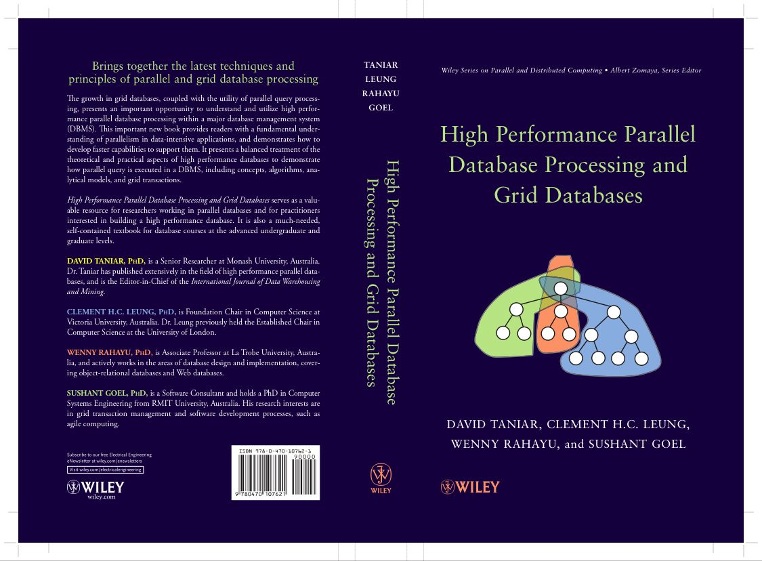
Chapter 4 Parallel Sort and GroupBy
4.1 Sorting, Duplicate Removal and Aggregate
4.2 Serial External Sorting Method
4.3 Algorithms for Parallel External Sort
4.4 Parallel Algorithms for GroupBy Queries
4.5 Cost Models for Parallel Sort
4.6 Cost Models for Parallel GroupBy
4.7 Summary
4.8 Bibliographical Notes
4.9 Exercises

Slide 3
4.1. GroupBy, and Serial GroupBy
Select Suburb, Count(*)
From Student
Group By Suburb;
Student | Suburb
Adam | Clayton
Ben | Hawthorn
Chris | Doncaster
Daniel | Caulfield
Eric | Kew
Fred | Richmond
Garry | Hawthorn
Harold | Elwood
Irene | Clayton
Jessica | Caulfield
Katie | Malvern
Leonard | Balwyn
Mary | Hawthorn

Slide 4
4.1. Serial GroupBy Processing (cont’d)
Select Suburb, Count(*)
From Student
Group By Suburb;
Student | Suburb
Adam | Clayton
Ben | Hawthorn
Chris | Doncaster
Daniel | Caulfield
Eric | Kew
Fred | Richmond
Garry | Hawthorn
Harold | Elwood
Irene | Clayton
Jessica | Caulfield
Katie | Malvern
Leonard | Balwyn
Mary | Hawthorn
Hash Table
Hash the record using a certain hash function
1
2
3
4
5
6
7
8 | Clayton | 1
9
Processing Steps:
Read the first student record, and hash the suburb to the hash table

Slide 5
4.1. Serial GroupBy Processing (cont’d)
Select Suburb, Count(*)
From Student
Group By Suburb;
Student | Suburb
Adam | Clayton
Ben | Hawthorn
Chris | Doncaster
Daniel | Caulfield
Eric | Kew
Fred | Richmond
Garry | Hawthorn
Harold | Elwood
Irene | Clayton
Jessica | Caulfield
Katie | Malvern
Leonard | Balwyn
Mary | Hawthorn
Hash Table
1 | Hawthorn | 1
2
3
4
5
6
7
8 | Clayton | 1
9
Processing Steps:
Read the first student record, and hash the suburb to the hash table
Read the second record and hash it

Slide 6
4.1. Serial GroupBy Processing (cont’d)
Select Suburb, Count(*)
From Student
Group By Suburb;
Student | Suburb
Adam | Clayton
Ben | Hawthorn
Chris | Doncaster
Daniel | Caulfield
Eric | Kew
Fred | Richmond
Garry | Hawthorn
Harold | Elwood
Irene | Clayton
Jessica | Caulfield
Katie | Malvern
Leonard | Balwyn
Mary | Hawthorn
Hash Table
1 | Hawthorn | 3
2 | Caulfield | 2
3 | Malvern | 1
4 | Balwyn | 1
5 | Kew | 1
6 | Richmond | 1
7 | Elwood | 1
8 | Clayton | 2
9 | Doncaster | 1
Processing Steps:
Read the first student record, and hash the suburb to the hash table
Read the second record and hash it
Read the subsequent records one-by-one and hash them

Slide 7
4.1. Serial GroupBy Processing (cont’d)
Select Suburb, Count(*)
From Student
Group By Suburb;
Hash Table in Main-Memory
1 | Hawthorn | 3
2 | Caulfield | 2
3 | Malvern | 1
4 | Balwyn | 1
5 | Kew | 1
6 | Richmond | 1
7 | Elwood | 1
8 | Clayton | 2
9 | Doncaster | 1
Query Results in Disk
Processing Steps:
Read the first student record, and hash the suburb to the hash table
Read the second record and hash it
Read the subsequent records one-by-one and hash them
Read the Hash Table, and store this in disk as the query results
Hawthorn | 3
Caulfield | 2
Malvern | 1
Balwyn | 1
Kew | 1
Richmond | 1
Elwood | 1
Clayton | 2
Doncaster | 1

Slide 8
4.1. Serial GroupBy Processing (cont’d)
Select Suburb, Count(*)
From Student
Group By Suburb;
Student | Suburb
Adam | Clayton
Ben | Hawthorn
Chris | Doncaster
Daniel | Caulfield
Eric | Kew
Fred | Richmond
Garry | Hawthorn
Harold | Elwood
Irene | Clayton
Jessica | Caulfield
Katie | Malvern
Leonard | Balwyn
Mary | Hawthorn
Hash Table
1 | Hawthorn | 3
2 | Caulfield | 2
3 | Malvern | 1
4 | Balwyn | 1
5 | Kew | 1
6 | Richmond | 1
7 | Elwood | 1
8 | Clayton | 2
9 | Doncaster | 1
This will work, if we assume that the main-memory can hold the entire Hash Table.
How about if the Hash Table is so big that it cannot fit into the main-memory.
For example, how about if the main-memory can only hold 4 hash records at a time? How does the Group By processing work?

Slide 9
4.1. Serial GroupBy Processing (cont’d)
Student | Suburb
Adam | Clayton
Ben | Hawthorn
Chris | Doncaster
Daniel | Caulfield
Eric | Kew
Fred | Richmond
Garry | Hawthorn
Harold | Elwood
Irene | Clayton
Jessica | Caulfield
Katie | Malvern
Leonard | Balwyn
Mary | Hawthorn
Hash Table
Assume that the main-memory can hold 4 records in the hash table.
It needs a bigger hash table, but it doesn’t have.

Slide 10
Ben | Hawthorn
Daniel | Caulfield
Garry | Hawthorn
Jessica | Caulfield
Mary | Hawthorn
In Main-Memory
Student | Suburb
Adam | Clayton
Ben | Hawthorn
Chris | Doncaster
Daniel | Caulfield
Eric | Kew
Fred | Richmond
Garry | Hawthorn
Harold | Elwood
Irene | Clayton
Jessica | Caulfield
Katie | Malvern
Leonard | Balwyn
Mary | Hawthorn
Hash Data Partitioning based on the Suburb
Eric | Kew
Fred | Richmond
Katie | Malvern
Leonard | Balwyn
In Disk
Adam | Clayton
Chris | Doncaster
Harold | Elwood
Irene | Clayton

Slide 11
Hash Processing
Ben | Hawthorn
Daniel | Caulfield
Garry | Hawthorn
Jessica | Caulfield
Mary | Hawthorn
In Main-Memory
Hash Table in Main-Memory
Hawthorn | 3
Caulfield | 2
Eric | Kew
Fred | Richmond
Katie | Malvern
Leonard | Balwyn
Still in Disk
Query Results in Disk
Adam | Clayton
Chris | Doncaster
Harold | Elwood
Irene | Clayton
Hawthorn | 3
Caulfield | 2

Slide 12
Hash Processing
Hash Table in Main-Memory
Ben | Hawthorn
Daniel | Caulfield
Garry | Hawthorn
Jessica | Caulfield
Mary | Hawthorn
Flush to Disk
Kew | 1
Malvern | 1
Richmond | 1
Balwyn | 1
Eric | Kew
Fred | Richmond
Katie | Malvern
Leonard | Balwyn
Query Results in Disk
Load to Main-Memory
Hawthorn | 3
Caulfield | 2
Kew | 1
Caulfield | 1
Richmond | 1
Balwyn | 1
Adam | Clayton
Chris | Doncaster
Harold | Elwood
Irene | Clayton
Still in Disk

Slide 13
Hash Processing
Hash Table in Main-Memory
Ben | Hawthorn
Daniel | Caulfield
Garry | Hawthorn
Jessica | Caulfield
Mary | Hawthorn
Flush to Disk
Clayton | 2
Doncaster | 1
Elwood | 1
Eric | Kew
Fred | Richmond
Katie | Malvern
Leonard | Balwyn
Flush to Disk
Hawthorn | 3
Caulfield | 2
Kew | 1
Caulfield | 1
Richmond | 1
Balwyn | 1
Clayton | 2
Doncaster | 1
Elwood | 1
Query Results in Disk
Adam | Clayton
Chris | Doncaster
Harold | Elwood
Irene | Clayton
Load to Main-Memory

Slide 14
4.4. Parallel GroupBy
Traditional methods (Merge-All and Hierarchical Merging)
Two-phase method
Redistribution method
Without data redistribution
With data redistribution

Slide 15
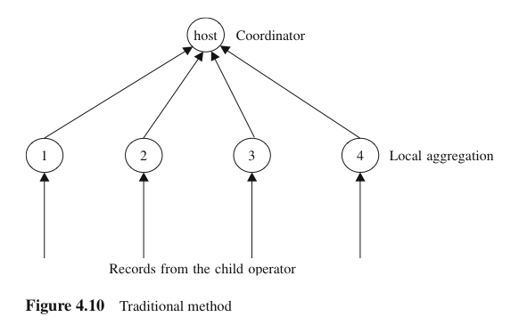
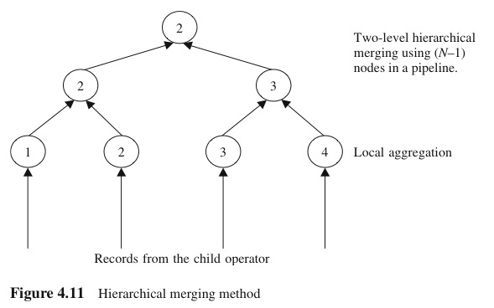
4.4. Parallel GroupBy (cont’d)
Traditional Methods
Step 1: local aggregate in each processor
Step 2: global aggregation
May use a Merge-All or Hierarchical method
Need to pay a special attention to some aggregate functions (AVG) when performing a local aggregate process

Slide 16
4.4. Parallel GroupBy (cont’d)
Traditional Method: Merge All
Initial Data Placement
Processor 1
Processor 2
Processor 3
Processor 4
Adam | Clayton
Ben | Clayton
Chris | Caulfield
Dennis | Malvern
Eric | Vermont
Fred | Hawthorn
George | Richmond
Harold | Elwood
Irene | Malvern
Jessica | Kew
Kelly | Balwyn
Lesley | Hawthorn
Megan | Kew
Naomi | Richmond
Oscar | Vermont
Peter | Elwood
Quin | Kew
Roger | Balwyn
Sarah | Malvern
Tracy | Clayton

Slide 17
4.4. Parallel GroupBy (cont’d)
Traditional Method: Merge All
Clayton | 2
Caulfield | 1
Malvern | 1
Vermont | 1
Hawthorn | 1
Richmond | 1
Elwood | 1
Malvern | 1
Kew | 1
Balwyn | 1
Hawthorn | 1
Kew | 1
Richmond | 1
Vermont | 1
Elwood | 1
Kew | 1
Balwyn | 1
Malvern | 1
Clayton | 1
Local Aggregation Phase
Processor 1
Processor 2
Processor 3
Processor 4
Adam | Clayton
Ben | Clayton
Chris | Caulfield
Dennis | Malvern
Eric | Vermont
Fred | Hawthorn
George | Richmond
Harold | Elwood
Irene | Malvern
Jessica | Kew
Kelly | Balwyn
Lesley | Hawthorn
Megan | Kew
Naomi | Richmond
Oscar | Vermont
Peter | Elwood
Quin | Kew
Roger | Balwyn
Sarah | Malvern
Tracy | Clayton

Slide 18
4.4. Parallel GroupBy (cont’d)
Traditional Method: Merge All
Clayton | 2
Hawthorn | 1
Balwyn | 1
Elwood | 1
… | …
… | …
Vermont | 1
Clayton | 1
Global Aggregation Phase
Clayton | 2
Caulfield | 1
Malvern | 1
Vermont | 1
Hawthorn | 1
Richmond | 1
Elwood | 1
Malvern | 1
Kew | 1
Balwyn | 1
Hawthorn | 1
Kew | 1
Richmond | 1
Vermont | 1
Elwood | 1
Kew | 1
Balwyn | 1
Malvern | 1
Clayton | 1
Processor 1
Processor 2
Processor 3
Processor 4

Slide 19
4.4. Parallel GroupBy (cont’d)
Traditional Method: Merge All
Clayton | 3
Hawthorn | 2
Balwyn | 2
… | …
… | …
Vermont | 2
Final results
Clayton | 2
Hawthorn | 1
Balwyn | 1
Elwood | 1
… | …
… | …
Vermont | 1
Clayton | 1
Global Aggregation Phase

Slide 20
Exercise 6 (FLUX Quiz)
The limitations of the Traditional Approach (Merge All) to process a Group By query are:
A. Global aggregation is carried out by one processor
B. Network bottleneck when sending the local aggregation results to the coordinator
C. No parallelism in the global aggregation phase
D. All of the above
E. Some of the above

Slide 21
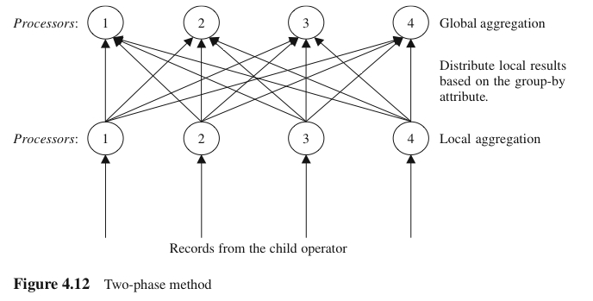
4.4. Parallel GroupBy (cont’d)
Two-Phase Method
Step 1: local aggregate in each processor. Each processor groups local records according to the groupby attribute
Step 2: global aggregation where all temp results from each processor are redistributed and then final aggregate is performed in each processor

Slide 22
4.4. Parallel GroupBy (cont’d)
Two-Phase Method
Initial Data Placement
Processor 1
Processor 2
Processor 3
Processor 4
Adam | Clayton
Ben | Clayton
Chris | Caulfield
Dennis | Malvern
Eric | Vermont
Fred | Hawthorn
George | Richmond
Harold | Elwood
Irene | Malvern
Jessica | Kew
Kelly | Balwyn
Lesley | Hawthorn
Megan | Kew
Naomi | Richmond
Oscar | Vermont
Peter | Elwood
Quin | Kew
Roger | Balwyn
Sarah | Malvern
Tracy | Clayton

Slide 23
4.4. Parallel GroupBy (cont’d)
Two-Phase Method
Clayton | 2
Caulfield | 1
Malvern | 1
Vermont | 1
Hawthorn | 1
Richmond | 1
Elwood | 1
Malvern | 1
Kew | 1
Balwyn | 1
Hawthorn | 1
Kew | 1
Richmond | 1
Vermont | 1
Elwood | 1
Kew | 1
Balwyn | 1
Malvern | 1
Clayton | 1
Local Aggregation Phase
Processor 1
Processor 2
Processor 3
Processor 4
Adam | Clayton
Ben | Clayton
Chris | Caulfield
Dennis | Malvern
Eric | Vermont
Fred | Hawthorn
George | Richmond
Harold | Elwood
Irene | Malvern
Jessica | Kew
Kelly | Balwyn
Lesley | Hawthorn
Megan | Kew
Naomi | Richmond
Oscar | Vermont
Peter | Elwood
Quin | Kew
Roger | Balwyn
Sarah | Malvern
Tracy | Clayton

Slide 24
4.4. Parallel GroupBy (cont’d)
Two-Phase Method
Clayton | 2
Balwyn | 1
Elwood | 1
Caulfield | 1
Elwood | 1
Balwyn | 1
Clayton | 1
Hawthorn | 1
Hawthorn | 1
Kew | 1
Kew | 1
Kew | 1
Malvern | 1
Malvern | 1
Malvern | 1
Richmond | 1
Vermont | 1
Richmond | 1
Vermont | 1
Distribute Local Aggregation Results Phase
Clayton | 2
Caulfield | 1
Malvern | 1
Vermont | 1
Hawthorn | 1
Richmond | 1
Elwood | 1
Malvern | 1
Kew | 1
Balwyn | 1
Hawthorn | 1
Kew | 1
Richmond | 1
Vermont | 1
Elwood | 1
Kew | 1
Balwyn | 1
Malvern | 1
Clayton | 1
Processor 1
Processor 2
Processor 3
Processor 4

Slide 25
4.4. Parallel GroupBy (cont’d)
Two-Phase Method
Final results
Clayton | 3
Balwyn | 2
Elwood | 2
Caulfield | 1
Hawthorn | 2
Kew | 3
Malvern | 3
Richmond | 2
Vermont | 2
Clayton | 2
Balwyn | 1
Elwood | 1
Caulfield | 1
Elwood | 1
Balwyn | 1
Clayton | 1
Global Aggregation Phase
Hawthorn | 1
Hawthorn | 1
Kew | 1
Kew | 1
Kew | 1
Richmond | 1
Vermont | 1
Richmond | 1
Vermont | 1
Malvern | 1
Malvern | 1
Malvern | 1
Processor 1
Processor 2
Processor 3
Processor 4

Slide 26
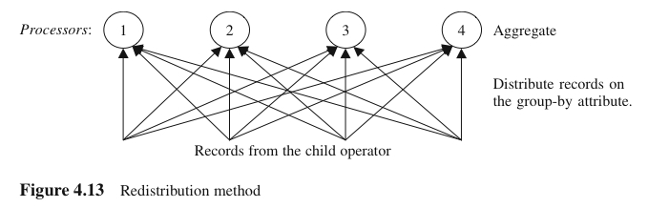
4.4. Parallel GroupBy (cont’d)
Redistribution Method
Step 1 (Partitioning phase): redistribute raw records to all processors
Step 2 (Aggregation phase): each processor performs a local aggregation

Slide 27
4.4. Parallel GroupBy (cont’d)
Redistribution Method
Initial Data Placement
Processor 1
Processor 2
Processor 3
Processor 4
Adam | Clayton
Ben | Clayton
Chris | Caulfield
Dennis | Malvern
Eric | Vermont
Fred | Hawthorn
George | Richmond
Harold | Elwood
Irene | Malvern
Jessica | Kew
Kelly | Balwyn
Lesley | Hawthorn
Megan | Kew
Naomi | Richmond
Oscar | Vermont
Peter | Elwood
Quin | Kew
Roger | Balwyn
Sarah | Malvern
Tracy | Clayton

Slide 28
4.4. Parallel GroupBy (cont’d)
Redistribution Method
Adam | Clayton
Kelly | Balwyn
Peter | Elwood
Ben | Clayton
Chris | Caulfield
Harold | Elwood
Roger | Balwyn
Tracy | Clayton
Partitioning Phase
Fred | Hawthorn
Lesley | Hawthorn
Quin | Kew
Megan | Kew
Jessica | Kew
George | Richmond
Naomi | Richmond
Eric | Vermont
Oscar | Vermont
Dennis | Malvern
Irene | Malvern
Sarah | Malvern
Processor 1
Processor 2
Processor 3
Processor 4
Adam | Clayton
Ben | Clayton
Chris | Caulfield
Dennis | Malvern
Eric | Vermont
Fred | Hawthorn
George | Richmond
Harold | Elwood
Irene | Malvern
Jessica | Kew
Kelly | Balwyn
Lesley | Hawthorn
Megan | Kew
Naomi | Richmond
Oscar | Vermont
Peter | Elwood
Quin | Kew
Roger | Balwyn
Sarah | Malvern
Tracy | Clayton

Slide 29
4.4. Parallel GroupBy (cont’d)
Redistribution Method
Final results
Clayton | 3
Balwyn | 2
Elwood | 2
Caulfield | 1
Hawthorn | 2
Kew | 3
Malvern | 3
Richmond | 2
Vermont | 2
Adam | Clayton
Kelly | Balwyn
Peter | Elwood
Ben | Clayton
Chris | Caulfield
Harold | Elwood
Roger | Balwyn
Tracy | Clayton
Aggregation Phase
Fred | Hawthorn
Lesley | Hawthorn
Quin | Kew
Megan | Kew
Jessica | Kew
George | Richmond
Naomi | Richmond
Eric | Vermont
Oscar | Vermont
Dennis | Malvern
Irene | Malvern
Sarah | Malvern
Processor 1
Processor 2
Processor 3
Processor 4

Slide 30
4.4. Parallel GroupBy (cont’d)
Redistribution Method
Clayton | 3
Balwyn | 2
Elwood | 2
Caulfield | 1
Hawthorn | 2
Kew | 3
Malvern | 3
Richmond | 2
Vermont | 2
Adam | Clayton
Kelly | Balwyn
Peter | Elwood
Ben | Clayton
Chris | Caulfield
Harold | Elwood
Roger | Balwyn
Tracy | Clayton
What is the problem here?
Fred | Hawthorn
Lesley | Hawthorn
Quin | Kew
Megan | Kew
Jessica | Kew
George | Richmond
Naomi | Richmond
Eric | Vermont
Oscar | Vermont
Dennis | Malvern
Irene | Malvern
Sarah | Malvern
Processor 1
Processor 2
Processor 3
Processor 4

Slide 31
4.4. Parallel GroupBy (cont’d)
Redistribution Method (Task Stealing)
Adam | Clayton
Kelly | Balwyn
Ben | Clayton
Chris | Caulfield
Roger | Balwyn
Tracy | Clayton
Create 5 buckets, instead of 4
Fred | Hawthorn
Lesley | Hawthorn
Quin | Kew
Megan | Kew
Jessica | Kew
George | Richmond
Naomi | Richmond
Eric | Vermont
Oscar | Vermont
Dennis | Malvern
Irene | Malvern
Sarah | Malvern
Peter | Elwood
Harold | Elwood
Processor 1
Processor 2
Processor 3
Processor 4
Adam | Clayton
Ben | Clayton
Chris | Caulfield
Dennis | Malvern
Eric | Vermont
Fred | Hawthorn
George | Richmond
Harold | Elwood
Irene | Malvern
Jessica | Kew
Kelly | Balwyn
Lesley | Hawthorn
Megan | Kew
Naomi | Richmond
Oscar | Vermont
Peter | Elwood
Quin | Kew
Roger | Balwyn
Sarah | Malvern
Tracy | Clayton

Slide 32
4.4. Parallel GroupBy (cont’d)
Redistribution Method (Task Stealing)
Adam | Clayton
Kelly | Balwyn
Ben | Clayton
Chris | Caulfield
Roger | Balwyn
Tracy | Clayton
Dennis | Malvern
Irene | Malvern
Sarah | Malvern
Fred | Hawthorn
Lesley | Hawthorn
Quin | Kew
Megan | Kew
Jessica | Kew
George | Richmond
Naomi | Richmond
Eric | Vermont
Oscar | Vermont
Task stealing
Peter | Elwood
Harold | Elwood
Peter | Elwood
Harold | Elwood
Processor 1
Processor 2
Processor 3
Processor 4

Slide 33
4.4. Parallel GroupBy (cont’d)
Redistribution Method (Task Stealing)
Clayton | 3
Balwyn | 2
Caulfield | 1
Hawthorn | 2
Kew | 3
Malvern | 3
Elwood | 2
Richmond | 2
Vermont | 2
Dennis | Malvern
Irene | Malvern
Sarah | Malvern
Adam | Clayton
Kelly | Balwyn
Ben | Clayton
Chris | Caulfield
Roger | Balwyn
Tracy | Clayton
Fred | Hawthorn
Lesley | Hawthorn
Quin | Kew
Megan | Kew
Jessica | Kew
George | Richmond
Naomi | Richmond
Eric | Vermont
Oscar | Vermont
Peter | Elwood
Harold | Elwood
Processor 1
Processor 2
Processor 3
Processor 4

Slide 34
Exercise 7 (FLUX Quiz)
The Redistribution Method has a load balancing option, through the Task Stealing method. The Two-Phase Method does not have a load balancing problem.
A. TRUE
B. FALSE

Slide 35
4.7. Summary
Parallel groupby algorithms
Traditional methods (merge-all and hierarchical methods)
Two-phase method - – Local aggregation before data redistribution
Redistribution method - – Local aggregation after data redistribution
Two-phase and Redistribution methods perform better than the traditional and hierarchical merging methods
Two-phase method works well when the number of groups is small, whereas the Redistribution method works well when the number of groups is large
Ambuj and Naughton. "Adaptive parallel aggregation algorithms." (1995):
Why??

Slide 36
Homework Exercises
1. Show how Load Balancing through Task Stealing be achieved in the Two Phase Method (using the same sample data as above) – EASY
2. Why is the Two-Phase Method good when the number of groups is small, whereas the Redistribution Method good when the number of groups is large? – MORE CHALLENGING
3. In what scenario may super linear speed up be achieved? – MORE CHALLENGING
(Hints: See slides #8-#13 ➔ the hash table cannot fit into main-memory)

