Slide 1
MONASH INFORMATION
TECHNOLOGY
FIT5202 – Data Processing for Big Data
Stream Data Processing
Prajwol Sangat
Edited by Ting Chee Ming (7 May 2021)

Slide 2
Last Lecture
Collaborative Filtering

Slide 3
This Week
Reminder: Student Evaluation of Teaching and Units (SETU)
Stream data processing
Streaming processing technology

Slide 4

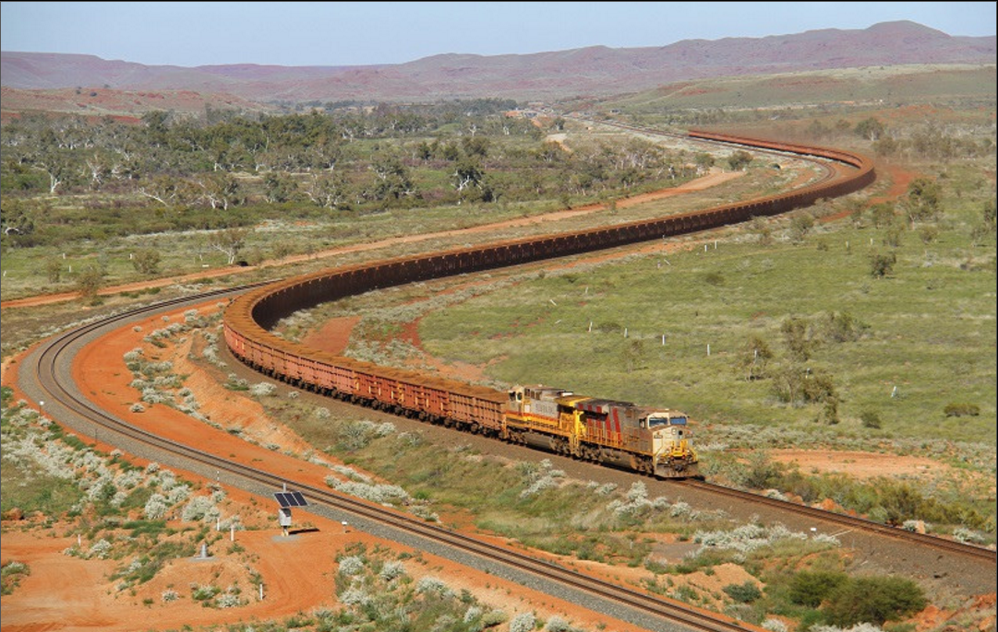


Data Stream Applications
#trending
Track monitoring
#Stock market
#Security

Slide 5
Characteristics of the application
Unbounded (infinite) data – data keeps coming in without boundary
Real time query at any given point in time
Get response quickly
Differ from batch query applied to entire table/data block
Data comes continuously
Uniform rate (e.g., data comes every 1 second)
Bursty (e.g., data records come in one single reading)
Interested in an “event” or trends across time.

Slide 6
Data stream
A data stream is a real-time, continuous, ordered (implicitly by arrival time or explicitly by timestamp) sequence of items.
∞
…
D8
D7
D6
D5
D4
D3
D2
D1
t_{n}
t₀

Slide 7
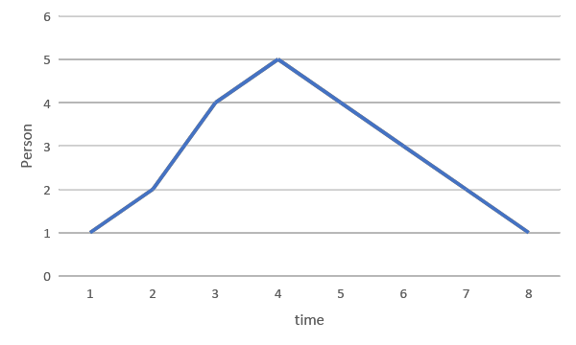
Data Stream Query - Examples
What is the total number of attendees up to tx?
What is the average number of attendees so far? (at time tx)
Will the next number be lower or higher than the current reading?
∞
…
1
2
3
4
5
4
2
1
t_{n}
t₀

Slide 8
What is the total number of attendees up to tx?
Assume memory can only keep 5 tuples.
Query
ACC
Keep an accumulator for the sum. There is no need to keep the tuples.
Possible issues:
What to do with incoming tuples if the incoming tuple arrival rate > processing time?
∞
…
1
2
3
4
5
4
2
1
https://aseigneurin.github.io/2018/08/27/kafka-streams-processing-late-events.html
t_{n}
t₀
Data streams: Can’t keep all incoming data, because data is unbounded
Database: Have persistent storage to store all data
→ Rely on accumulator as a summary of the stream

Slide 9
What is the average number of attendees so far? (at time tx)
Query
ACC
Keep two accumulators for the sum and count. There is no need to keep the tuples.
∞
…
1
2
3
4
5
4
2
1
t_{n}
t₀

Slide 10
Will the next number be lower or higher than the current reading?
Query
Prediction
Prediction may need all/some previous tuples.
Memory can only keep 5 tuples.
What can we do?
∞
…
1
2
3
4
5
4
2
1
Learn from previous data (create summary/model based on previous data)
t_{n}
t₀

Slide 11
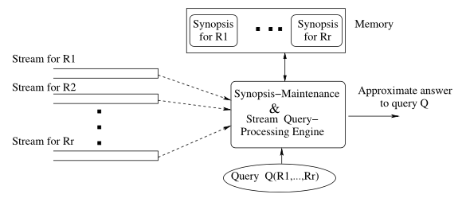
Stream Processing System Architecture
Garofalakis M., Gehrke J., Rastogi R. (2016) Data Stream Management: A Brave New World. In: Garofalakis M., Gehrke J., Rastogi R. (eds) Data Stream Management. Data-Centric Systems and Applications. Springer, Berlin, Heidelberg

Slide 12
Time Decay
Is it possible to reduce the importance of older tuples, without eliminating their influence, on the results of the analysis?
Popular approach: windowing
Query processing is performed only on the tuples inside the window.
Window types:
Time-based
Tuple-based (count-based)

Slide 13
Stream Window – Time Based Window
_{Time}
t_{e}
t_{s}
Window size 2 seconds
Slides 1 second.
∞
…
1
2
3
4
5
4
2
1
t_{n}
t₀
Size of window is specified by fixed time duration
Number of tuples in windows may vary depending on how many tuples are available while processing
It may be high due to bursty arrival of data due to delay in data transfer
Tuples in the windows will be processed, no matter how many tuples in the windows
∞
…
1
2
3
4
5
4
2
1
t_{n}
t₄
t₃
t₂
t₁
t₀

Slide 14
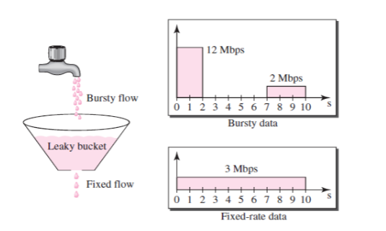
Bursty data
Data rate change suddenly in short time
Image source: https://www.quora.com/What-is-the-difference-between-token-bucket-and-leaky-bucket-algorithms

Slide 15
Stream Window – Time Based Window
_{Time}
t_{e}
t_{s}
Window size 2 seconds
Slides 1 second.
∞
…
1
2
3
4
5
4
2
1
t_{n}
t₃
t₂
t₁
t₀
t₄
_{Overlapping Sliding Window}

Slide 16
Stream Window – Time Based Window
_{Time}
t_{e}
t_{s}
Window size is based on time, eg 2 seconds
Window can be advanced by:
t_{e}-t_{s} (window size)
Duration less than the window size (sliding window).
In uniform data rate, the number of tuples will be the same for each window.
∞
…
1
2
3
4
5
4
2
1
t_{n}
t₄
t₂
t₀
∞
…
1
2
3
4
5
4
2
1
t_{n}
t₄
t₂
t₀
_{Non-Overlapping Sliding Window}
Slide of window is equal to size of window
Two windows are disjoint
No influence of data in previous window on current window

Slide 17
Stream Window – Time Based Window
_{Time}
t_{e}
t_{s}
Window size is based on time, eg 2 seconds
Window can be advanced by:
t_{e}-t_{s} (window size)
Duration less than the window size (sliding window).
In uniform data rate, the number of tuples will be the same for each window.
∞
…
1
2
3
4
5
4
2
1
t_{n}
t₄
t₂
t₀
_{Non-Overlapping Sliding Window}

Slide 18
Stream Window – Tuple Based Window
_{Time}
tp_{e}
Window size is 3 tuples
Slide window by 1 tuple
tp_{s}
∞
…
1
2
3
4
5
4
2
1
Size of window is specified by number of tuples in the window
The window always has a fixed number of tuples
We count the number of tuples and create windows. If the window has required numbers of tuples, then that window will be processed
The time duration of windows may vary
t_{n}
t₆
t₅
t₁
t₀
∞
…
1
2
3
4
5
4
2
1
t_{n}
t₇
t₅
t₁
t₀

Slide 19
Example of Burst Data Arrival
(8,h,12)
(7,g,12)
(3,c,4)
(6,f,12)
(5,e,8)
(4,d,6)
(2,b,4)
(1,a,2)
t₁₂
t₁₀
t₈
t₆
t₄
t₂
t₀
(eventTime, value, processingTime)
Event Time: The time stamp when the data is generated
Processing Time: the time stamp when the data arrived at the processing.

Slide 20
Time Based Window
W₁{(1,a,2),(2,b,4),(3,c,4),(4,d,6)}
W₂{(1,a,2),(2,b,4),(3,c,4),(4,d,6),(5,e,8)}
W₃{(2,b,4),(3,c,4),(4,d,6),(5,e,8)}
W₄{(4,d,6),(5,e,8),(6,f,12),(7,g,12),(8,h,12)}
Processing time window.
Window size 6 units, slide by 2 units
(8,h,12)
(7,g,12)
(3,c,4)
(6,f,12)
(5,e,8)
(4,d,6)
(2,b,4)
(1,a,2)
t₁₂
t₁₀
t₈
t₆
t₄
t₂
t₀

Slide 21
Tuple Based Window
(8,h,12)
(7,g,12)
(3,c,4)
(6,f,12)
(5,e,8)
(4,d,6)
(2,b,4)
(1,a,2)
t₁₂
t₁₀
t₈
t₆
t₄
t₂
t₀
Window size is 3 tuples.
Slide by 1 tuple
W₁{(1,a,2),(2,b,4),(3,c,4)}
W₂{(2,b,4),(3,c,4),(4,d,6)}
W₃{(3,c,4),(4,d,6),(5,e,8)}
W₄{(4,d,6),(5,e,8),(6,f,12)}
Need to drop some of the tuple with processing timestamp 12

Slide 22
Practice Question
A data stream application processes incoming data from a data source. The data source emits a single tuple per second (constant rate). The data are received by the data stream application in the format of (eventTime,value). Once it arrives in the server, the processing timestamp is added to the tuple. The final tuple format after the addition of the processing timestamp is (eventTimestamp, value, processingTimestamp).
Examples of tuples are as followed:
{1,a,1}
{2,b,4}
{3,c,4}
{5,e,6}
{6,f,8}
{7,g,8}
{8,h,9}
{9,i,10}
{10,j,11}
Based on the above data and scenario answer next exercise.

Slide 23
Exercise 2
Let's say we follow a time-based windowing mechanism. The window size is three seconds and the slide is two seconds. Assume the timing start at processing timestamp 1. What will be the content of the third window?
A. {1,a,1}, {2,b,4}, {3,c,4}
B. {2,b,4}, {3,c,4}, {5,e,6}
C. {5,e,6}, {6,f,8}, {7,g,8}
D. {3,c,4}, {5,e,6}, {6,f,8}

Slide 24
Event vs Processing time
Event time: the time when the data is produced by the source.
Processing time: the time when data is arrived at the processing server.
In ideal situation, event time = processing time.
In real world event time is earlier than the processing time due to network delay.
The delay can be uniformed (ideal situation) or non-uniform (most of real network situation).
Data may arrive in “burst” (bursty network).

Slide 25
Database vs Stream Processing
Bounded data (assess to entire data).
Relatively static data
Complex, ad-hoc query
Possible to backtrack during processing
Exact answer to a query
Tuples arrival rate is low
Unbounded data (data keeps coming without end).
Dynamic data.
Simple, continuous query
No backtracking, single pass operation.
Approximate answer to a query
Tuples arrival rate is high
Sliding Window: Produce an approximate answer to a data stream query is to evaluate the query not over the entire past history of data streams, but rather only over sliding windows of recent data from the streams.

