Slide 1

FIT9137 - Assignment 2 2024 Semester 2
Adrian Leong – 27030768
Request For Proposal:
Design Wired/Wireless LANs
and support Backbone Network

Slide 2
The Problem/Scenario
2 new buildings hosting 270 new employees across 3 floors per building
Reliable backbone network connectivity crucial
Frequent access of main office network resources

Slide 3
Project Requirements
Employee capacity = 270 employees across 2x 3-storey buildings
45 employees/floor
50 wired devices/floor
30 Mbps wired traffic per user
1000 Mbps peak total wired traffic
Ethernet connections for all employee PCs
200 Mbps peak total WLAN traffic
Backbone network connectivity at all times
Frequent access of main office network resources

Slide 4
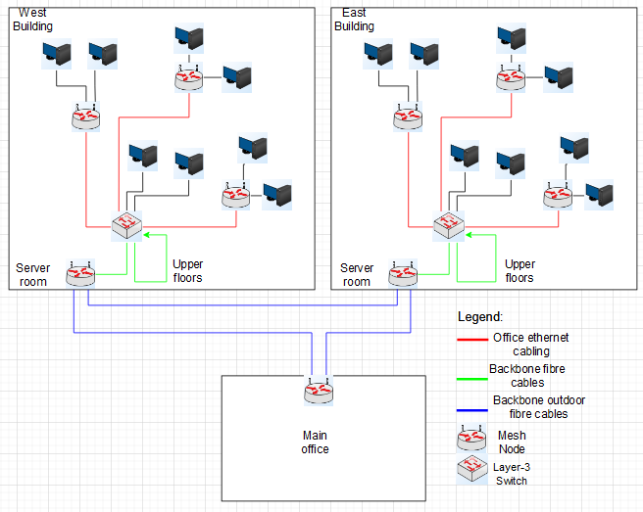
Conceptual plan: Mesh Network
Mesh nodes provide stable wireless network
Wireless network will run both 2.4GHz and 5GHz band for compatibility with more devices
Switches connect user PCs to hub to then connect with each building’s server room

Slide 5
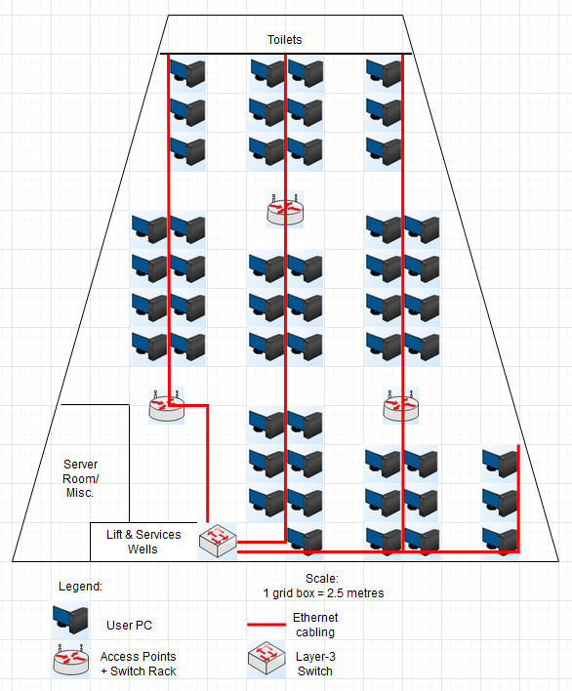
General floor plan - East building
Cat5+ Ethernet cables for user PCs
Mesh nodes ensure WiFi stability
Mesh node placements ensure max of 12.5m distance from a mesh node
Switches to handle ethernet port cabling limits

Slide 6
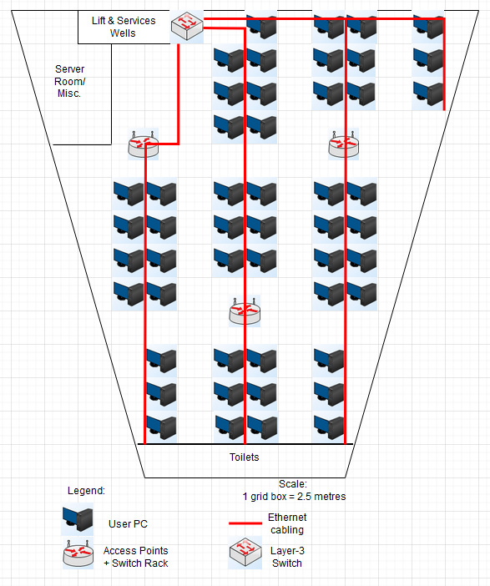
General floor plan - West building (symmetric mirror)
Cat5+ Ethernet cables for user PCs
Mesh nodes ensure WiFi stability
Mesh node placements ensure max of 12.5m distance from a mesh node
Switches to handle ethernet port cabling limits

Slide 7
Hardware Specifications
Switch hub next to the lift and services well needs to be a layer-3 switch to connect with the other buildings and floors.
Switches at the mesh node switch racks can be layer-2 switches, but for easier procurement/management we still use layer-3 switches.
Mesh nodes are used to function as both the routers and access points required.
Stable network, as routers become interchangeable.
Switches are still necessary to handle the many ethernet ports required.
Mesh nodes are in a triangle formation to provide optimal radial coverage matching building shape. Switches are also there to save space (both ethernet port space and convenient physical location).
Indoor ethernet cabling can be any Cat5+ cables - cheap and good enough
Backbone network cabling between switches and mesh nodes should be fibre optics - very high data transfer requirements needed

Slide 8
The Math - Network traffic
Recommended throughput per floor/building/backbone network:
50/150/600 wired devices
30 Mbps per user wired traffic
1200/3600/14400 Mbps peak total wired traffic
240/720/2880 Mbps peak total WLAN traffic
Calculations:
(270 new employees/3 floors)/2 buildings = 45 employees/floor
Peak active users = 200 across both buildings and all floors
200 users/6 floors = 33.33 ~= 34 peak users per floor
30 Mbps wired traffic per user x 34 peak users = 1020 Mbps peak wired traffic
WLAN traffic = 20% of wired traffic = 204 Mbps peak WLAN traffic For safety, it is recommended to allocate up to about 20% more than the modelled peak usage to allow for fluctuations, so we round these figures up.
Backbone network includes existing main building, which has almost the same capacity as both new buildings combined

Slide 9
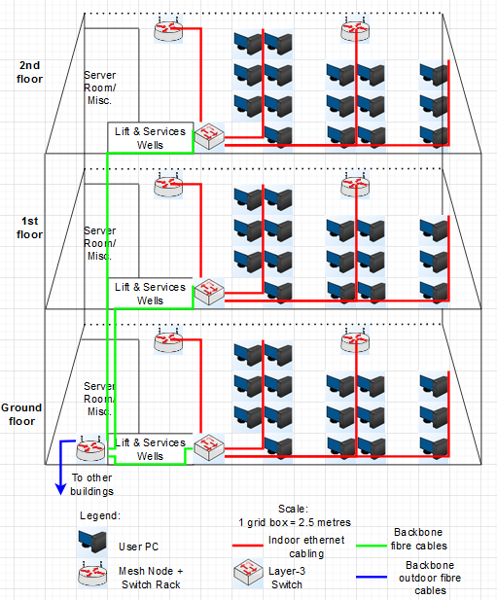
Backbone connection diagrams (vertical view)
Cat5+ Ethernet cables for user PCs
Mesh nodes ensure WiFi stability
Mesh node placements ensure max of 12.5m distance from a mesh node
Switches to handle ethernet port cabling limit
Fibre optic cables for backbone cabling between floors/other buildings
Cable length from server to switches is 8m/11m/14m to ground floor/1st floor/2nd floor respectively

Slide 10
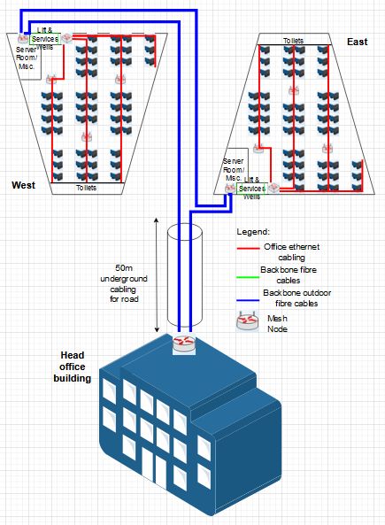
Building-level backbone network connectivity
Cat5+ Ethernet cables for user PCs
Mesh nodes ensure WiFi stability
Mesh node placements ensure max of 12.5m distance from a mesh node
Switches to handle ethernet port cabling limit
Fibre optic cables for backbone cabling between floors/other buildings
Underground cabling to cross the road

Slide 11
Potential unethical behaviour on network:
Potential unethical activities by employees:
Employees could access confidential data they are unauthorized for
Employees could distribute confidential data they are authorized for to others
Employees could delete important data as they leave

Slide 12
Ethical Network Usage policy:
Potential mitigating policy directives:
Network filtering/monitoring: block unauthorized/inappropriate sites, log employee data access to monitor any unusual employee data access
User authentication: mandate admin authorization for employees to access confidential data. For even more secure actions, mandate double authorization.
Backups: store multiple backups of data and restrict access to these backups in case of an employee deleting data as they leave

Slide 13
Conclusion
For highly reliable wireless network, use mesh nodes
If one router goes down, another node will take its place as the new router
All other nodes will be access points to extend network range
Use 2.4GHz/5GHz dual-band for wider device compatibility support
Use fibre optic cables for crucial backbone network cabling
Individual employee connections have smaller loads and can use normal Cat5+ cables
Use layer-3 switches at each floor for VLAN between floors and buildings

Slide 14
References
I used Gemini (https://gemini.google.com) for explaining to me the key concepts and how these work
James Freeman (2024). Icons of network diagram symbols. https://www.edrawsoft.com/logical-network-symbols.html

