Slide 1

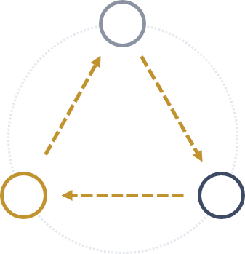


CLOSING THE LOOP · INDIVIDUAL FIELDWORK PRESENTATION
The Loop We Keep Losing People In
Megan Whinna August 2026
1
THE LOOP
"Does anyone need me?"
2
THE FIELD
Pew's Four Engagement Segments
OUTSIDER
MOBILIZERS
CONNECTORS
3 · DROP OFF –IMPACT: ACT AGAIN
1 · DROP OFF – WANT TO ACT
28%
37%
9%
65%
doubt their involvement would make a difference
THE CHOICE
TO CONTINUE
ENGAGING
say community decisions are dominated by the same "usual suspects"
“What can I actually do?"
Community Engaged
“Did I have an impact?"
Do It All
SPECTATORS
OUTSIDERS
SPECTATOR
31%
31%
CONNECTOR
2 · DROP OFF – KNOW HOW TO ACT
9%
Follow Along
Total Disconnect
of people say they receive public information on time
Pew Research Center, "How Americans Are Engaged..." (2026)
3
THE QUESTION
CIRCLE/Tufts 2026 · National Civic League 2025 — full citations in the companion briefing
Where exactly do we lose Connectors, Spectators, and Outsiders — and what would it take to keep them in the loop?

Slide 2
