Slide 1
Méthode PERT

Slide 2
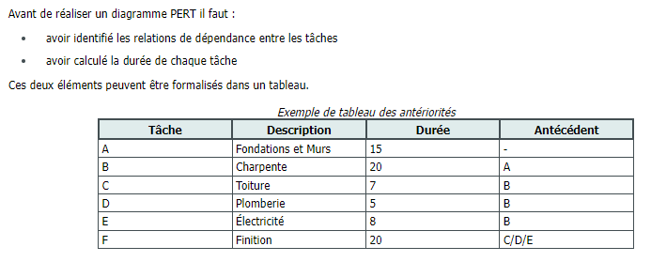

Slide 3
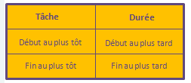


Slide 4
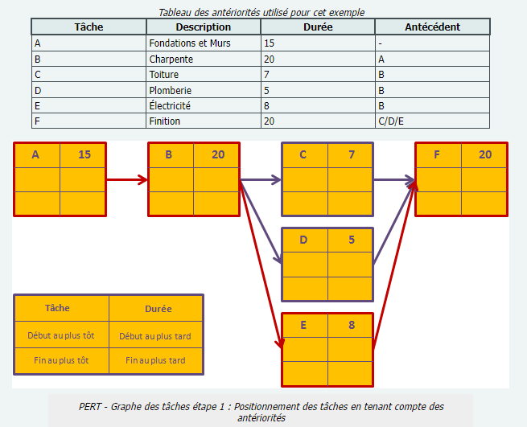

Slide 5
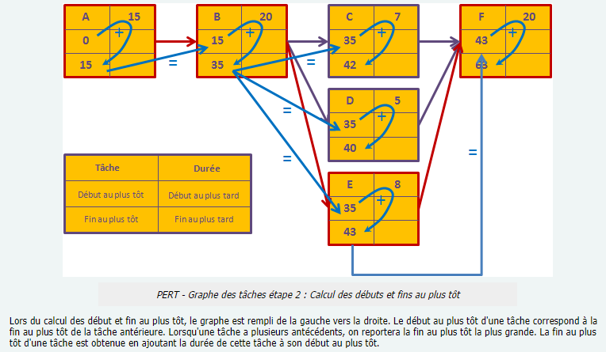

Slide 6
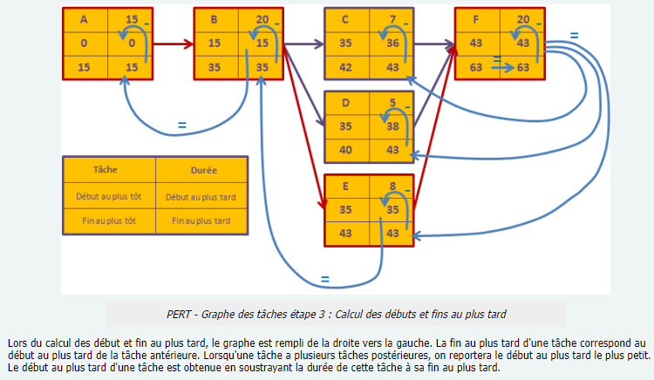

Slide 7
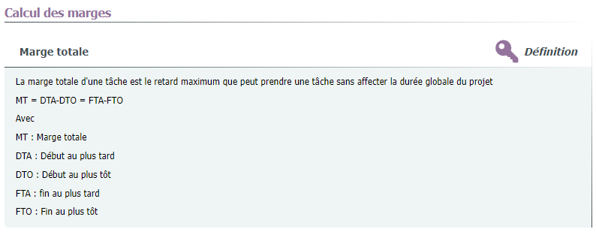

Slide 8
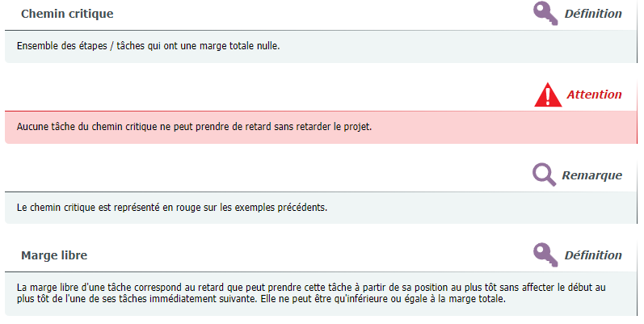

Slide 9
Source:
https://moreauva.scenari-community.org/MP_02-DefinitionProjet_web/co/methodePERT.html

