Slide 1


Dataset design Dashboard
Amal Vaishnav Srithanvi Uddaraju Sahil Sood Varun Varia

Slide 2
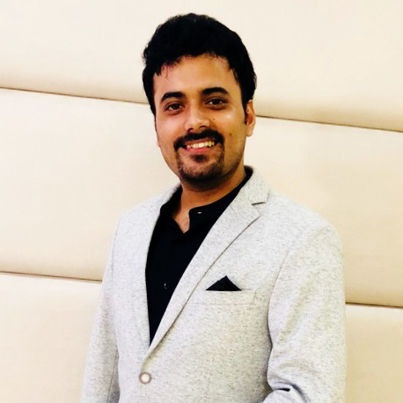



Sahil Sood CEO Programmer Analyst at Cognizant Technology
MEET OUR DREAM TEAM’S LEADERSHIP
Varun Varia CTO Business Analyst at FinIQ Consulting
Amal Vaishnav COO Software Development intern at Lintel Technologies
Srithanvi Uddaraju CFO Technical Manager at IEEE

Slide 3
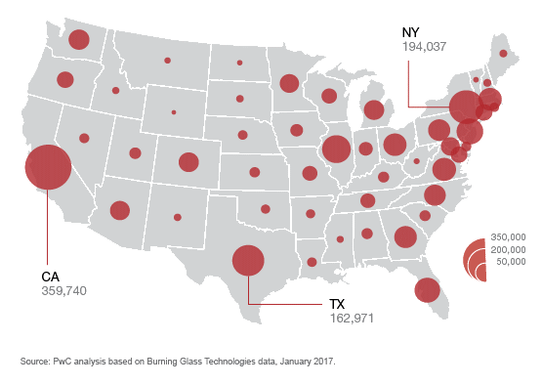

Data Science Everywhere
California ranked highest amongst all other states with 359,740 competitors
New York 2nd with 194,037 enthusiasts
Texas in south with 162,971 enthusiast
Talent spread out all across the country

Slide 4

Requirement #1
Google the term Big Data, you will get 94,300,000 results in about 1.14 seconds
How is the Size of Data important?
http://blogs.verdantis.com/data-credibility-critical-dimension-data-quality-2/

Slide 5
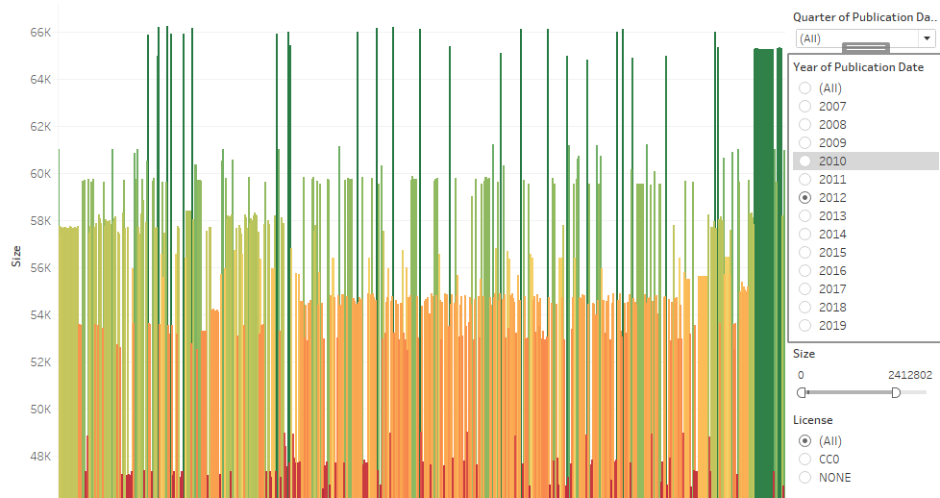

Slide 6

Requirement #2
Data credibility is the extent to which the good faith of a provider of data or source of data can be relied upon to ensure that the data really represents is what the data is supposed to represent, and that there is no intent to misrepresent what the data is supposed to represent.”

Slide 7
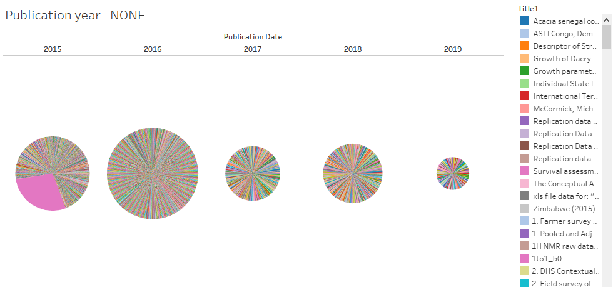

Slide 8
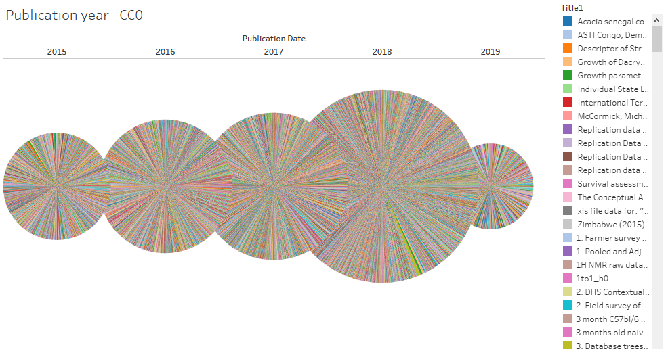

Slide 9

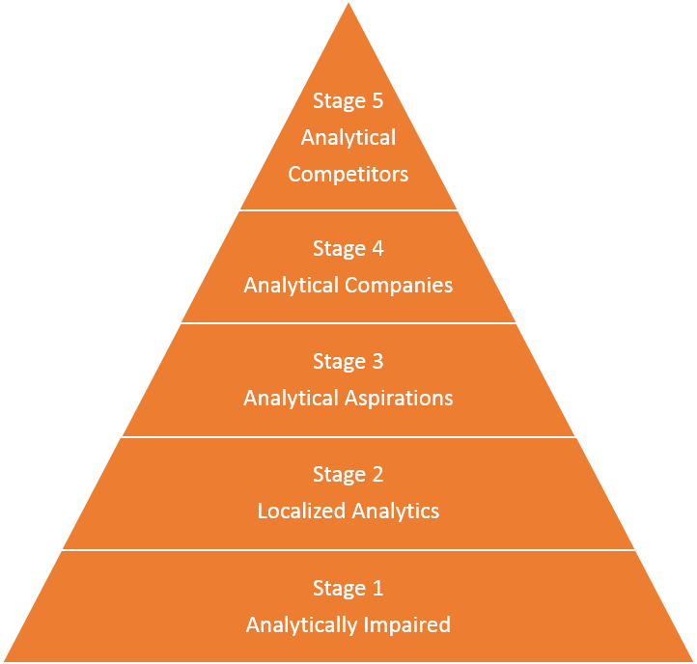
Requirement #3
Does age matter? Perhaps not, but maturity certainly does. The level of analytics maturity, in particular, makes a big difference to the options open to companies, and the strategies that they can adopt to get best value from analytics.

Slide 10
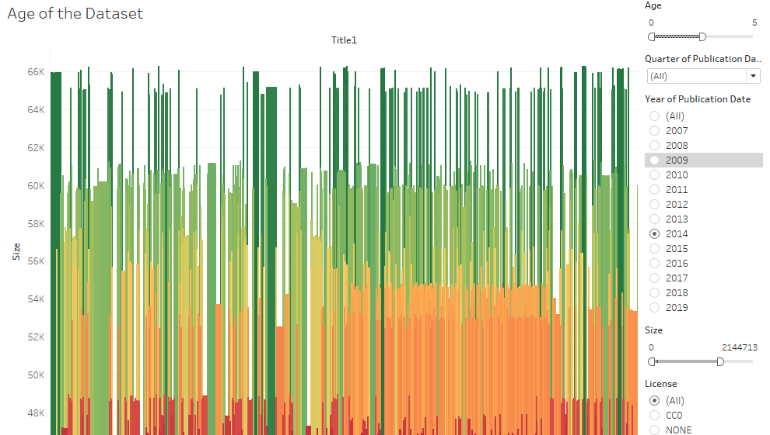

Slide 11
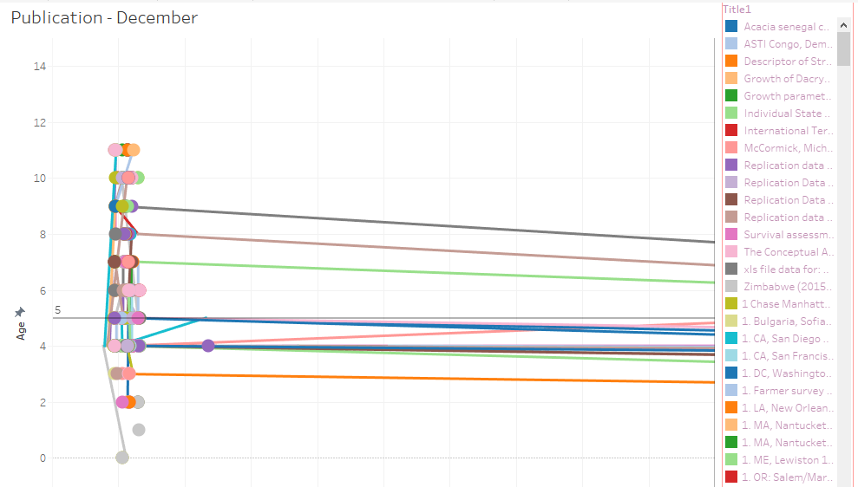

Slide 12
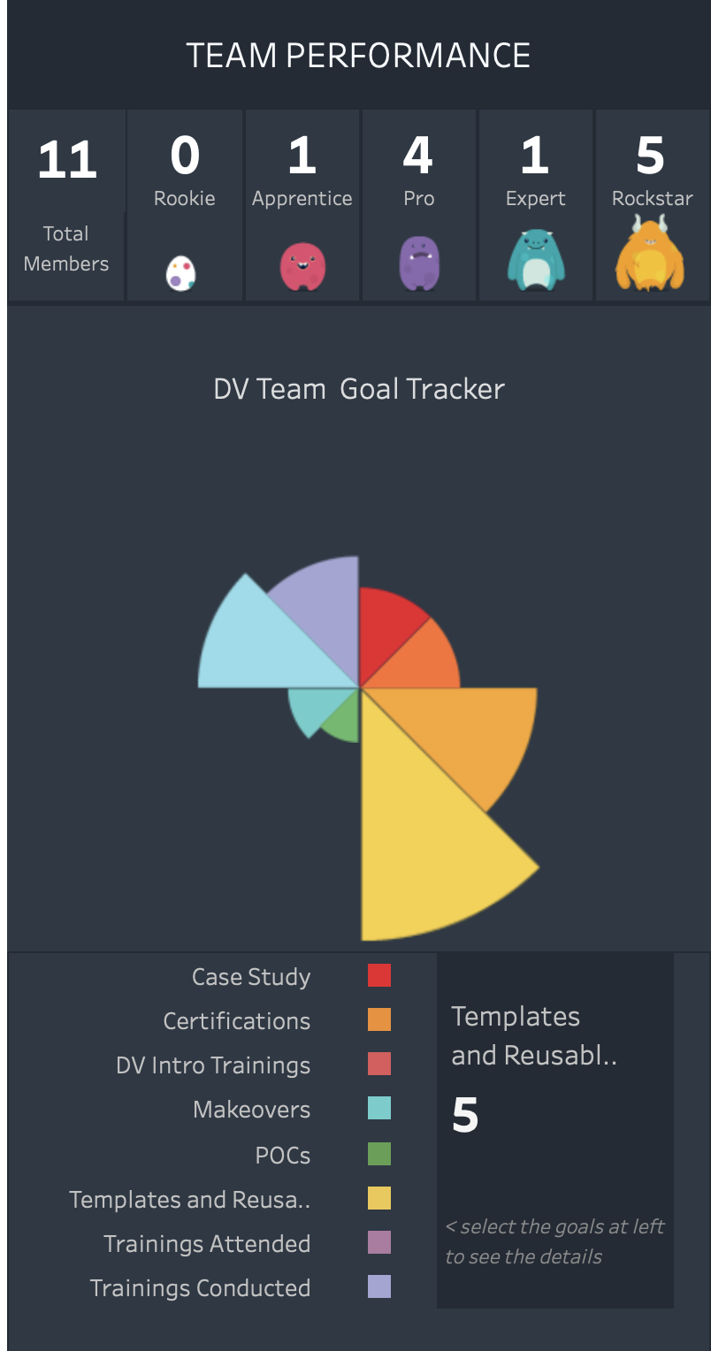
Future Work
Create a competition for students, professional, and display real time results
https://public.tableau.com/profile/ratnesh2928#!/vizhome/PerformanceGamification_GenericVersion/PerformanceGamification

Slide 13
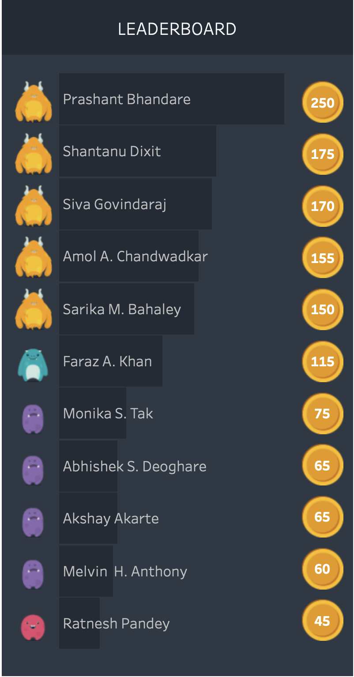
Future Work
Display the leaderboard
https://public.tableau.com/profile/ratnesh2928#!/vizhome/PerformanceGamification_GenericVersion/PerformanceGamification

Slide 14
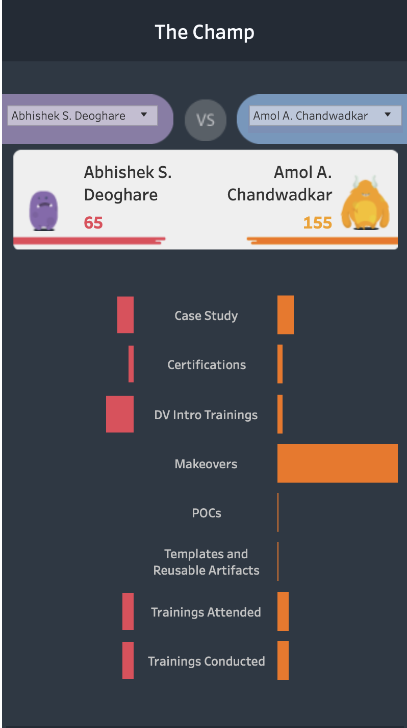
Future Work
Head to head
https://public.tableau.com/profile/ratnesh2928#!/vizhome/PerformanceGamification_GenericVersion/PerformanceGamification

Slide 15
Questions?
I hope Google will consider investing in Kaggle.

