Slide 1

Ecommerce Customer

Slide 2
Contents
Problem Statement
Business objective
Data Preprocessing
Visualization
Model Building
Deployment
Conclusion
Challenges Faced and potential solutions

Slide 3

Problem Statement
APP
Website
The problem is to determine whether the ecommerce company should focus its efforts on improving the mobile app experience or the website, based on customer behavior and sales data.

Slide 4
Business Objective
Analyze customer engagement metrics such as session length, app usage, website activity, and membership duration to identify the key drivers of annual income.
Build a predictive model to forecast yearly customer spending, enabling data-driven strategies to enhance platform performance.

Slide 5
Data Preprocessing
1
Dataset contains 500 rows and 8 col.
There are
8 rows
X features : 4 rows
Y feature : 1 row
Remove unwanted features: Email, Address and Avatar
Missing Values and duplicates.
No null values
No duplicates
Outliers.
Outliers are Removed
Standardizing the data.

Slide 6
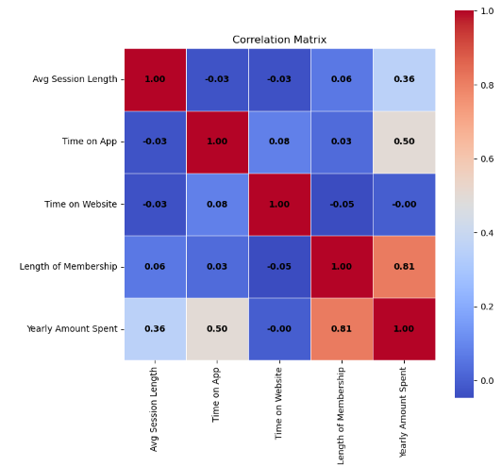
Correlation Matrix
Visualization
Key Insights
Strong correlation between Length of Membership (0.81) and Yearly Amount Spent, followed by Time on App (0.50).

Slide 7
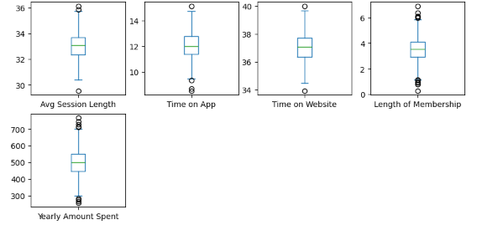
Outliers detection
Outliers are observed in "Length of Membership" and "Yearly Amount Spent," indicating potential anomalies or unique customer segments.
Treating outliers through detailed analysis can help refine predictions and improve model performance.

Slide 8
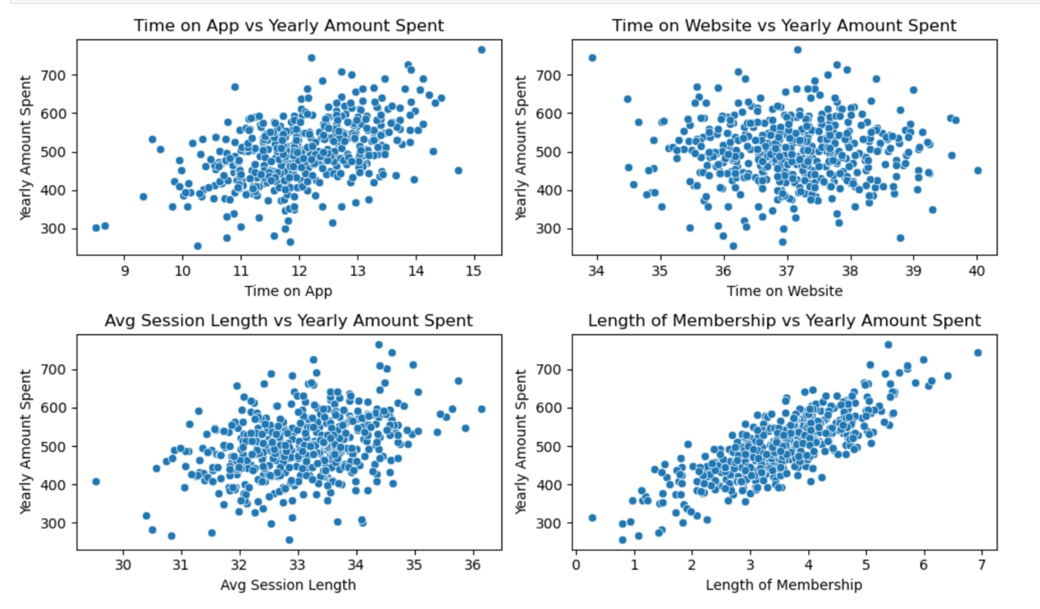
Scatterplot
Customer spending is most strongly influenced by the length of membership, showing a clear positive correlation. Time on the app and average session length also moderately impact spending, while time on the website has a weaker effect.

Slide 9
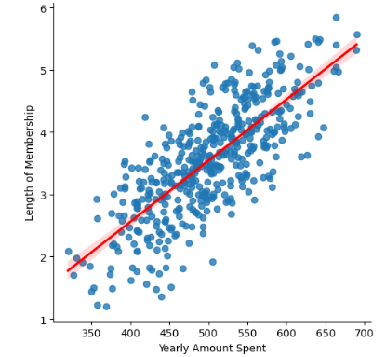
Lmplot
Lmplot to show how data is scattered along the regression line

Slide 10
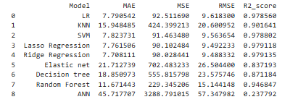
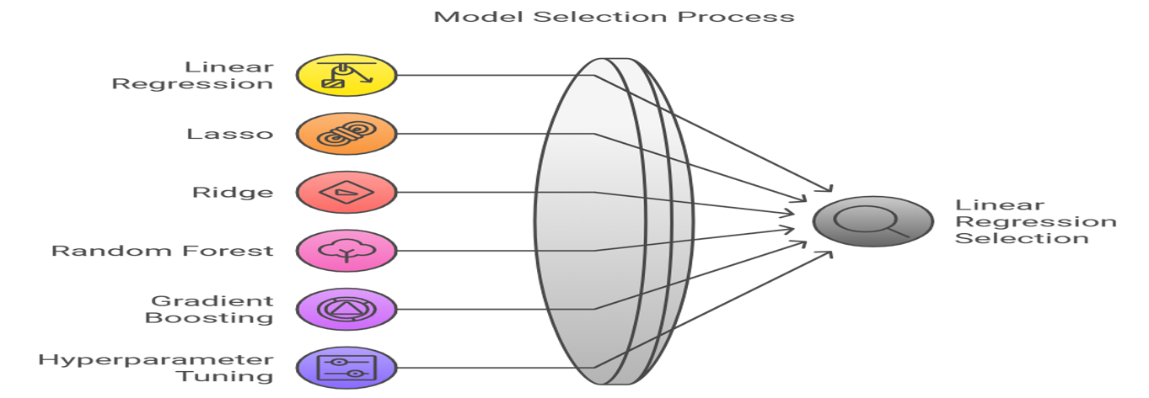
Model Selection
The models were evaluated using R-squared and RMSE as the primary metrics. While Lasso Regression and Ridge Regression showed strong performance during testing, Linear Regression offered a good balance of simplicity and accuracy, making it the best choice for deployment.

Slide 11
The Linear Regression model effectively predicts the Yearly Amount Spent by customers using the provided features.
R² (Coefficient of Determination): Demonstrates the model's strong explanatory power, indicating a high level of variance in the dependent variable is captured by the independent features
Mean Squared Error (MSE): Shows the model's accuracy, with low MSE reflecting minimal prediction error between the predicted and actual values.
Overall, Linear Regression offers a balance between simplicity and predictive accuracy, making it suitable for deployment in forecasting customer spending
Concluded

Slide 12
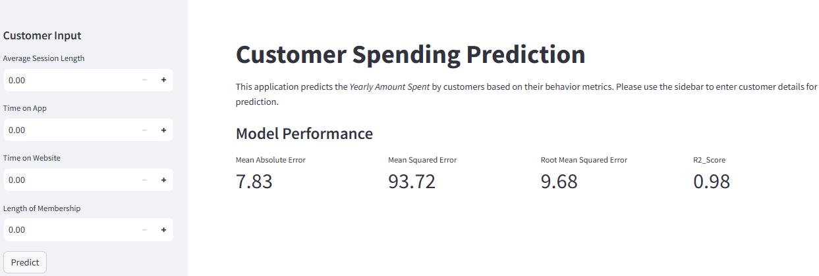
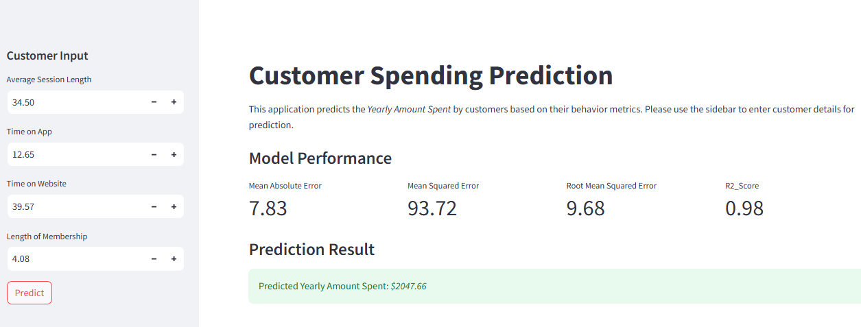
Deployment

Slide 13
Challenges Faced and Potential Solutions
Should delete the first three columns, or should Keep them ?
After Careful observation it was determined that the first three columns were unnecessary.
Given that the outlier percentage is very small, is there a need to drop the outliers?
We dropped the outliers present in the dataset.
Model Selection
The models were evaluated using R-squared and RMSE as the primary metrics. While Lasso Regression and Ridge Regression showed strong performance during testing, Linear Regression offered a good balance of simplicity and accuracy, making it the best choice for deployment.

Slide 14
Group-6
Jeeshan Ansari
Abhesh Roy
Abdul Raheem
Vedansh Dixit
A K Sharath Rao
Parmishetty Bharath
Gorantla Gopi Siva Koteswara Roa

Slide 15
Thank You

