Slide 1
AN alternative approach to FIRST LEGO LEGUE ROBOTS: MINIMIZING Attachments
HOTSHOT HOTWIRES

Slide 2
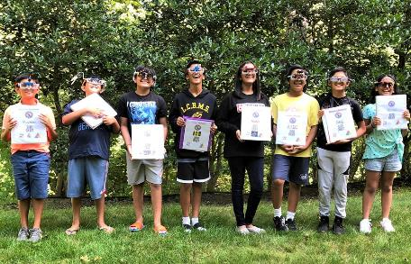
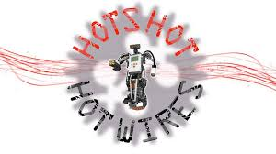
About the Author
The Hotshot Hotwires is a community-based FIRST LEGO League team in the mid Hudson Valley region of New York.
The team started in 2012, although all of the original coaches and students have graduated.
The photograph is of our 2018-19 team, comprised of 5th-8th graders.

Slide 3
The Conventional Approach
A common approach to robot design by many experienced teams is as follows:
Build a base robot for mobility, with access to power from two motors (the other two of the four motors are used to drive the robot).
Build attachments that draw power from the motors on the base robot. Each attachment performs a few missions.
Change attachments between programs.
Rubber bands or pneumatics can be used as additional power sources.

Slide 4
A Simple and Effective Alternative
Goal: obtain a respectable score…
Without using complex attachments
While minimizing attachment change
Approach:
Combining actuators so that when one or both motors move, it enables the robot to perform a wide variety of missions.
Enables simultaneous and independent movement in all three axes of 3D space, like a 3D printer.

Slide 5
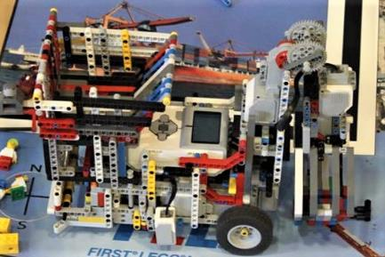
No Additional ATTACHMENTS
Sometimes, it might be possible to solve several missions with no added attachments on your robot
Pros: Saves time in base, reduces errors, and reduces complexity
Cons: May not be able to complete all missions, but will complete most
Examples:
Watch the video to see our robot complete more than half the missions in one program with no attachments added to the robot : https://youtu.be/0rPKrHTP688

Slide 6
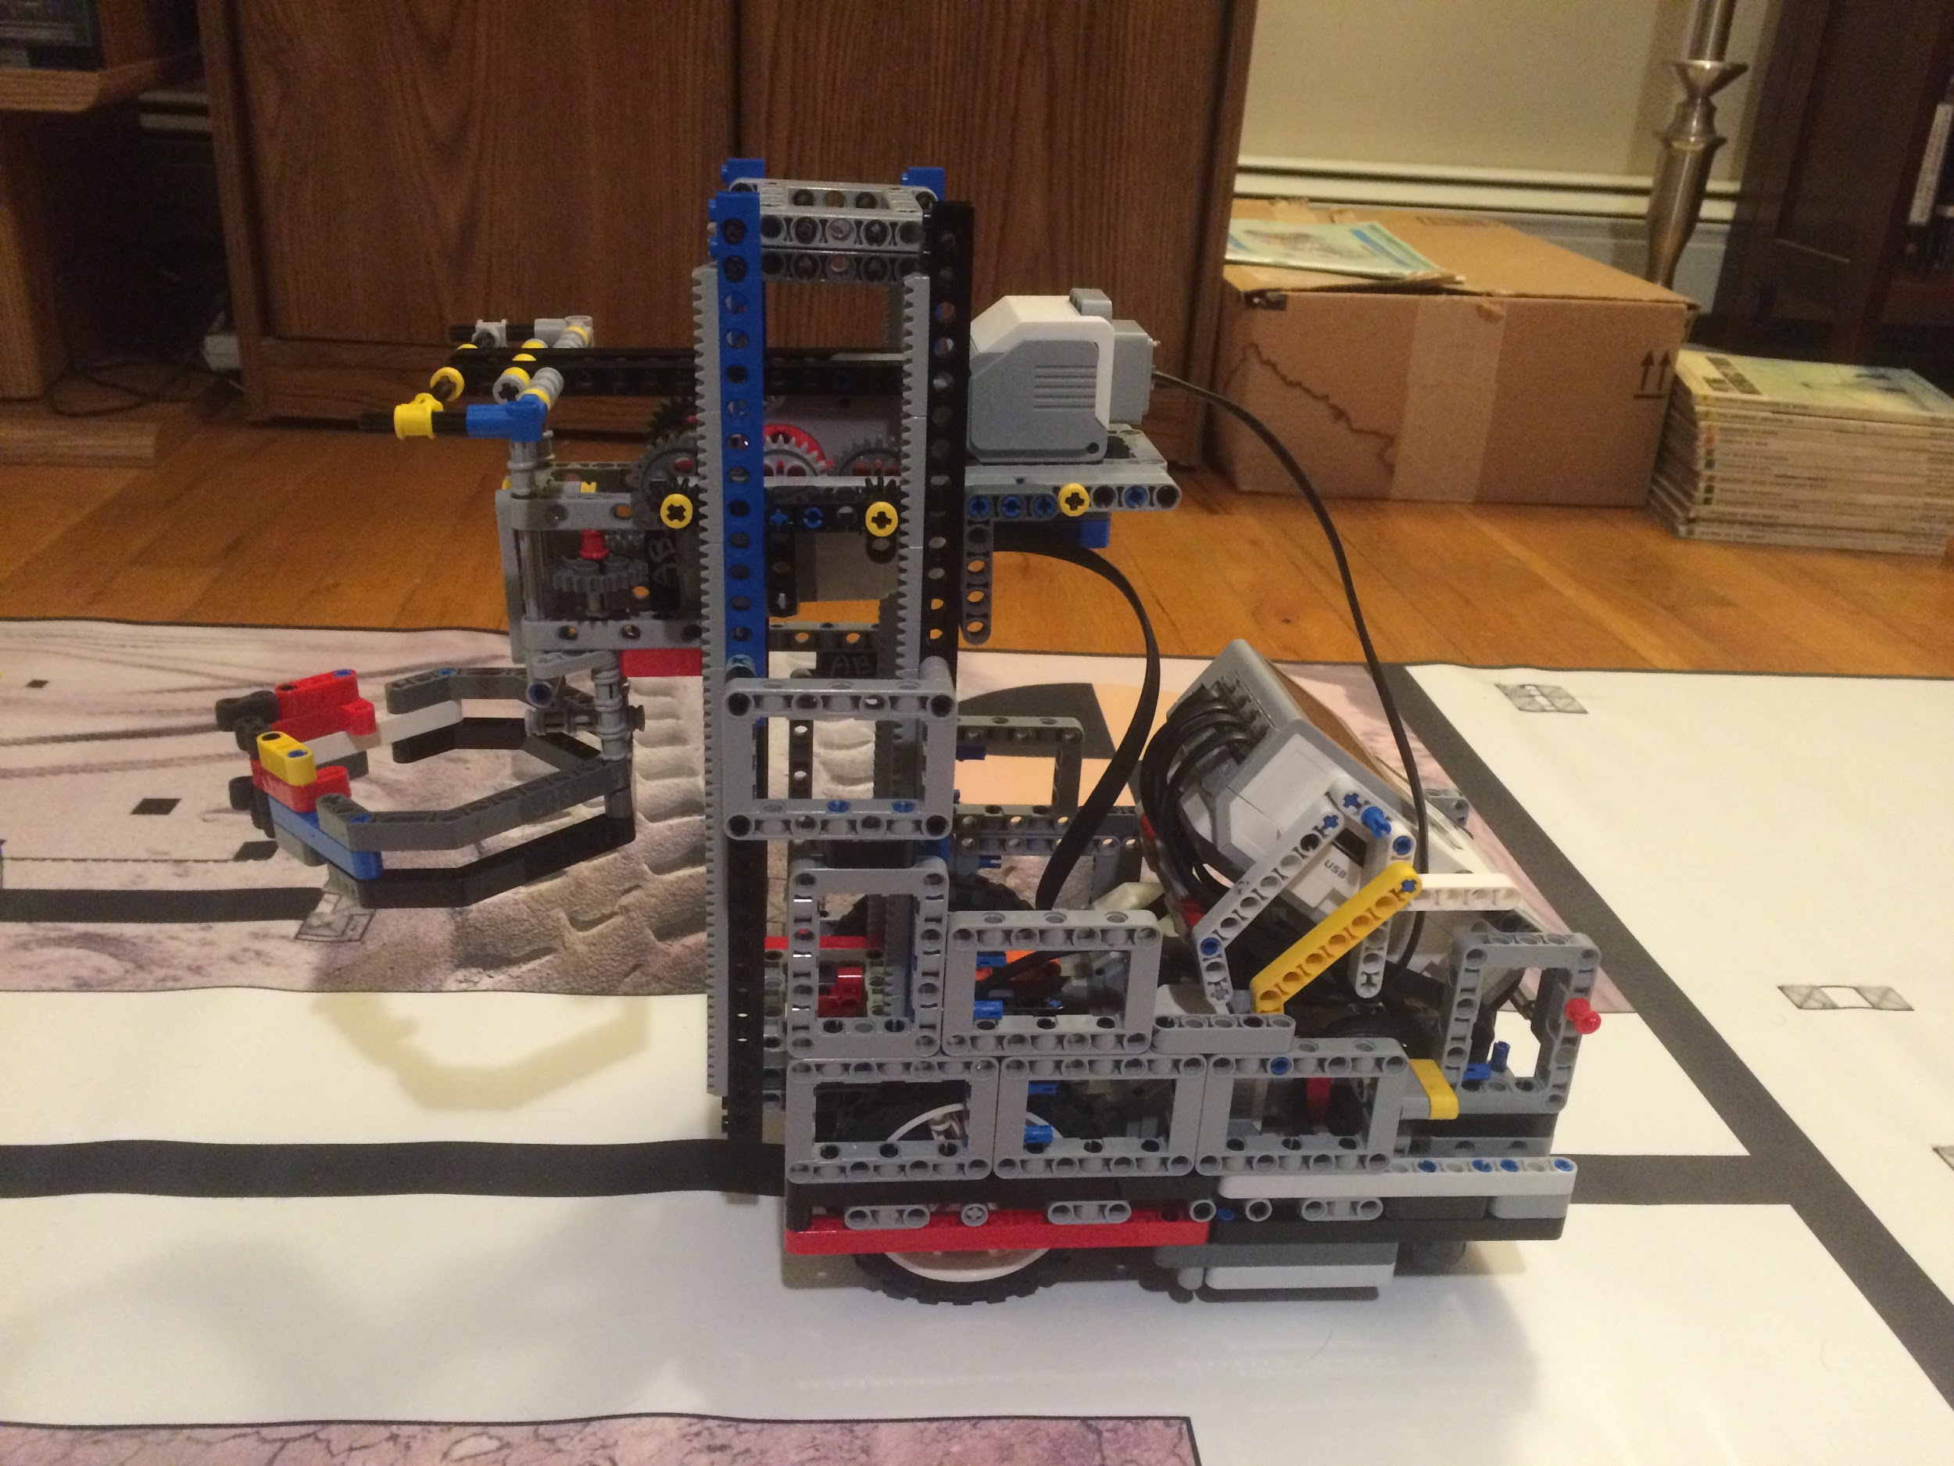
No ATTACHMENT SYSTEM
If you plan to add nothing to your robot, then you have to think about what versatile tool that would complete the most missions
Hotshot Hotwires recommends learning to make a forklift and learning to make a claw
This allows for up-down and grab-release movements that are universally needed for FIRST LEGO League missions

Slide 7
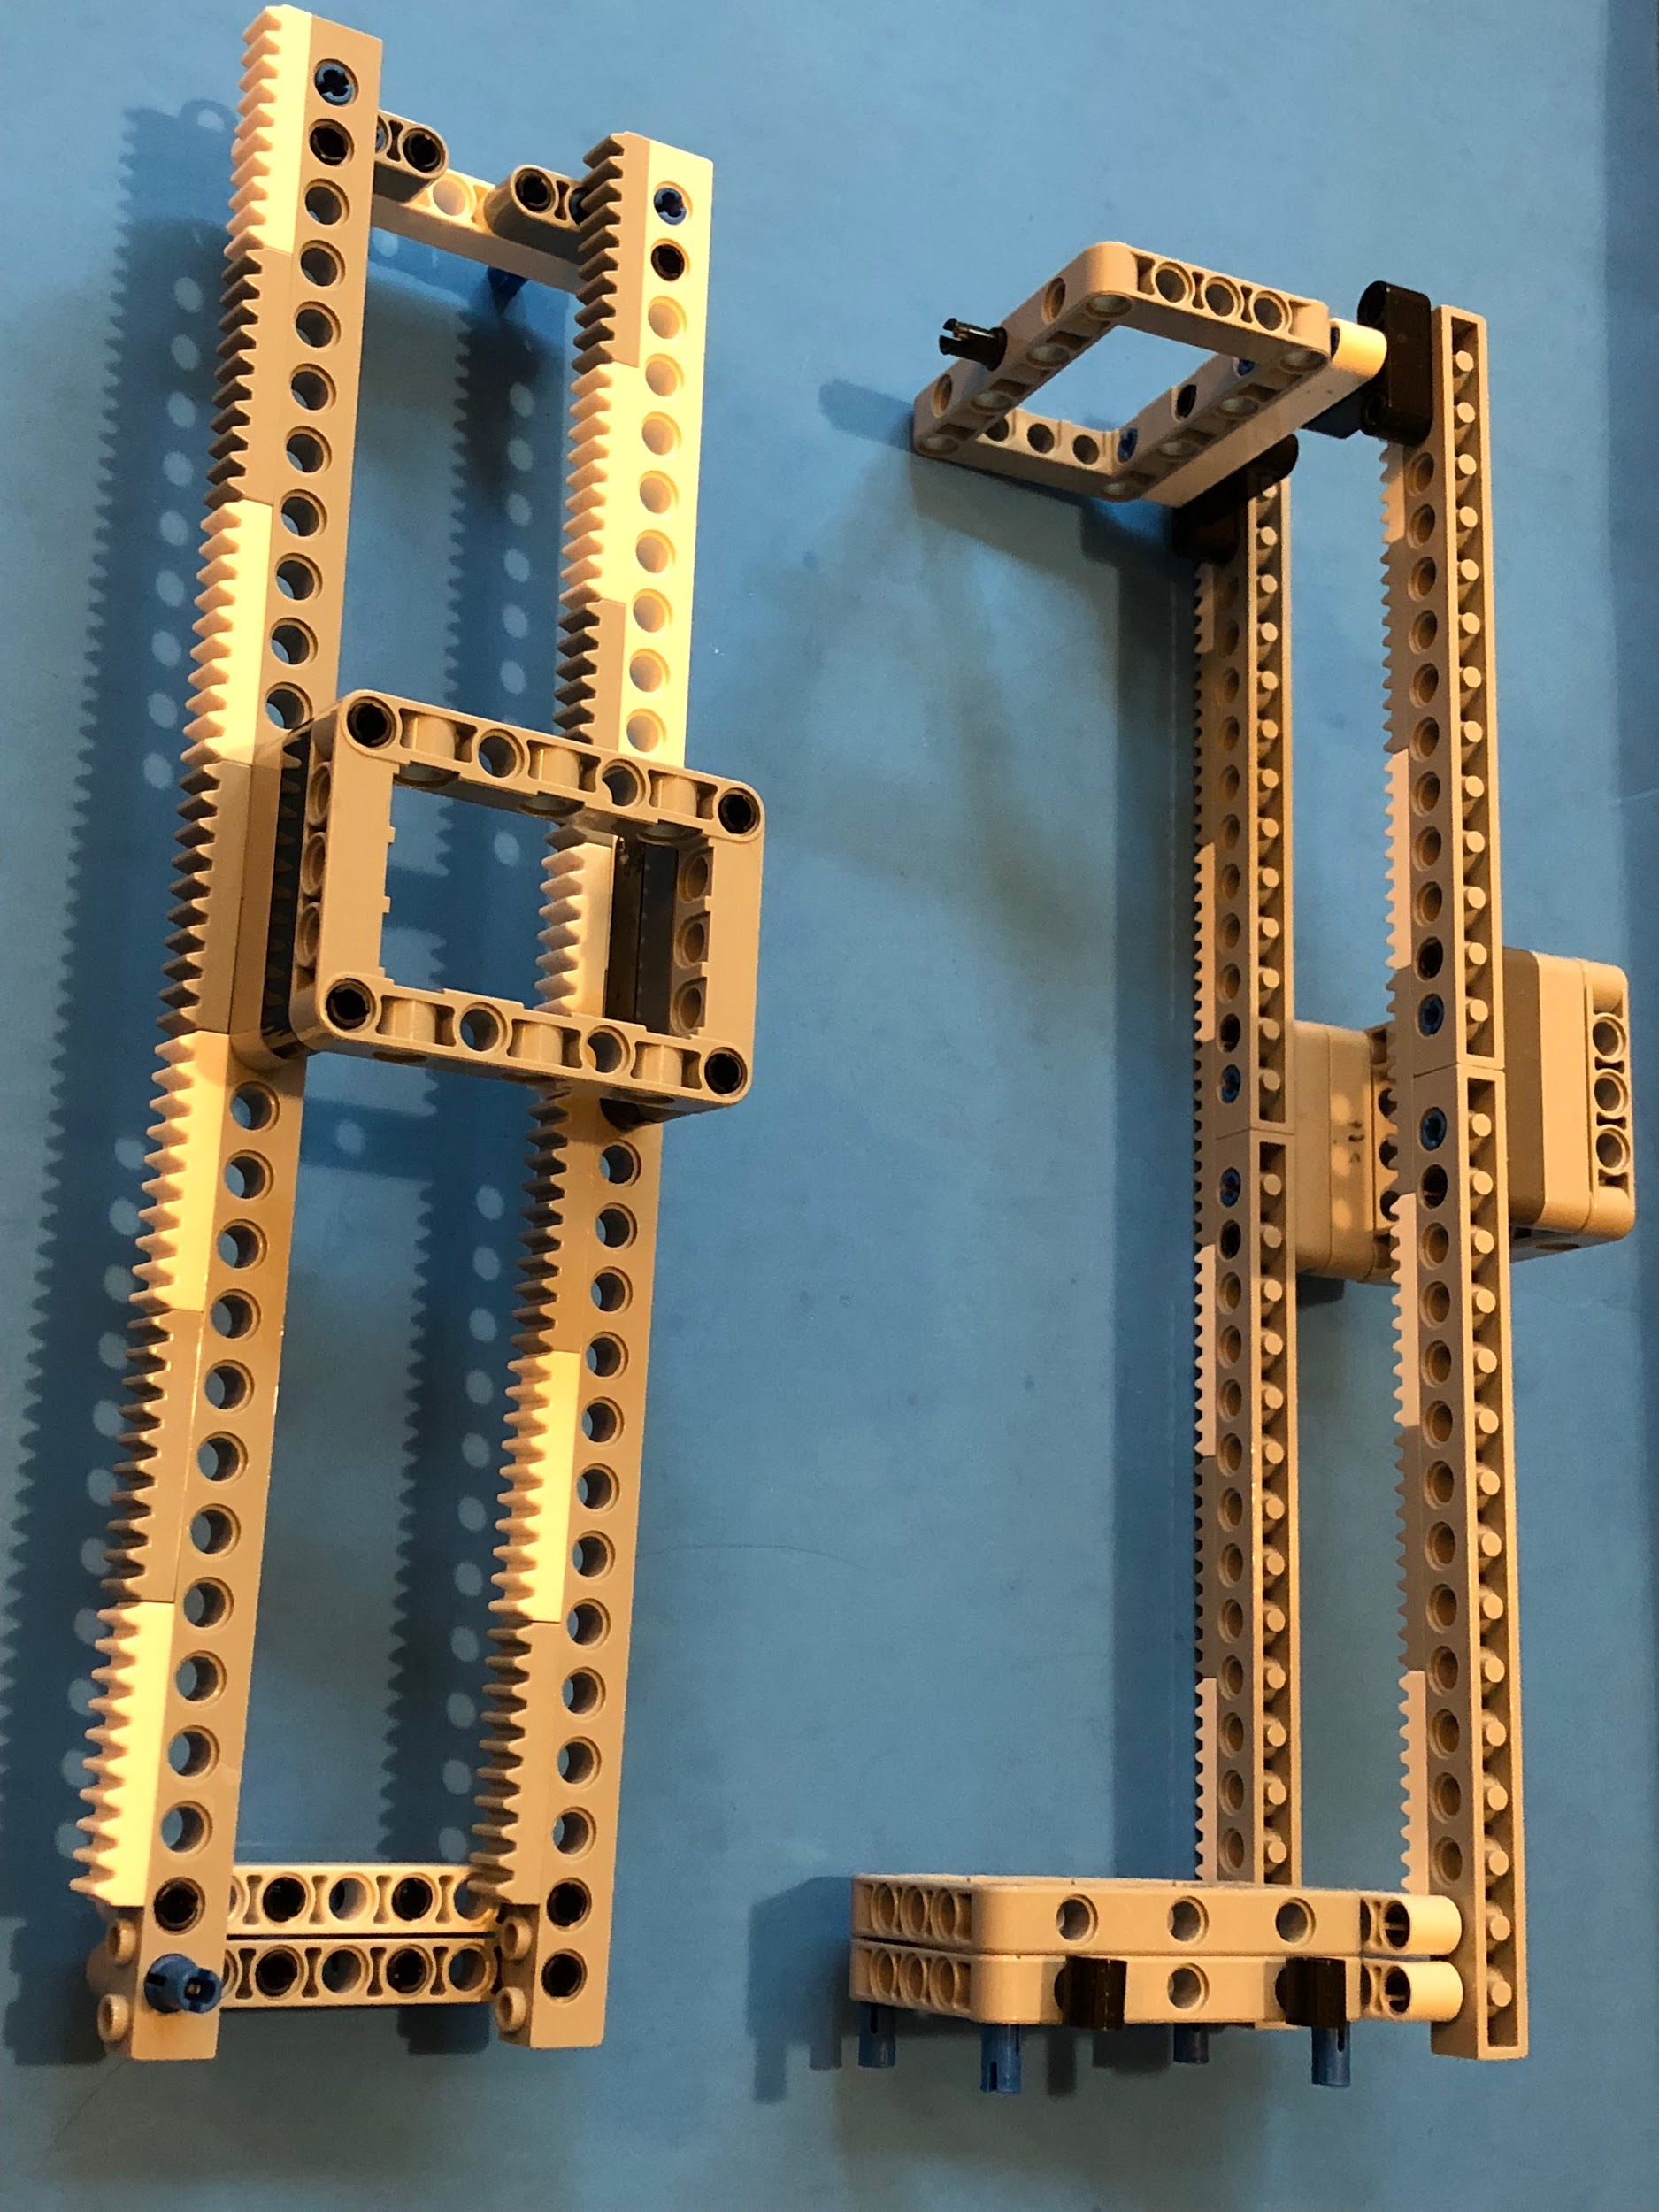
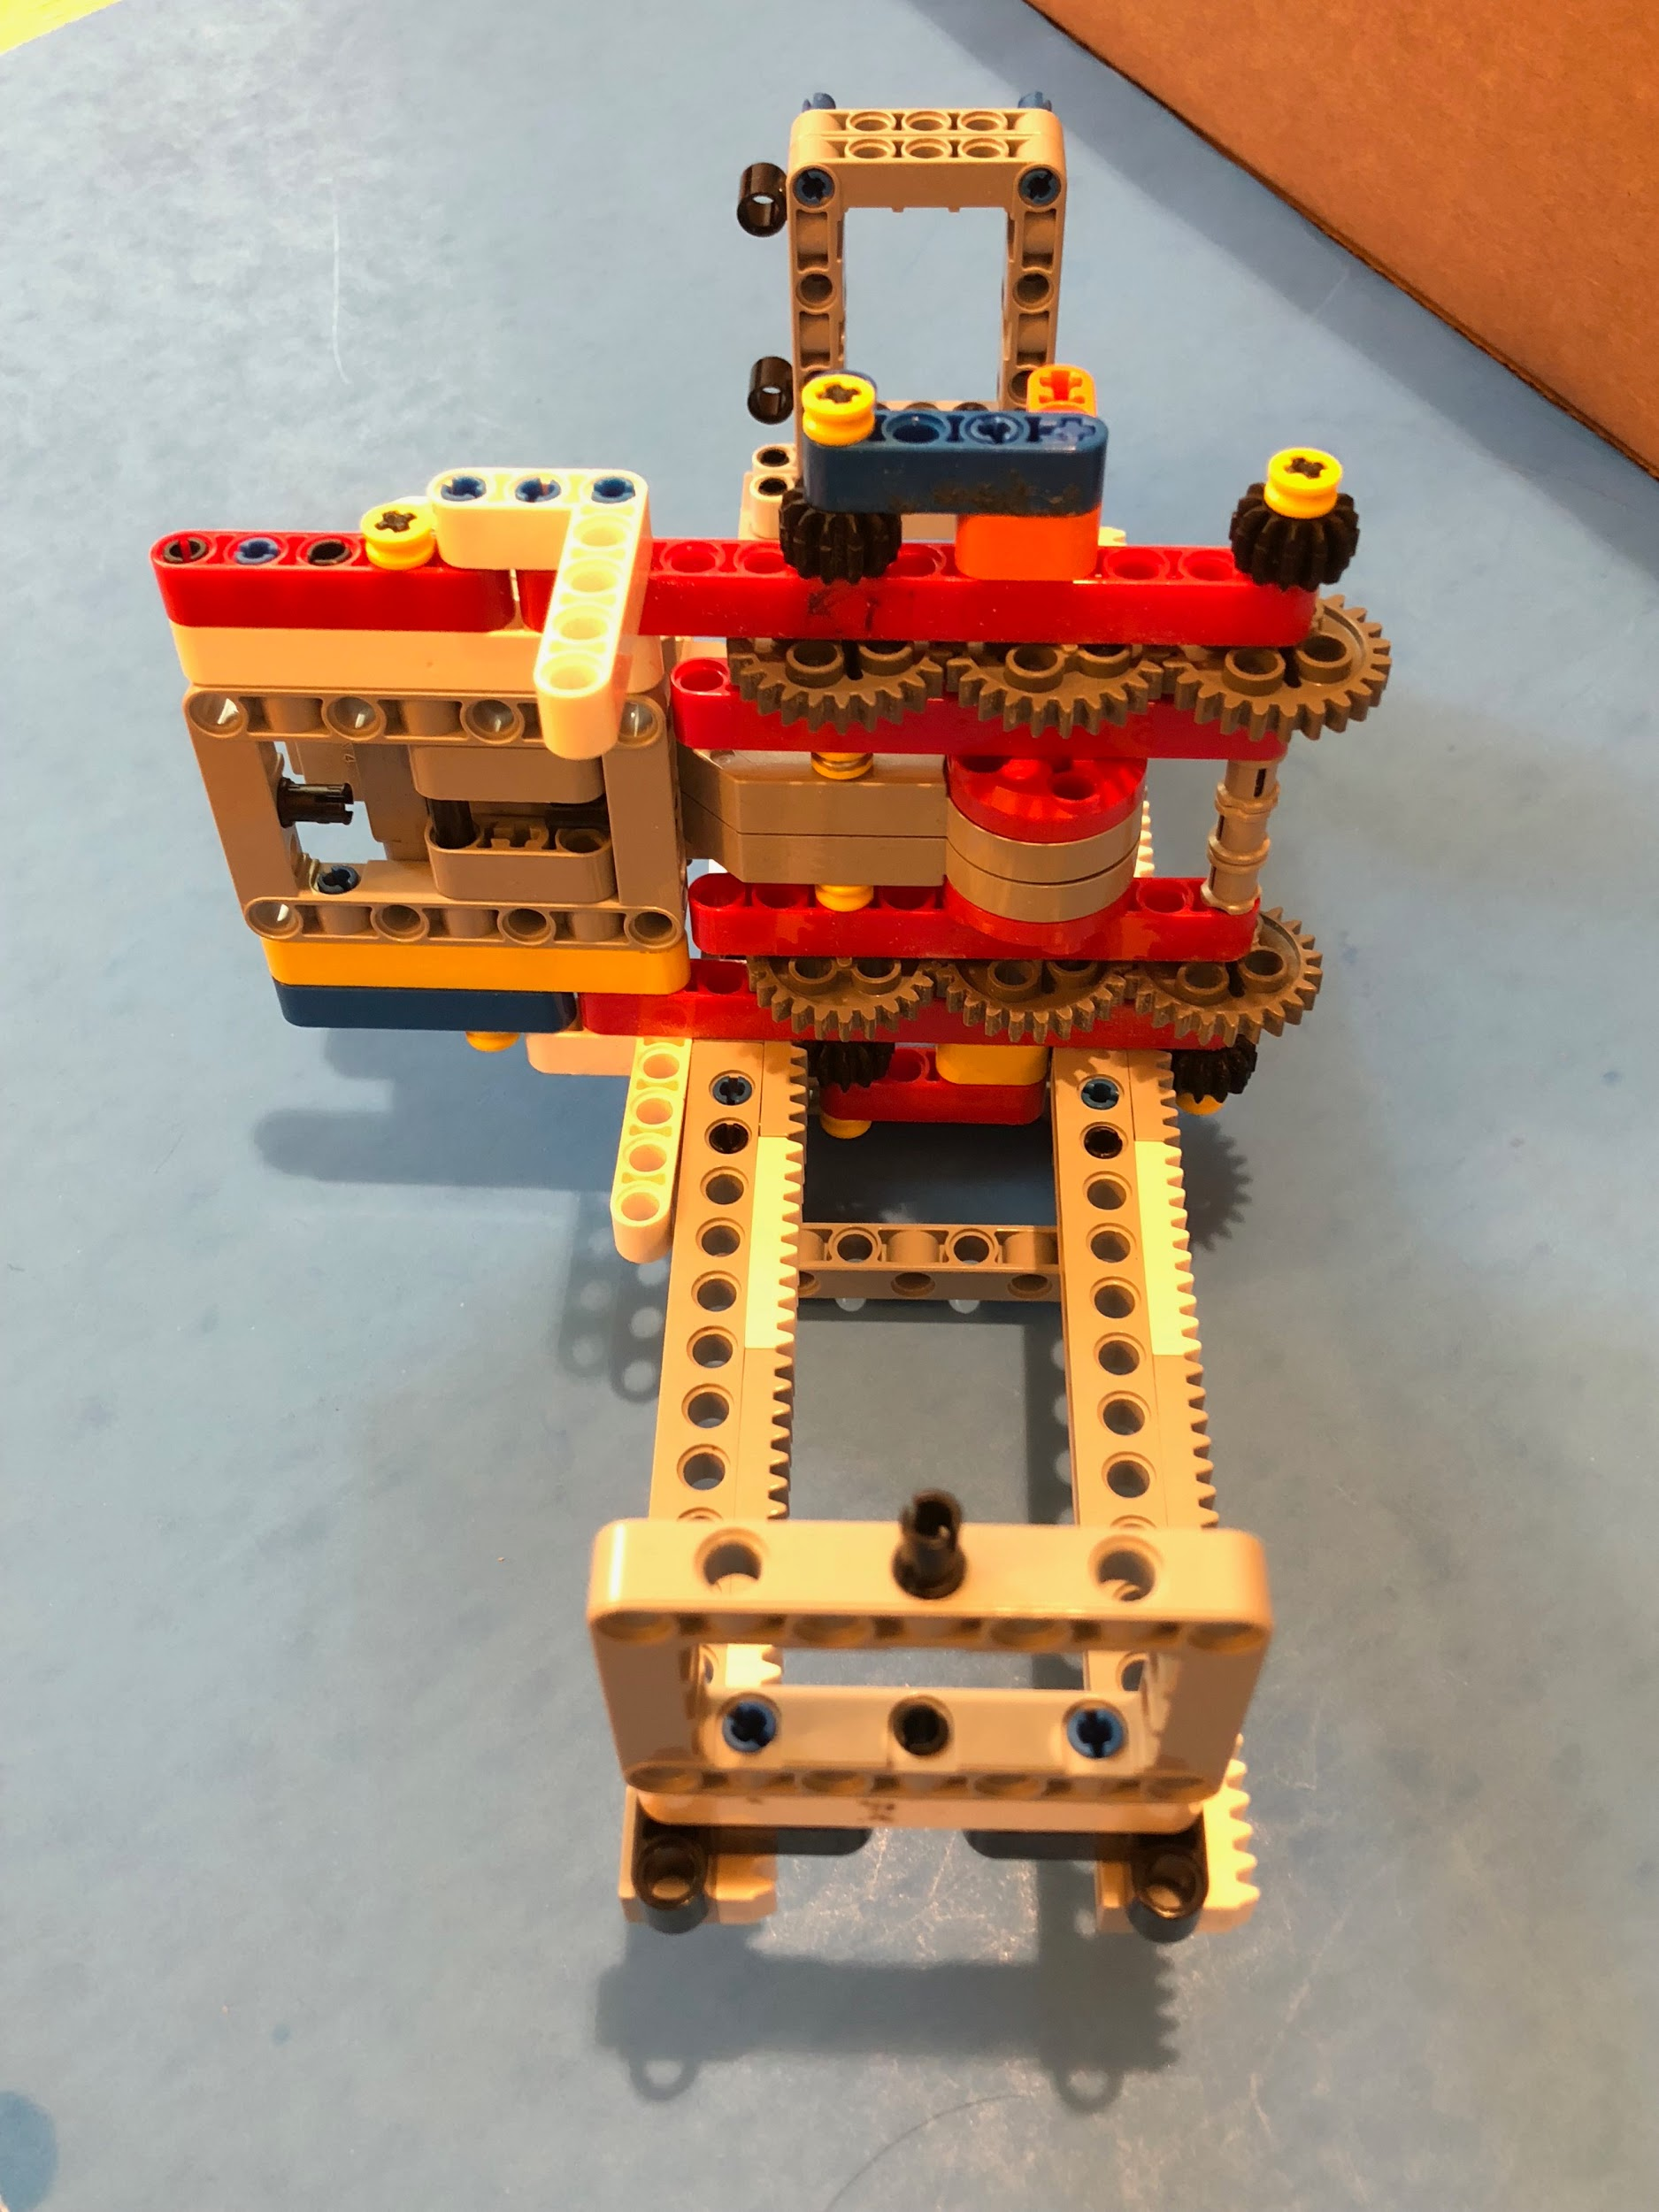
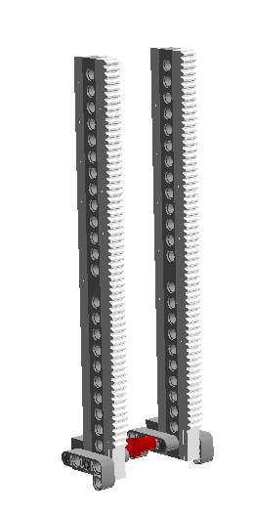
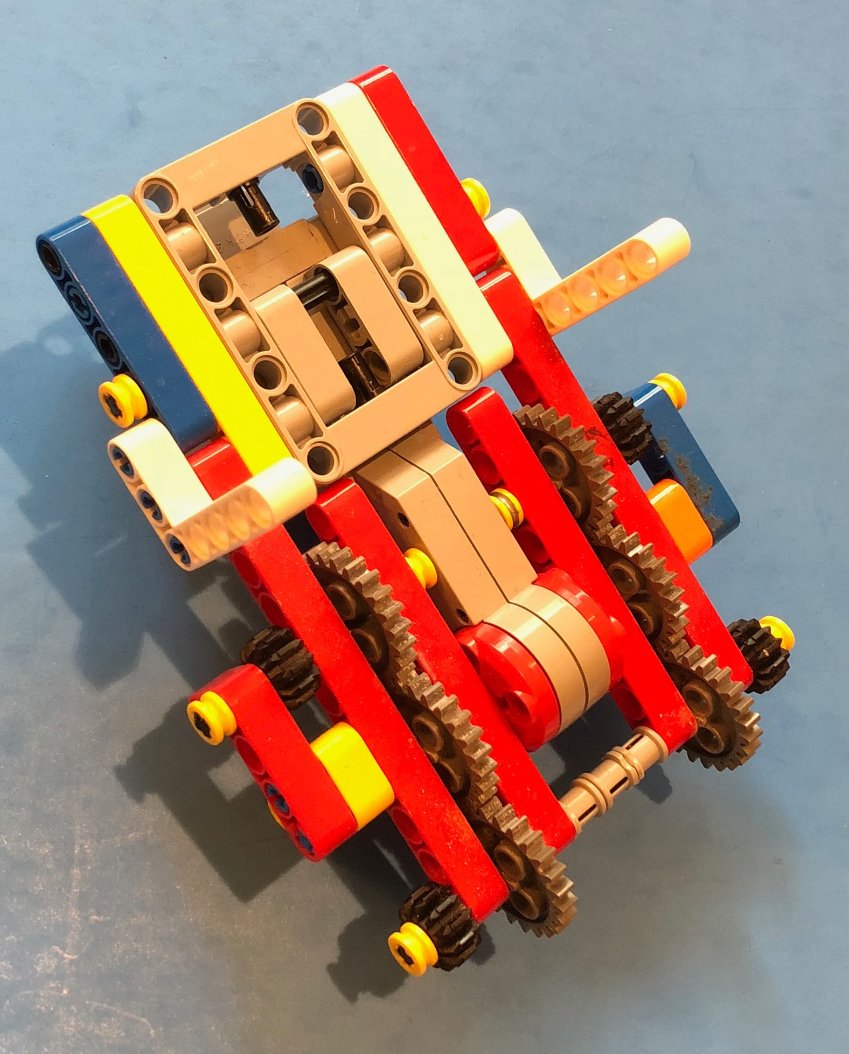
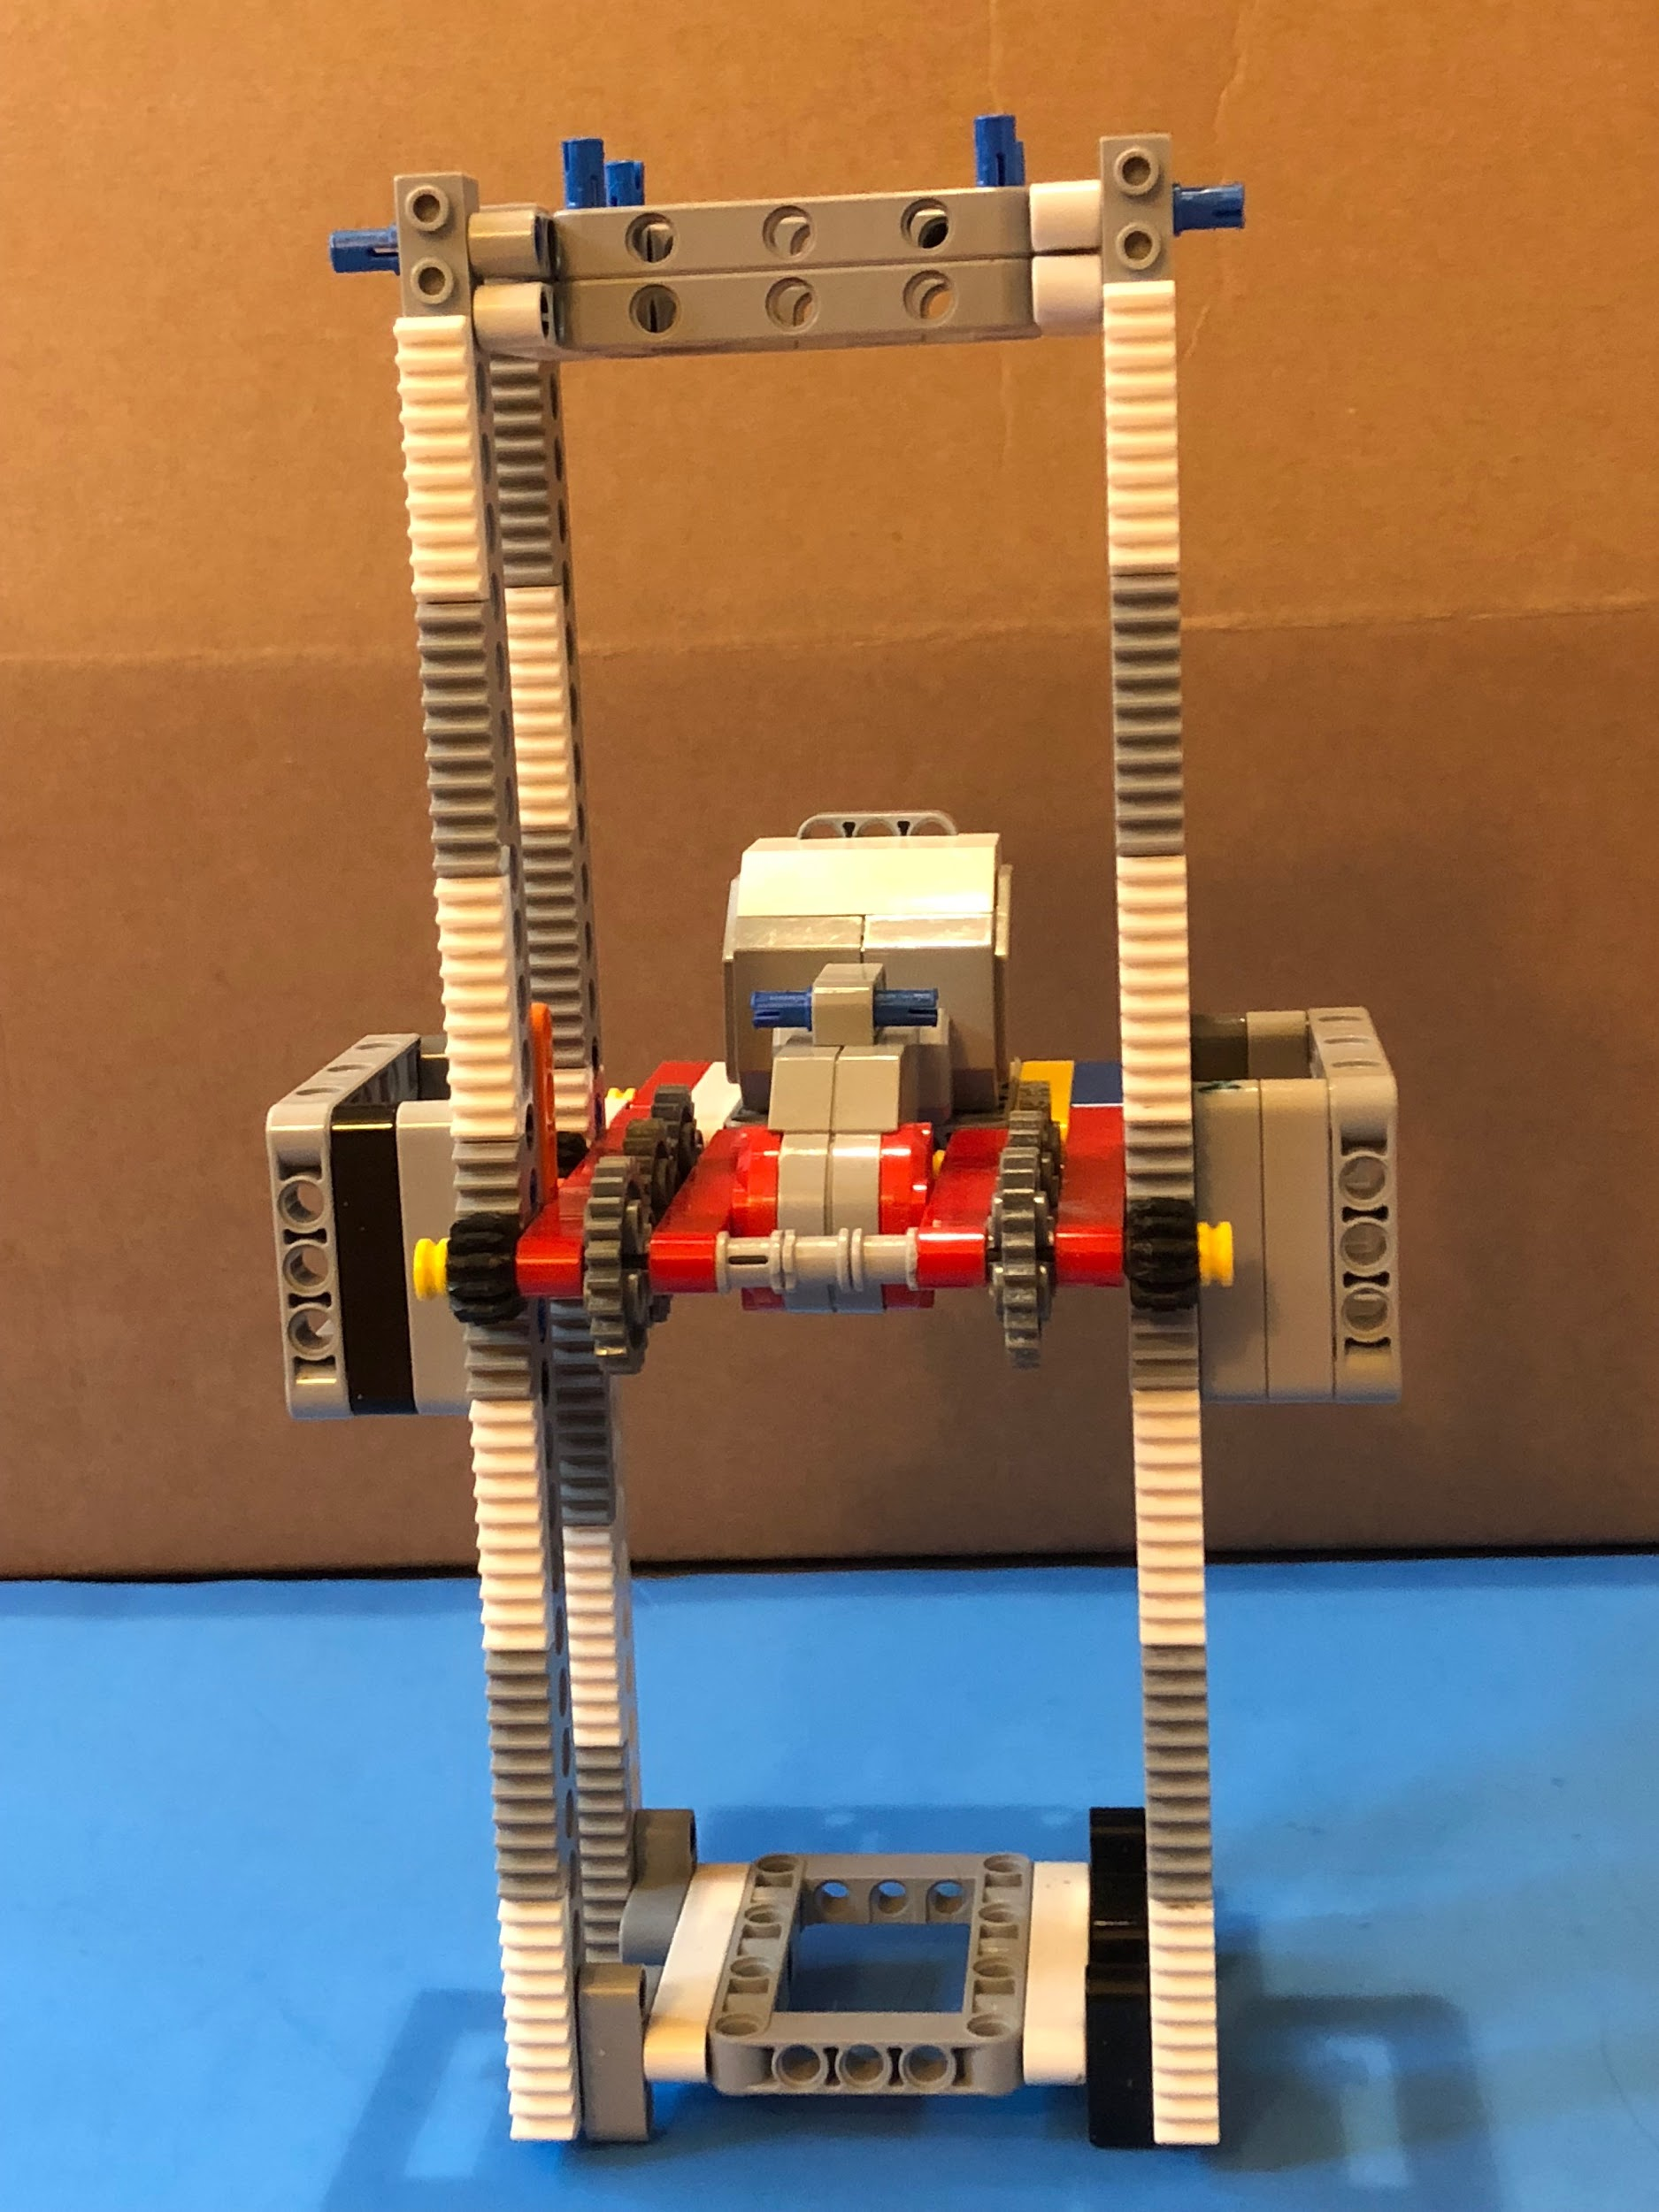
FORKLIFT BASICS: RACK AND PINION SYSTEM
A forklift can be made in many ways including using string or LEGO chains
We used 2 pairs of rack and pinion gears for ours
Watch this 20sec video on rack & pinion: https://www.youtube.com/watch?v=oS7QyMNCZ_4
The component with the Large motor moves up and down along the racks to complete the forklift
Expert tip: for strength, sandwich gear rack (#3743), technic bricks (eg #32018), and optionally thin system plates (eg #3460) together.

Slide 8
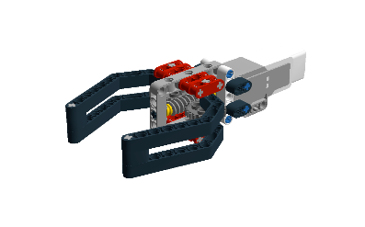
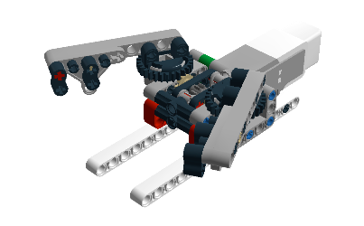
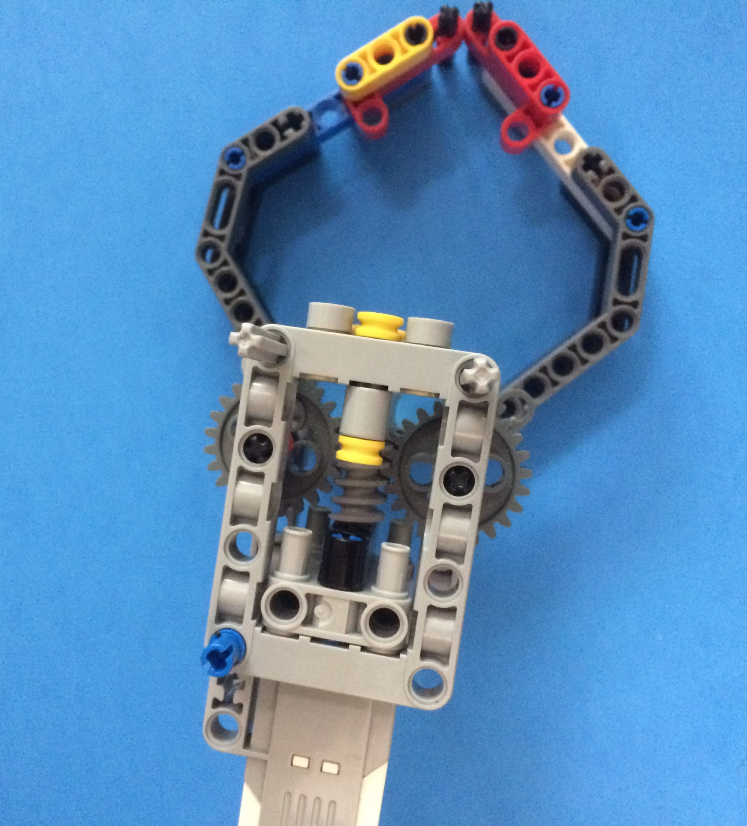
CLAW ARM BASICS
Start with the design from Yoshihito Isogawa’s LEGO MINDSTORMS EV3 Ideas book and modify it to suit your needs (make it stronger, larger, make it grab and lift, etc.)
Whatever claw you design will need to be motorized and connect to the forklift
"Most Simple EV3 Robot Claw" by William
Grab and lift by Ogaworks

Slide 9
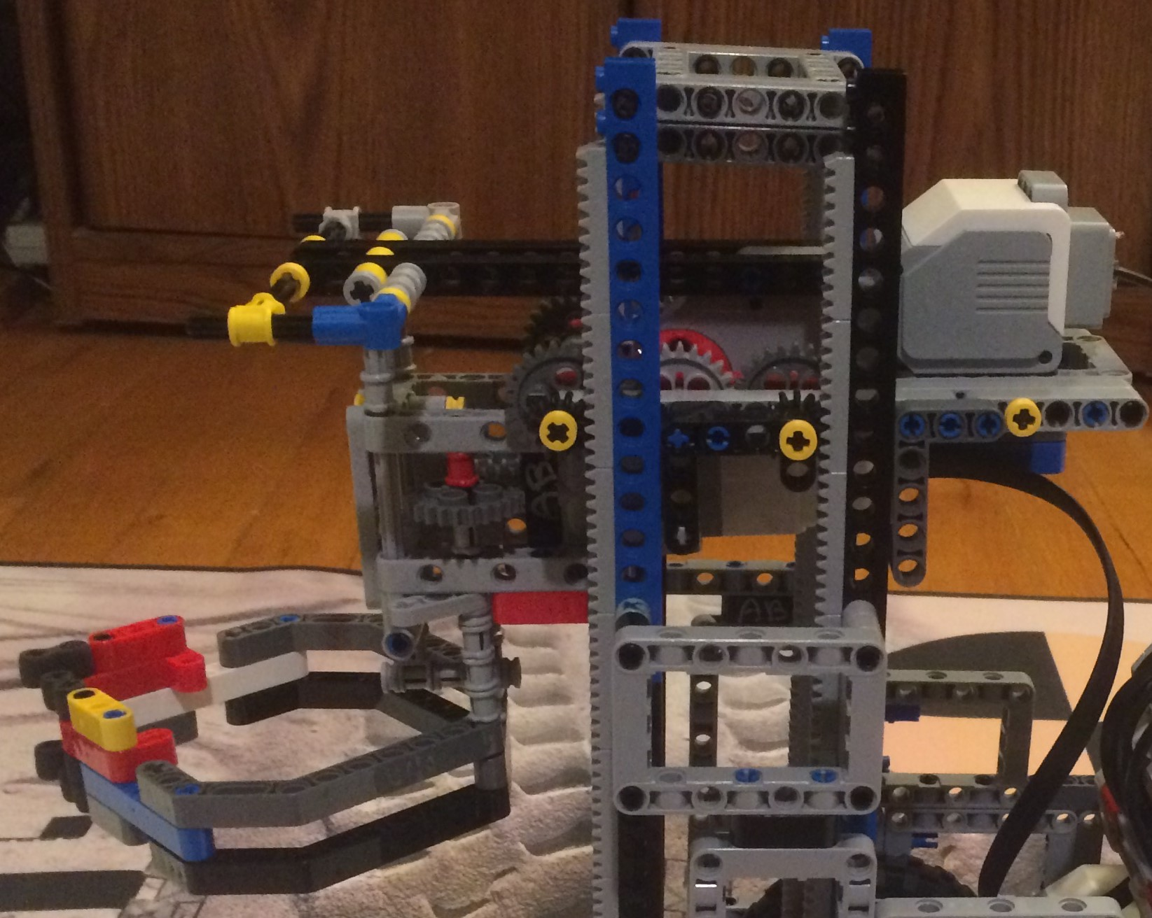
PUTTING IT TOGETHER
Add the claw arm to the forklift.
The claw arm on the forklift allows for a versatile tool that we call “compound actuator”
You can now move up-down and grab-release
You can complete a lot of missions with this one permanent tool
Watch video to see our robot complete missions with this tool.
https://youtu.be/EUToojAwfa4

Slide 10
Credits
This tutorial was created by Hotshot Hotwires.
Facebook Page: https://www.facebook.com/hotshothotwires/
YouTube Channel: https://www.youtube.com/channel/UCC2U3CBy-QD1Dr09WZRx2Ug
Contact us at hotshothotwire@gmail.com or l_nino@yahoo.com
More lessons at www.ev3lessons.com and www.flltutorials.com
This work is licensed under a Creative Commons Attribution-NonCommercial-ShareAlike 4.0 International License.

