Slide 1


Global Innovation Award (GIA)
By Team 3659 NeXt Gen

Slide 2
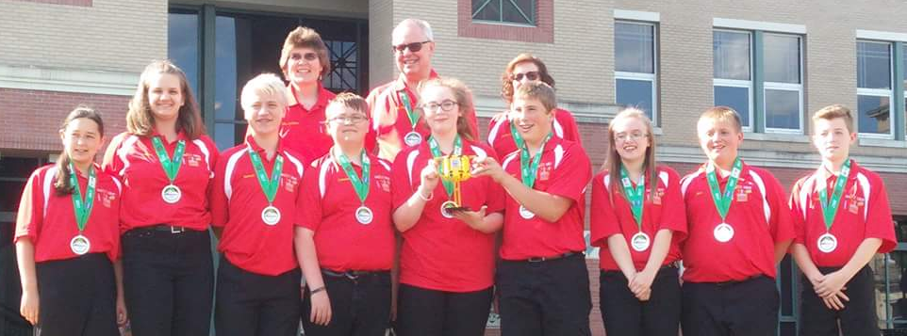
About Us
Middle school team from Garrett County, Maryland
13 years in FIRST LEGO League (including competing in International Tournaments)
First place 2013 Global Innovation Award for the Gramma Jamma
Top 20 GIA Semi-Finalist in 2017 for innovative solution, BeeHaven
First Place Innovative Solution at Mountain State Invitational in 2017

Slide 3
Nomination & Application Process
Most regions nominate their top-ranked team in the Innovative Solution Award from their State/Championship event.
Once nominated, you have to fill out an application (due at the end of March)
Based on the application, the top 20 teams are invited to the Global Innovation Award Event in Washington, D.C. in June.
For more information about GIA nomination, visit https://www.firstinspires.org/robotics/fll/global-innovation
Application Requirements
Problem Identification
Solution Development
Innovation
Implementation
Publicly Posted Information
Team Description
Innovative Solution

Slide 4
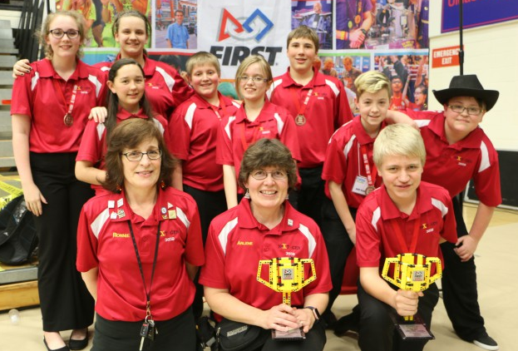
Problem Identification Section
Problem Identification
Overview: Describe the problem and why you are trying to solve it (200 words max)
Cleary describe the problem they are trying to solve, the reason why the team is trying to solve that problem, and why it relates to the team. This does not include any information about the solution.
Detailed Description: Describe the solution, how it works, how it solves the problem (300 words max)
The team needs to explain what their solution is, but it must be understandable by the judges. It’s not too technical because there are is a max of 300 words. Make every word count. This is one of the most difficult descriptions. Look at what the team has to include and include those parts but save the other parts that don’t have to be in this description for somewhere else in the application.

Slide 5
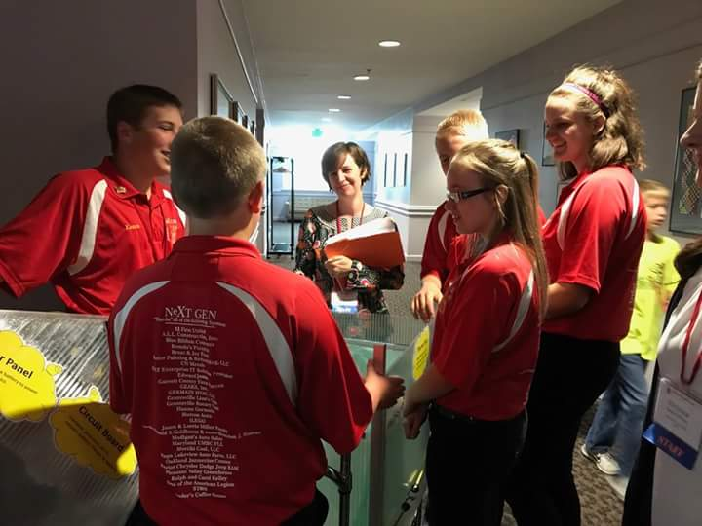
Innovation Section
Innovation
The team has 500 words to explain how their solution solved the problem in a new way and/or improved on existing solutions in a meaningful way.
Include existing solutions and why they don’t work, why the team’s solution works, what makes their solution work, what makes their solution innovative, and who benefits from their solution.
This is where listing at least three innovative features of their solution helps. By innovative features, we mean what makes the team’s solution their solution? How is it different from any of the other existing solutions?
Once the team has their innovative features listed, use those as the frame of the description. Then, the team can break it up into multiple paragraphs. We also recommend using the scientific method. Include the hypothesis which uses if and then statements.

Slide 6
Solution Development Section
Solution Development
The team has 500 words maximum to describe how they developed their solution, the steps they followed to narrow, evaluate, and verify their solution; and how they improved their solution after receiving feedback from experts/professionals. This is where we really recommend using the scientific method as the frame for the description. Include the following:
The problem
How the team researched the problem and existing solutions
The hypothesis
How the team built and modified their prototypes
How the team tested their prototype(s) and hypothesis by experimenting
What the team plans on doing next to improve their solution
Image Credit: https://garrettcountyschools.org/public-information/news/2017/05/local-youth-recognized-for-innovation-as-first-lego-league-global-innovation-award-presented-by-xprize-semi-finalist

Slide 7
Implementation Section
Implementation
The team has 500 words maximum to describe how their solution will be implemented, what factors they considered (cost, materials, manufacturing, market research), how they determined feasibility, their marketing plan, whether or not they will get a provisional patent, and would they consider getting a full patent for their solution.
We recommend, once the team determines the cost of their solution, asking experts/professionals who could use the solution what they think of the cost, whether it’s too expensive or if it is worth the cost or if they would buy it.
Discuss as a team who the target market (customers) would be and research.
Research and/or speak with experts/professionals in manufacturing, marketing, and patents.
Research the difference between provisional patents and patents.
Learn about how to apply for provisional patents and patents.

Slide 8
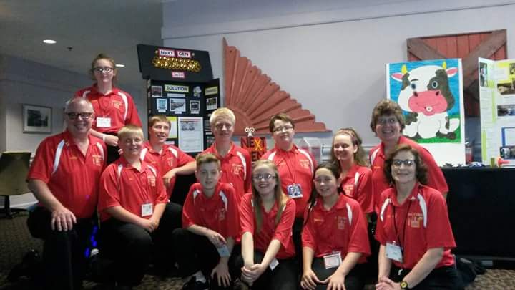
Public Website Sections
Team Description
Innovative Solution
As part of the application, teams create descriptions that will not be evaluated by the judges. The descriptions of the 20 semi-finalists are published on the FIRST LEGO League Global Innovation Award website
Team Description: Brief description of your team, no personal information (500 words max)
Write a description of the team, where they’re from, what they’ve done as a team this season, what they enjoy about FLL, really anything about the team they want to share with others.
Public Innovative Solution: Description of the problem and how your innovative solution solves it (300 words max)
Briefly describe the problem, why they chose it, what their solution is, and how it solves the problem.

Slide 9
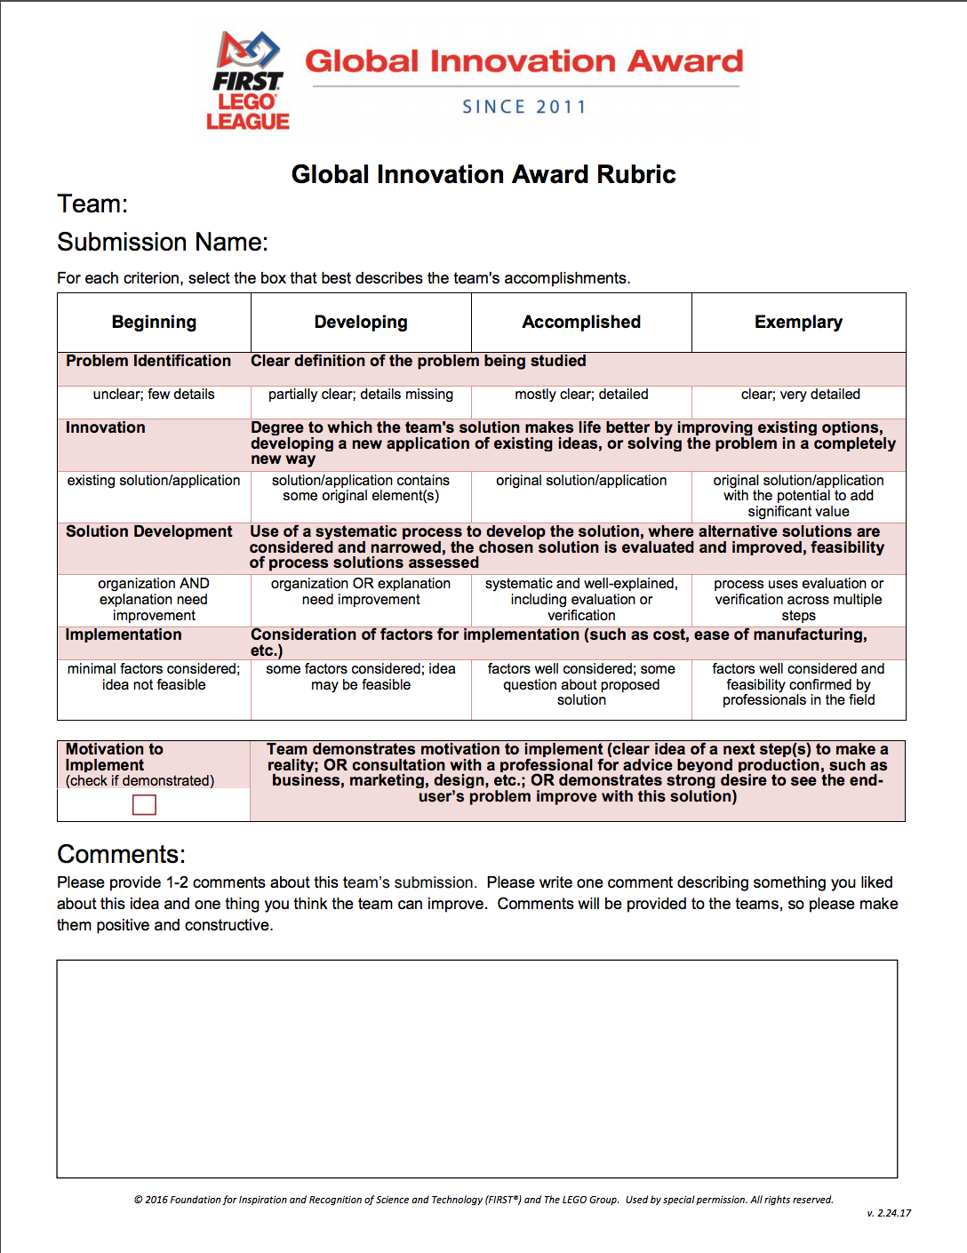
Understanding the GIA Rubric
Problem Identification: The team has to clearly explain the problem they chose to solve. However, it must be detailed enough to understand why it is a problem.
Innovation: The team needs to explain why their solution is original, innovative, and will have a large impact on others.
Solution Development: The team needs to know the entire process of how the solution was developed, how they took into consideration experts/professionals’ feedback and used it to improve their solution, how they’ve tested the solution, why the solution is better than existing solutions, and if the solution is more expensive than existing solutions why it is worth the extra expense.

Slide 10
Understanding the GIA Rubric
Implementation: The team has to know the cost of the solution, how they would manufacture the solution, the cost of manufacturing the solution, and what their marketing plan is. This is also where patents come into play. Do they have a provisional patent for their solution? Will they consider a full patent?
Motivation to Implement: The team must be committed to following through with their marketing plan and the continuation of their project for possibly years. Research about marketing, provisional patents, and patents. Discuss how far the team is willing to go with their project.

Slide 11
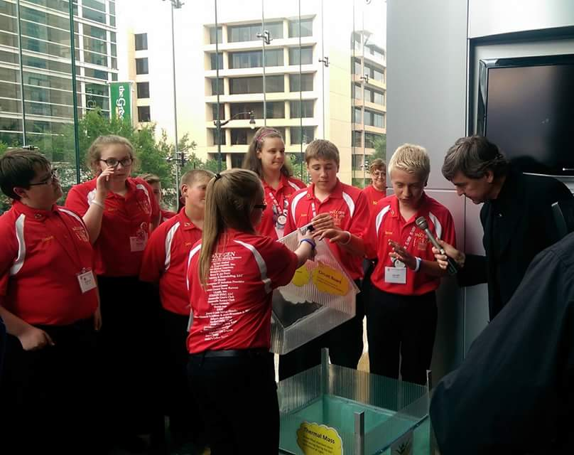
What Happens as a Semi-Finalist?
Invited to attend the Global Innovation Award Event in Washington, D.C.
The team will need to create a 5 minute presentation for the judges. Judging will last 15 minutes. Judges have 10 minutes to ask questions.
You also have to fill out an Engineering Change Notice form.
It is recommended that semi-finalist, that the team get a provisional patent on their solution since information about the team’s solution will be listed on the Global Innovation Award website.

Slide 12
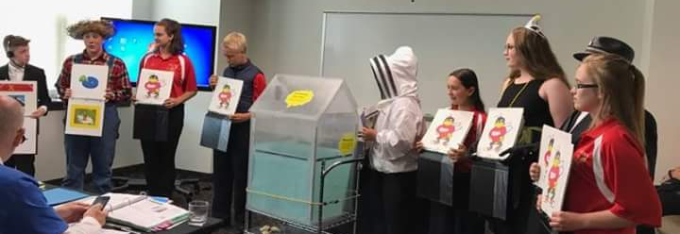
GIA Judging Presentation
We highly recommend that the team creates a new presentation for the Global Innovation Award
We recommend writing a script based on the GIA rubric. Make your presentation creative and unique, and make sure the entire team participates.
If the team has a prototype, they need to bring it! Bring a smaller model if needed.
If you are a semi-finalist, FIRST also suggests getting a provisional patent.
Image credit: USPTO

Slide 13
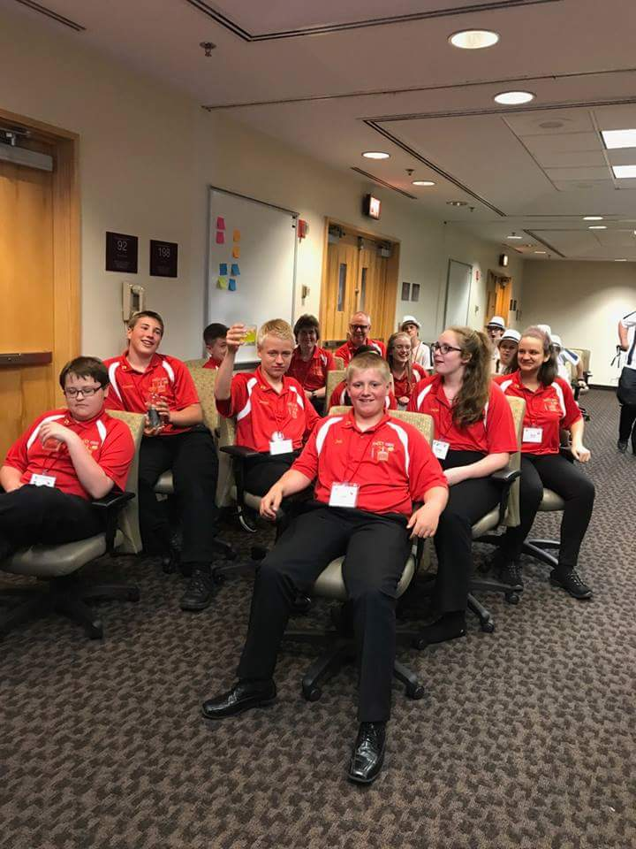
Tips for Judging Part 1
We recommend having a “captain” who helps direct questions and makes sure everyone answers a question.
The captain needs to know what everyone feels comfortable talking about. The captain answers questions too.
Just because there is a captain for a judging session, does not mean that the team has an overall team captain.
If the judges don’t have questions, you can present additional information to them.

Slide 14
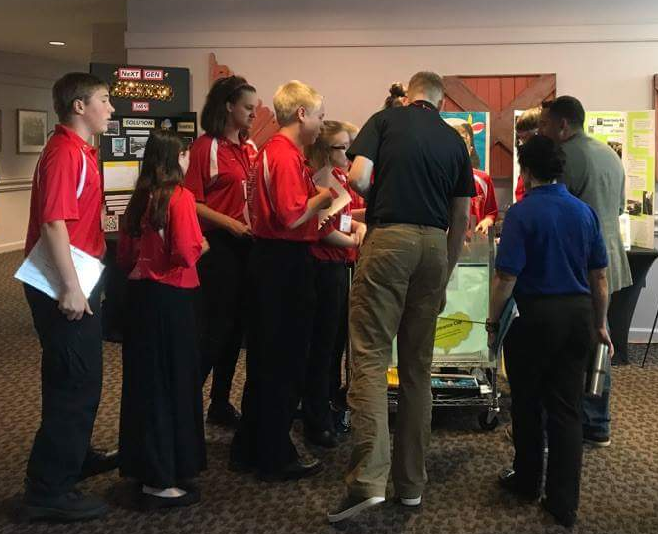
Tips for Judging Part 2
Additional judges may come to the pit area and ask questions about the team’s project.
Everyone from the team should be there during the pit area judging and everyone needs to answer a question.
It’s a good idea to have a display board that summarizes the team’s project. It can serve as a useful prompt for the team.
Show the judges the prototype/model.
Don’t let the judges walk away without knowing everything about the team’s project.

Slide 15
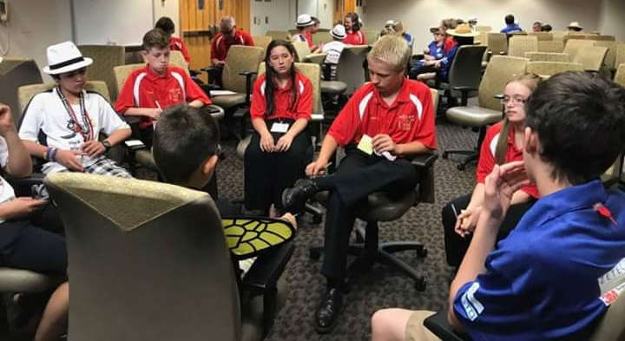
Engineering Change Notice Form
The team lists all the changes they’ve made to their solution. They can include the changes since they were nominated from their championship event or they can include all the changes since they first developed their solution.
Include several drawings of the team’s solution. Describe the changes and how they improved the solution.
The Engineering Change Notice form is basically about the team’s solution development. Think back to every change that was made which is why it is helpful to track the changes that were made while the team was developing their solution. Explain why they made those changes.

Slide 16

Credits
This lesson was written by Team 3659 NeXT GEN, with some edits by EV3Lessons
You can contact Team 3659 NeXT GEN through their Facebook page: Garrett County FIRST LEGO League Team 3659.
More lessons available at www.ev3lesssons.com and www.flltutorials.com

