Slide 1

Sharing Your Project
By Team 3659 NeXt Gen & NOT THE DROIDS YOU ARE LOOKING FOR

Slide 2
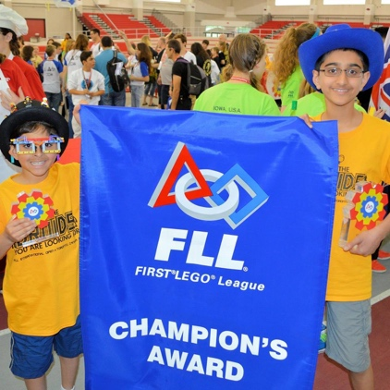
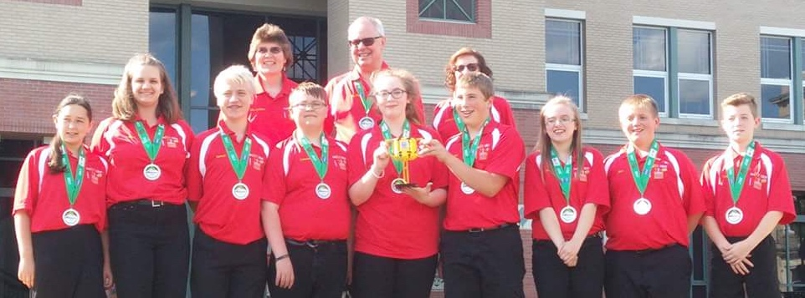
About Us
NeXT Gen are a middle school team from Garrett County, Maryland with 13 years in FIRST LEGO League (including competing in International Tournaments).
They have won first place in 2013 Global Innovation Award. They also won Top 20 GIA Semi-Finalist in 2017 for innovative solution, BeeHaven.
In addition, they won first Place Innovative Solution at Mountain State Invitational in 2017.
Not the Droids You Are Looking for is a 7th year team from Pittsburgh, PA
They were Global Innovation Award Semi-Finalists for their Trash-Trek Project, Invisi-Sort, in 2016.
EV3Lessons.com was their award-winning World Class project in 2014-15.
They have also won First Place Innovative Solution at the International Open in Toronto in 2014.

Slide 3
Why Share?
In FIRST LEGO League, sharing your project is a very important component.
Sharing your project involves the presentation given to judges (which is covered in the lesson on Presentations), but also sharing with members of the public.
Not only is it good practice for your team to share your project, but it is a key part of FIRST LEGO League

Slide 4
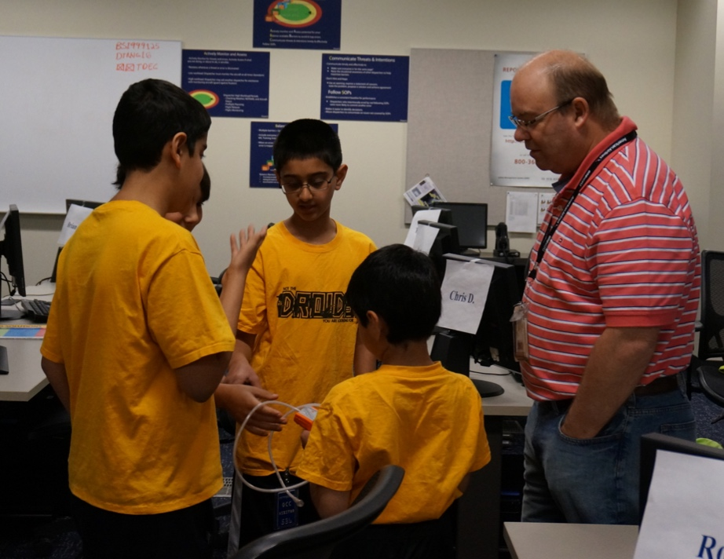
Who Should You Share With?
Starting with friends and family is a good
Sharing with school teachers and classmates is also great
But also make sure to share with people who would actually use your innovative solution
Shared by: Not the Droids You Are Looking For

Slide 5
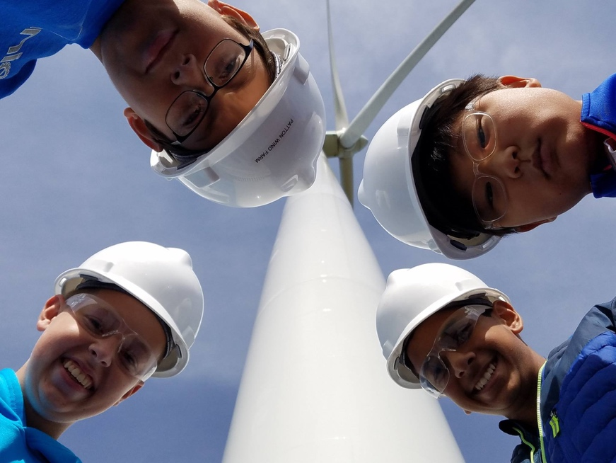
Examples
Project: Bats killed by turbines
Shared with: Turbine operators
Project: Ash clouds causing engine damage
Shared with: Airline operators
Project: Senior Citizens needing reminders
Shared with: Your own grandparents as well those in nursing homes
Shared by: Not the Droids You Are Looking For

Slide 6
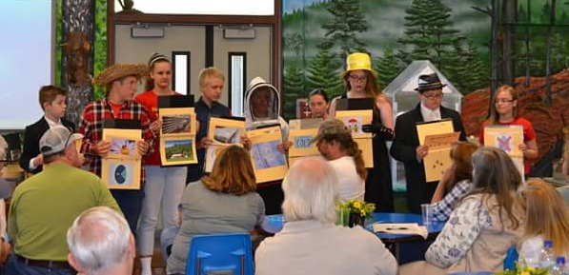
How to Share Your Project
When the team is sharing their project
Introduce the team enthusiastically
Explain FIRST LEGO League
Explain the theme of this season
Define the problem
Explain existing solutions
Explain the solution
Explain why the solution is innovative
If the team tested the solution and made prototypes, explain the data that was received and talk about the prototype(s).
Tip: If your presentation for the judges is ready, use this opportunity to present it. This gives the team practice and allows the team to see what can be improved.
Shared by: NeXT GEN

Slide 7
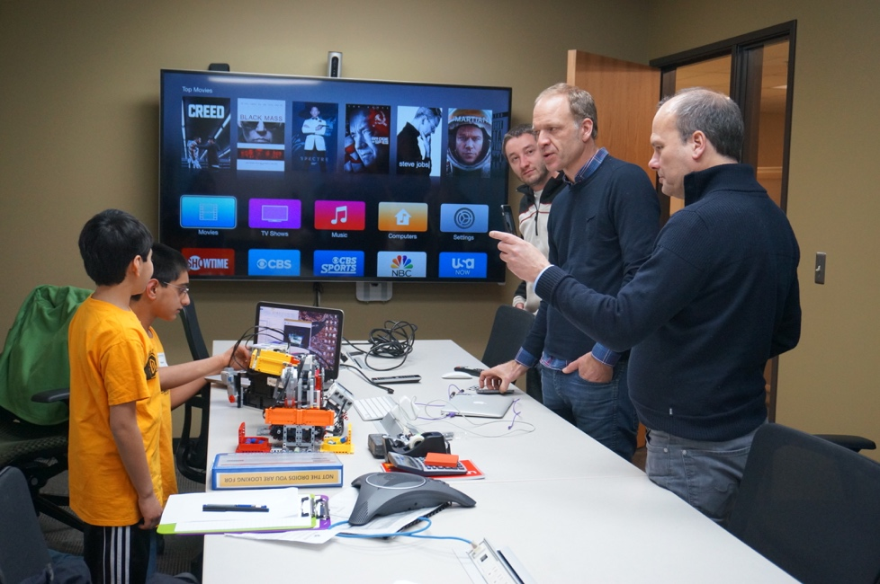
What Next?
People you shared with might give you some useful feedback
Try to incorporate the ideas into your innovative solution
More than likely, the questions they asked you are also ones the judges may ask you.
So, listen well and use their feedback to also improve your presentation
Shared by: NeXT GEN and Not the Droids You Are Looking For

Slide 8

Credits
This lesson was written by Sanjay and Arvind from Not the Droids You Are Looking For and Team 3659 NeXT GEN (Facebook:Garrett County FIRST LEGO League Team 3659).
It has been shared with permission with www.ev3lessons.com and www.flltutorials.com

