Slide 1

ROBOT DESIGN Lesson
Cable Management

Slide 2
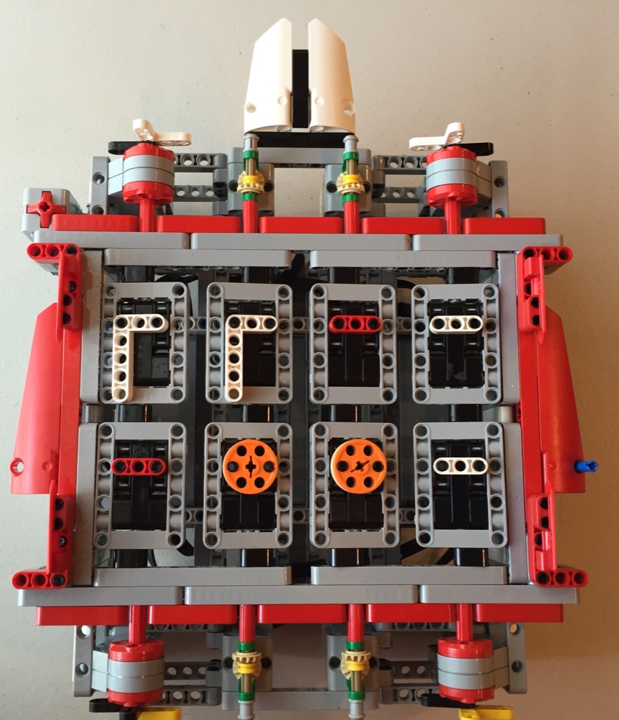
What is cable Management?
No matter what robot you are building (for fun, for a class, or competition), you have to be able wire your robot well
There are three reasons:
Aesthetics – The robot needs to look nice
Convenience – The wires should not be in the way of operating the robot
Identification – If you need to replace a part on the robot or rewire, you should be able to trace which wire goes where
EV3 M3MORY GAM3

Slide 3
EV3 Cables
The EV3 Edu Core set (#45544) and the Retail set (#31313) come with the following cable lengths
4 x 25 cm/10 in. cables, 2 x 35 cm/14 in. cables, and 1 x 50 cm/20 in. cables.
If you are a casual robot designer (not for competition) you can purchase custom length cables or even make your own
Mindsensors has compatible custom lengths
http://www.mindsensors.com/51-cables-connectors
Mindsensors also has parts to make-your-own cable
http://www.mindsensors.com/ev3-and-nxt/115-nxtev3-compatible-male-plugs-10-pack
If you break the tip on the cables or you need extra wires, you can buy replacements from LEGO: http://shop.lego.com/en-US/EV3-CablePack-45514

Slide 4
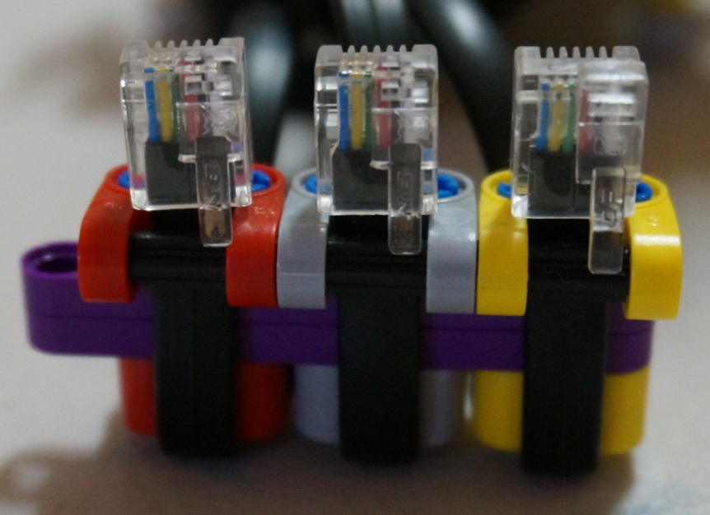
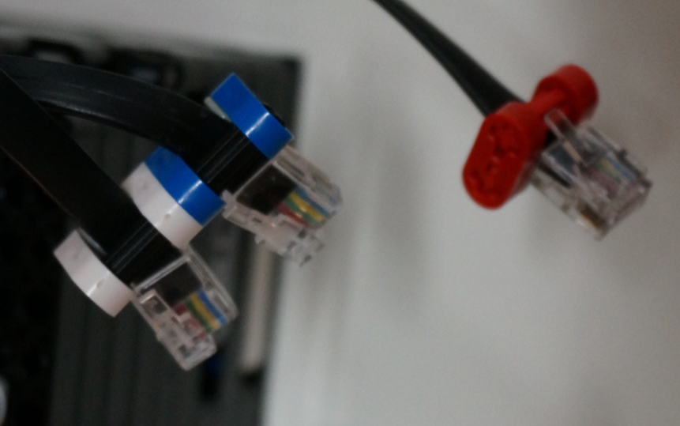
IDENTIFICATION
Some people like to use LEGO rubber bands to indicate with wire is for which sensor or motor
We do not use this technique as LEGO rubber bands are expensive and fragile, and not that easy to replace. You only get a small number in each set and there are lots of other uses for them.
Instead, consider wrapping your wire with colored LEGO pieces

Slide 5
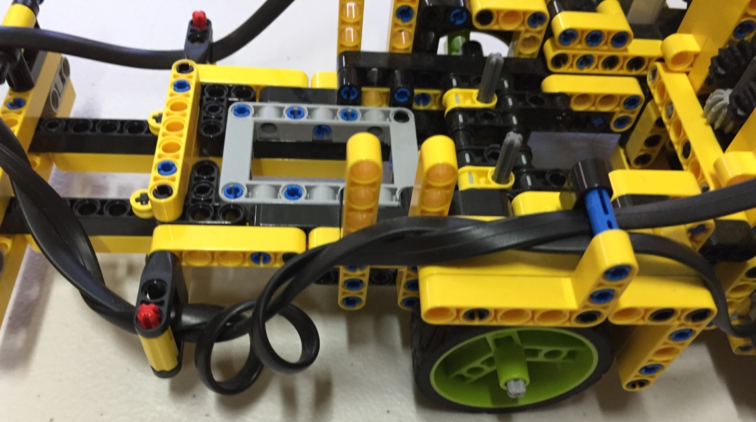
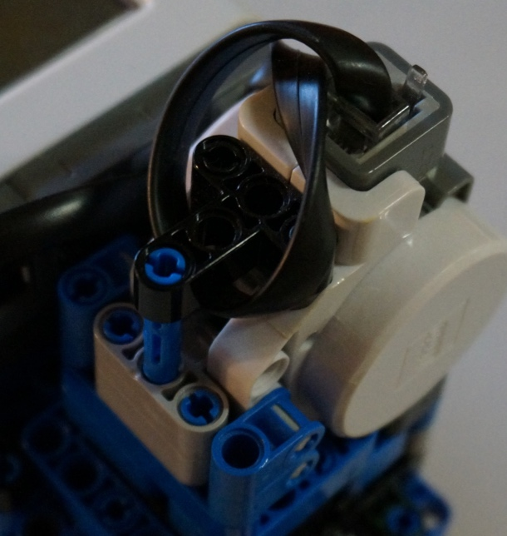
Shorten Cables
Use the most appropriate length cable for the connection first
However, if the cables are too long…
You can wrap them around each other or beams

Slide 6
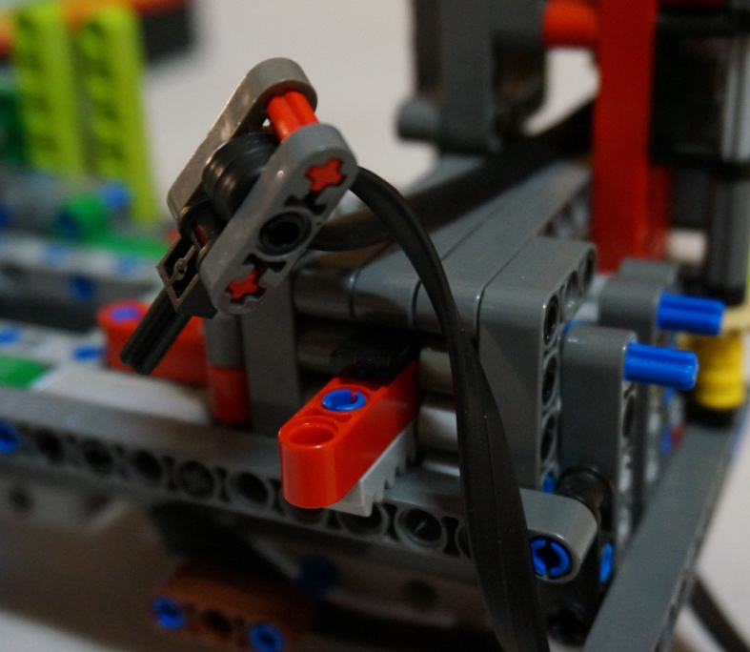
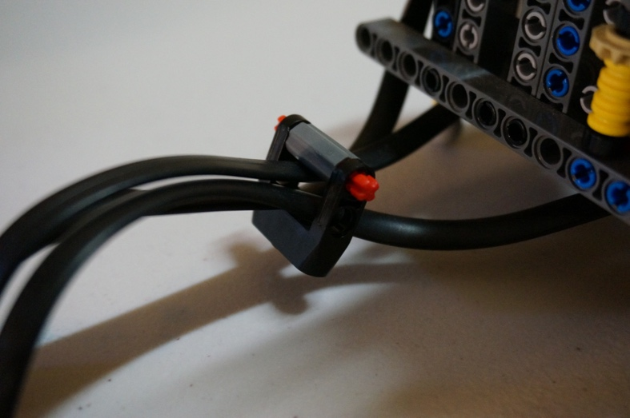
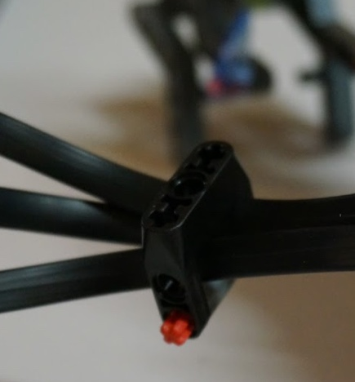
CABLE HOLDERS FOR BUNDLING
Cable holders can identify what they are (use different colors for each sensor/motor)
They can be used to keep multiple wires together
They can be used to attach the wire to a beam (see next page for examples)
LEGO gear boxes can find a new use as cable holders. In the images, cables are fed through a gear box piece. They are spacious enough to hold multiple cables.

Slide 7
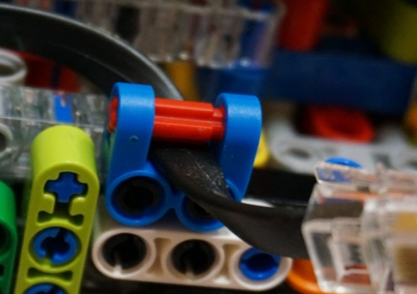
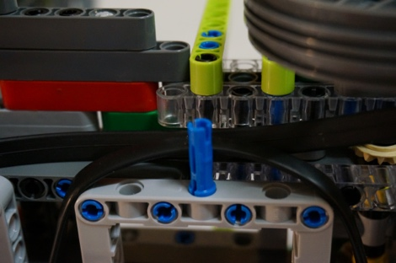
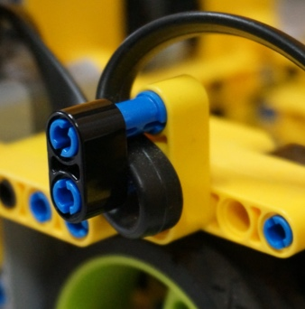
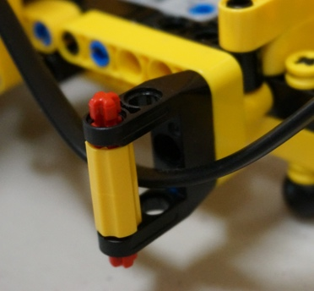
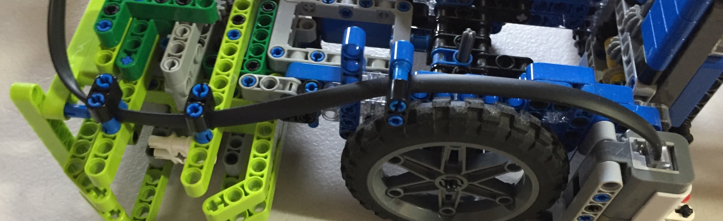
CABLE GUIDE RAILS
Building guide rails for long EV3 wires helps to keep them out of the way of movable parts of the robot and makes them always stay in the same spot on your robot.

Slide 8
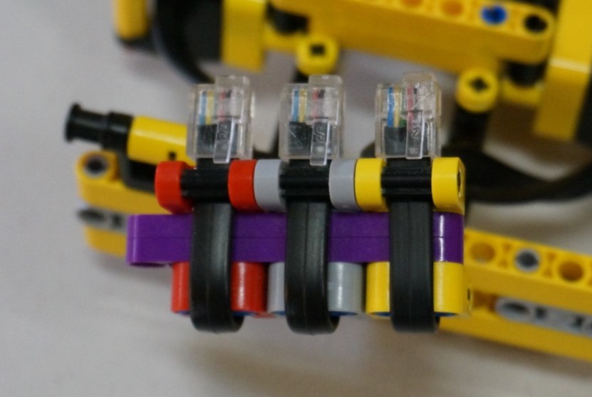
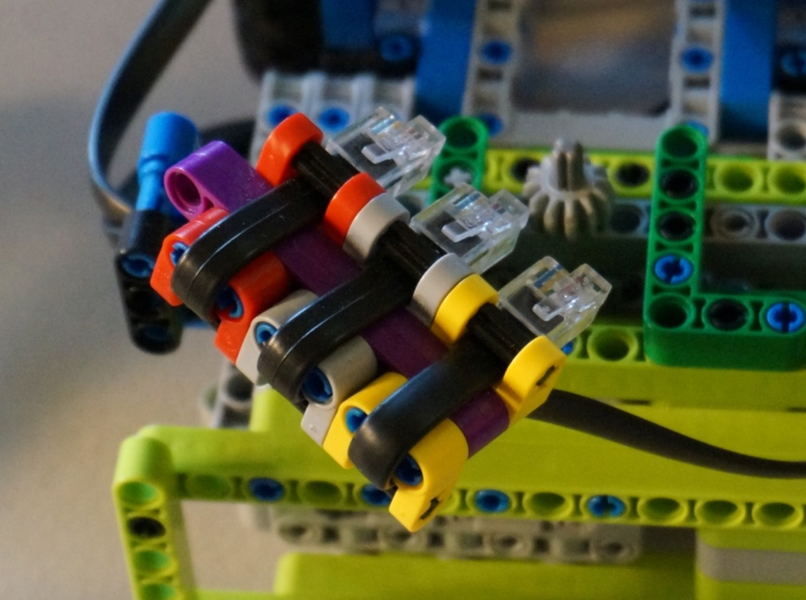
PLUG-IN Guides
If you design a robot where you have to frequently change your motors/sensors out, you need a way to plug the cables in efficiently
The technique in the image on the right keeps the spacing between the wires correct at all times and lets you install them all at the same time.
Using different colors lets you color code which wire goes to which sensor or motor.

Slide 9
Credits
This tutorial was created by Sanjay Seshan and Arvind Seshan
Photos and ideas from FIRST Tech Challenge 8393 Giant Diencephalic BrainSTEM Robotics (Former FIRST LEGO League Team)
More lessons at www.ev3lessons.com
This work is licensed under a Creative Commons Attribution-NonCommercial-ShareAlike 4.0 International License.

