Slide 1
ROBOT DESIGN LESSON
Gearing For LEGO Robots

Slide 2
Objectives
1. Learn about the different types of LEGO gears and what you use them for
2. Learn how to calculate gear ratios
3. Learn some useful gearing techniques

Slide 3
What Is a Gear?
A gear is a wheel with teeth that meshes with another gear
There are many different kinds of gears
Gears are used to
Change speed
Change torque
Change direction

Slide 4
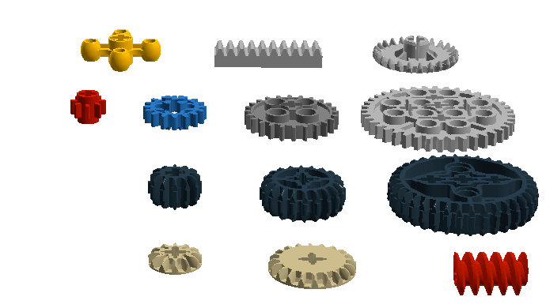
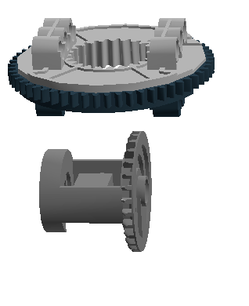
COMMON LEGO GEARS
Turntable
Knob Wheel
Rack Gear
Crown Gear
Spur Gears
Double Bevel Gears
Differential
Single Bevel Gears
Worm Gear

Slide 5
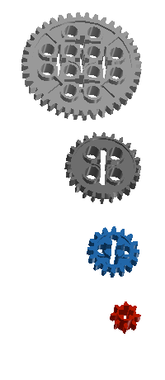
Naming LEGO GEARS
LEGO gears are referred to by their type and the number of teeth they have
40 tooth spur gear
24 tooth spur gear
16 tooth spur gear
8 tooth spur gear

Slide 6
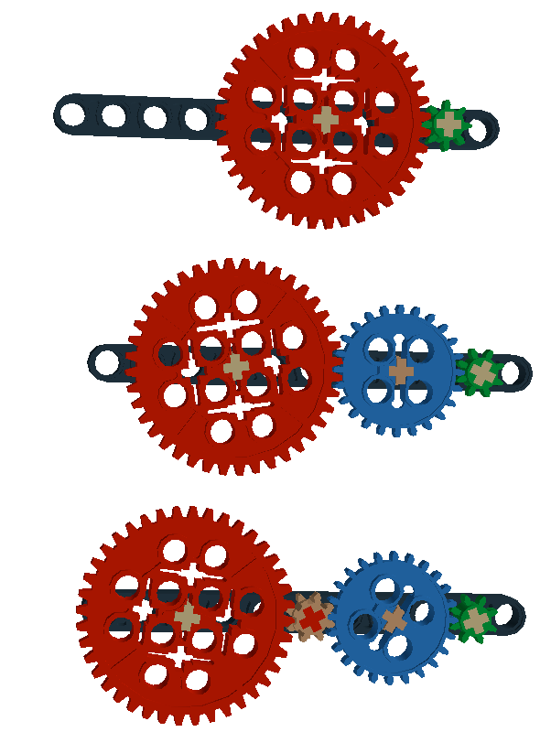
Drivers, Followers & Idlers
Driver
Driver: gear that applies force (the gear connected to the motor on a robot)
Follower: final gear that is driven
Idler: gear turned by driver which then turns the follower
Notes about gears:
1) When 2 gears mesh, the driver makes follower turn in the opposite direction
2) You need an odd number of idler gears to make driver and follower turn in same direction.
3) You need an even number of idlers (or none) to make driver and follower turn in opposite direction
Follower
Idler
Idler
Idler

Slide 7
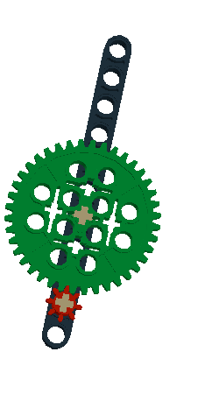
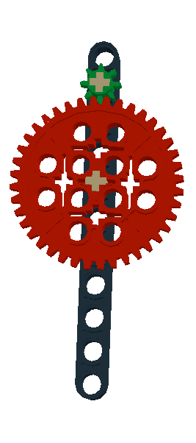
Gearing Down and Up
Gearing Down
(increases torque, decreases speed)
Gearing Up
(increases speed, decreases torque)
Small Driver
Large Follower
Large Driver
Small Follower
Drive
Drive

Slide 8
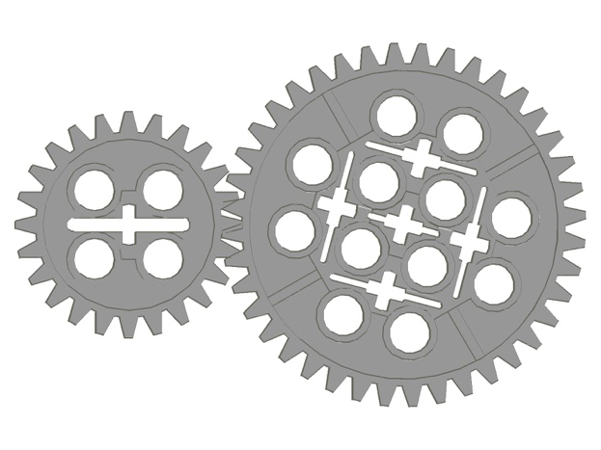
Calculating Gear Ratios
Gear Ratio = number of teeth in follower: number of teeth in driver
Gearing Down
(increases torque, decreases speed)
Gearing Up
(increases speed, decreases torque)
Driver
Follower
Driver
Follower
40/24 = 5:3
24/40 = 3:5

Slide 9
Change the Direction of Motion
You can use gears to change the direction of motion.
Credits: All the animated images are from: http://technicopedia.com/fundamentals.html. To view them correctly, you will need to use “Slideshow Mode” on PowerPoint.

Slide 10
PROBLEMS with LEGO gears
Two common problems that you might face:
Gear Slip: Slippage is when the teeth skip on the gears when you apply power
Gear Backlash: Backlash is space between the teeth where the gears mesh. When the space is too much, it is called slack/slop. When there is too little, you create too much friction.
Solution: Try to avoid long sequences of gears. Use a gear box. Mesh gears according to specification.

Slide 11
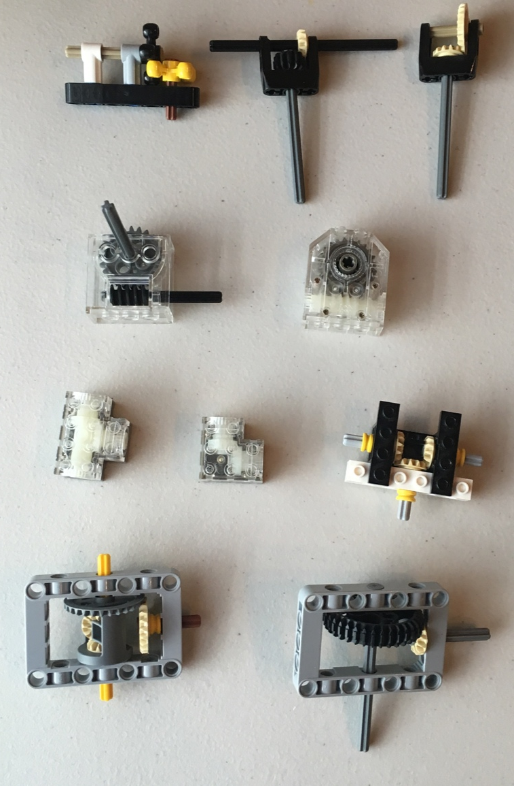
Gear boxes Can be helpful
Gear boxes can help reduce some of the issues you may face when building with gears.
Some are pre-built (with gears included)
Some need gears inserted into a gear box
Some can be assembled from scratch using technic pieces
Pre-built
Pre-built
Pre-built

Slide 12
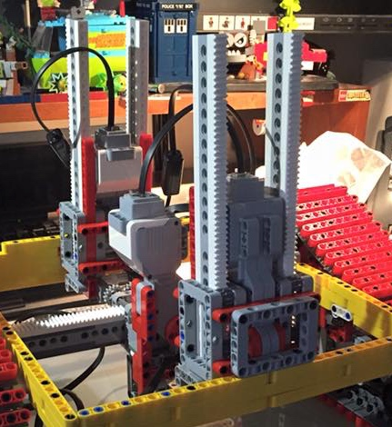
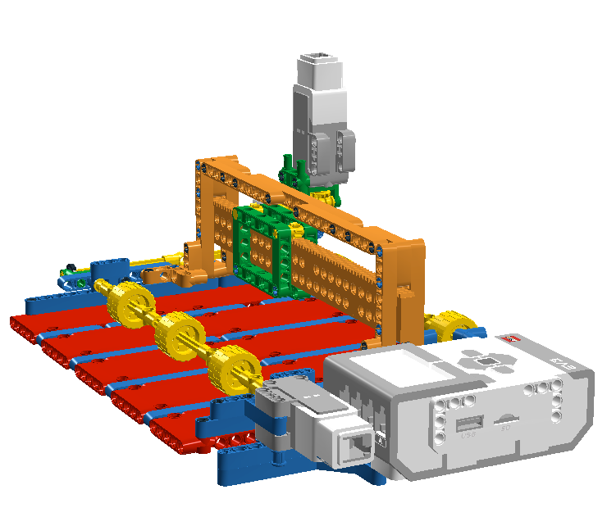
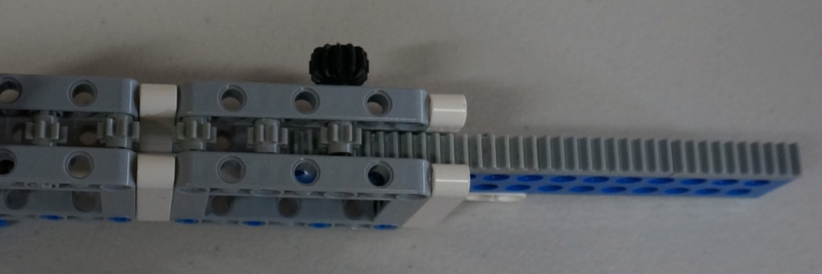
RACK GEARS For Vertical & Horizontal Movement
PIX3L PLOTT3R by Sanjay and Arvind Seshan uses rack gears
Support structure of Wall-E7 by Marc-Andre Bazergui is made with rack gears

Slide 13
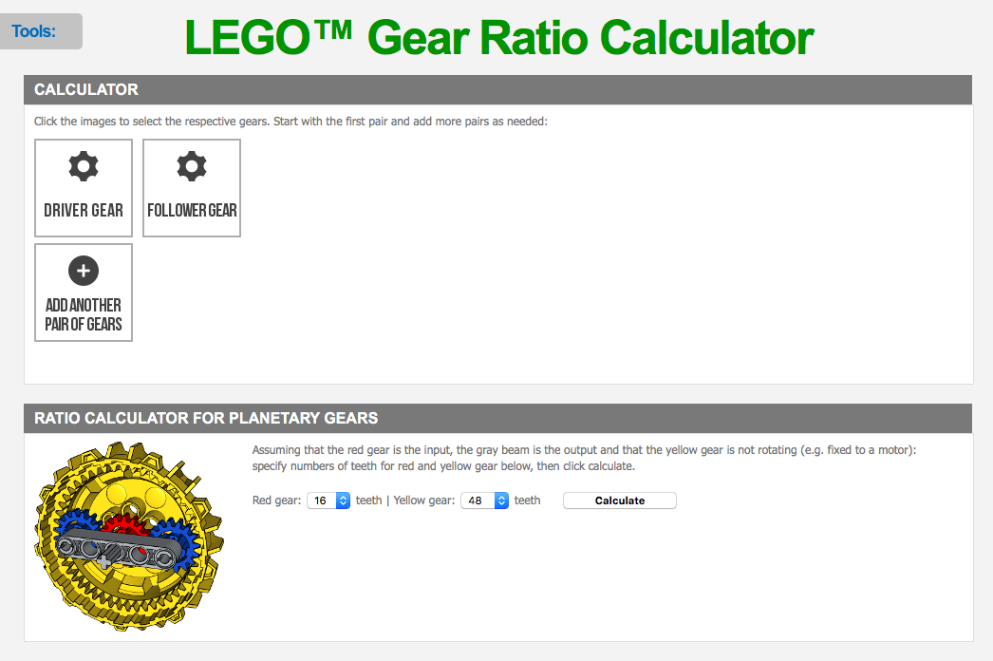
USEFUL ONLINE GEAR TOOL
http://gears.sariel.pl/

Slide 14
OTHER Useful resources
More about gears: http://sariel.pl/2009/09/gears-tutorial/
Gear animations: http://technicopedia.com/fundamentals.html
Technic Gearing: Books by Yoshihito Isogawa

Slide 15
Credits
This tutorial was created by Sanjay Seshan and Arvind Seshan
More lessons at www.ev3lessons.com and www.flltutorials.com
This work is licensed under a Creative Commons Attribution-NonCommercial-ShareAlike 4.0 International License.

