Slide 1

Robot DESIGN Lesson
Basic Building Techniques for LEGO Robots

Slide 2
Are you New to TECHNIC?
This lesson is an introductory lesson to common technic pieces
This lessons does not cover every Technic part. It is just an introduction to commonly used parts in MINDSTORMS robots

Slide 3
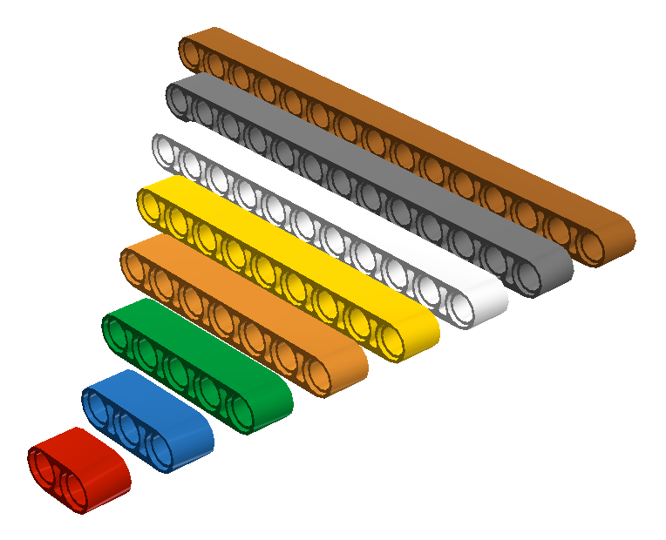
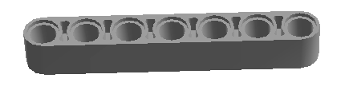
LIFTARMS
Liftarms come in various sizes from 2M to 15M length
Technic is measured in Modules (M)
The number of holes corresponds to the Modules
15M
13M
11M
9M
7M
5M
3M
2M
1M
1M
7 Modules = 7M

Slide 4
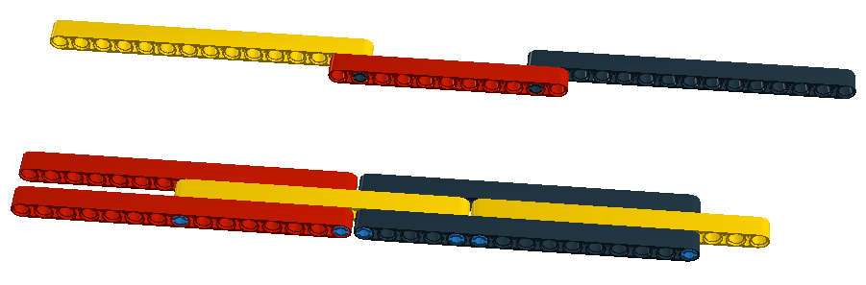
TEST: MAKING SOMETHING LONG
What if you want to build something long
Build both models below. Which one is stronger?

Slide 5
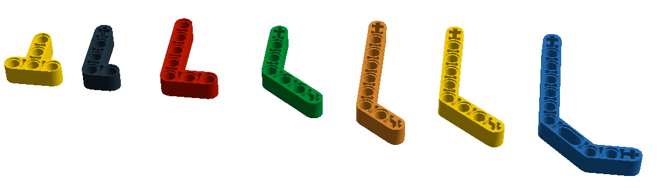
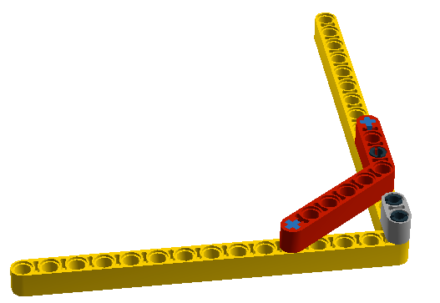
LIFTARMS – ANGLES
T-beam
3X3
4X2
90 degrees
4X3
90 degrees
Angle
4X4
Angle
4X2
Angle
3X7
Double Angle
3X7
Don’t force LEGO into angles they are not meant for. You will put stress on the liftarms and the pegs
These beams all have a 53.1° angle. This angle makes 3:4:5 right triangles like this one.

Slide 6
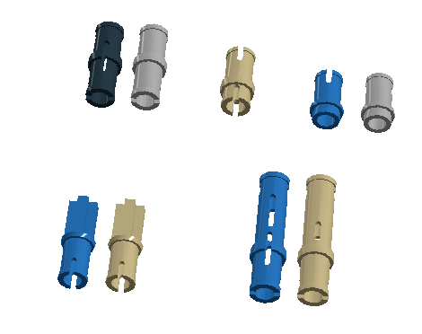
TECHNIC PEGS
LEGO makes two type of pegs: With Friction and Frictionless pegs
A common mistake is to use either peg in builds
However, which peg you use does matter!
WF FL
FL
FL FL
WF FL
WF FL
FL – Frictionless
WF- Friction

Slide 7
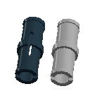
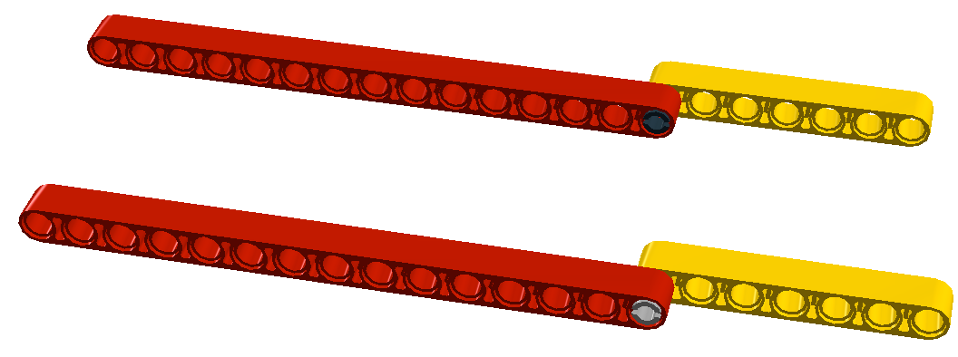
TECHNIC PEG TEST
Build both these models. One uses a black peg with friction and the other uses the grey frictionless peg
What is different?
WF FL

Slide 8
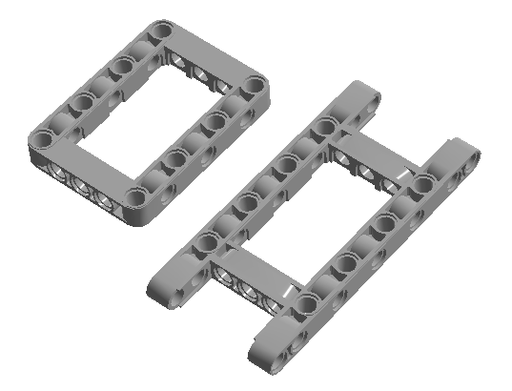
FRAMES
Open frames and H- frames can add strength to your builds without as much weight

Slide 9
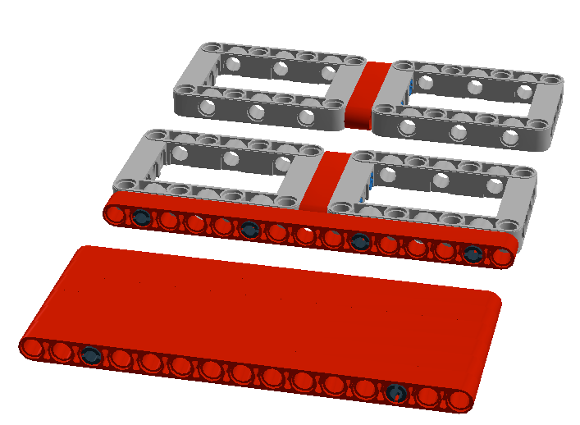
FRAMES TEST
Build each of these.
Compare them for weight and strength
Try to pull the pieces apart. Which one stays together the best?

Slide 10
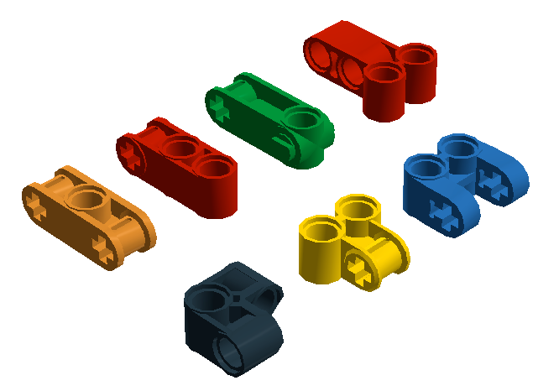
Changing Directions
These connectors can be used to change directions
You might sometimes need to be a ½ module off. Some of these connectors can come in handy for this.

Slide 11
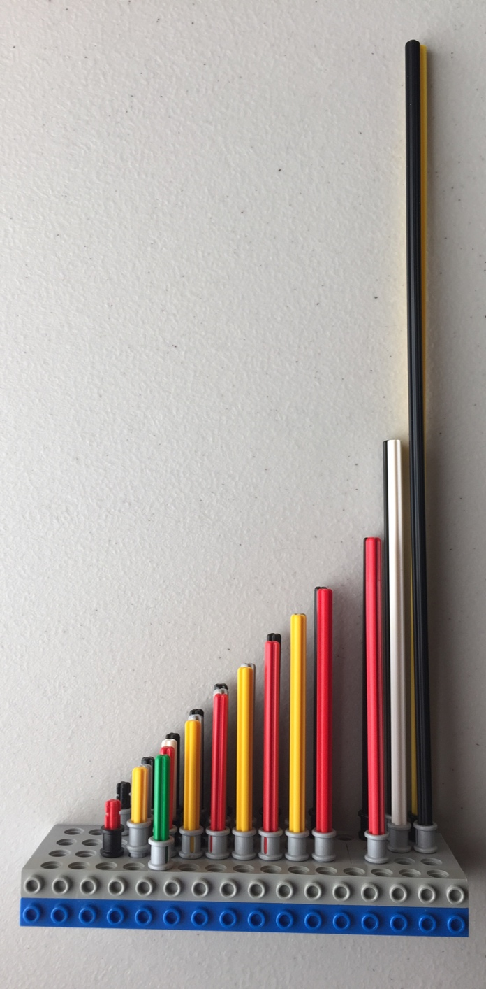
AXLES
32
Axles come in lengths of 2M to 32M in various colors
The MINDSTORMS set generally has black, red (2 length), and grey axles, but newer technic sets are changing to all red and yellow
16
12
10
9
8
7
6
5
4
3
2

Slide 12
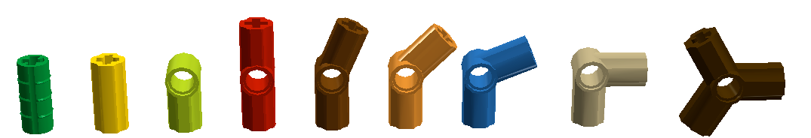
Axle CONNECTORS
Axle connectors come in various angles. Many of them are labeled with a number
Don’t force LEGO into angles they are not meant for. You will put stress on the axles and connectors
1
2
3
4
5
6
22.5°
45°
67.5°
90°

Slide 13
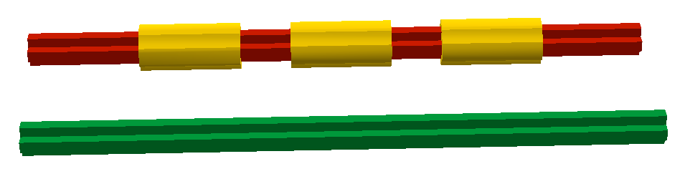
AXlE TEST
Sometimes, shorter axles with connectors are a lot stronger than one long axle
Construct both builds below. Try bending/twisting them. Which one is stronger?
Three length axles with connectors
12 length axle

Slide 14
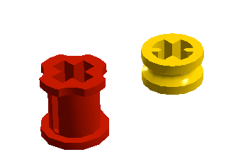
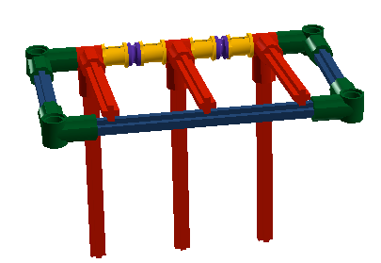
BUSHINGS
Bushings can come in very handy
They are used in axles like a space holder

Slide 15
Credits
This tutorial was created by Sanjay Seshan and Arvind Seshan
More lessons at www.ev3lessons.com and www.flltutorials.com
This work is licensed under a Creative Commons Attribution-NonCommercial-ShareAlike 4.0 International License.

