Slide 1
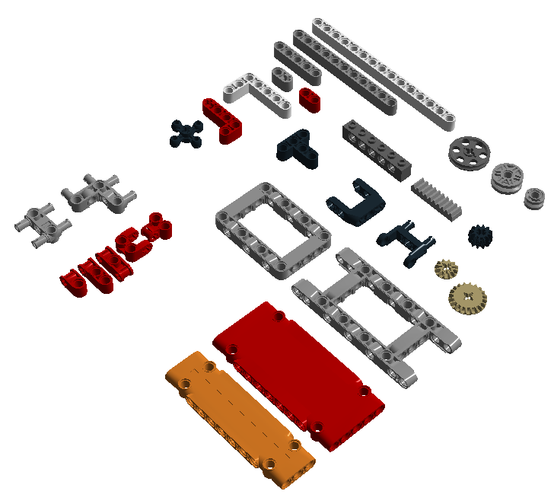
Useful Parts
for FIRST LEGO League
By FLLTutorials.com
Lift arms of different sizes
Wheels for wall riding
Rack gears
Useful for Changing Directions
Panels
Gear boxes
Frames

Slide 2
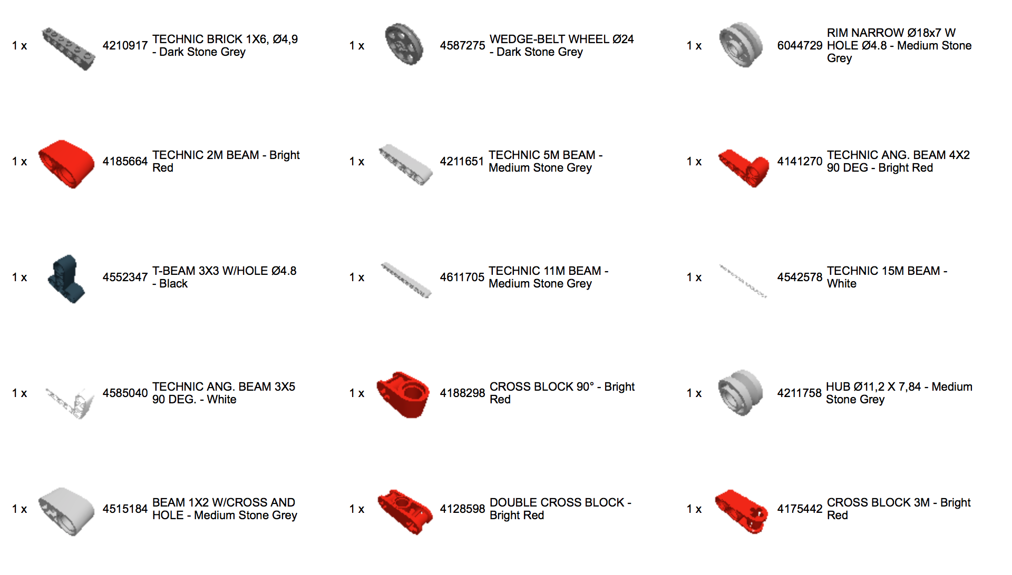
Useful Parts for FIRST LEGO League by FLLTutorials.com
FLLTutorials.com

Slide 3
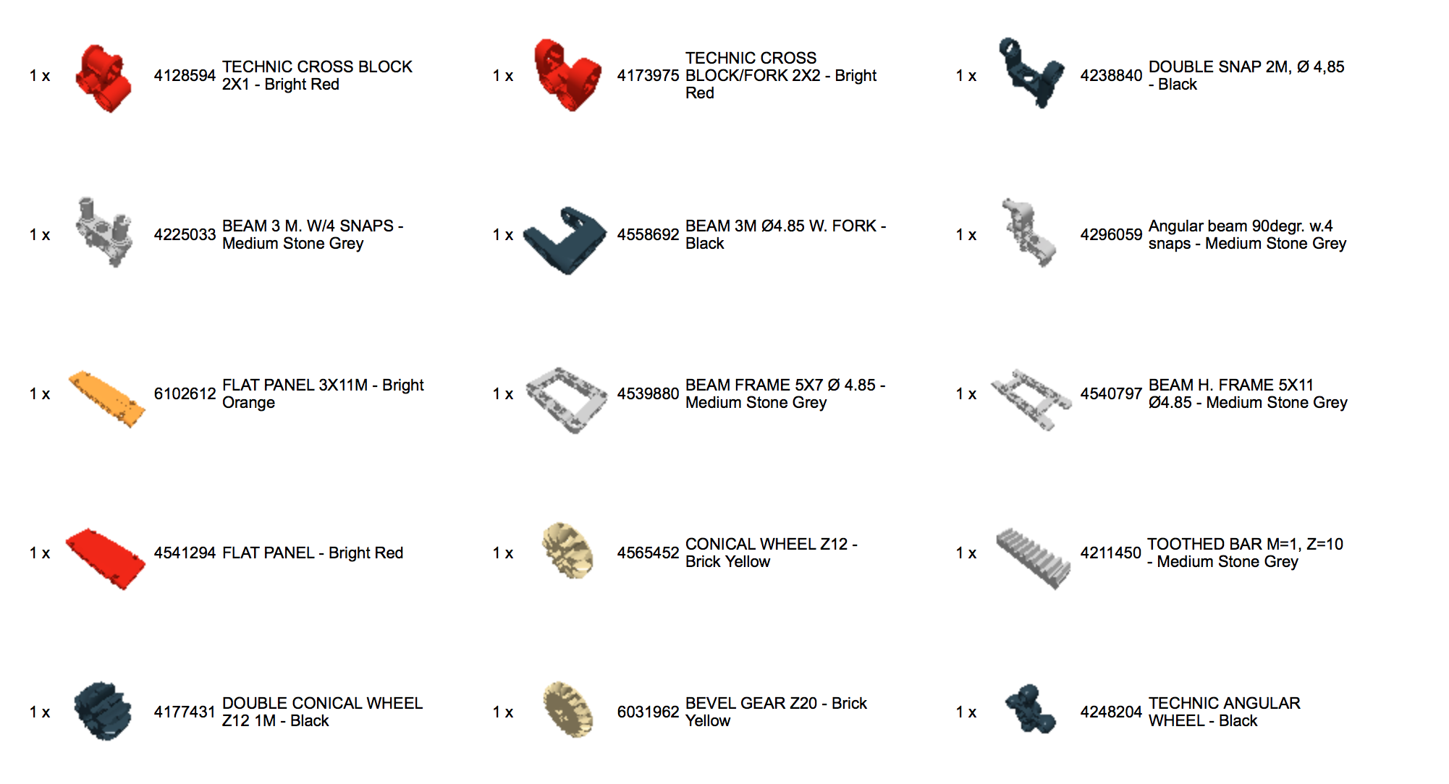
Useful Parts for FIRST LEGO League by FLLTutorials.com
FLLTutorials.com

