Slide 1
What makes a good Project? Tips from three GIA TEAMS
ShARON TIGER TECHS, NOT THE DROIDS YOU ARE LOOKING FOR, LEGO LEgion

Slide 2
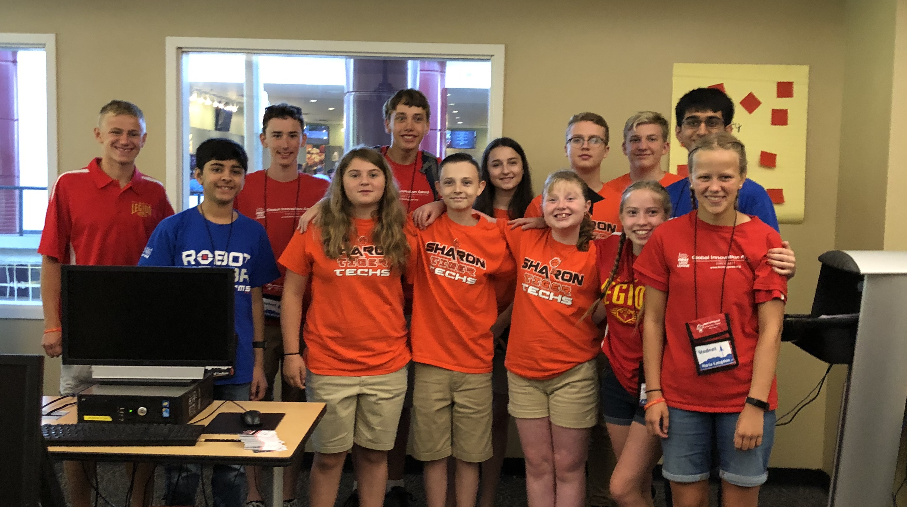
About The AUTHORs
All three authors are Global Innovation Award Top 20 Teams
Sharon Tiger Techs (2019), LEGO Legion (2018), Not the Droids You Are Looking For (2016)

Slide 3
GETTING A Head Start in the OFF SEASON
Techs fill in
Using key words
Add a photo of the post-it session

Slide 4
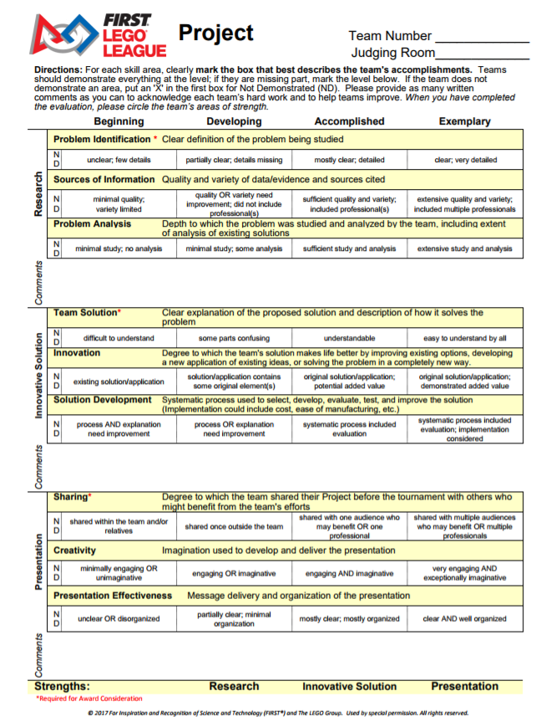
Communicate your content in your 5 mins
It is vert important to communicate all the key information in your 5 minute presentation so that judges can easily mark the rubric.
5 minutes includes set-up time, so keep the setup short and easy always so you have more time for your presentation

Slide 5
Always have more to tell in Q&A
A good project will have more information than what you presented in the 5 mins.
Keep a binder with your additional data
During Q&A, you will have a chance to share this additional information.
Anyone have. A nice photo?

Slide 6
MAKE EXPERTS count – not just parents
Find good, meaningful experts
How do you find them?
LEGO LEGION Fill in

Slide 7
SHARE WITH THOSE WHO CARE
LEGO Legion fil lin – Oxo, etc.
Take the feedback and improve

Slide 8
What makes it innovative?
Techs fill in

Slide 9
DISCUSSION
Watch the following videos of project presentations
ADD LINKS HERE FROM YOUTUBE
XXX
What can we learn from each presentation?
What did they do well?
How many students were involved?
Were you able to fill in a rubric?
Were they creative?
What made this presentation different?

Slide 10
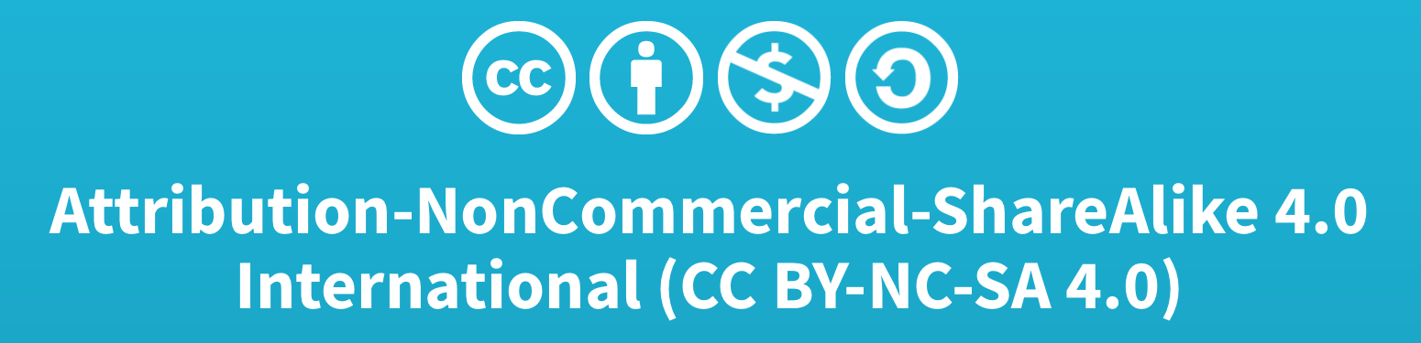
Credits
This lesson was written by Tiger Techs, LEGO Legion and Droids
More lessons available at www.ev3lessons.com and www.flltutorials.com

