Slide 1
Introduction to Core Values
Vicky Zhai, FTC 9873

Slide 2

Core values
The Robot Game and Project are what teams do.
The Core Values are how they do it.

Slide 3
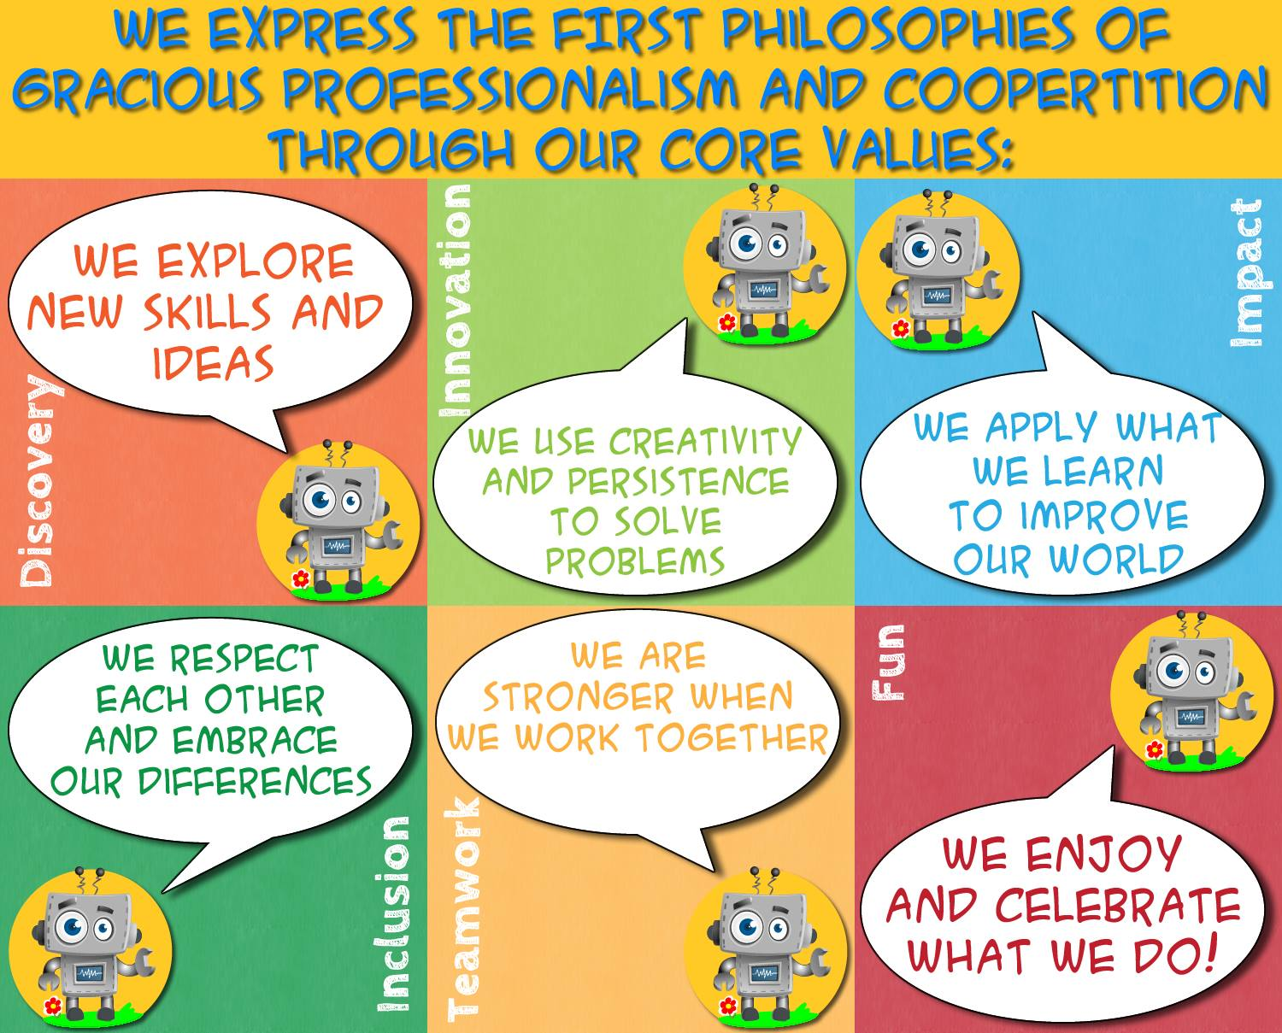
The FIRST Core Values are YOUR Team’s GUIDE
The Core Values were updated in 2018
These Core Values are consistent across all four FIRST programs
This graphic is available for teams to use: https://www.facebook.com/media/set/?set=a.589364151426694.1073741832.588716398158136&type=1&l=1bd0c4767f

Slide 4
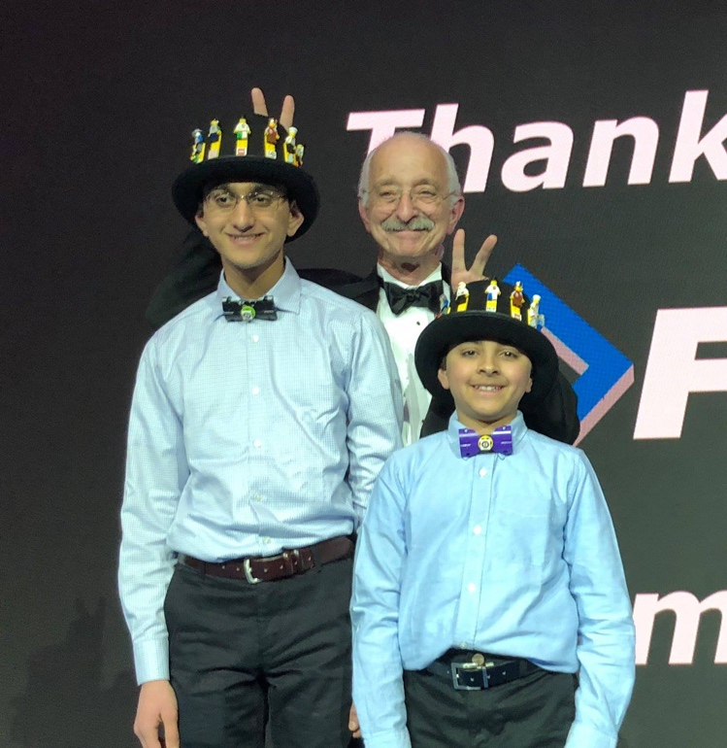
Gracious professionalism
“Learn and compete like crazy, but treat one another with respect and kindness”
Dr. Woodie Flowers, FIRST Distinguished Advisor

Slide 5
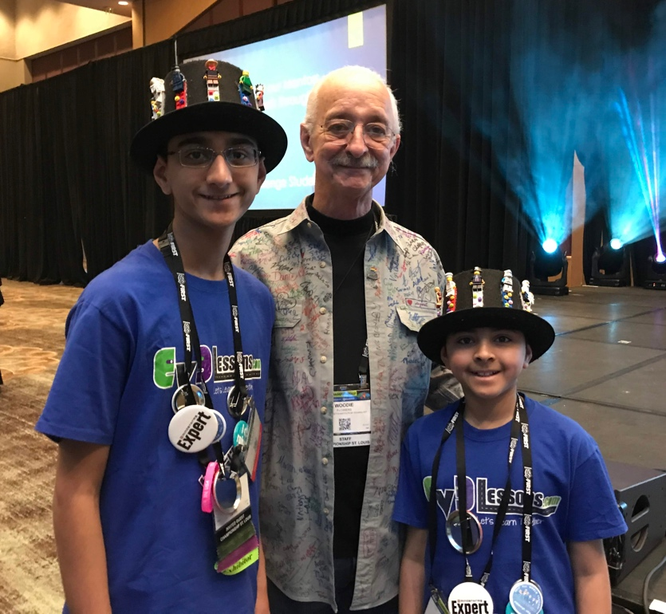
Coopertition
“ Teams can and should help and cooperate with each other even as they compete”
Dr. Woodie Flowers, FIRST Distinguished Advisor

Slide 6
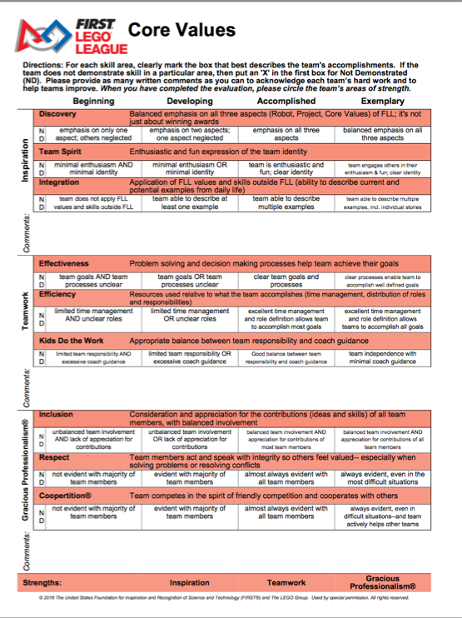
TERMS USED in the CORE VALUES RUBRIC
Look closely at the Rubrics and understand the meaning of each term:
Discovery: Equal time on all parts of FIRST LEGO League
Team Spirit: Having your own identity
Integration: Using what you learn in FIRST LEGO League outside FIRST LEGO League
Teamwork: Being able to work together effectively, and efficiently without coach help
Inclusion: Making sure all team members are included
Respect: Valuing each member
Coopertition: Helping others and accepting help from others, working with other teams
Notes:
Have examples for each?
Animate that teamwork is judged by teamwork activity, other parts are judged using poster/presentation

Slide 7
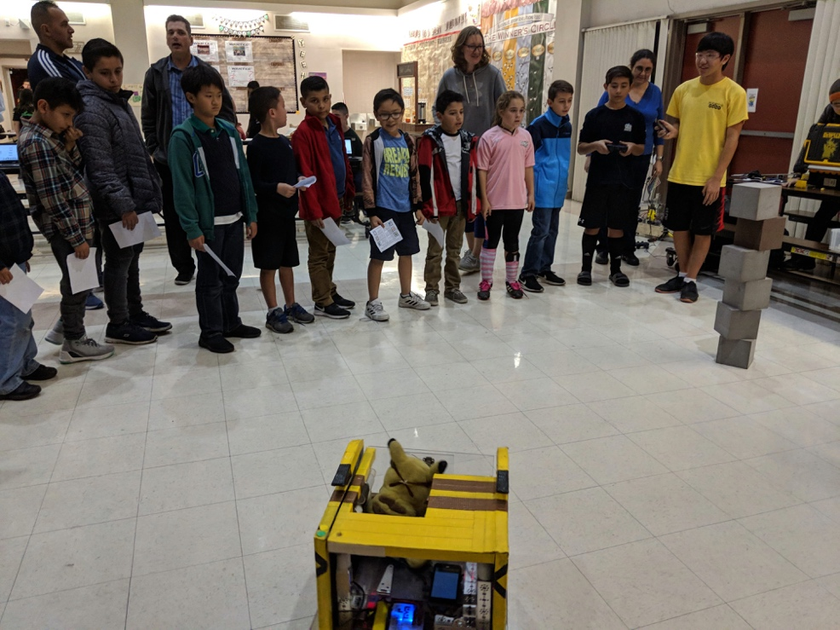
Displaying COOPERTITION is important
Why is it important?
It encourages learning from your teammates, competitors, and mentors
It is what makes the FIRST program different
Many ways to show Coopertition
Lending a team a part if they need it, even if it helps them to score higher
Inviting teams to your house to teach them how to make better projects and teach them your robotics skills
You don’t solve the challenge for them and provide solutions. Instead, you inspire them and show them how to discover their own solutions

Slide 8
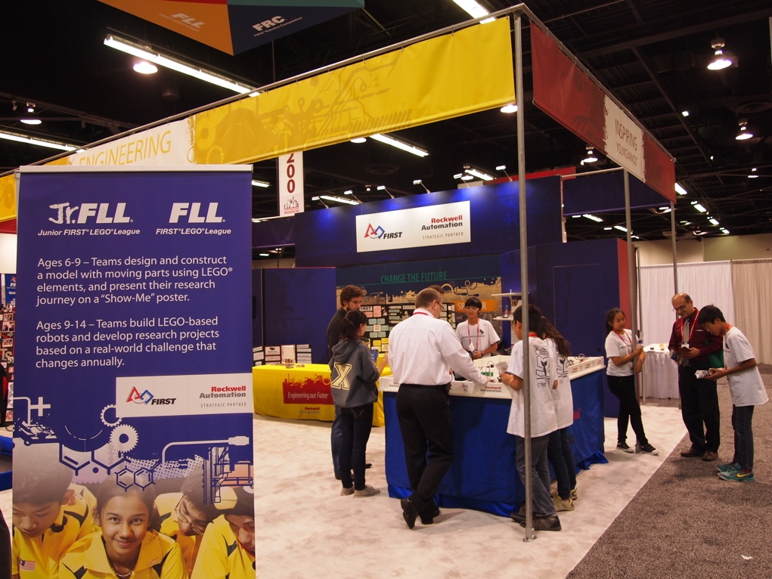
WHY DO OUTREACH ACTIVITES?
Give back to the community
Share your knowledge
Share your passion for FIRST and STEM
Encourage other students and adults to participate in FIRST

Slide 9
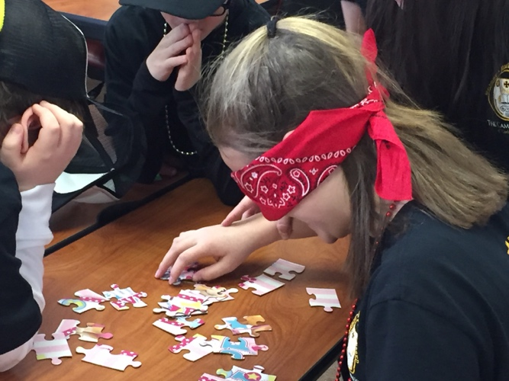
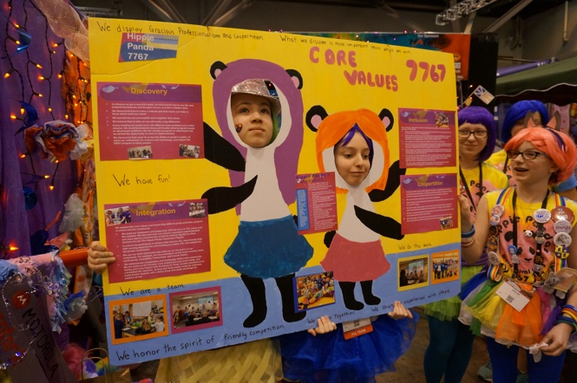
JUDGING CORE VALUES - OVERVIEW
Judges present a team activity
The team will then get to present their Core Values poster
Judges will ask follow-up questions about events presented on poster, and additional questions about applying core values outside of FIRST LEGO League
9

Slide 10
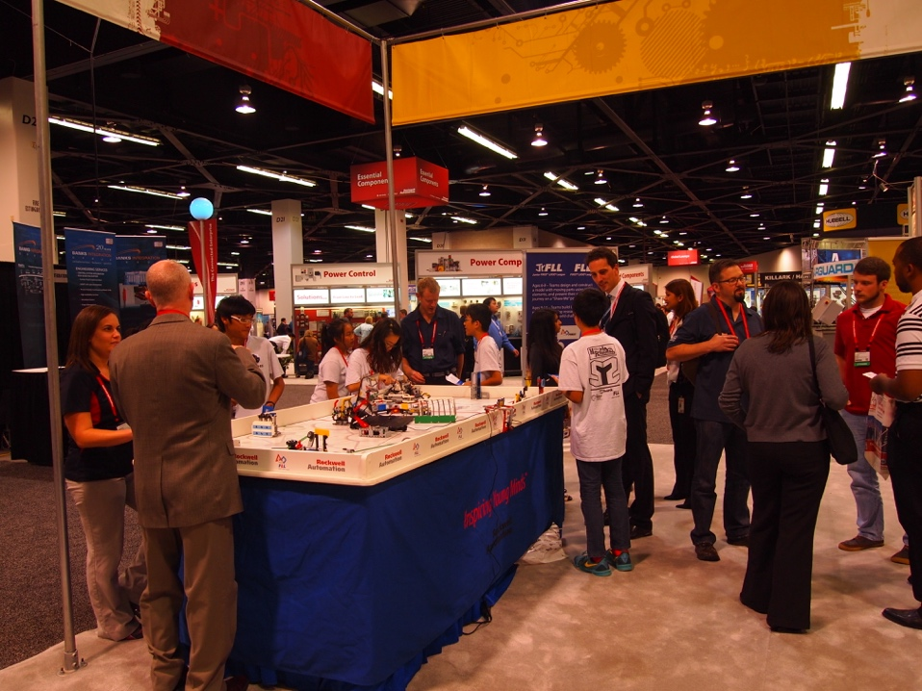
MOST IMPORTANT: Embrace CORE VALUES
Core Values is not just something you do.
It is a way, a METHOD of doing things that builds character and guides us throughout the whole experience!
10

Slide 11
MOST Importantly: Embrace CORE VALUES
Core Values is not just something you do.
It is a way, a METHOD of doing things that builds character and guides us throughout the whole experience!
11

Slide 12
CREDITS
The primary author of this lesson is Vicky Zhai from FTC 9873. Additional information from Christopher Haines and Chris Baker was incorporated into the lesson.
More lessons for FIRST LEGO League are available at www.flltutorials.com
Creative Commons Attribution-NonCommercial-ShareAlike 4.0 International License

