Slide 1
DEVELOPING A TEAM IDENTITY
PRETTY SMART POWER GIRLS

Slide 2
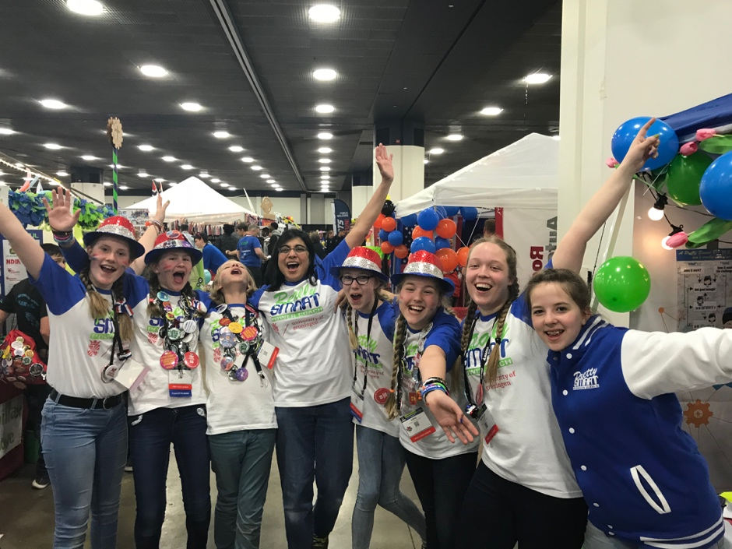
MEET THE TEAM
Pretty Smart Power Girls are a team of friends from Noordhorn, Groningen, The Netherlands
All-girls team
4th year in FIRST LEGO League
2018 BeNeLux Champions (Hydro Dynamics)
FIRST World Festival Detroit, MI 2018

Slide 3
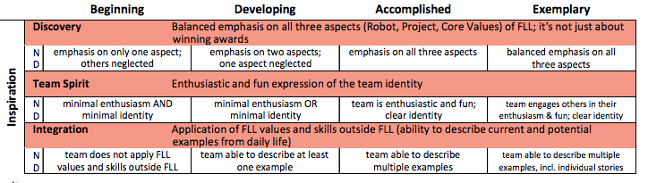
WHY DEVELOP A Team IDENTITY?
It helps with team building: finding out about your team’s identity also strengthens your team by appealing to a common denominator for all team members.
It helps with team recognition: having a well-defined identity makes you easily recognizable and other teams and volunteers will be able to remember you in different seasons and competitions
It helps make an impression on the judges: FLL is a judged sport. Judges will recognize and appreciate your efforts at establishing a fitting team identity.
It is fun. No explanation needed.
3

Slide 4
GET TO KNOW YOUR TEAM
Some of your team identity can be planned. Others get added over time.
The best way to find an identity that matches your team and your teammates is to do many Core Value / Team Building exercises.
You can find lots of ideas on FLLtutorials.com

Slide 5
AN IDENTITY FOR ONE SEASON AND BEYOND
One time: build an identity for a single season
Prolonged: build an identity for multiple seasons
Maybe your team only competes once in FLL
You want to emphasize the season’s theme
You aim to participate over multiple seasons and want to remain recognizable.
You want to emphasize your team’s identity or personality

Slide 6

Choosing a team name
Theme based: Base your team name on the season’s theme. For the Hydro Dynamics season a lot of teams had ‘hydro’, ‘aqua’ or ‘water’ in their names.
Examples: Hydrabots, Water BuffaLEGOs, Aqua Challengers, The Hydro Haulks. Pros: Fits current theme, spectacular. Cons: One time use
Location or Organization based: Base your name on your city or school.
Examples: Princeton Unimators, Pennsylvania's Finest Robotics, Cadmes Creators, Frencken’s Future. Pros: Easily identifiable, reusable. Cons: sometimes less memorable
Fantasy Name: Make up your own name. It can be anything you and your team are comfortable with. It can be descriptive or completely made up. Be creative!
Pros: Spectacular, reusable, easily identifiable, creative. Cons: Maybe your school or sponsor wants to included

Slide 7
Case Study: COMING UP WITH OUR NAME
We wanted an international sounding name, so we chose an English name although we are from the Netherlands.
We are all girls. So”Girls” should be in the name.
We make fun of “pretty” being THE defining quality for girls. We are just as smart as boys.
So we came up with Pretty Smart Girls. Our coach explained that in English Pretty Smart can mean different things, it is a pun. Pretty is “beautiful”, but also “quite”. And Smart is “intelligent”, but also “Stylish, fashionable”. The combination “pretty smart” can mean many things!
POWER is an acronym for what we do (in Dutch): Programming, Onderzoek (research), Wetenschap (science), Experimenting, Robotics.
All combined makes us Pretty Smart POWER Girls.
Whatever name you pick, make sure it has a meaning for your team.

Slide 8
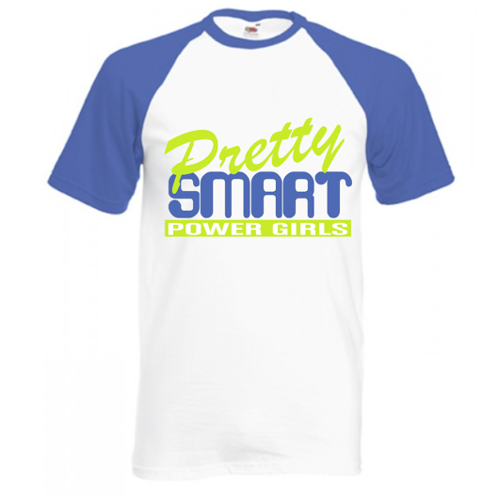
Developing a TEAM LOGO
Every team needs a name
A team logo is optional, but fun!
We have a colorful logo that represents our fun and diveristy and passion for science.
The words in the logo have a typeface that matches their meaning.
We have different logos for online/print and for shirts. But they are still easily identifiable.
8

Slide 9
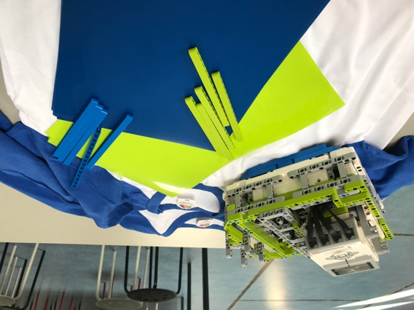
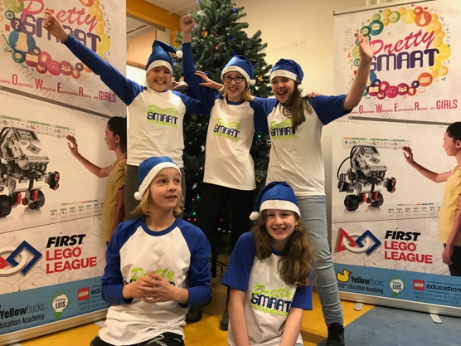
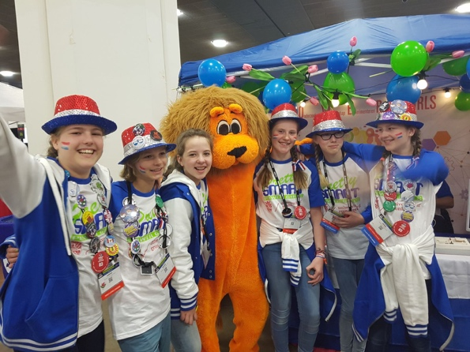
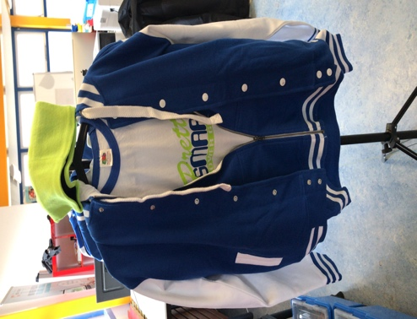
SHIRTS and hats help create an identity
Our shirts vary every season. We started simple, but as we got more experienced, we also put more time into our appearance.
We always wear some kind of hat. It’s just so much more fun!
This year we also added sweaters and jackets
Our robot and shirts match!
Christmas hats in december
Dutch hats, makeup and ribbons
for internationals

Slide 10
TEAM CHEERS
Having a cheer, yell or a song can define you as a team.
You can add to your identity by creating a yell or cheer that is unique and enhances your team presence.
Maybe you can even add dance moves!

Slide 11
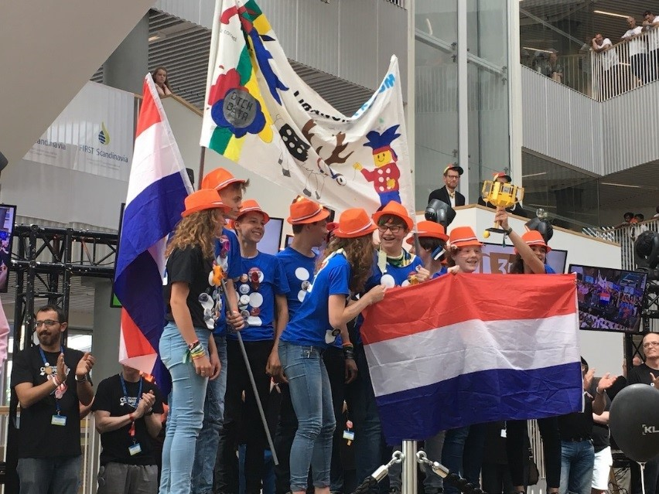
Flags, Banners, Mascots
Flags are a good way to show where you are from. (Country, state, city, or school)
Banners
Mascots
Photo: Dutch Delta

Slide 12

Social media
Also very important for establishing an identity: online presence!
Facebook, website, instagram, twitter, youtube,…
Talk about your team, your goals and dreams, the team members, your project, and any other amazing findings
Use these social media sites to share and inspire!

Slide 13
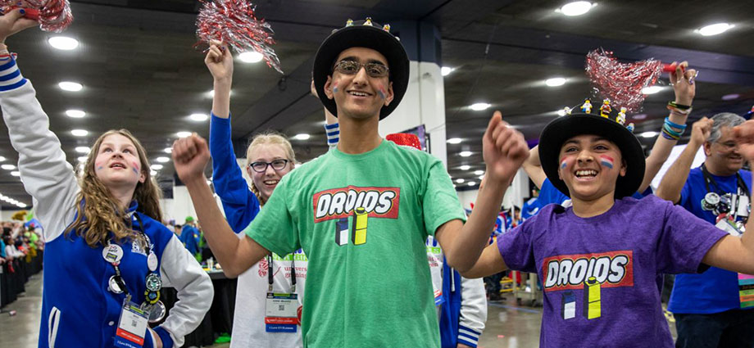
TIP: Be authentic
No matter what identity you have or want to create, always be authentic, be true to who you are as a team.
For example, if you are all shy kids, don’t create an image that you are extroverted party people. Or if you are cheery bouncy kids, don’t try the “professional” look. Do what makes you happy!
Don’t copy an other teams’ identity just because they seem succesful. It probably won’t work for you. See above.
Pretty Smart supporting the Droids at 2018 Detroit World Festival

Slide 14
CREDITS
This lesson was written by Pretty Smart Power Girls (https://www.facebook.com/prettysmartfll/)
More lessons for FIRST LEGO League are available at www.flltutorials.com
Creative Commons Attribution-NonCommercial-ShareAlike 4.0 International License

