Slide 1
Consolidated judging
Seshan brothers

Slide 2
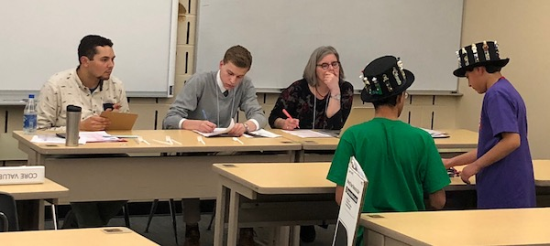
What is consolidated judging?
Some regions are using a consolidated judging system
Instead of teams having to move from room-to-room, all judging happens in one room
Your team will have a 20-30 minute single judging slot that covers Robot Design, Project, and Core Values

Slide 3
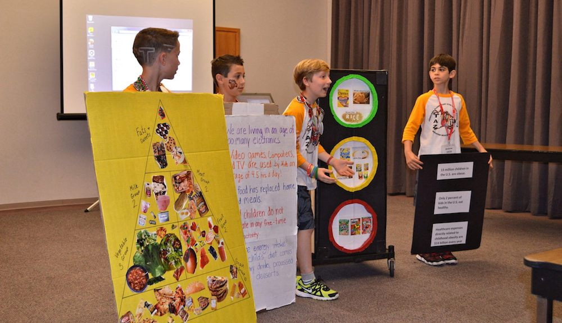
What happens in Consolidated judging?
Sample* 20-min judging schedule:
5 minute Project presentation
2 minutes questions about the Project
5 minute Robot Design judging. No game table will be in the room. You are allowed 2mins for a prepared presentation if you want to. with your Tournament Director.
Photo Credit: Razorback Open
* There may be regional variation as to how this is implemented. Always check with your Tournament Director.
5-minutes for Core Values judging. You are allowed to use 2 minutes for a Core Values poster presentation if you want to.
3-minutes for judges to ask any questions they want to

Slide 4
Consolidated RUBRIC
* Sample from 2018 INTO ORBIT. Make sure you have the most recent version if your region uses this rubric

Slide 5
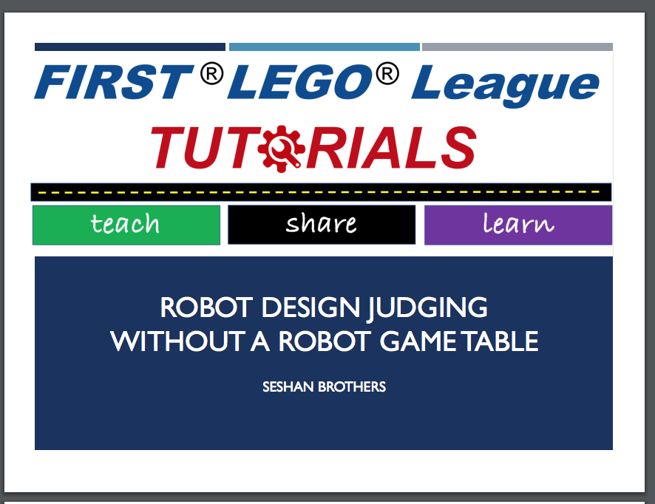
TIPS in judging
Be efficient. Timing starts as soon as you enter the room. Since project is first, be ready to go with costumes, props, etc. Minimize set up time.
Be prepared. Have everything ready for Robot and Core Values Presentations so that it is quick and easy to switch to the next presentation. Consider having everything on one cart.
Be ready to explain. There is no robot game table. Prepare to explain your process, not show your runs. (Take a look at the lesson on FLLTutorials for additional tips.)
Have a plan and communicate well. Make sure that you communicate everything you want to in your presentation time. Use the rubrics as your guide.
Leave a summary sheet. If you want to leave documentation, you can. Include some highlights about your robot, project and core values.

Slide 6
Advantages of consolidated judging
Easier for teams as they do not need to find their next room
Gives a chance for teams to get to know their judges in 20 (or 30) mins.
Judges can evaluate throughout the 20 (or 30) mins; this allows judges from each core area to evaluate and ask questions.
During deliberations, the judges can advocate for the teams with a deeper understanding of each of the core areas
Improved judging and training due to having to recruit less judges
Teams still get all the presentation time they would get in individual/separated judging slots.

Slide 7
Credits
This tutorial was created by Sanjay Seshan and Arvind Seshan
More lessons at www.ev3lessons.com and www.flltutorials.com
This work is licensed under a Creative Commons Attribution-NonCommercial-ShareAlike 4.0 International License.

