Slide 1
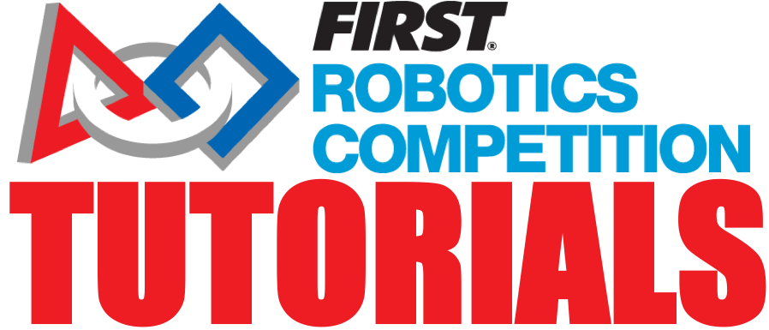
Passing Inspection
Team 8027

Slide 2
What is Inspection?
Every robot must pass inspection twice:
On Thursday
On Saturday before playoffs. This inspection round is easier. You just have to account for any changes from the previous round.
They will weigh your robot without bumpers and weigh the bumpers separately on Thursday
On Saturday, you will not have to take off the bumpers for the reweighing process

Slide 3
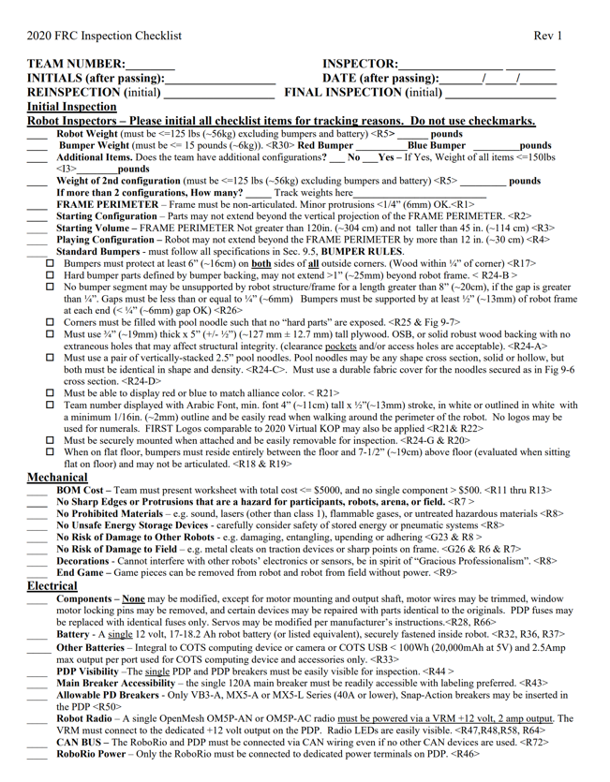
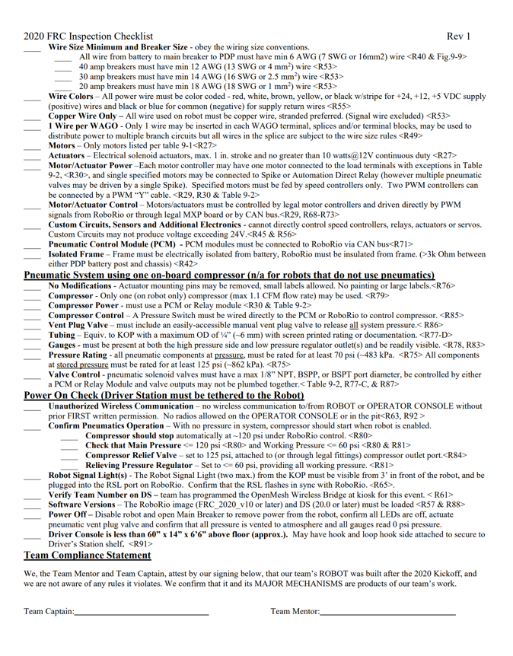
Know the Rules and Use the Checklist
The framer perimeter, wiring and bumper information is available in the challenge documents (https://firstfrc.blob.core.windows.net/frc2020/Manual/2020FRCGameSeasonManual.pdf)
The inspection Checklist is provided to all teams in advance so use it to conduct your own inspection the week before. There should be no big surprises
https://firstfrc.blob.core.windows.net/frc2020/Manual/2020-inspection-checklist.pdf

Slide 4
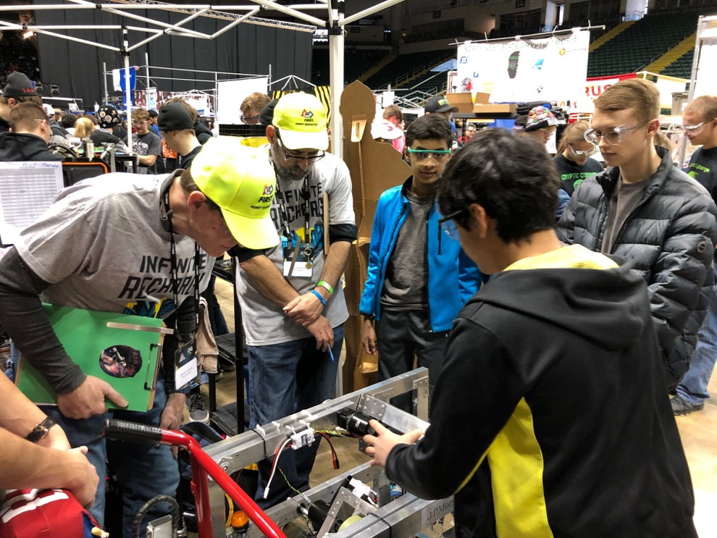
What to bring
Flashlight
Multimeter
Robot
Proof of wire gauge
Any documentation for pneumatics and electronics
Completed Bill of Materials (BOM) (https://firstfrc.blob.core.windows.net/frc2020/AuxFiles/2020BillofMaterial-Template.xlsx)

Slide 5
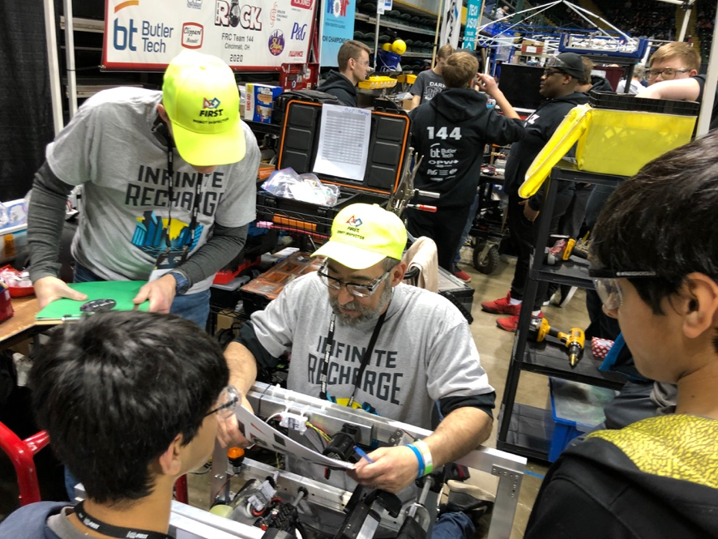
Tips for Success
Get inspected early. Get your robot weighed and then get in line for inspection as soon as you can.
That way, if you have any problems, you will have time during the day to solve them.
Keep your pit clean and organized
Make sure you have no protrusions/sharp edges
You must be able to take off and put back your bumpers during inspection within a reasonable amount of time.
[Rookie Tip] Talk to your inspector and ask them to explain if you don’t understand.

Slide 6

Credits
This lesson was written by FRC 8027 for FRCTutorials.com
You can contact the author at team@droidsrobotics.org
More lessons for FIRST Robotics Competition are available at www.FRCtutorials.com
This work is licensed under a
Creative Commons Attribution-NonCommercial-ShareAlike 4.0 International License.

