Slide 1


Pneumatics
“Wiring with Air”
TEAM 4150

Slide 2
What pneumatics can be used for
At its base function, a pneumatic cylinder can either push or pull, and can only go from retracted to extended and back again.
With some creative design and build, they can be used for:
Positioning
Lifting
Rotating

Slide 3
Common Parts of a Pneumatic System
Pneumatic systems generally consist of several components:
Compressor
Air tanks
Gauge
Reglator
Release / Control valve
Cylinders and Actuator
Solenoids
PCM
Tubing and connectors

Slide 4
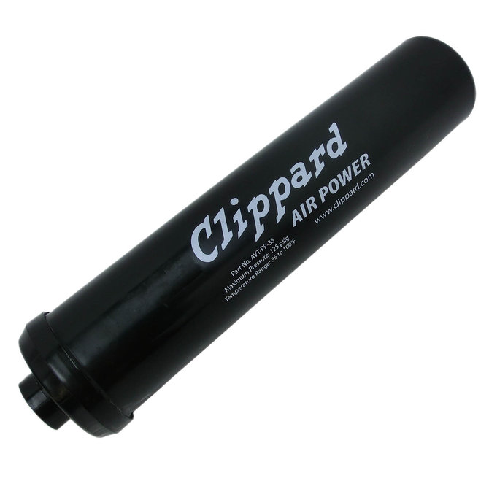
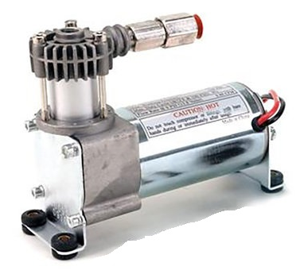
Compressor
Air Tanks
The compressor takes surrounding air and compresses it to be sent to the tanks. An FRC bot often uses a 12V DC Compressor from AndyMark this can be obtained from the kit of parts, first choice as well as directly from AndyMark.
Air Tanks store the air that has been compressed. The more cylinders you have, the larger they are, and the more often you use them, the more tanks you need. Air is often stored here at 120 psi.

Slide 5
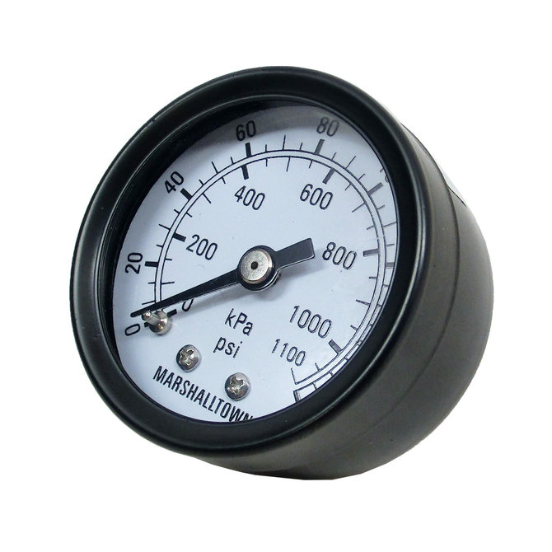
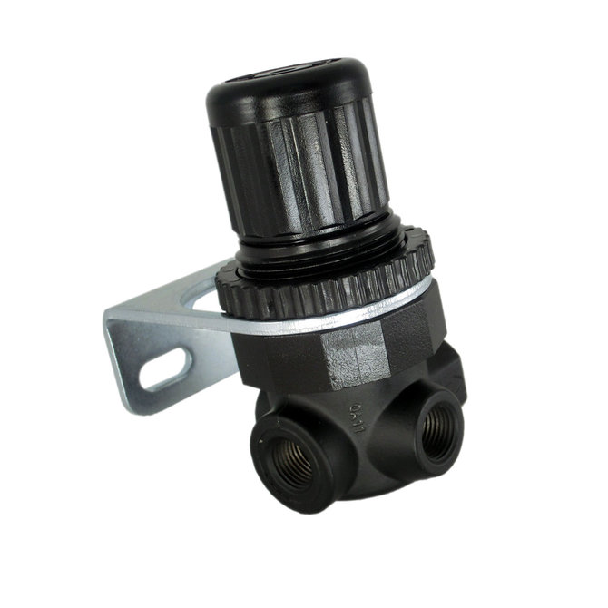
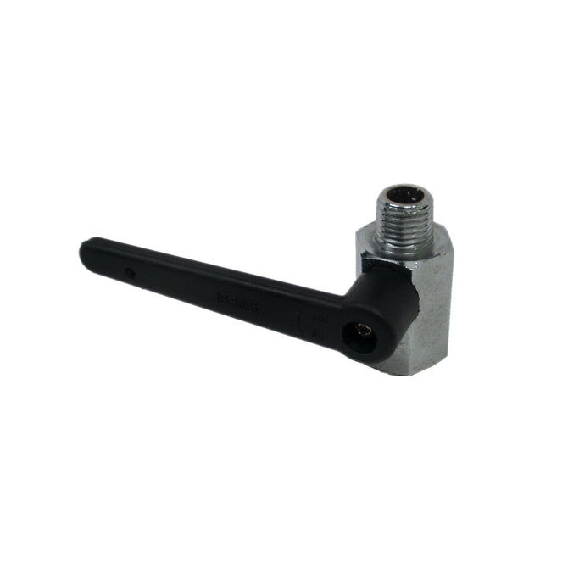
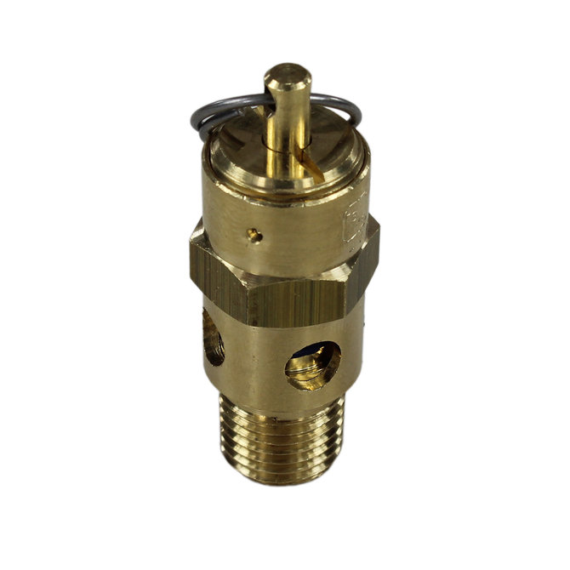
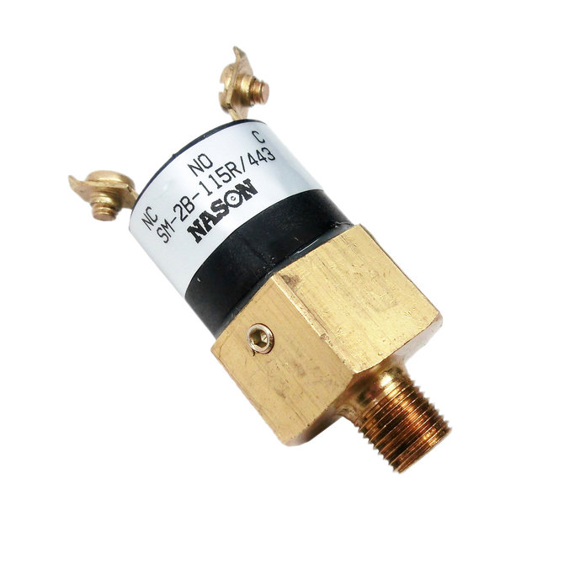
Gauge
Regulator
A regulator is used to take the pressurized air and make it a desired pressure. This brings the working pressure from the 120 psi of the tanks to 60 psi for use.
The gauge shows the pressure of the pneumatic system.
Release / Control Valve
Release valves let air out of the system, whether as air released from the regulator or from a team member depressurizing the robot.

Slide 6
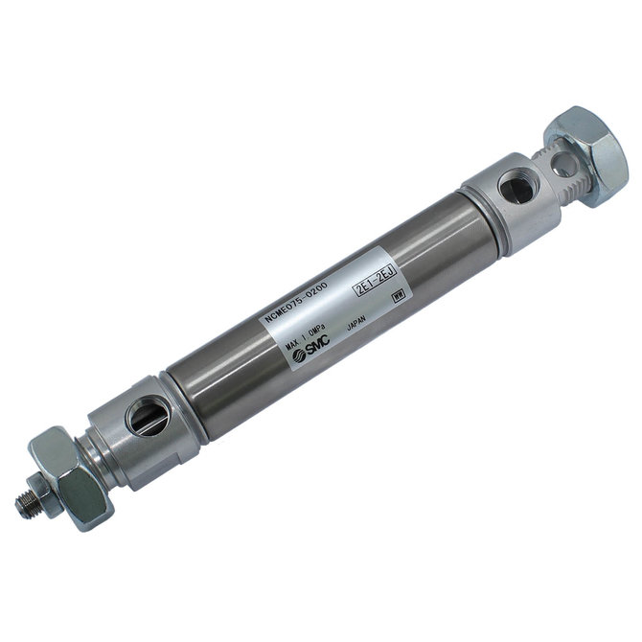
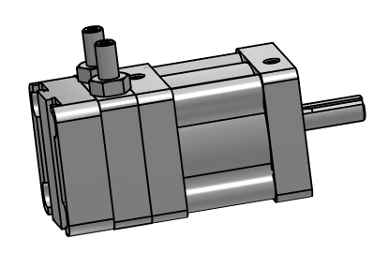
Cylinders and Actuators
Pneumatic cylinders are what actually use the compressed air. They can be both expanded and contracted under pressure. Actuators use the air to provide rotational motion. They use mechanical stops to control the angle they rotate. The positions of these stops can be changed

Slide 7
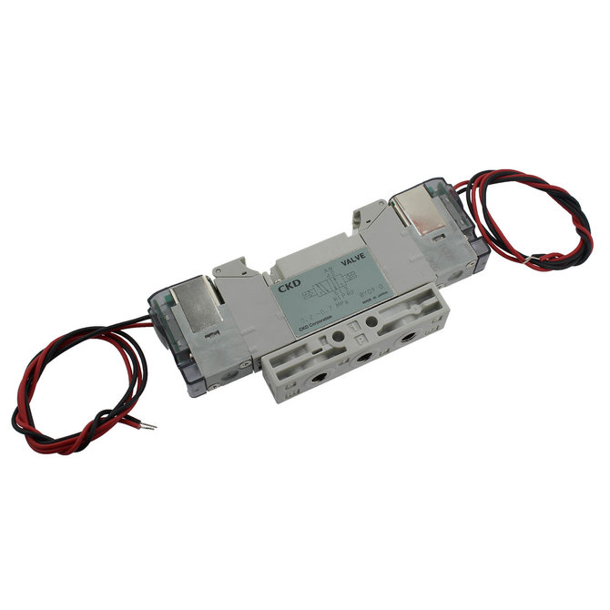

Solenoids
Pneumatic Control Module (PCM)
Solenoids communicate with the PCM to control the flow of air to the cylinders and actuators.
The PCM communicates with the RoboRio to find out what the driver wants the cylinders to do. It then uses this information to tell the solenoids to extend or contract a cylinder. It is the only main part that does not have air go to or from it.

Slide 8
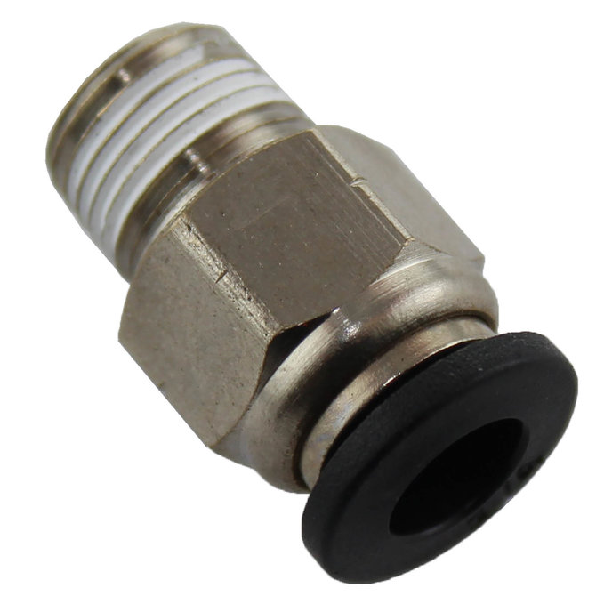
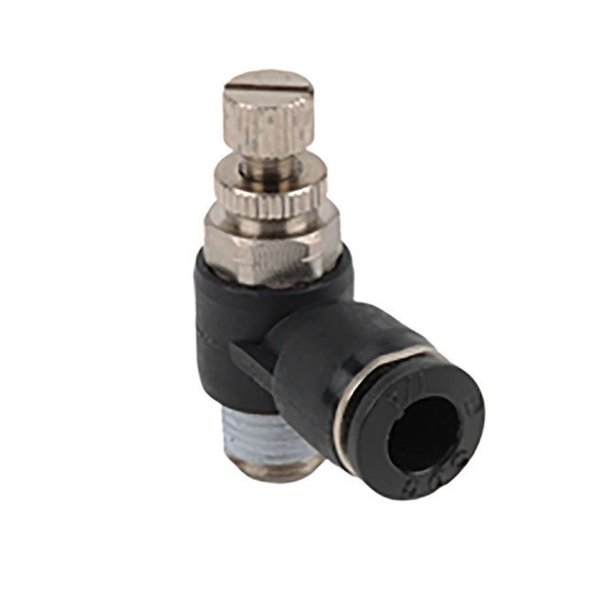
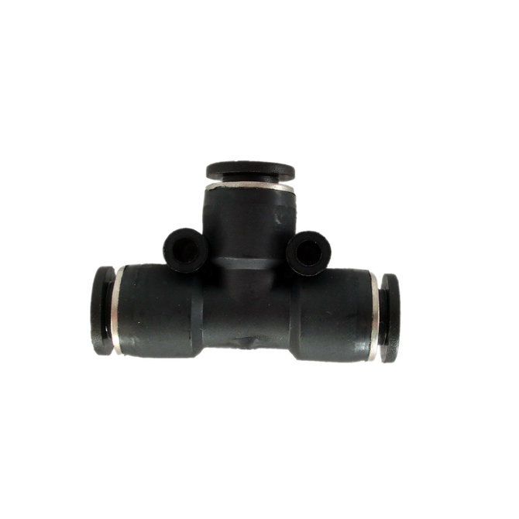
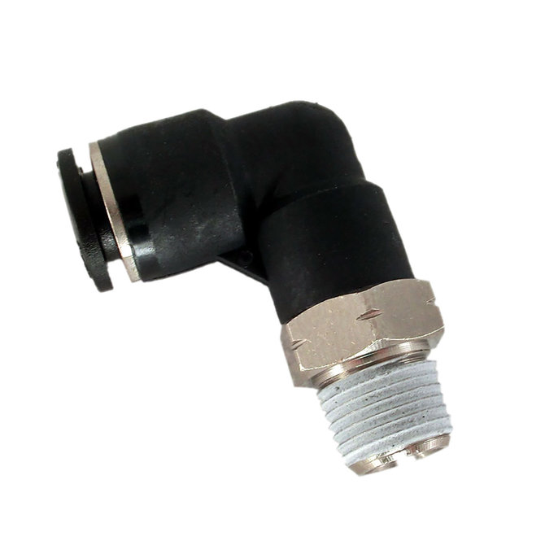
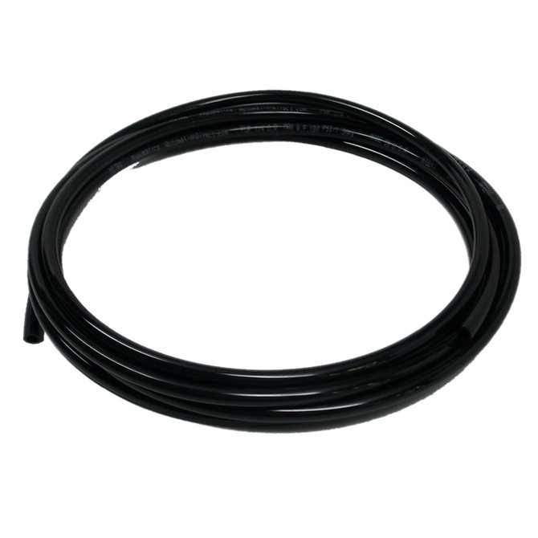
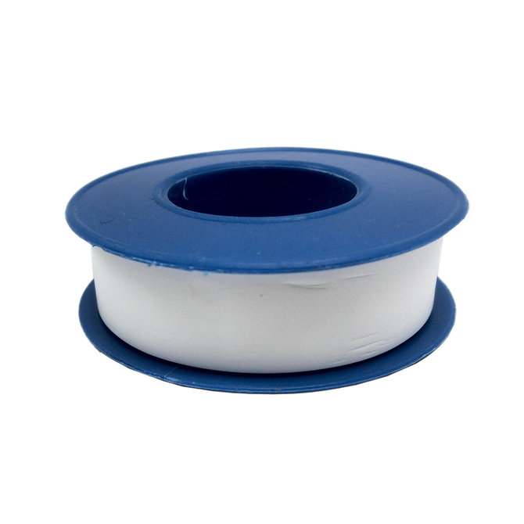
Tubing and Connectors
Tubing is used to bring air to all the components in the system. Make sure that you use the right size connectors with the right size tubing, otherwise you may not be able to get the tube into the connector or may have leaks.All connectors with threads should be teflon taped to prevent leaks.
Teflon tape

Slide 9
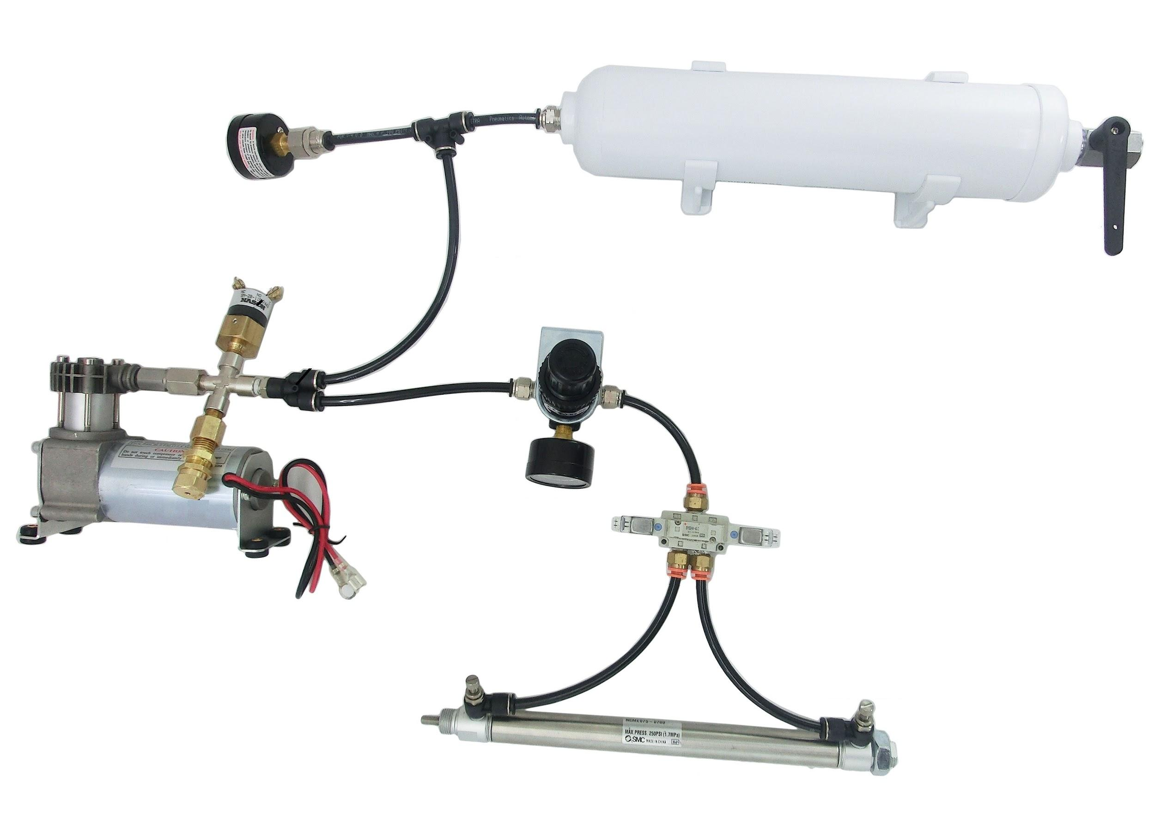
Pneumatic Mockup
Air Tank
Gauge
Pressure switch and Release valve
Regulator
Compressor
Solenoid
Cylinder

Slide 10
Tips
Watch mixing metric tubing and fittings with imperial. ¼” tubing looks the same as 6mm, but a ¼” tube inserted into a 6mm fitting will not be removed easily (if at all)
Cylinders want to push the piston all of the way out, or pull it all of the way in. Stopping at some other point requires mechanical stops.
Calculate cylinder force by multiplying the working pressure (normally 60psi) times the cross sectional area of the cylinder in sq inches [3.14*(D/2)²]
Worn compressors can be ‘refreshed’ by rebuilding the cylinder head. Kits are available online.

Slide 11
Credits
This lesson was written by FRC 4150 in partnership with FRC 8027 for FRCTutorials.com
You can contact the author at froboticsteam4150@gmail.com.
More lessons for FIRST Robotics Competition are available at www.FRCtutorials.com
This work is licensed under a
Creative Commons Attribution-NonCommercial-ShareAlike 4.0 International License.

