Slide 1


Soldering
Team 4150

Slide 2
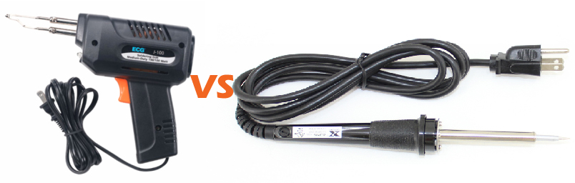
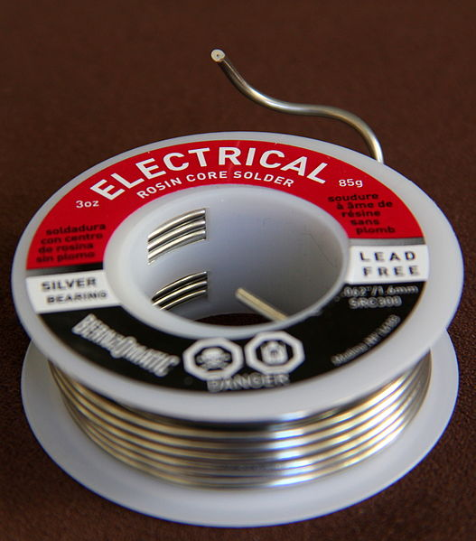
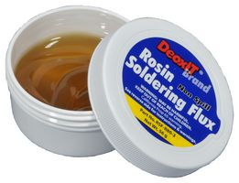
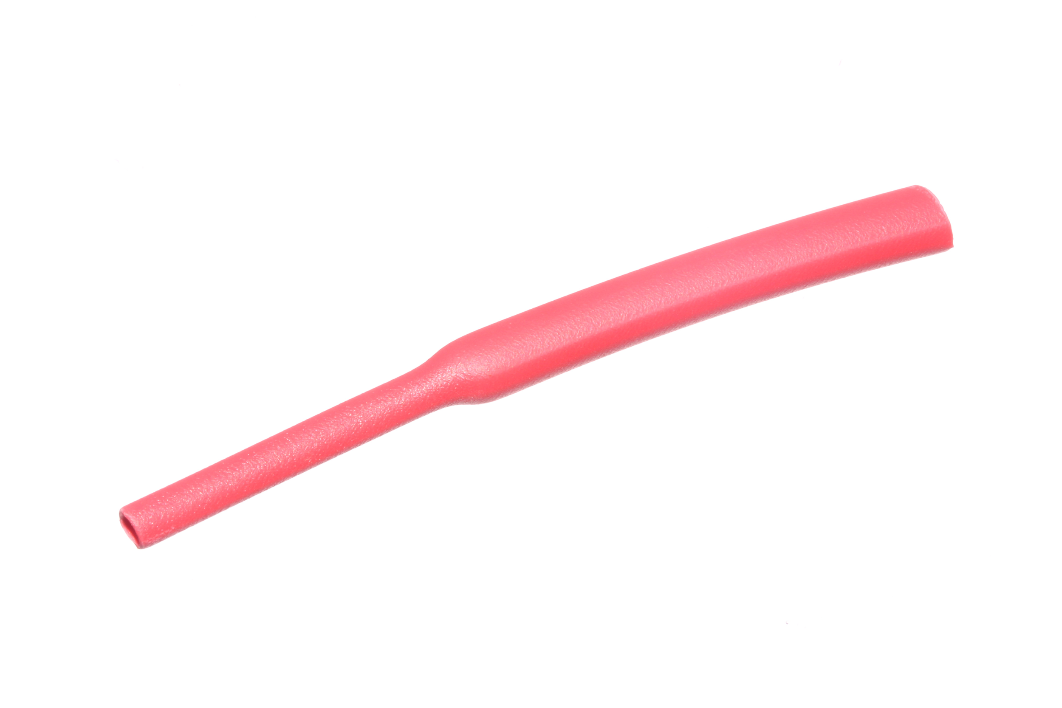
Tools for success
Soldering gun or iron
Solder (Preferably lead free for safety, and rosin cored to help connectivity)
Something to clean the soldering iron tip, a wet sponge or rag
Flux
Heat shrink tape/tube
A suitable surface for soldering (i.e. a metal welding bench) that will not be burned or severely heated up by the iron

Slide 3
Preparing the connections
Make sure your workspace is clean and clear
Make sure the power cable is out of the way, plug the iron/gun into an outlet, and heat it up
Clean the tip by wiping it off on a wet sponge or rag
When the iron/gun is hot, dip it in the flux, then tin the tip by briefly touching the solder to the tip
Touch the tinned iron tip to the site of the connection to heat it before flowing solder

Slide 4
Soldering Safety
Ventilation: If the soldering is being done inside, ensure it is in a well ventilated room and the fumes are being blown away from the person soldering. This is especially important if using lead solder.
Face protection: Always be wearing safety glasses when soldering. A face mask is also recommended to reduce fume inhalation.
Burns: Soldering irons are hotter than you think. Avoid touching any metal pieces on the iron, even if you think it is not a heated part. If you burn yourself, do not leave the iron alone. Get a mentor, and leave the iron with another responsible person while having the burn treated as soon as possible. Don’t hold the iron and continue to burn yourself, but also don’t leave it to potentially start a fire.

Slide 5
Soldering Styles
Soldering Wires Together
Twist the bare ends together, hold the tip to the bottom of the wires, feed solder into the heated wires until they look tinned
Electrical Boards
Tin the tip of the iron, use the tip to bridge the gap between the pad and the inserted metal/wire, feed solder into the gap but don’t let it pool up on the other side
Battery Wires
Slide terminal connection onto the bare 6 gauge wire, heat connection with a small blowtorch, feed solder into the terminal connector

Slide 6
Final Tips and Definitions
Too much flux? - If the connection on a pad for a board will not let solder flow into it, you may have too much flux on the pad already. To fix this, gently scrape the pad until it is clean, but do not dislodge it.
Burning wire casing? - If the casing on the wires is starting to melt off, you should definitely stop to let it cool down for a bit. When you start again, keep the heat closer to the connection and further from the casing.
Heat shrink tape/tube: Tape or tubing to put over a connection that you can heat with a heat gun to seal and secure the connection between wires.
Flux: Material that preserves the connection and improves electrical contact and integrity. Rosin-core is used for electronics. Do not use acid-core. That’s for plumbers.
Tinning: Another name for soldering. Also used to say when a surface is coated in a thin layer of solder, such as when tinning the iron.
Pad: The metal plate surrounding the holes on electrical boards.
Terminal connection: Metal spatula-like connectors that attach to the terminals on
the battery. They have a hole in the top to flow solder into.

Slide 7
Credits
This lesson was written by FRC 4150 in partnership with FRC 8027 for FRCTutorials.com
You can contact the author at froboticsteam4150@gmail.com.
More lessons for FIRST Robotics Competition are available at www.FRCtutorials.com
This work is licensed under a
Creative Commons Attribution-NonCommercial-ShareAlike 4.0 International License.

