Slide 1


Useful Sensors
Team 4150

Slide 2
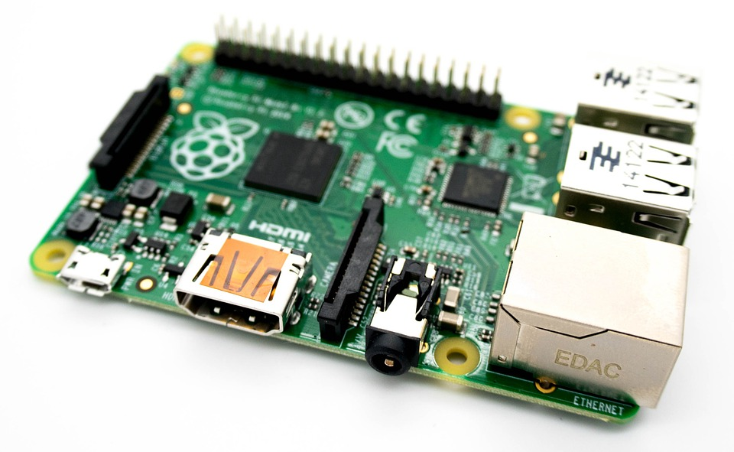
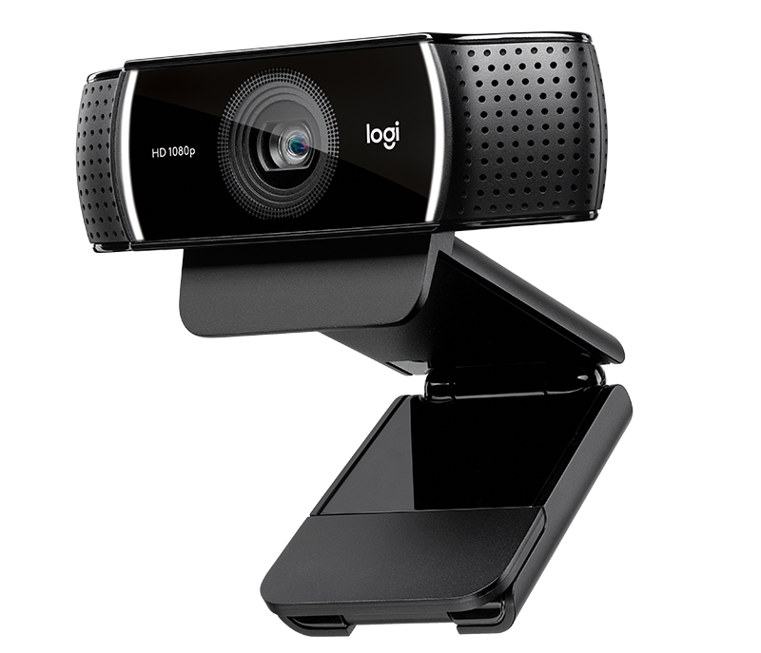
Cameras
Cameras are used when the drivers need to be able to see the field relative to the robot, or to align the robot when used with a light and vision code.
Cameras generally operate using a built-in USB cable in conjunction with a Raspberry Pi, which requires ethernet connection to the RoboRIO and power supplied from the 5V/2A terminal of the Voltage Regulator Module.

Slide 3
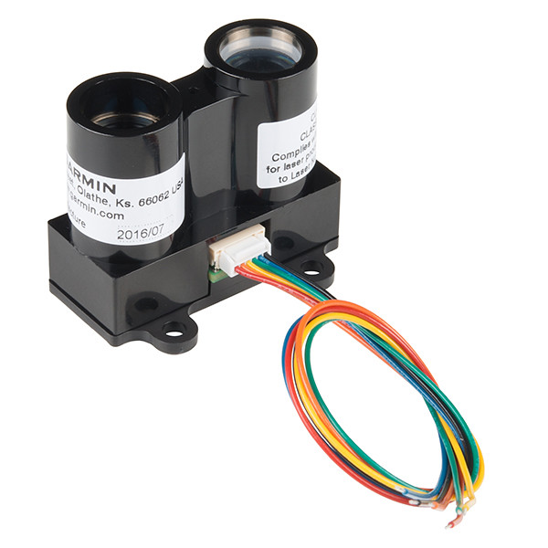
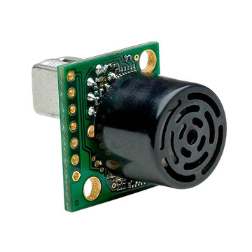
Distance and Proximity Sensors
LIDAR: Lidar is a method for measuring distances by illuminating the target with laser and measuring the reflection. These require unique connections and the use of resistors to connect to the DIO port on the RoboRIO.
Sonar/Ultrasonic: Sonar/Ultrasonic sensors produce sound waves and sense how long it takes to bounce back to the sensor to calculate distance or the presence of an obstruction. They also use the DIO ports on the RoboRIO.

Slide 4
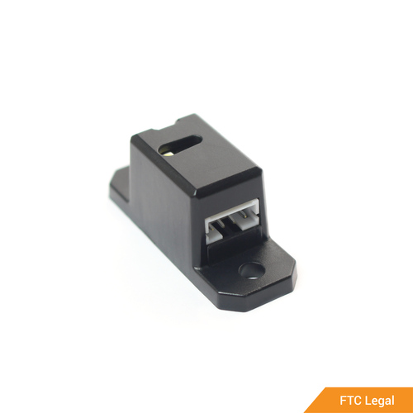
Color Sesnsors
These sensors are used to read and compare colors, and can have have a built-in IR (optical) Proximity Sensor and white LED for active target lighting. This specific model was provided for FIRST Infinite Recharge. It utilizes the I2C communication port on the RoboRIO and allows the user to create identities for Red, Yellow, Blue, and Green.

Slide 5
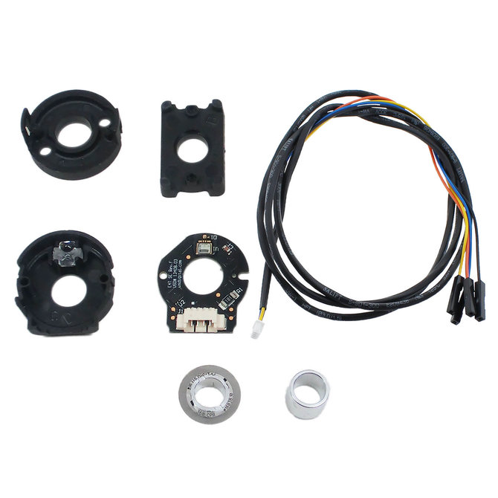
Encoders
Encoders are devices that are used to count rotations of a shaft or gear. They use a series of markings referred to as “ticks” that can be converted to a distance or number of revolutions. They are most often used on the drive train to measure the speed and distance driven, but can also be used to measure the speed of any mechanism with a gearbox, or shaft if you are using an encoder that can attach directly to a shaft mount.

Slide 6
Encoders, cont.
Encoders attach so that they are built into the shaft or gearbox of the mechanism that you are measuring.
They use a 4-pin cable. It can either be spliced into a PWM and connected to the RoboRIO PWM port, or connected to a motor controller breakout board to be used for speed control. If you would like to know more about speed control systems, information can be found in the General Wiring Guide.

Slide 7
Review of Types of Sensors
Cameras (Imaging and Vision Alignment)
Distance/Proximity
LIDAR
Sonar/Ultrasonic
Color/Photoelectric
Encoders (Gearbox and Shaft mounting)

Slide 8
Credits
This lesson was written by FRC 4150 in partnership with FRC 8027 for FRCTutorials.com
You can contact the author at froboticsteam4150@gmail.com.
More lessons for FIRST Robotics Competition are available at www.FRCtutorials.com
This work is licensed under a
Creative Commons Attribution-NonCommercial-ShareAlike 4.0 International License.

