Slide 1

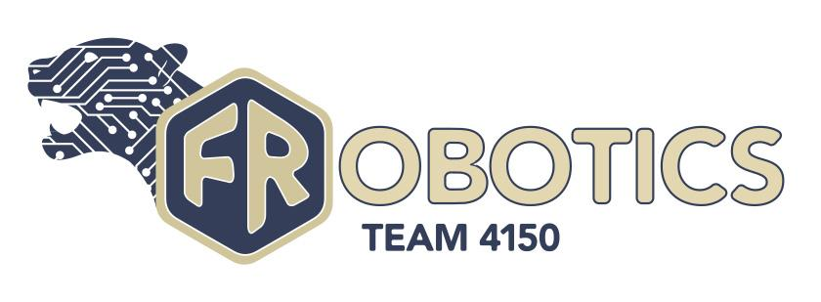
Roles and Responsibilities
TEAM 4150

Slide 2
Example Team Structure
This is just one example of many ways to structure your FRC Team. This model includes defined roles for both students and adults involved with the team.
Officers
Head Mentors
Subteam Leads
Members
Workshop Mentors
Parent Volunteers

Slide 3
Responsibilities for Leaders
All leaders (officers, subteam leads, and head mentors) are expected to fulfill these responsibilities:
Attend regular officer/lead/mentor meetings.
Carry out their duties, or inform the President and head mentors if they are unable to do so.
Provide leadership for team activities and guide students. There are many opportunities for conflicting ideas for the robot build and team activities during the build season. The leaders should help resolve conflict and keep the team moving in a positive direction.

Slide 4
Students - Officers
The officers are the main student leadership of the team and serve as communicators between the students and mentors.
President: Manages and leads the team as a whole; works with members and mentors to ensure that the team runs smoothly and that all tasks are done.
Vice President: Assists the President in their tasks, serves as Acting President in the President’s absence, manages most administrative aspects of the team.
Secretary: Manages team communication and keeps track of what happens within the team and all meetings.
Treasurer: Manages finances, ensures competition registration fees are paid, and works with marketing to raise money for the season.

Slide 5
Students - Subteam Leads
Each subteam below has a lead. Each lead is responsible for managing their subteam, and reports to the officers and head mentors.
Build Team: Builds and maintains the robot; Works with Programming and Wiring to ensure that the robot is built and tested in time.
Programming Team: Uses Java and / or other programming language to program autonomous and teleoperated control programs to control the robot; Creates, debugs, tests, integrates, and maintains the robot’s software.
Wiring Team: Designs and completes circuitry among the control system, power distribution system, motors, sensors, and various electronic components; Keeps the batteries charged, maintains wiring connectivity, and assists Build and Design teams with wiring compatibility.

Slide 6
Students - Subteam Leads Cont.
Outreach Team: Community service aspect of the team; Organizes the food drive, Relay for Life, Science Fairs, school demos and other social events.
Marketing Team: Creates fundraising plans; Writes proposals for awards and grants; Oversees the art department and FRobotics advertising at school; Maintains business plan and keeps a working budgets; Updates the bill of materials and keeps treasury records.
Drive/Strategy/Scouting Team: Gathers information on other teams’ strengths, weaknesses, and statistics; Examines the rule manual to create and refine robot designs; Develops game strategy; Maintains training and strategy of the drive team.
Safety: Conducts a team meeting to inform members of important safety rules & how to use various workshop machinery; A safety team member must remain in the pit at all times during competition.

Slide 7
Students - Members
Members are expected to attend team meetings and events throughout the school year, such as training, safety orientations, fundraising, planning, work days, setup/cleanup days, community service, outreach events and social activities.
Each student is responsible for their own behavior, and is expected to follow the rules and regulations of the school district/community organization that oversees the team.
Together, we strive to be positive role models in our community and to emulate FIRST’s principle of Gracious Professionalism and Coopertition so as to reflect positively on others and our community.

Slide 8
Adults - Mentors
FRobotics usually has 2-3 Head Mentors who advise the team and oversee day-to-day activities. FIRST requires the two Head Mentors to be cleared through the Youth Protection Program, as well as to follow any local clearance requirements.
Head mentors also manage a schedule of workshop mentors to make sure that there is enough adult supervision at any event workshop or team event. Workshop mentors assist the head mentors with hands-on teaching and safety supervision. Workshop mentors also need to have appropriate clearances.

Slide 9
Adults - Parent Volunteers
Parent volunteers come to the workshop occasionally to drop off snacks/meals or to help organize fundraisers or sponsorships, and typically act as an extra set of hands for the mentors as needed.

Slide 10
Credits
This lesson was written by FRC 4150 in partnership with FRC 8027 for FRCTutorials.com
You can contact the author at froboticsteam4150@gmail.com.
More lessons for FIRST Robotics Competition are available at www.FRCtutorials.com
This work is licensed under a
Creative Commons Attribution-NonCommercial-ShareAlike 4.0 International License.

