Slide 1

Computer-Aided Design (CAD)
Team 8027
*Instructions within this presentation are for the CAD software SOLIDWORKS only*

Slide 2
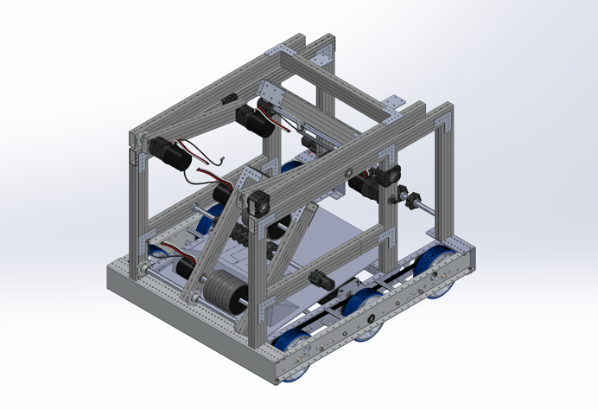
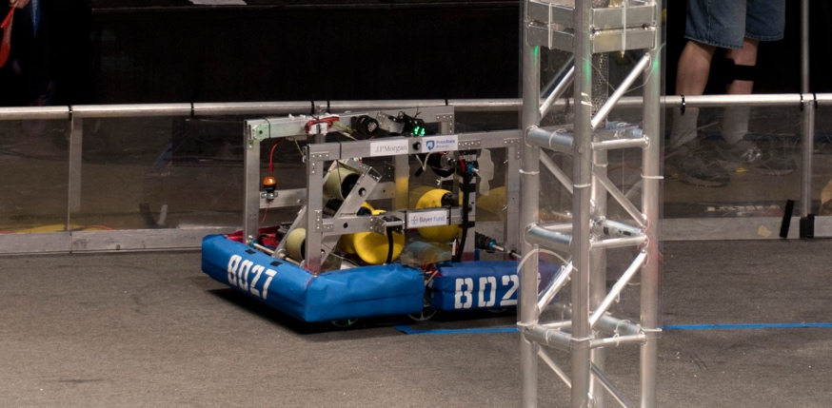
Importance of CAD - FRC
CAD – Computer-Aided Design is an extremely important and useful tool in the creation of an FRC Robot
Creating a CAD version of your robot prior to building allows the CAD to serve as a template for when you begin building
It can help you organize ideas and parts into your deisgn to easily come back to later when you are building

Slide 3
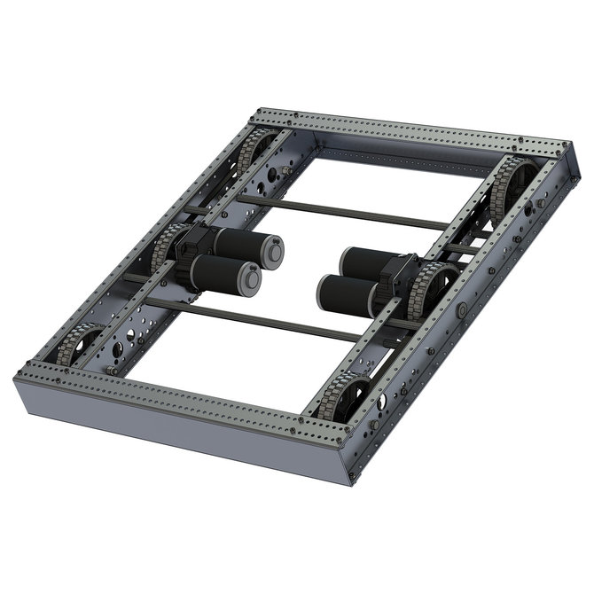
Importing FRC Parts
To begin building your FRC Robot in CAD, a useful and necessary skill is to be able to import CAD files of FRC parts from FRC vendors such as (Andymark, VEX Robotics, REV Robotics, etc.)
This is important as it allows you to have the exact parts that you would be purchasing for your actual robot within your CAD
Most parts on most of these robotics sites have CAD files – and even certain assemblies (such as the base chassis to the right) have available CAD files
Instructions to import parts are on the next slide

Slide 4
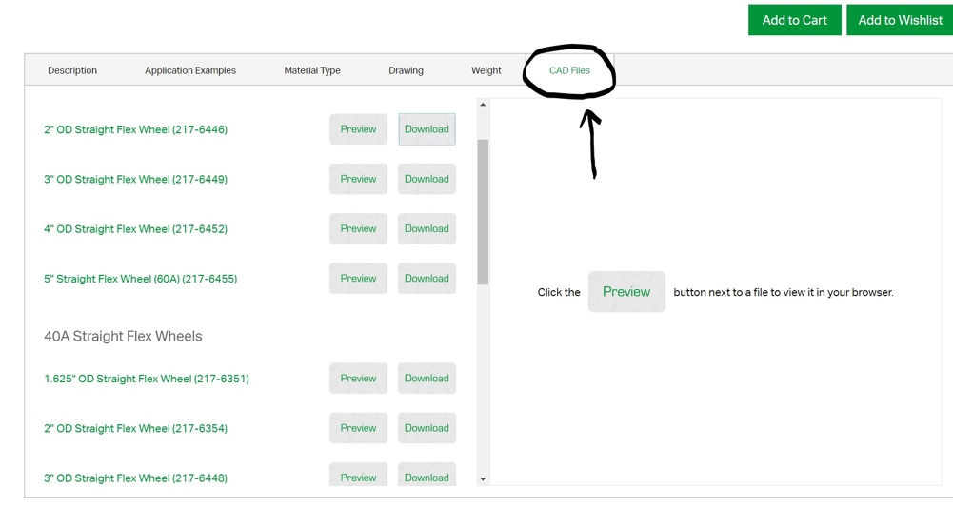

Importing FRC Parts
In order to import CAD parts from certain robotics websites, you must first find the file for your part on the webpage – this is usually located on the bottom of the page with your parts -- (SEE IMAGE 1)
After you have downloaded the file, click the tab for it and open the part within the SOLIDWORKS software -- (SEE IMAGE 2)
Following this, save the file of this part onto your computer with a name that you will remember, and then leave the solidworks page
Image 2
Image 1

Slide 5
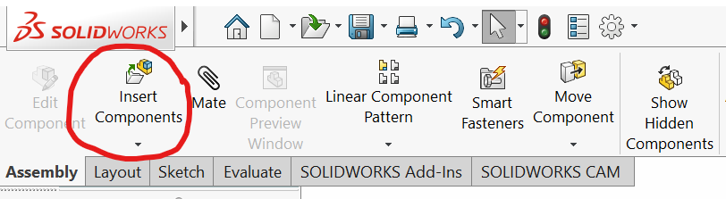
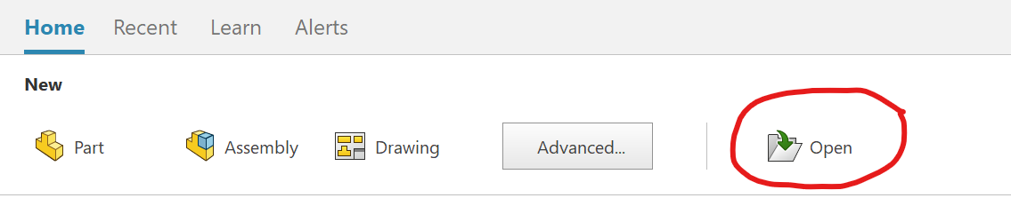
Importing FRC Parts – Cont.
After this, if you wish to create an assembly with the part, you can open the new assembly tab in the SOLIDWORKS homepage, and click on the insert components button – you can then choose the correct part you wish to import -- (SEE IMAGE 3)
To open the part as just a part, not into an assembly, click the open button on the homepage and then choose the correct file -- (SEE IMAGE 4)
Image 4
Image 3

Slide 6
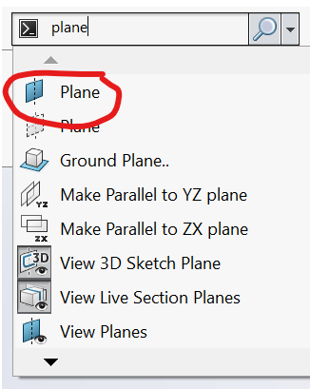
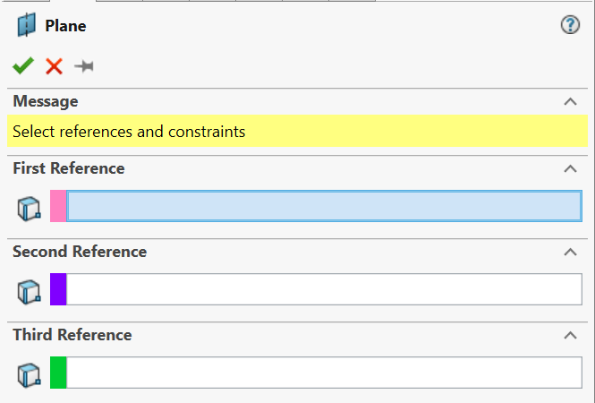
Creating Planes (Step 1 of Cutting Parts)
Cutting parts is also a very useful skill if the parts you download are not the right length
To show the software where you want to cut a part, first you have to make a plane
To make a plane, you must click one of the right, top, or front planes and make it visible (choose the plane that is parallel to the plane where you want to cut)
Then, to make the plane where you want to cut, you must go to the search commands bar and search "plane" -- (SEE IMAGE 5)
After you click this, a menu should appear on the left of the screen - (Image 6) - where you can select the plane that you created eariler and adjust how far you want your plane that will cut to be
Image 5
Image 6

Slide 7
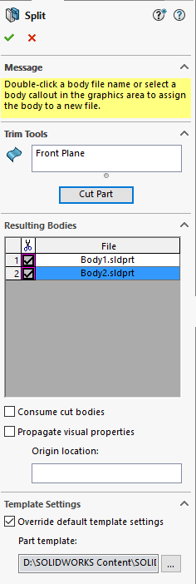
Split Feature – (Step 2 of Cutting Parts)
Once the plane is positioned into the right spot, go to the search commands bar once more and search "split" - the menu from the image to the right should appear on the left of the screen
Click the plane that you created in the right spot earlier, then click the cut part option
To finish, it should label both of the cut parts, and you can double click the correct "body" to save it as a separate part

Slide 8
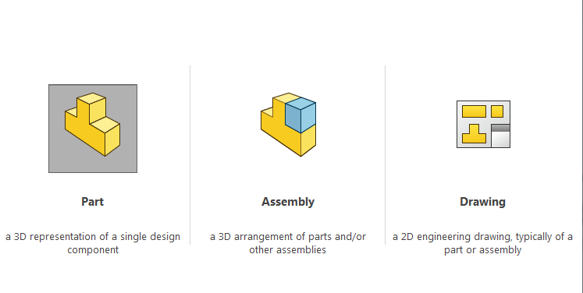
Creating Parts & Assemblies
Often times your robot may require a part that you cannot get from a robotics vendor – in which case you would make your own part
You can create both assemblies and parts in Solidworks by choosing one of the options from the menu similar to the one to the right
There are many different features in SOLIDWORKS that you can use to create almost any part such as boss extrude, hole wizard, etc.

Slide 9
Useful Links – CAD Softwares & Sites
Onshape:
https://www.onshape.com/
Solidworks:
https://www.solidworks.com/sw/support/downloads.htm
GrabCAD:
https://grabcad.com/

Slide 10

Credits
This lesson was written by FRC 8027 for FRCTutorials.com
You can contact the author at team@droidsrobotics.org
More lessons for FIRST Robotics Competition are available at www.FRCtutorials.com
This work is licensed under a
Creative Commons Attribution-NonCommercial-ShareAlike 4.0 International License.

