Slide 1

Useful Tools
Team 8027

Slide 2
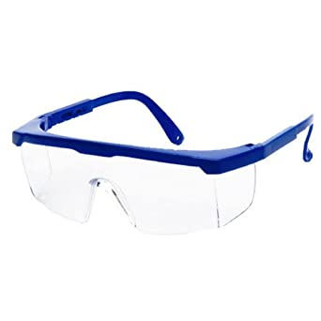
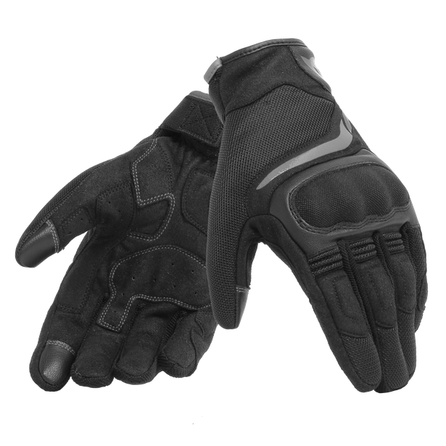
Safety First
Safety is the biggest priority in FRC
Having and using proper safety equipment is instrumental in the success of an FRC team
This includes gloves, safety glasses, and proper safety guards on dangerous equipment

Slide 3
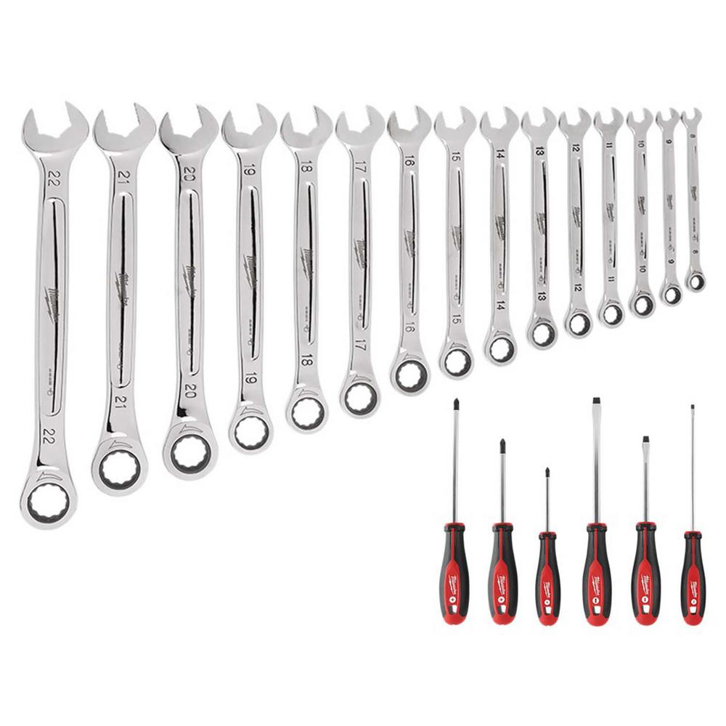
Screwdrivers and Wrenches
In order to easily and effectively add and remove screws and nuts of all different sizes, screwdrivers and wrenches can be very useful
Wrenches can be used to tighten nuts into the right places in addition to removing nuts quickly
Screwdrivers can be used to tighten and remove screws
Also useful are allen keys, which can tighten and remove screws with a socket in the shape of a hexagon

Slide 4
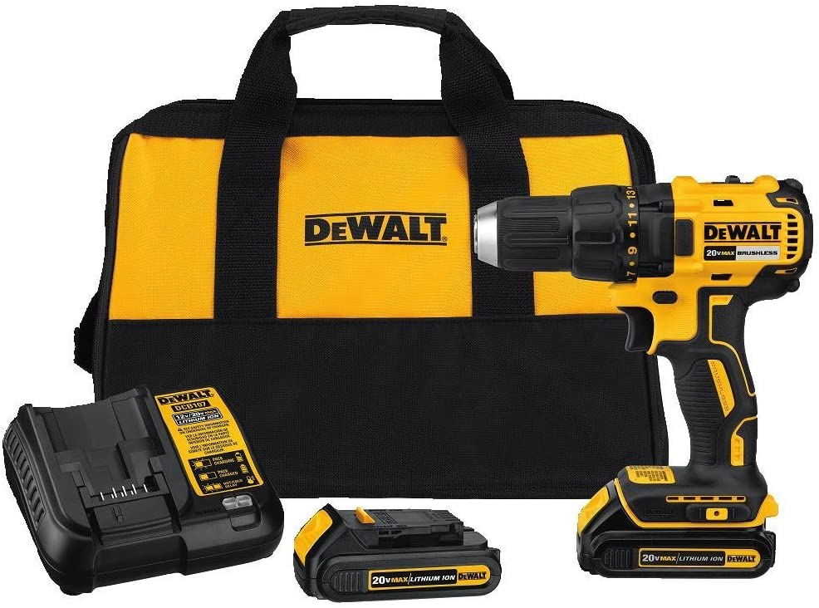
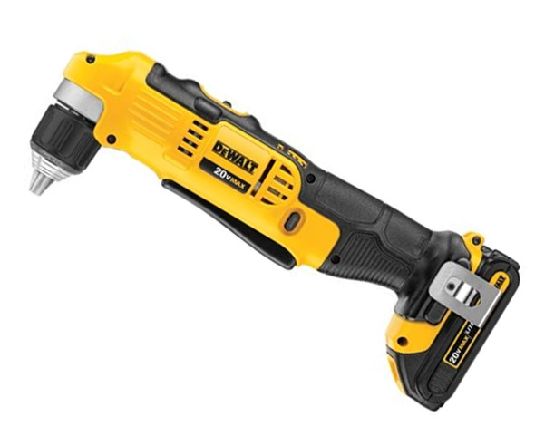
Handheld Drills
Another very useful tool to have to create screwholes and other holes in metal is a handheld drill
These are easy to use to drill into harder to reach areas
There are different types of handheld drills, some used to get into hard to reach areas, such as the right angle drill

Slide 5
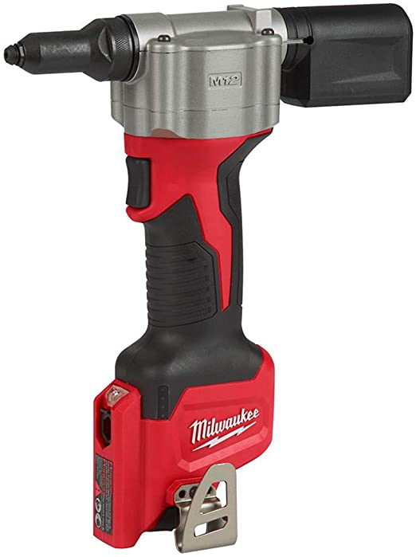
Rivets and Rivet Gun
An alternative to using screws in some scenarios is to use a rivet which can be very useful
These are easier to remove and add than certain screws and are more cost effective
Having a automatic riveting gun can be very useful as it can allow you to add rivets much faster than with a manual rivet gun or with certain screwdrivers and screws

Slide 6
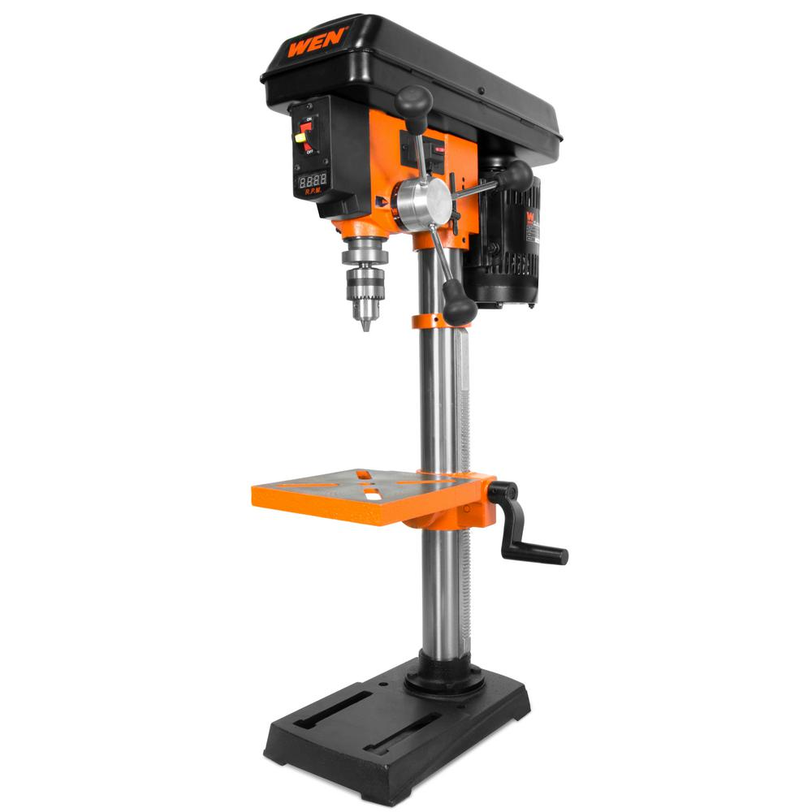
Drill Press
In FRC, there are often larger holes that must be made in parts for certain purposes
These require the use of a larger, more powerful machine known as the drill press which is a semi – automatic drill
The drill press can used to make anywhere from small holes for smaller screws to larger holes for axles
You can adjust the size of the holes by adjusting changing out the drill bit, which is the part of the drill press that actually makes the holes

Slide 7
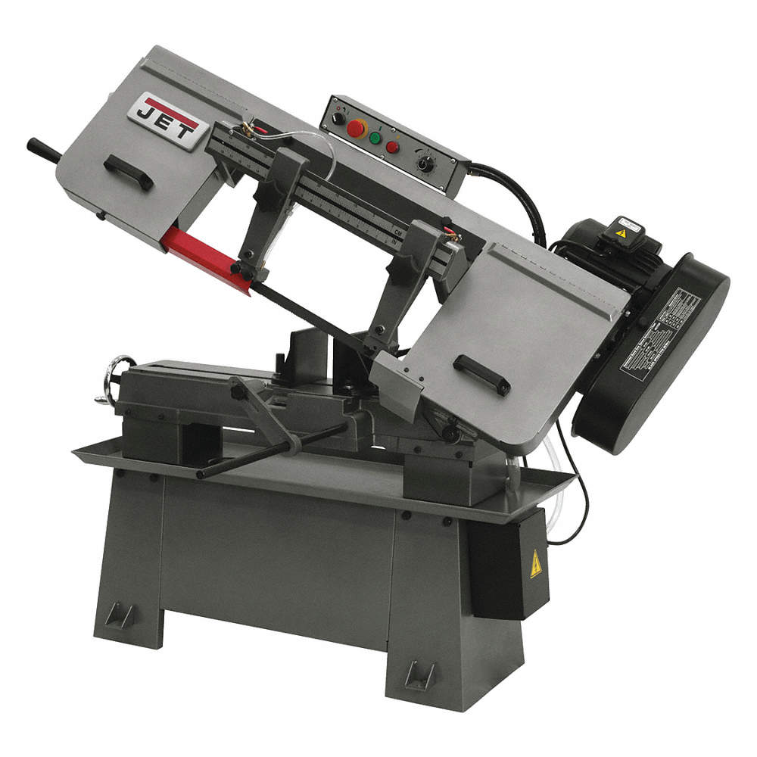
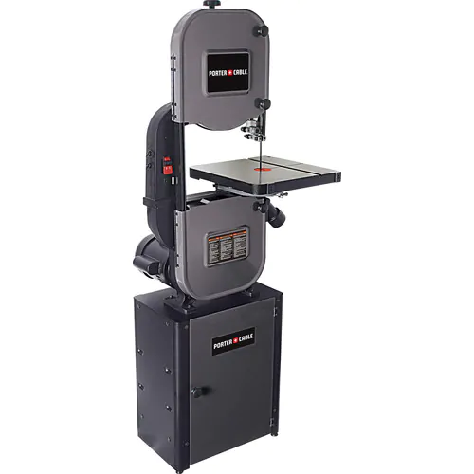
Band Saw
Additionally, larger cuts may need to be made on certain parts in FRC
To make these, the use of a machine known as the band saw is often required
The band saw is large, automatic saw that is used to cut and shape metal (and wood occasionally) with a continuous blade

Slide 8
Useful Links
Band Saw:
https://www.homedepot.com/b/Tools-Power-Tools-Saws-Band-Saws-Stationary-Band-Saws/N-5yc1vZc3wt
Drill Press & Drill Bits:
https://www.homedepot.com/s/drill%2520press?NCNI-5
https://www.homedepot.com/s/drill%2520bits?NCNI-5
Allen Keys Set:
https://www.amazon.com/AmazonBasics-Hex-Allen-Wrench-Ball/dp/B0776C2D6H
Wrench Set:
https://www.homedepot.com/p/Milwaukee-SAE-Metric-Combination-Ratcheting-Wrench-Mechanics-Tool-Set-30-Piece-48-22-9416-48-22-9516/309800942

Slide 9
Useful Links - Continued
Screwdriver Set:
https://www.amazon.com/CREMAX-Magnetic-Screwdriver-Cushion-Phillips/dp/B07K1C744B?ref_=s9_apbd_orecs_hd_bw_b2Jwu&pf_rd_r=QVWH5WXS4FCVS51XQR07&pf_rd_p=6e4d9b8c-4111-590f-8aaf-f17fa8bd5a04&pf_rd_s=merchandised-search-10&pf_rd_t=BROWSE&pf_rd_i=553344
Right-Angle Drill:
https://www.amazon.com/DEWALT-Right-Cordless-Driver-DCD740C1/dp/B0052MII3C/ref=sr_1_3?dchild=1&keywords=right+angle+drill&qid=1591126331&s=hi&sr=1-3
Hand-Held Drill:
https://www.amazon.com/DCD777C2-Controlador-taladro-compacto-escobillas/dp/B01J7UPHIS/ref=sr_1_3?dchild=1&keywords=drill+dewalt&qid=1591126483&s=hi&sr=1-3
Vaccuum Cleaner:
https://www.amazon.com/DEWALT-DCV517B-Baretool-Cordless-Portable/dp/B01CKIZ8BA/ref=sr_1_1?dchild=1&keywords=vacuum+cleaner+dewalt&qid=1591126453&s=hi&sr=1-1
Rivet Gun:
https://www.amazon.com/URGENEX-Rivet-Riveter-Rivets-Professional/dp/B08357W8RN/ref=sr_1_2?dchild=1&keywords=rivet+gun&qid=1591126414&sr=8-2

Slide 10

Credits
This lesson was written by FRC 8027 for FRCTutorials.com
You can contact the author at team@droidsrobotics.org
More lessons for FIRST Robotics Competition are available at www.FRCtutorials.com
This work is licensed under a
Creative Commons Attribution-NonCommercial-ShareAlike 4.0 International License.

