Slide 1

Finding a Place to Meet
Team 8027

Slide 2
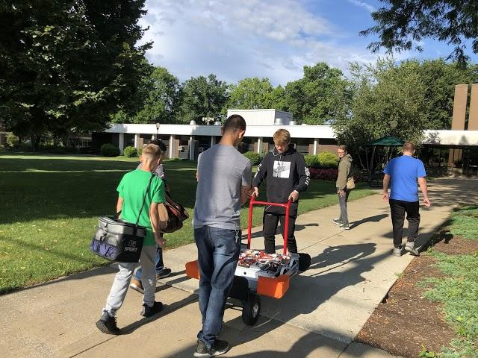
Factors to Consider : Location and Time
Be sure the place is accessible for all members.
This includes a drivable distance and accessibility to get into the building
Ensure that the hours the team would like to meet are approved in advance
Check if the location is willing to to be flexible in the hours

Slide 3
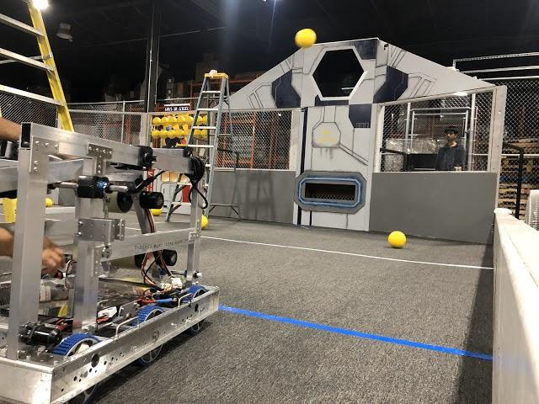
Factors to Consider: Size
It is important that the space is large enough for your team.
Consider a workspace for building the robot, programming the robot, and driving the robot.
A room that is 20 ft x 30ft might be on the small side, but could be doable for an FRC team
The height of the room should be taken into account to accommodate field elements that are sometimes large and tall

Slide 4
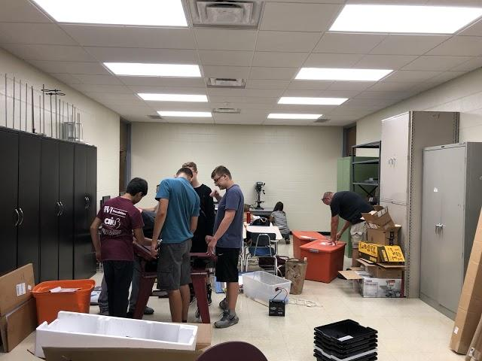
Factors to Consider: Cost
Consider you team’s budget
If a space is being provided for an FRC team, cost is a factor to think about
Since an FRC program is a large expense every year, consider asking for space to be donated in-kind or free of charge
If a space cannot be provided at no charge, negotiate the monthly fee

Slide 5
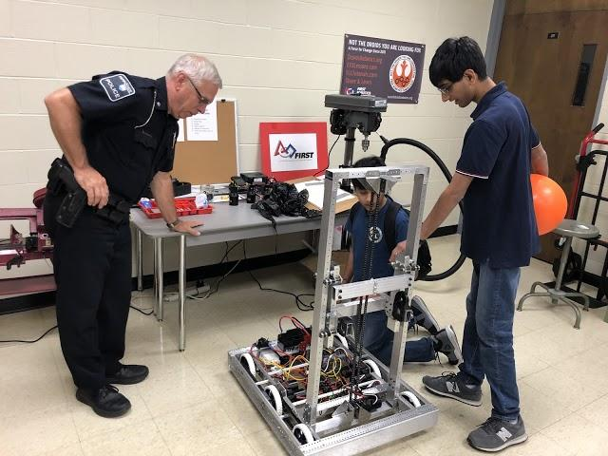
Factors to Consider: Safety
Ensure that you can lock the room and storage cabinets
A locked room provides safety to outside members and it protects the equipment from damage
A team may also be required to needs to have insurance to use the space. This protects both the space and the members on the team.

Slide 6
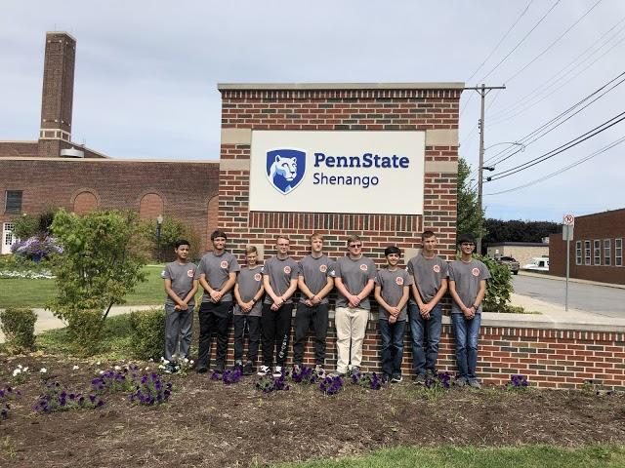
Options for a Meeting Place
A local college/university
Empty warehouse
Large room of an office building
Large room of a community center
Church hall
Business Incubator
An abandoned mall
A school

Slide 7
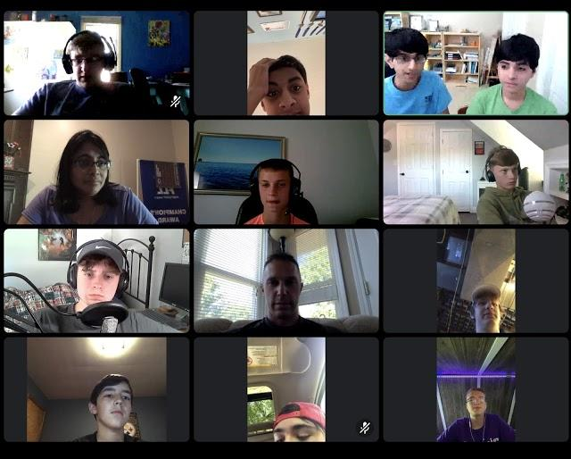
Alternative Meeting Options
If a team cannot meet at the regular location, consider the following:
Team member’s house
Virtual (Zoom, Discord, Skype)

Slide 8

Credits
This lesson was written by FRC 8027 for FRCTutorials.com
You can contact the author at team@droidsrobotics.org
More lessons for FIRST Robotics Competition are available at www.FRCtutorials.com
This work is licensed under a
Creative Commons Attribution-NonCommercial-ShareAlike 4.0 International License.

