Slide 1

Team Rules and Expectations
TEAM 8027

Slide 2
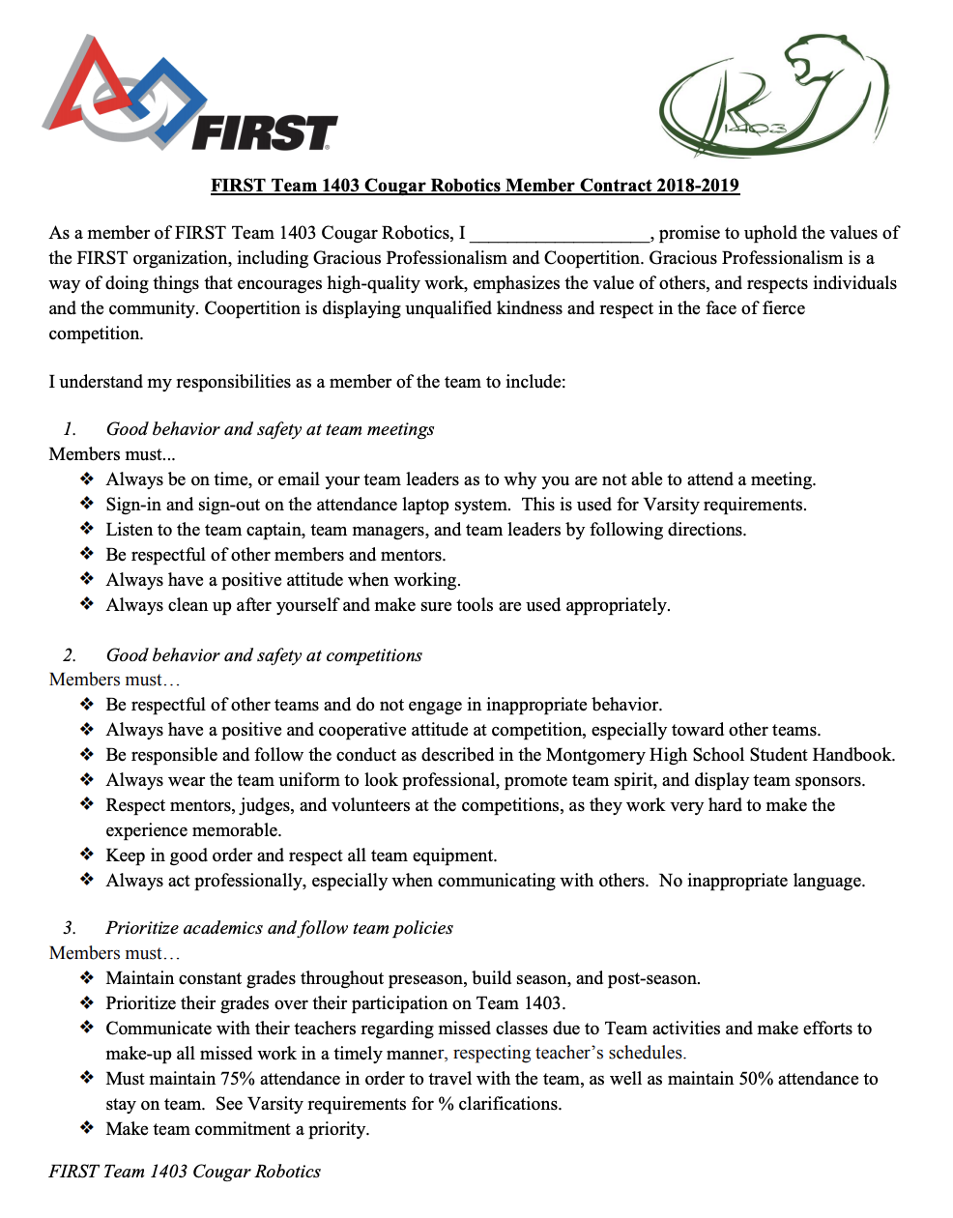
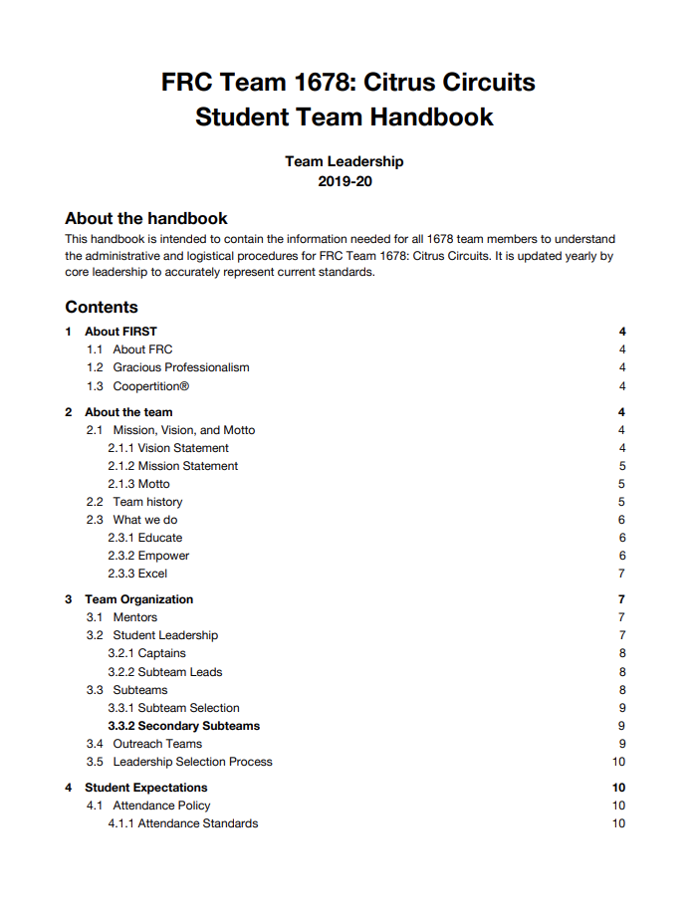
Guidelines and Rules
Once your team has been formed, set up guidelines for the team
Some teams create a team handbook
Some teams create a team contract
These documents allow both the mentors and students to create their team’s culture
Rules and expectations for the members help the team be on the same page
Be sure to address codes of conduct, team travel policies, fundraising requirements, participation requirements, meeting schedules, and anything else that is important to your team’s culture

Slide 3
Example Rules: Code of Conduct
Behavior rules should align with FIRST Core Values and focus on inclusion, respect, and good communication
_____ I agree that my behavior in posts, messages, meetings and competitions will be gracious, and I will treat my teammates, volunteers, other teams, and my mentors with respect.
_____ I agree to respect the space and equipment used by the team.
_____ I agree to cooperate on whatever solution the team chooses, even if it is not my choice.
_____ I am responsible for reading and responding promptly to email and messages and communicating with my coaches and team members

Slide 4
Example Rules: Effort and Contribution
The level of effort required and attendance expectations need to laid out clearly so that the student can plan ahead.
_____ I agree that I will make every effort to attend all events and meetings and prioritize robotics. If a conflict arises, I will notify the mentors 2 days prior to the meeting.
_____ I agree to work the hours needed (even outside team meetings) to get the work I commit to done at the highest quality possible.
_____ I agree that the goal of my team should be to do our best work. As a member of the team, I will contribute to all aspects of the process, not just the parts I like best.

Slide 5
Examples from Other Teams
Team Contracts:
Team 971 http://frc971.org/content/TeamRulesAndExpectations
FRC 1511 http://penfieldrobotics.com/docs/TeamHandbook.pdf
FRC 1678 http://www.citruscircuits.org/uploads/6/9/3/4/6934550/2018-19_citrus_circuits_team_handbook.pdf
FRC 1828 http://1828boxerbots.org/docs/Handbook%20Contract.pdf
FRC 1403 https://cougarrobotics.com/wp-content/uploads/2019/03/Team-Contract-18-19.pdf
Safety Rules:
FRC 1676 https://team1676.com/safety
FRC 3637 https://www.team3637.com/safety/

Slide 6
Parents Also Need Rules
Having a contract with parents can also help make sure that everyone affiliated with the team is on the same page
_____ I agree to discuss all items listed in the student contract with my child and provide any support they might need to meet their obligations.
_____ I realize that the team’s mentors are voluntarily contributing a significant amount of time and effort to provide this rewarding experience for my child and the team. I will try to be as cooperative and helpful as possible.
_____ I agree to drop off and pick up my child promptly.
_____ I understand that I may be asked to volunteer at events or competitions.
_____ I understand that photos and videos of my child may be taken and included in team marketing materials and shared on social media.
_____ I authorize my child’s mentors to supervise my child at meetings, events, and competitions, and give permission for them to care for my child as needed.
_____ I understand that my family will be asked to help the team fundraise, seek sponsorships, or contribute money for registration fees and robot equipment.

Slide 7
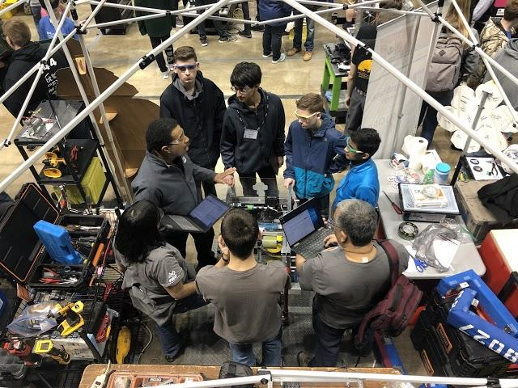
Rules & Expectations at Events
Teams are also expected to follow rules are events
Rules may change at different venues
Make sure that you respect other teams, the organizers as well as any venue-specific rules
(https://www.firstinspires.org/resource-library/frc/event-experience)

Slide 8

Credits
This lesson was written by FRC 8027 for FRCTutorials.com
You can contact the author at team@droidsrobotics.org
More lessons for FIRST Robotics Competition are available at www.FRCtutorials.com
This work is licensed under a
Creative Commons Attribution-NonCommercial-ShareAlike 4.0 International License.

