Slide 1

Creating a Team Identity
Team 8027

Slide 2
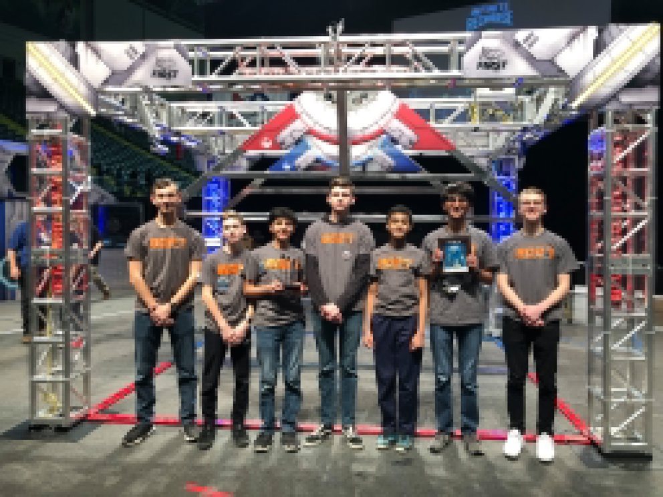
What is Team Identity?
A team identity is what defines your team.
The team identity is what other people know you as.
What you do as a team determines your team identity.

Slide 3
How do you Create Team Identity?
Branding
Work Ethic
Attitude
Outreach
Logos
Colors
T-shirts
Diligence
Quality of work
Conduct both on and off the field
Assisting other teams
Sharing with the community

Slide 4

Branding: T-shirts, Logos, and Colors
Logos and team colors are important to team identity.
If you have a specific logo or color scheme, other teams will recognize you
Your logos represent your team and your team identity.
For example, our team’s logo uses black and orange to represent our city (Sharon). The rebel alliance icon represents the coming together of three FIRST LEGO League teams to create one alliance.

Slide 5
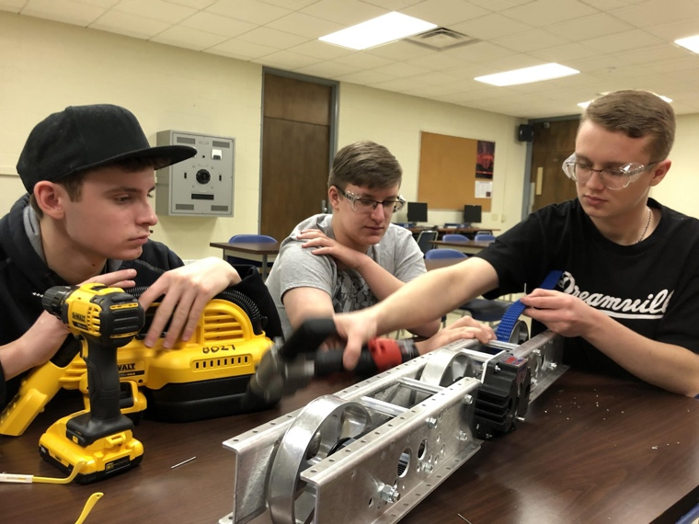
Display Good Work Ethic
Your work ethic also contributes to your team identity.
If you have a good work ethic, you will get a lot done and other teams will know that you are a good, hard-working team.
Some ways you can let others know of your work ethic:
Share your work on Social Media to show how productive you are
At events, stay focused in your pits and in queue
If another team asks for assistance, do it promptly

Slide 6
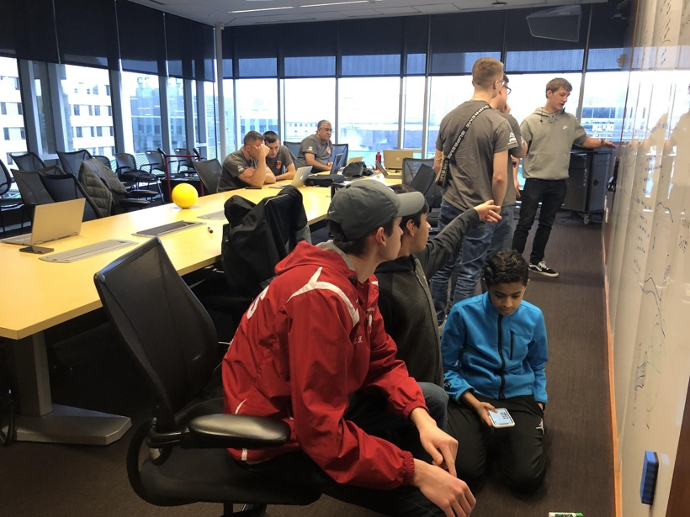
Have a Positive Attitude
Your attitude reflects your team identity.
A good attitude creates an overall positive team identity.
For example at a tournament, when judges or another team come to ask you a question, be engaged and do your best
A bad attitude creates a negative team identity.
At an event, if your team’s robot is not doing well, you should not be complaining about whose fault it is. Instead, work together to help the team.

Slide 7

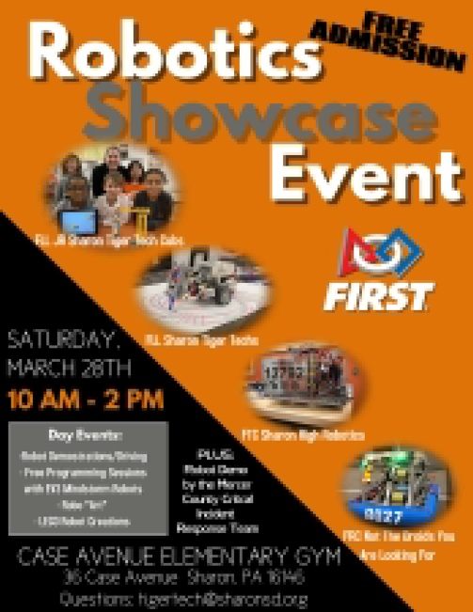
Do Community Outreach
Outreach can help determine your team identity in many ways.
If you help other teams out, other teams know your team better
If you do a lot in your community, your community will get to know who you are and what your team represents.

Slide 8

Credits
This lesson was written by FRC 8027 for FRCTutorials.com
You can contact the author at team@droidsrobotics.org
More lessons for FIRST Robotics Competition are available at www.FRCtutorials.com
This work is licensed under a
Creative Commons Attribution-NonCommercial-ShareAlike 4.0 International License.

