Slide 1

Team Member Selection
Team 8027

Slide 2
Team Member Qualities
Our team values the following six qualities in a FIRST team member
When recruiting new team members, we look for these qualities
Responsibility
Work Ethic
Focus
Positive Attitude
Teamwork Skills
Interest in STEAM

Slide 3
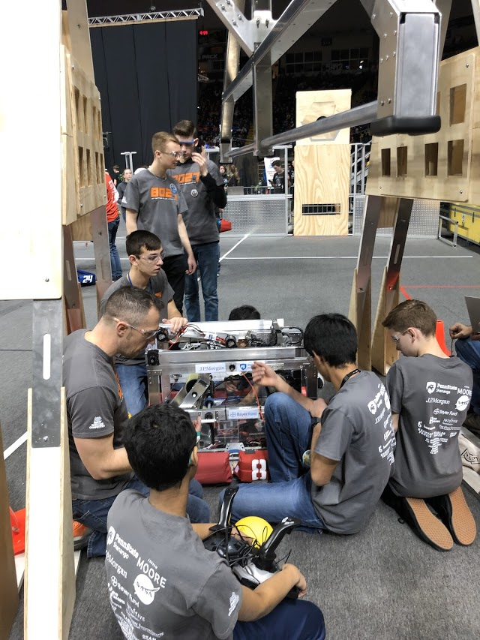
Show Responsibility
Respond to texts/emails promptly
Attend as many team meetings as possible (or according to your team’s rules)
If you are unable to attend a meeting, let a team mentor know at least 2 days in advance
If you commit to getting work done, you have the responsibility to have it done by then.

Slide 4
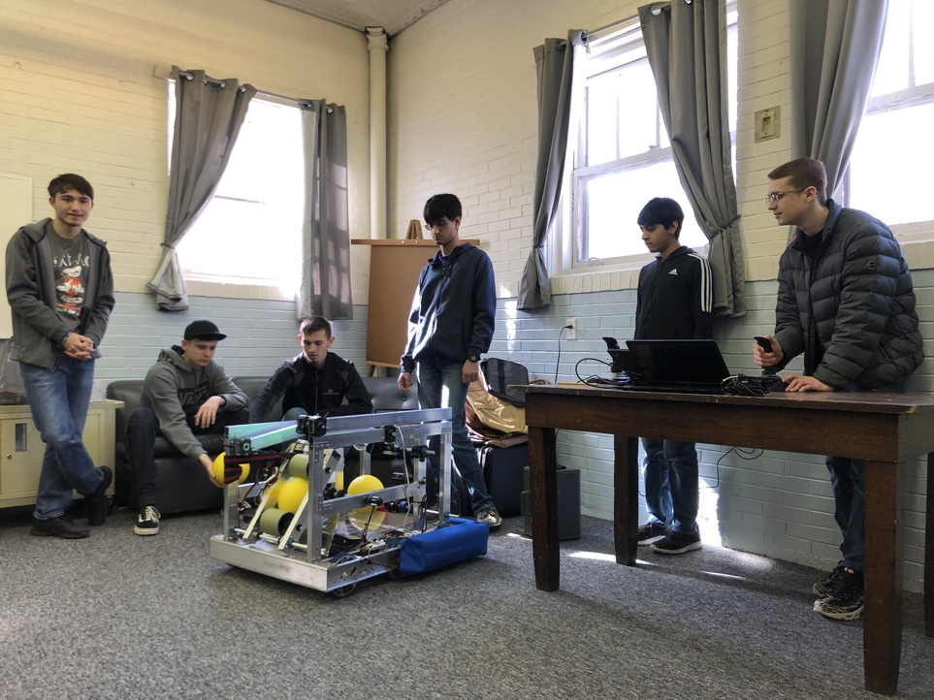
Demonstrate Accountability
Own up to mistakes during and outside FIRST competitions
Make it clear when you do not understand something or need help
It is your job to complete work when it is due/assigned
Show honesty!

Slide 5
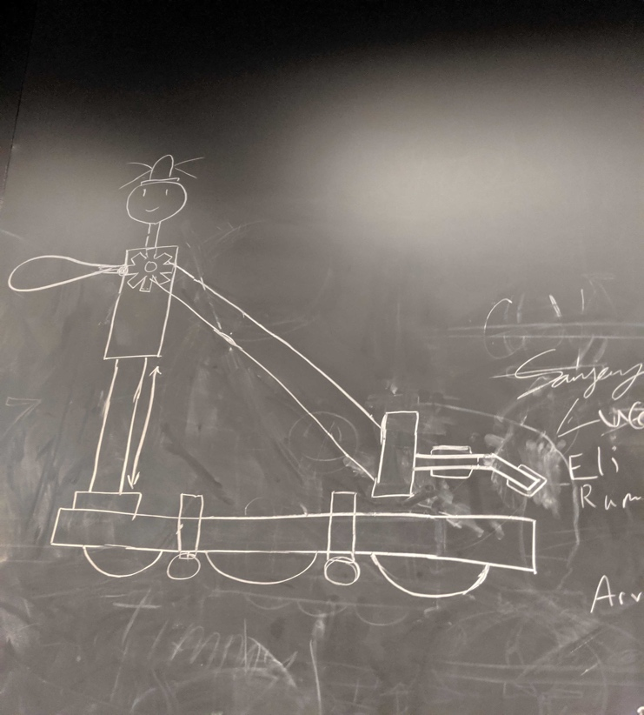
Show Diligence and Good Work Ethic
A good work ethic goes a long way in FIRST and it is a great characteristic to have as so get older
This quality helps the team get the work done on time
Always complete what you started even when that means staying after hours to get the job done
When the work is done diligently there are usually little or no mistakes which allows for extra time to be spent on areas of the team that need more attention

Slide 6
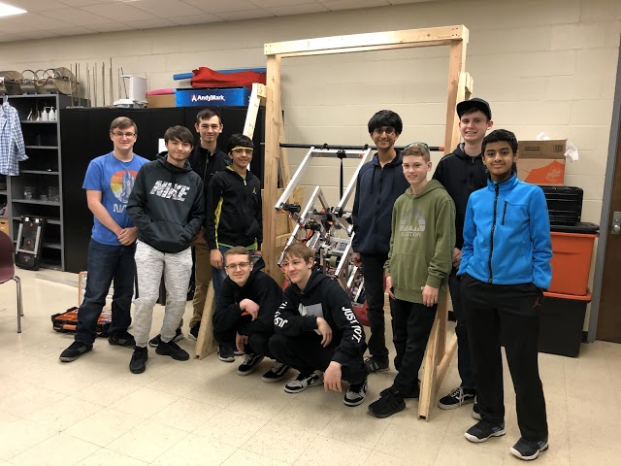
Demonstrate Good Teamwork Skills
Work well with others in even in times of pressure
Be open to all ideas, and be willing to compromise, even if some of the ideas are not your own
Do not be afraid to ask for help or say you don’t know. If not, it will only hurt the team
Always be willing to help others out when in need of assistance, even if you have to stop what you are doing

Slide 7
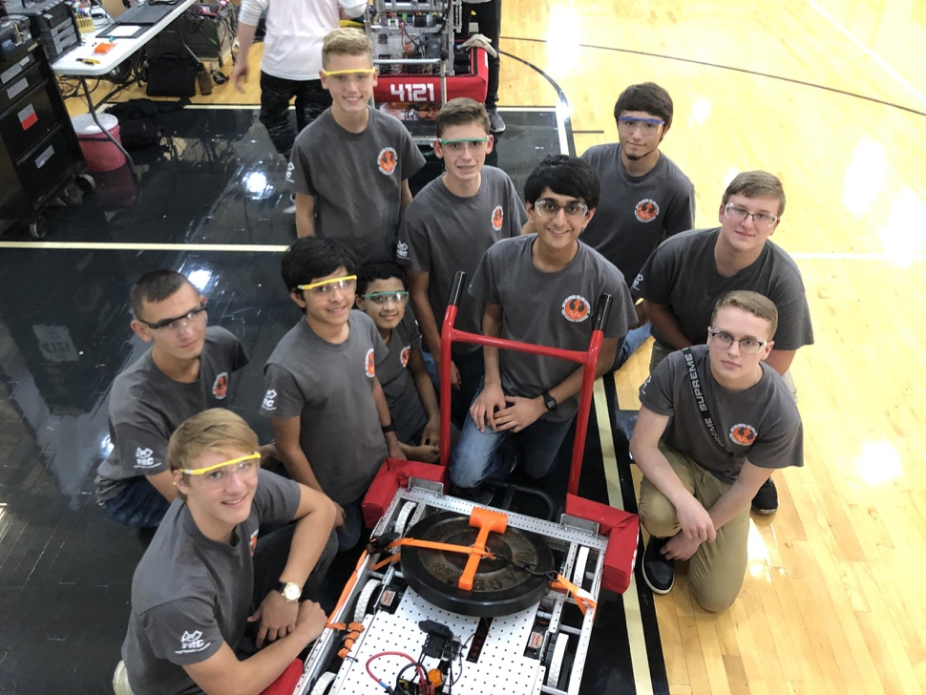
Stay Focused At All Times
Stay off of your cell phone during practice
Be willing to give mentors and students your utmost focus at every meeting or event
Do not get distracted by playing with the team equipment or horse playing (it can be a safety issue)

Slide 8
Have a Good Personality
Why is it important to have a good personality?
In order for a team or and organization to run like a well- oiled machine he or she must always have a good attitude and personality
FIRST students are…
Energetic
Willing to help others
Unafraid to fail
Willing to strive towards his or her goals
Stick to his or her word
Team players!

Slide 9
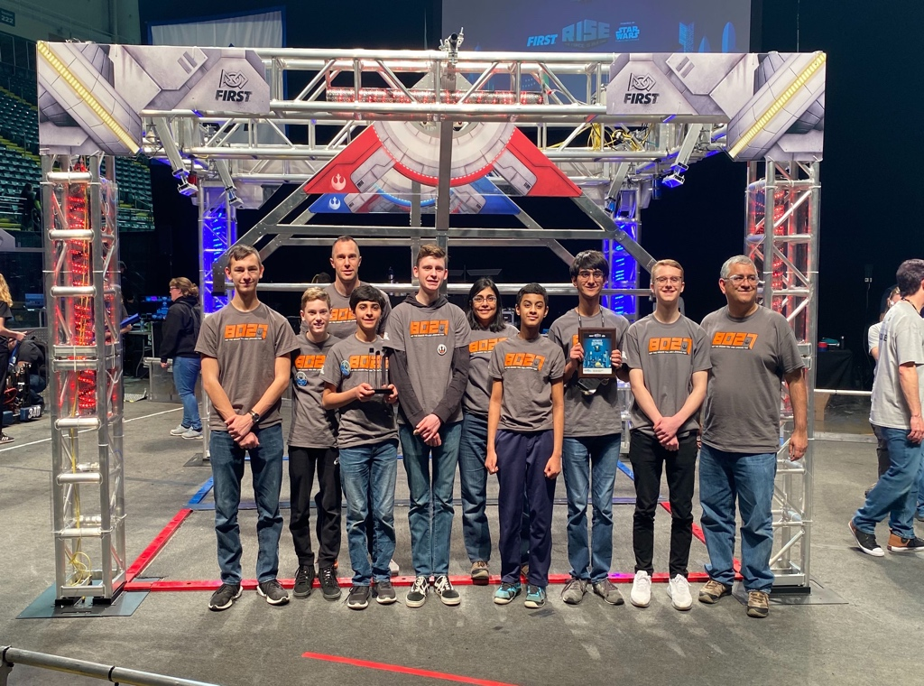
Have an Interest in STEAM
Students looking to pursue a career in a STEAM-related field in the future will have a stronger interest in FIRST
Students who have either been involved previously with STEAM related activities or have always wanted to be a part of it will enjoy FIRST

Slide 10

Credits
This lesson was written by FRC 8027 for FRCTutorials.com
You can contact the author at team@droidsrobotics.org
More lessons for FIRST Robotics Competition are available at www.FRCtutorials.com
This work is licensed under a
Creative Commons Attribution-NonCommercial-ShareAlike 4.0 International License.

