Slide 1

Drive Team Selection
Team 8027

Slide 2
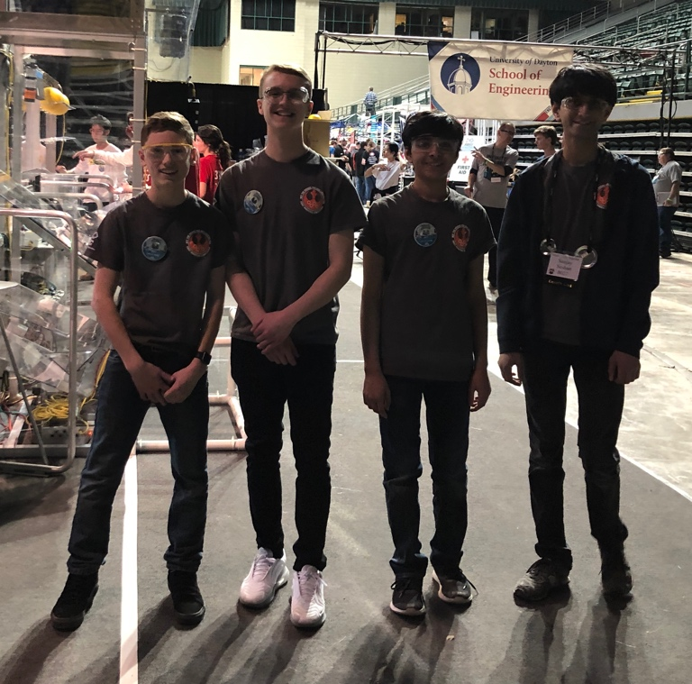
What is the Drive Team?
Only a small subset of your team goes onto the field
Coach – Has a full view of the field and communicates information to the drivers
Driver 1 – Main driver and many operate some of the mechanisms
Driver 2 – Operates some of the robot mechanisms
Human Player – delivers field elements to drivers and communicates information to help drivers
These four must coordinate and communicate. Along with the Technician, they will set up their robot and controllers prior to the match
The team mentors generally select the drivers based on experience, talent and other qualities described in this lesson

Slide 3
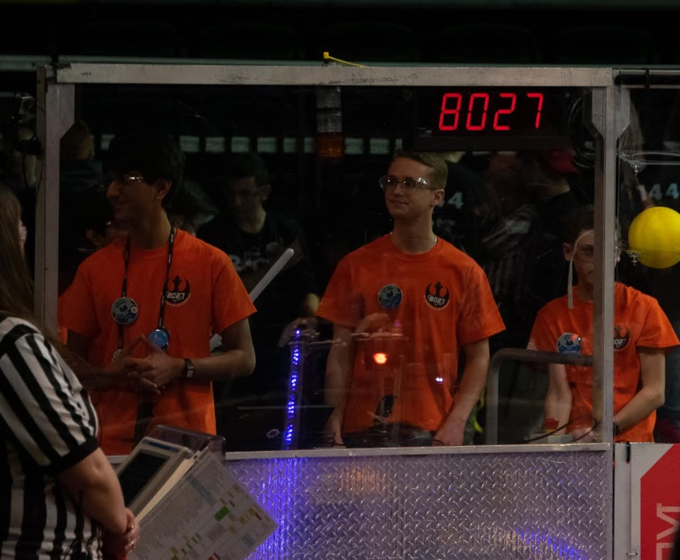
How do you pick a driver?
Some teams hold tryouts to pick the drivers every year
Most teams do not have a field. Therefore, drivers simulate their abilities in any empty space with some obstacles
Some teams pick young drivers and keep them for several years
Drivers must know the rules of the game and also demonstrate their driving skills
[Rookie Tip] Participate in off-season competitions and use them to try out drivers and to give them practice

Slide 4
Dependable and Calm
The drivers must take the responsibility seriously. It is an honor to be chosen by your team and you must represent the team well.
They need to be calm under pressure. Driving can get stressful.
They need to be reliable and wiling to come to extra practices. It takes practice to learn to drive.
They need to make their team their priority. Students with many other extracurricular commitments are usually unable to prioritize robotics.

Slide 5
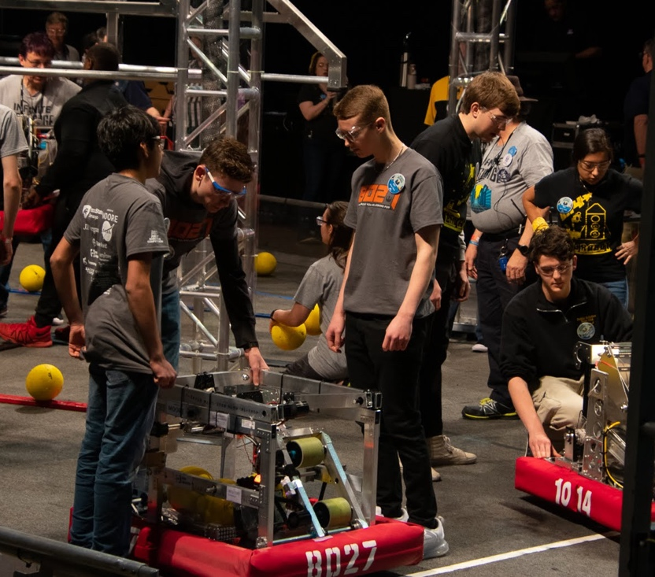
Strong Communication Skills
The drivers must be able to communicate easily and clearly with the coach, human player, each other, and other teams
They must be willing to listen as much as willing to speak
They must be able to take feedback from the rest of their team and other teams

Slide 6
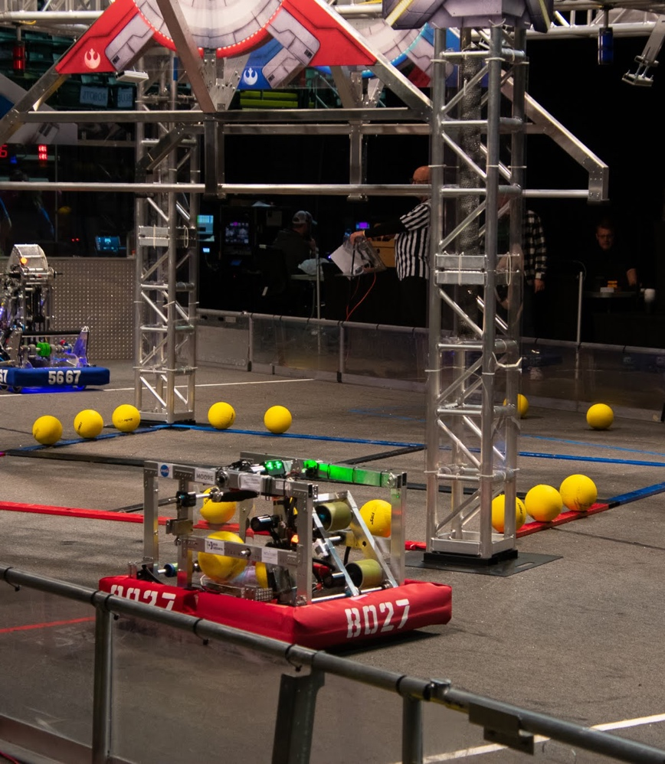
Think on the Fly
The game changes every time you play it because you have different teams on your alliance or your robot functions differently.
They must be able to make decisions quickly
They must be willing and able to adapt to the situation.

Slide 7
Talent
Drivers must be able to use controllers with ease
Excellent hand-eye coordination is necessary
They must be able to judge distances on the field
Good instinct and reaction times are needed
They must be aggressive (in a good way)

Slide 8
Overall Team Contribution
8027 also takes into account the overall commitment and contribution to the team since we believe that a student willing to put in additional hours and committed to producing high-quality work for the team has the necessary dedication level
A student who understands the robot (mechanical or programming) is also helpful as they may be able to make some decisions based on this knowledge.

Slide 9

Credits
This lesson was written by FRC 8027 for FRCTutorials.com
You can contact the author at team@droidsrobotics.org
More lessons for FIRST Robotics Competition are available at www.FRCtutorials.com
This work is licensed under a
Creative Commons Attribution-NonCommercial-ShareAlike 4.0 International License.

