Slide 1
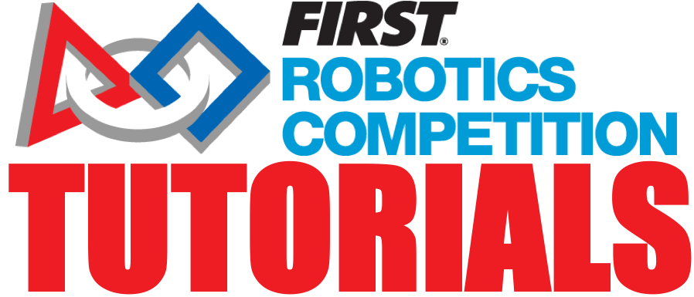
Electrical: Safety Concerns
FRC 624

Slide 2
SAFETY
Considering that we will be moving on to field training soon it’s important that we go over some safety reminders to prevent injuries.
Remember anytime you hurt yourself to tell your VP of Safety or a safety deputy what happened and make sure you write it up.

Slide 3
ELECTRICAL SHORTS
Caused by bare wire touching bare wire or exposed metal. Also can occur with contacts from the opposite polarity touching
All improper electrical paths need to be avoided to reduce the risk of injury and damage to both electrical and mechanical components.
Electrical components need to be kept clean of aluminum shaving/wires/debris (swarf) in any electrical component. This can cause a robot to dangerously malfunction or permanently damage electrical systems.
A dropped screw or nut can damage components by shorting-out the circuit board. An example of this is what happened to our Raspberry pi.
Electricity follows the path of least resistance. If the connection is not proper or sufficient for the components, excessive heating will be generated possibly causing damage, fire, or poor performance.

Slide 4
DANGERS OF 12 VOLTS
With 12 Volts and various current, if exposed wire gets in contact with its surroundings, it can cause damage.

Slide 5
PROPER INSULATION
Bare wire should never be showing. Damaged insulation should be reported and replaced. Wire connection with bare wire should be covered with electrical tape of appropriate color (black - ground, red - positive)
In areas where wire will rub against another surface, the surface should be deburred (if possible) and heat shrink wrap should be placed around the wire for extra insulation. Friction tape can also be used.

Slide 6
HANDLING BATTERIES
Never grab or hold battery by cables or terminals.
Carry them with both hands. If dropped, report to a mentor immediately, as the battery may be damaged and could possibly malfunction. If you notice leakage from a battery notify a mentor and then retrieve and use the acid spill kit from the safety station at the front of the bay.
Do not run 357 sec batteries below 12 volts while robot is in standby mode and do not run any battery until completely dead. Deep discharges of the batteries will permanently damage them to the point that full charge is not achievable making that battery useful for practice or cart status only.

Slide 7
DANGERS OF A HEAT GUN
The metal part of the heat gun is extremely hot. When bending plastic, bring a friend and use leather/other heat resistant gloves. When not using the gun, place it so the heated part is stably facing upwards and is not at risk of falling over and hitting someone or something. When completely finished, unplug the heat gun, allow it to cool by putting it into the holders on the side of the electrical bench, and wrap the wire up appropriately.

Slide 8
DANGERS OF A SOLDERING IRON
Extremely hot surface. When using solder, make sure it doesn’t get on your skin. It may burn you if it does. When you are not using the soldering iron during your work, place it back in its holder. If there is rosin build up on the iron, stick the iron into the tip cleaner. When you are finished, turn off the soldering iron while it is in its holder.
Do not breathe in the smoke from soldering iron. If the smoke is following you, use a small fan to blow it away.

Slide 9
STRIPPING WIRE
Stripping wire over the bot can cause shorts and generate short causing swarf. Do not strip wires over any electrical components.

Slide 10
PNEUMATICS
Before adding pneumatics to the bot, test the system/pistons/etc. with the pneumatic kit and mentor approval. Always have the switch on auto.
Beware staying in front of pistons or other pneumatic parts as they can deal out a massive amount of force and could result in injury.
Ensure that a pressure relief system is in place and working any time a pneumatic compressor is turned on.
Ensure that regulators are working properly.
If there is a hissing or popping noise, stop immediately and ask a mentor to check your pneumatic wiring/system.
Only use properly rated equipment on both the high side and low side of the pneumatic system.

Slide 11
ELECTRICAL BENCH HOUSEKEEPING
Connectors, sensors, tapes, etc. returned to their proper location
Heat guns, soldering irons, etc. returned to their proper location
Surge protector & bench light
Water bottles emptied and recycled
Student owned materials, bags, etc. returned to rightful owners
Food trash in bins (if after potluck, etc.) emptied in dumpster by two volunteers

Slide 12
TABLES IN BAY HOUSEKEEPING
Tools, parts, etc. that will not be worked on immediately in the next build session returned to their proper locations
Aluminum shavings, wood shavings, paper towels, etc. disposed of properly
Water bottles emptied and recycled
Student owned materials, bags, etc. returned to their rightful owners
Retractable extension cables reverted as far as possible
Food trash in bins (if after potluck, etc.) emptied in dumpster by two volunteers

Slide 13

Credits
This lesson was written by FRC 624 in partnership with FRC 8027 for FRCTutorials.com
You can contact the author at http://team624.org/
More lessons for FIRST Robotics Competition are available at www.FRCtutorials.com
This work is licensed under a
Creative Commons Attribution-NonCommercial-ShareAlike 4.0 International License.

