Slide 1

Developing a Team Culture
FRC 624

Slide 2
What is a team culture?
A team culture is the fundamentals of how a team works, plays, and acts.
It’s unofficial behavior guidelines and official traditions, as well as the relationships from student to student.
A positive team culture keeps you on the path of growth and success, draws in new members and helps retain returning members, and makes teams into families.

Slide 3
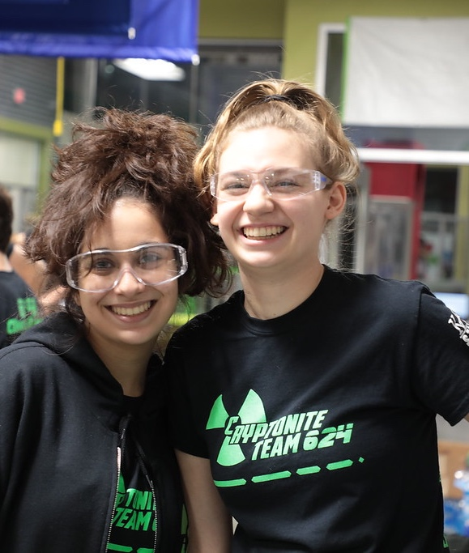
How do you create a team culture?
It's all about the little things.
Team dinners and potlucks, and occasional icebreakers or games will get any team off to a good start.
Traditions are also great for bonding team members, especially if the tradition is a little outside of the box.
With a little bit of love and a little time, a team culture will form by itself.

Slide 4
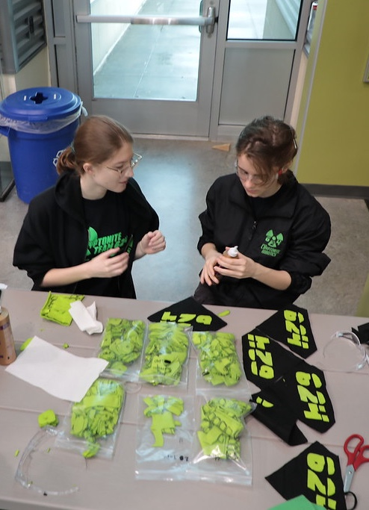
How do you promote a positive team culture?
Making sure a team culture doesn’t grow toxic can be hard, because a team culture is dependent on the people within it.
Create behavior standards and make sure they are enforced.
Set consequences, make sure the punishment matches the crime, and keep track of patterns.
A team meeting to discuss how that behavior can be addressed and prevented may be necessary.
For the students, self-policing and representing the team culture you want to have is effective.
For the coaches, be a good role model

Slide 5
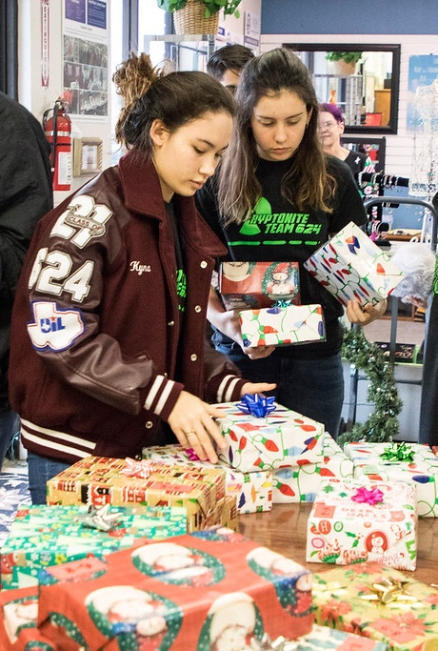
Team Bonding
One way we make sure our team culture is preserved is through various “team-bonding” events.
Team-bonding events are where we get together outside of a robotics context to do something just for fun.
We run a variety of events throughout the year, such as our team social, human player, and movie night, and host team potluck dinners every week during build season.
These events are easy to set-up and fun for both students and mentors.

Slide 6

Credits
This lesson was written by FRC 624 in partnership with FRC 8027 for FRCTutorials.com
You can contact the author at http://team624.org/
More lessons for FIRST Robotics Competition are available at www.FRCtutorials.com
This work is licensed under a
Creative Commons Attribution-NonCommercial-ShareAlike 4.0 International License.

