Slide 1

Bill of Materials (BOM)
Team 8027

Slide 2
What is a BOM?
BOM refers to a Bill of Materials. There is a link to the file from inside the Game Manual.
Every team must submit one to their Inspector at each event.
It is a spreadsheet that documents all the expenses on your robot
The total cost of all items on the robot cannot exceed $5000
No individual item may also exceed $500
There are detailed rules about how to account for fabrication
Read the rules in Section 9.4 of the Game Manual (https://firstfrc.blob.core.windows.net/frc2020/Manual/2020FRCGameSeasonManual.pdf)
[Rookie Tip] It is unlikely that a rookie team using the Kit of Parts is likely to exceed the $5000 limit, but be sure you still have the BOM filled out before Inspection

Slide 3
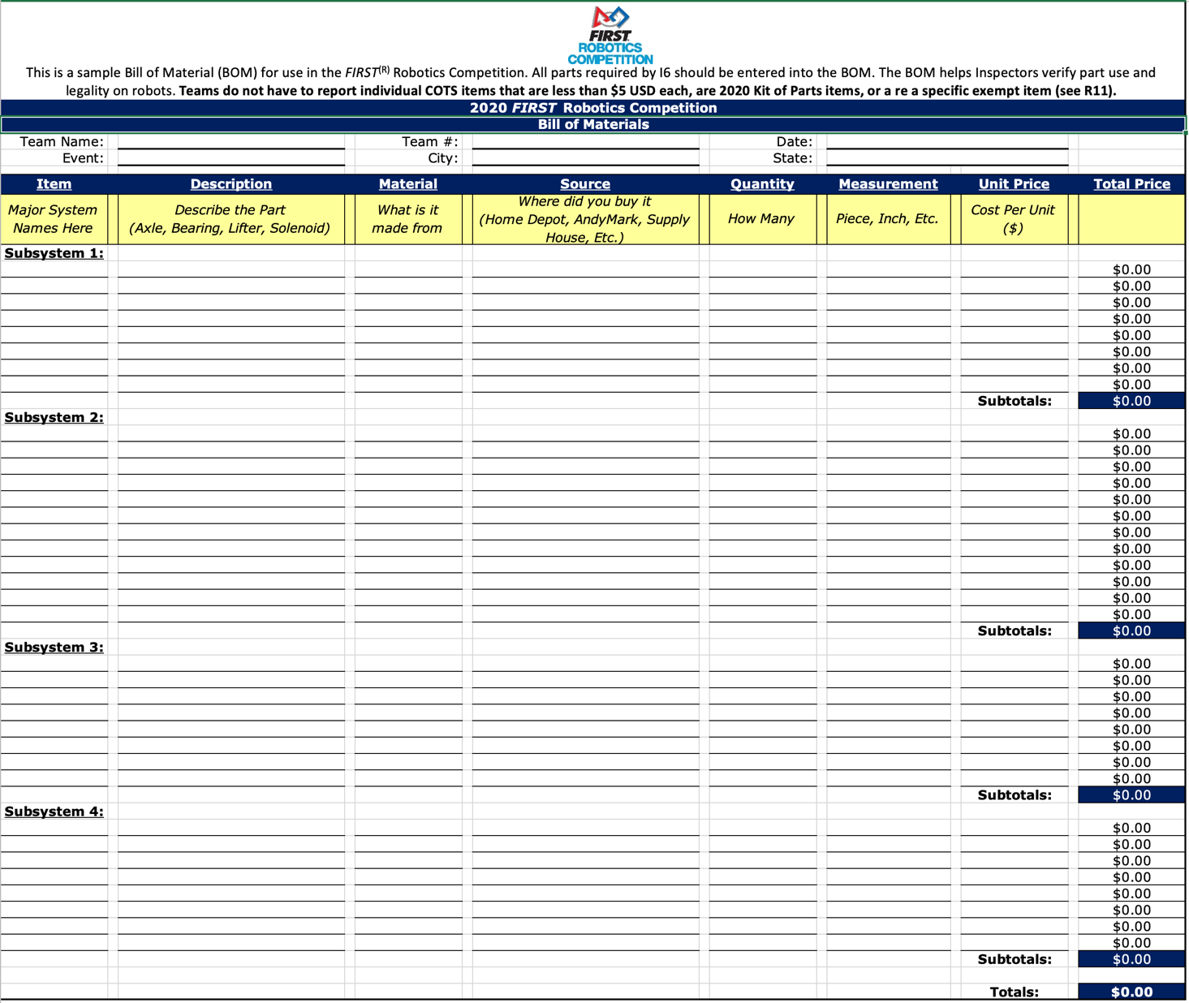
BOM Template from FIRST
Download the BOM template from FIRST
2020: https://firstfrc.blob.core.windows.net/frc2020/AuxFiles/2020BillofMaterial-Template.xlsx
[Rookie Tip] The BOM requires a fair bit of detail. It is important for the team to remember where you purchased the parts and the cost. Don’t wait until the last day.

Slide 4
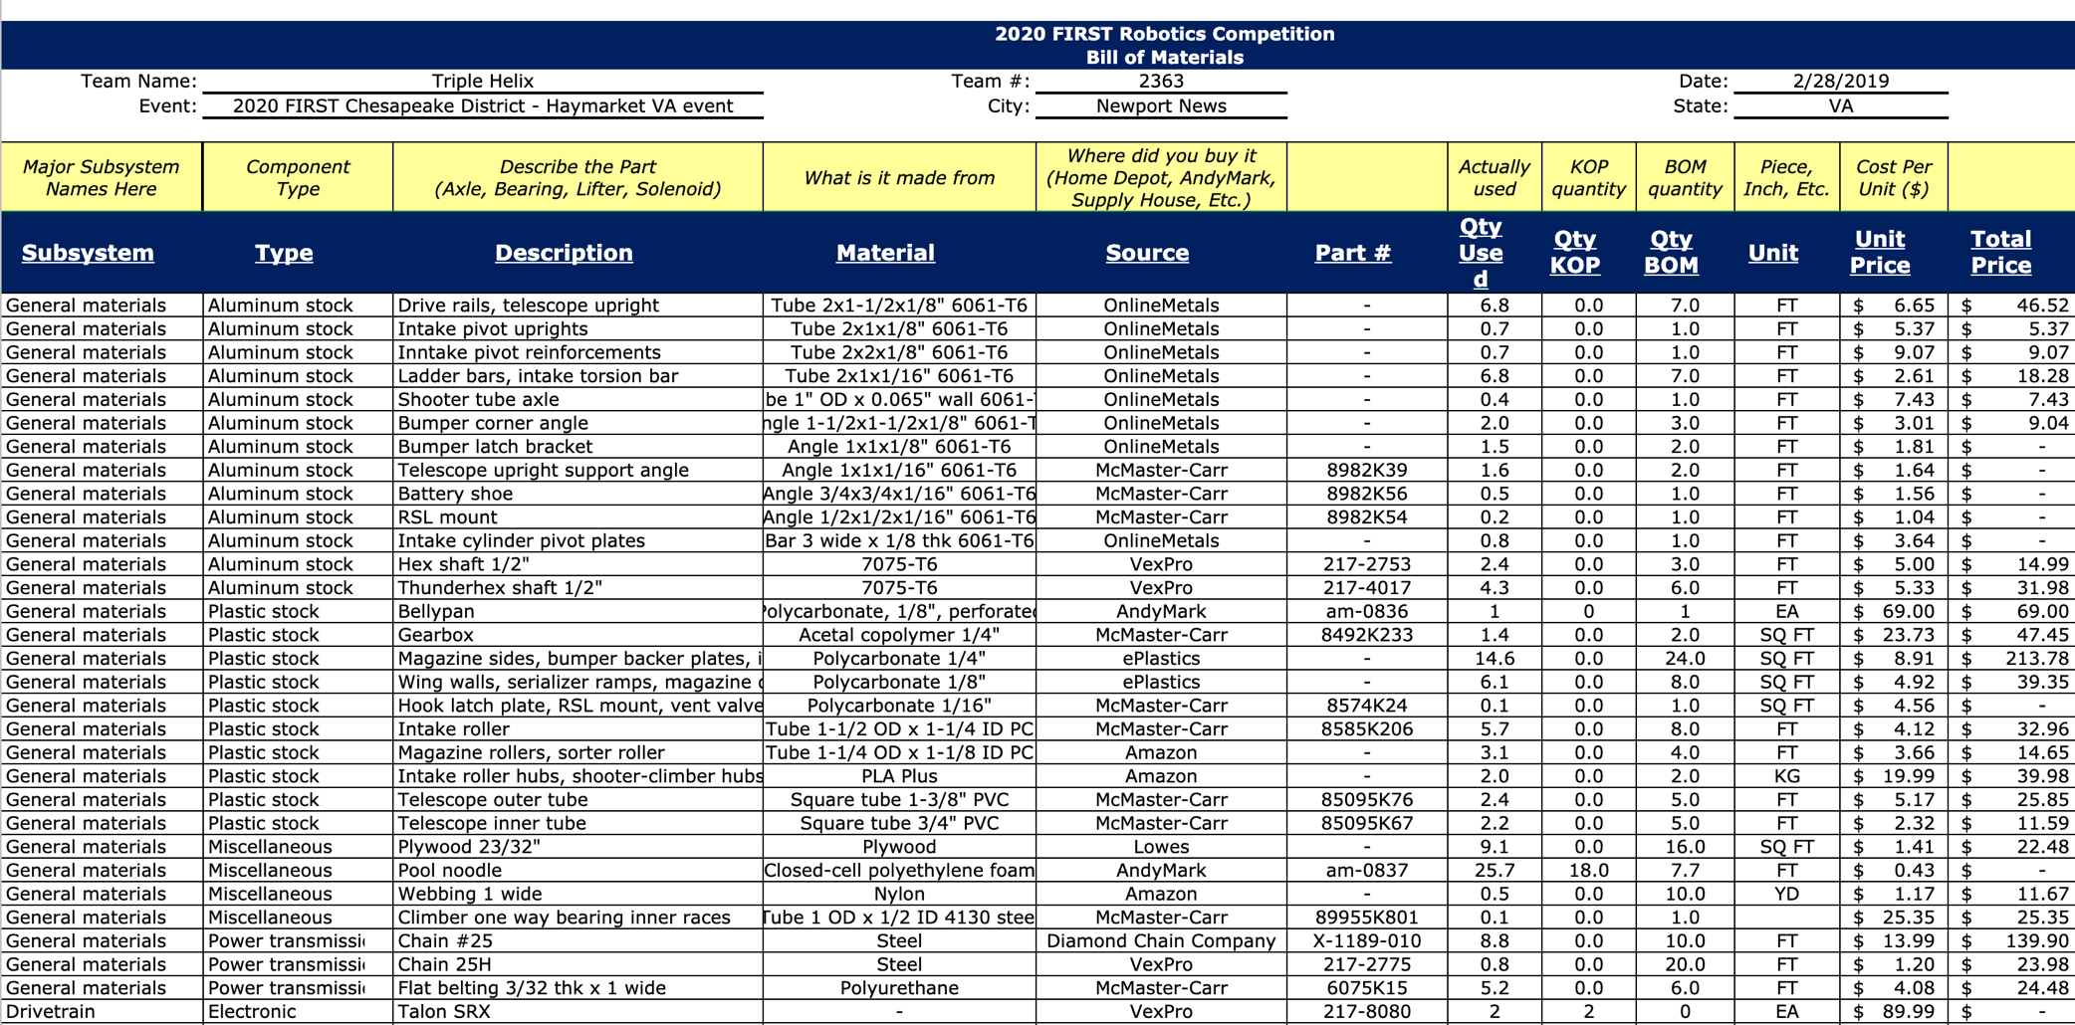
Sample BOM: FRC 2363
Source: https://docs.google.com/spreadsheets/d/1e-QDjoLRXlUStmRFy4l8-R2gZZbercMC_56jADxp0fc/edit#gid=1234046063

Slide 5
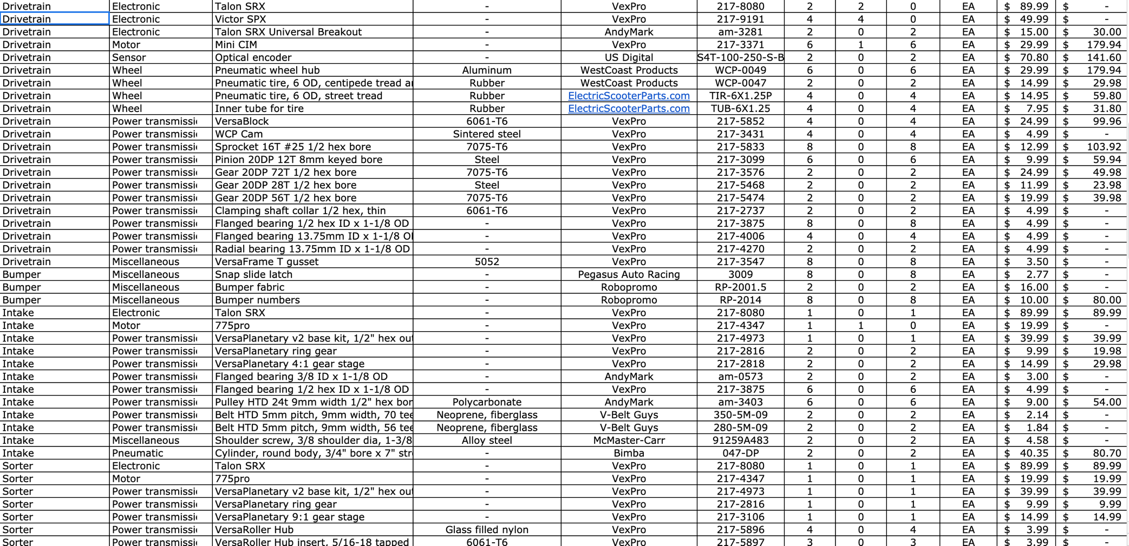
Sample BOM: FRC 2363
Source: https://docs.google.com/spreadsheets/d/1e-QDjoLRXlUStmRFy4l8-R2gZZbercMC_56jADxp0fc/edit#gid=1234046063

Slide 6
Exceptions
Items from your Kit of Parts, including anything purchased with your FIRST Choice Credits do not count against your total
Items that cost less than $5 each also do not count against your total
Also look for specific exemptions each year:
Specific exempt items listed in the 2020 manual:
i. One (1) Inertial Measurement Unit (Note that R12 still applies)
ii. Rockwell Automation sensors available through FIRST Choice in any season
iii. tags used for location detection systems if provided by the event

Slide 7

Credits
This lesson was written by FRC 8027 for FRCTutorials.com
You can contact the author at team@droidsrobotics.org
More lessons for FIRST Robotics Competition are available at www.FRCtutorials.com
This work is licensed under a
Creative Commons Attribution-NonCommercial-ShareAlike 4.0 International License.

