Slide 1

Bumper Basics
Team 8027

Slide 2
The role of bumpers in FRC
Depending upon your match, you might be either on the Red Alliance or the Blue Alliance
Based on the alliance, you have to have a matching bumper color
If your bumper falls off or changes colors in the middle of a match, the FTA can disconnect you from the field and not let you play
Since you keep your team number forever and always are either red or blue, your bumpers are reusable in future years.

Slide 3
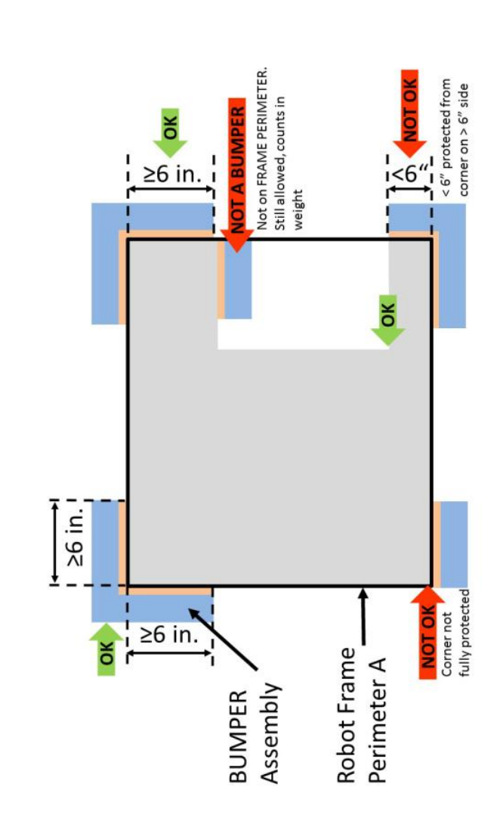
Bumper Rules
Read the Bumper Rules in Section 9.5 Carefully
https://firstfrc.blob.core.windows.net/frc2020/Manual/2020FRCGameSeasonManual.pdf
Some key rules:
At least 6 in (~16 cm) of bumper must be placed on each side of each outside corner
Be backed by ¾ in thick (~19mm) by 5 in ± ½ in. (~127 mm ± 12.7 mm) tall plywood
Bumpers should not be taller than 7.5 inches from the floor

Slide 4
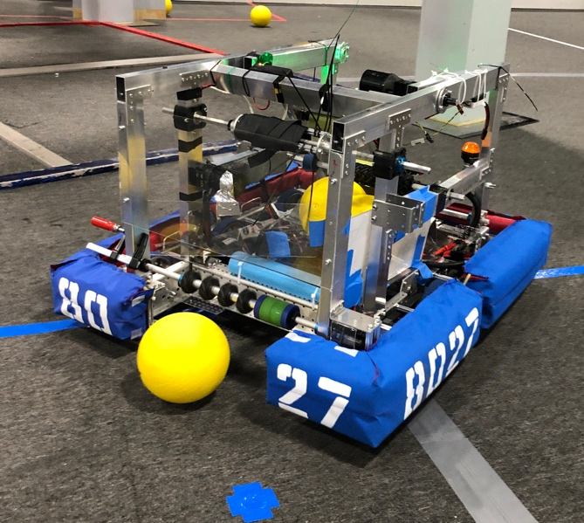
Bumper rules, cont.
Bumpers need to be very secure – should not fall off even if you bump into the field, field elements or run into an aggressive robot playing defense.
But, bumpers need to be able to come off and on for inspection

Slide 5
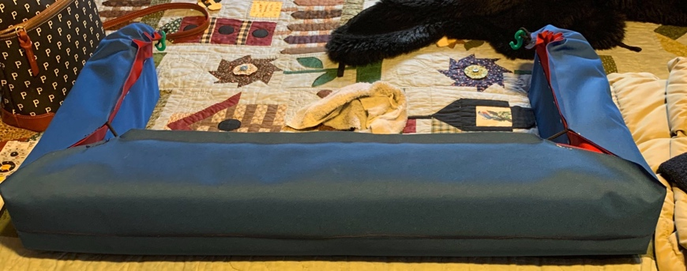
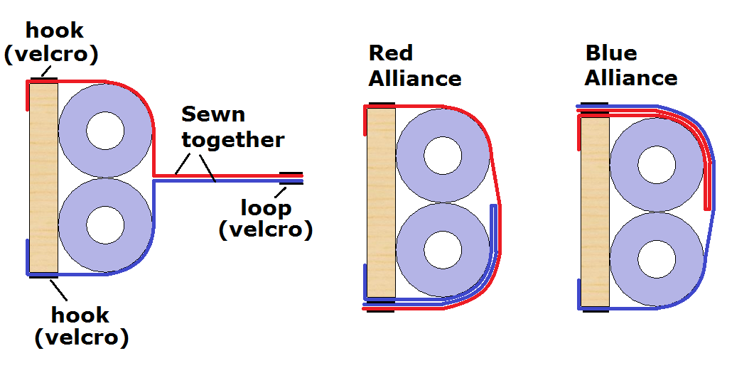
Tips for switching bumpers
Bumpers need to be switched out easily
According to the rules, bumpers should be able to be installed or removed by two people in fewer than five minutes.
If possible, get some help to make reversible bumper covers. That way, all you have to do is flip them to change the color. Some teams use snaps, some teams use Velcro. 8027 uses surgical tubing as elastic to hold the fabric in place.
RoboPromo sells reversible bumbers https://www.robopromo.com/
[Rookie Tip] Even if you have flippable bumper covers, remember that you need to be able to take them off and put them back on for Inspection
Image Source: Grabcad

Slide 6
Bumper Materials
Common materials used by teams include the following:
Cordura – this is most common and provided to teams in the Kit of Parts for rookies
Sailcloth – Teams use this material because it has less friction. Many teams use this in Infinite Recharge as the Power Cells (and other robots) glide off.
Vinyl – Some teams opt for vinyl cloth that is more durable and has less friction than cordura

Slide 7
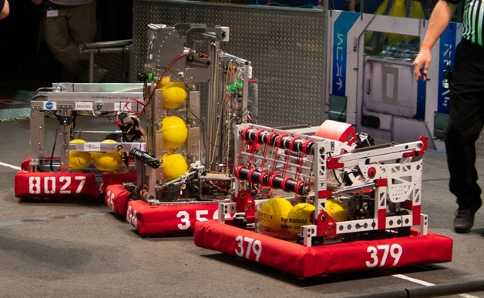
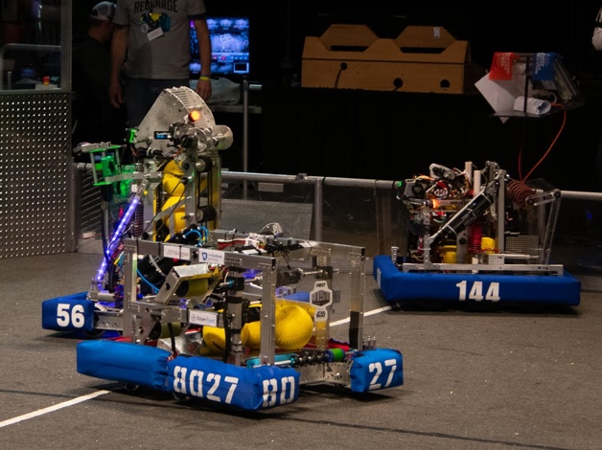
Bumper Numbers
You do need to add numbers to your bumpers to all the sides. You are allow to split up long numbers
The rules state: at least 4 in. (~11 cm) high, at least ½ in. (~13 mm) in stroke width, and either white in color or outlined in white [See rules for more details]
Teams apply numbers to their bumpers in different ways:
Iron-on numbers – RoboPromo sells them https://www.robopromo.com/
Hand painted – use stencils and white fabric paint. You will need to apply several layers
Silk Screen – you probably need to ask a professional for help here.
Stitch on fabric numbers – Less common, but you do see some teams with stitched numbers

Slide 8
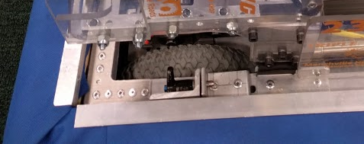
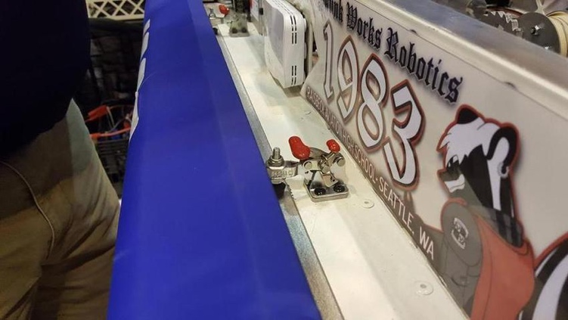
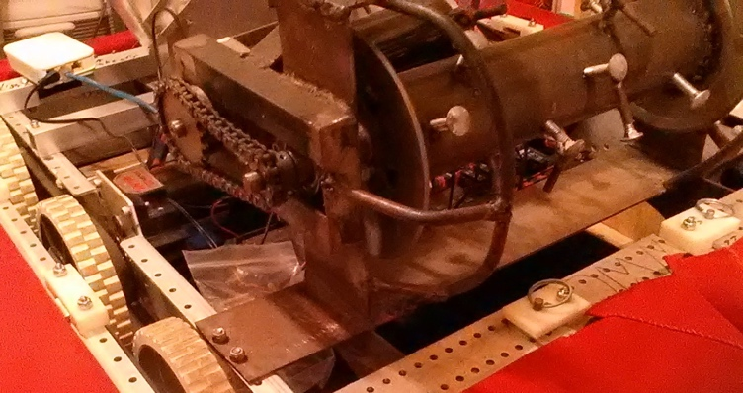
Bumper Mounting
There are many ways to attach bumpers
The hardware provided to rookies in the Kit of Parts can be challenging
Other common attachment mechanisms include:
Rivet Nuts
Toggle Clamps
Snap Latches
Ring-Grip Quick Release Pins
studs and cotter pins
Source: https://www.chiefdelphi.com/t/best-methods-of-bumper-mounting/152160/42
https://www.chiefdelphi.com/t/bumper-mounting/349135/24
https://www.chiefdelphi.com/t/1678-bumper-mount-questions/360409/2

Slide 9

Credits
This lesson was written by FRC 8027 for FRCTutorials.com
You can contact the author at team@droidsrobotics.org
More lessons for FIRST Robotics Competition are available at www.FRCtutorials.com
This work is licensed under a
Creative Commons Attribution-NonCommercial-ShareAlike 4.0 International License.

