Slide 1
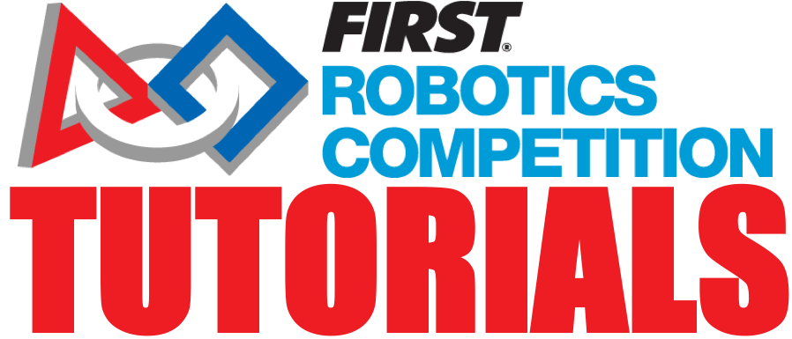
Passing Inspection
Team 8027

Slide 2
What is Inspection?
Every robot must pass inspection twice:
On Thursday. This is a full inspection. It can take an hour+
On Saturday before playoffs. This inspection round is easier. You just have to account for any changes from the previous round.
They will weigh your robot without bumpers and weigh the bumpers separately on Thursday at the Inspection station. After weighing, you will sign up for inspection in your pit.
On Saturday, you will not have to take off the bumpers for the reweighing process at the Inspection Station. If your weight has changed, you will have to explain it to the Inspectors.
Once you have completed inspection on Thursday, you are allowed to fill in for teams who have not shown up for their practice matches. Therefore, it is helpful to complete inspection early in the day.

Slide 3
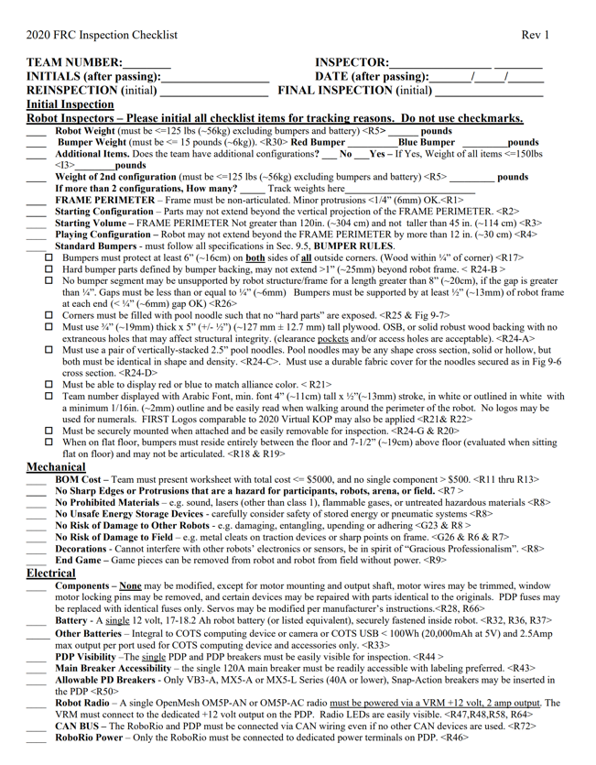
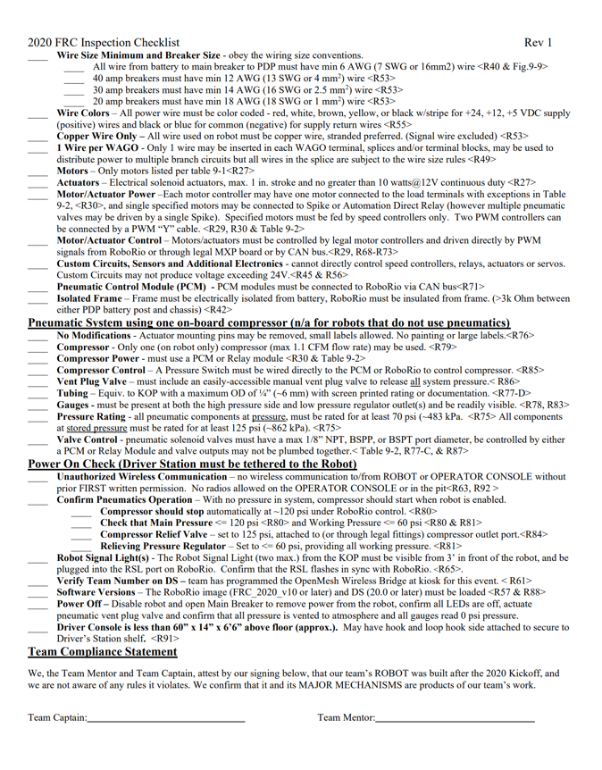
Know the Rules and Use the Checklist
The frame perimeter, wiring and bumper rules are available in the challenge documents (https://firstfrc.blob.core.windows.net/frc2020/Manual/2020FRCGameSeasonManual.pdf)
The Inspection Checklist is provided to all teams in advance so use it to conduct your own inspection the week before. There should be no big surprises https://firstfrc.blob.core.windows.net/frc2020/Manual/2020-inspection-checklist.pdf

Slide 4
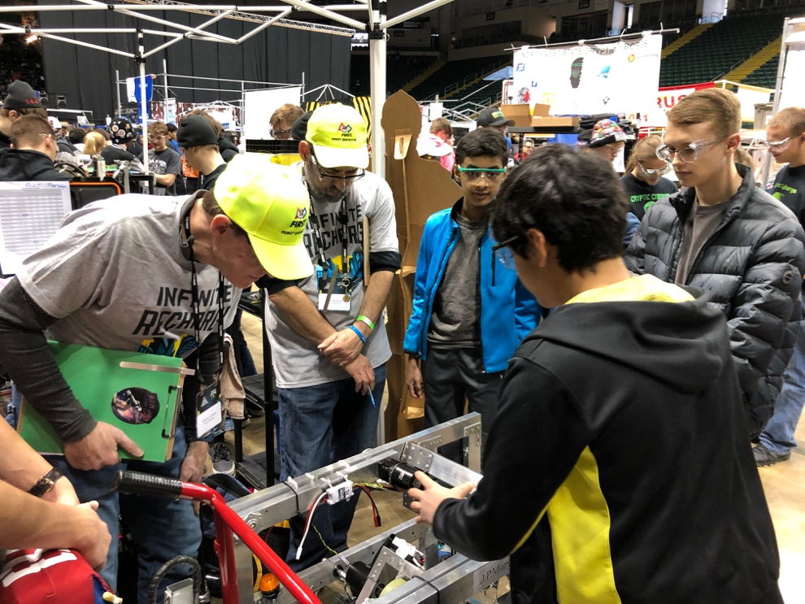
What to bring
Flashlight
Multimeter
Robot with all the mechanisms on it
Proof of wire gauge
Any documentation for pneumatics and electronics
Completed Bill of Materials (BOM) (https://firstfrc.blob.core.windows.net/frc2020/AuxFiles/2020BillofMaterial-Template.xlsx)

Slide 5
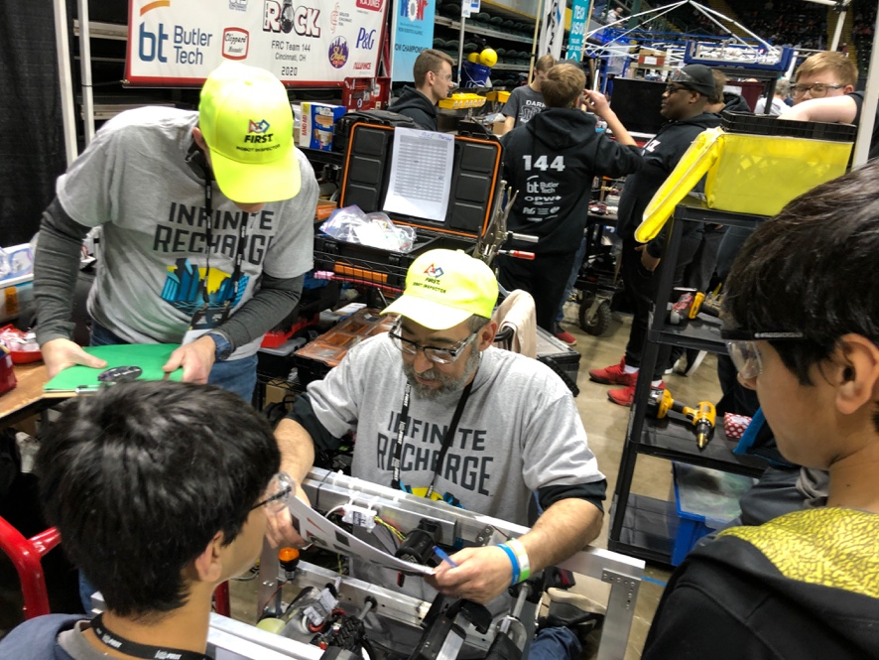
Tips for Success
Get inspected early. Get your robot weighed and then get in line for inspection as soon as you can.
That way, if you have any problems, you will have time during the day to solve them.
Keep your pit clean and organized
Make sure you have no protrusions/sharp edges
You must be able to take off and put back your bumpers during inspection within a reasonable amount of time.
[Rookie Tip] Talk to your inspector and ask them to explain if you don’t understand.

Slide 6

Credits
This lesson was written by FRC 8027 for FRCTutorials.com
You can contact the author at team@droidsrobotics.org
More lessons for FIRST Robotics Competition are available at www.FRCtutorials.com
This work is licensed under a
Creative Commons Attribution-NonCommercial-ShareAlike 4.0 International License.

