Slide 1

Competition Preparation
Team 8027

Slide 2
Schedule Overview
Wednesday evening: Optional load in for 5 team members
Thursday: Optional load for 5 team members, Inspection, Practice matches during the day.
Friday: Competition matches and judging, some non-team awards such as Woodie Flowers.
Saturday: More judging, last of the qualifiers, elimination rounds, awards

Slide 3
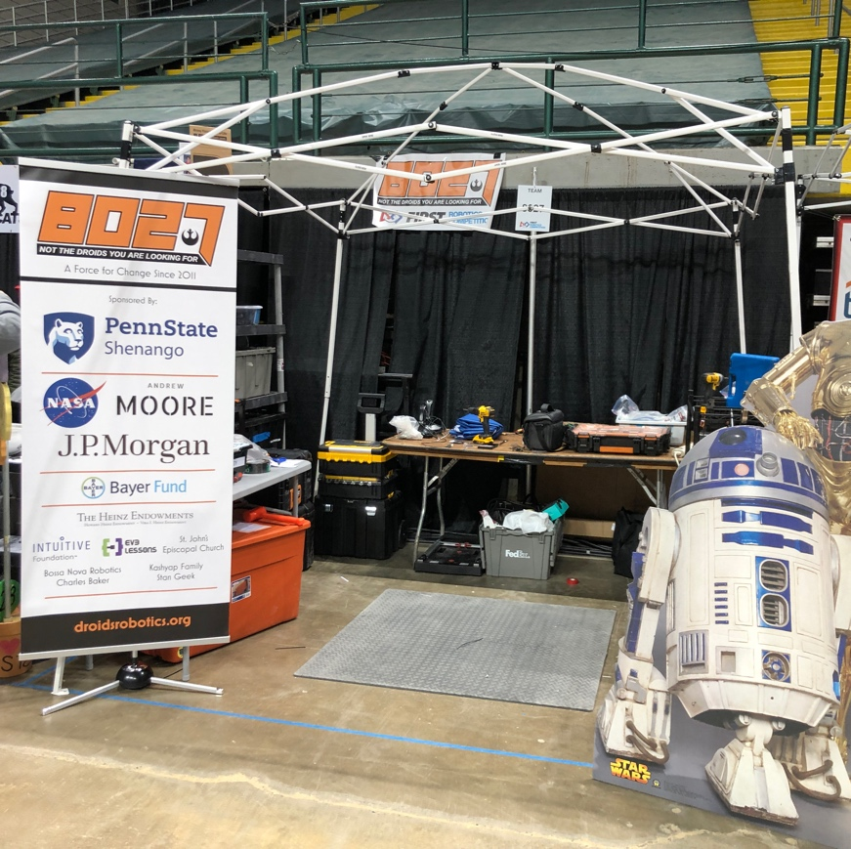
What to bring
A small folding table
All your tools, spare parts, supplies
Multimeter, electric tape, duct tape, zip ties
A small shop vac and cleaning supplies to keep your pit clean (trash bag, dustpan)
Something to demarcate you pit area – canopy, PVC structure, etc.
Safety glasses for your team
Robot cart to transport robot to the field
Bill of Materials (*required)
Team Roster and all Consent Forms (*required)
Chairman’s Documentation and Video on USB stick
Drive Team buttons (you will be given them at the event)
Most teams also have a sign to acknowledge their sponsors
Some pits are very elaborate. Others are simple. Follow your budget.

Slide 4
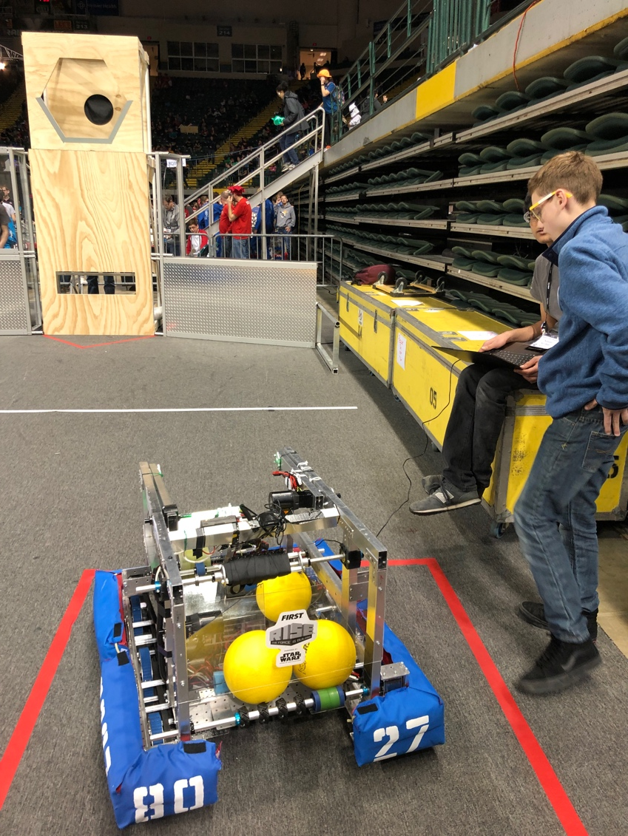
What is available for teams
There is usually a workshop with a drill press, bandsaw, vise and other tools you can access during the event.
There is usually a practice field where you can sign up for 15min practice slots (may vary by venue). 15mins goes by very quickly. Come to the field prepared so you don’t have to return to the pit for forgotten items.
The pit area is small. Your entire team is not going to be able spend their time there. Be prepared to have them sit in the stands.
It is loud, it is crowded, it is stressful. There is usually a quiet room, but prepare your students.
There are usually food options for purchases and lunches you can preorder

Slide 5
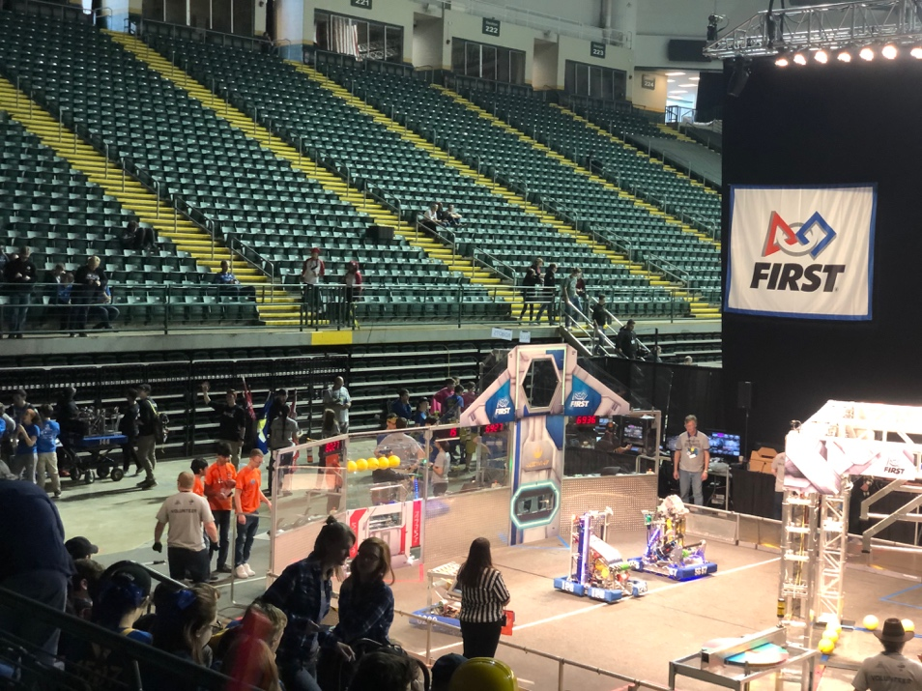
Event Tips
Only 5 team members may stay and work in the pits during Opening Ceremonies. No power tools during this time. Make sure your team knows this.
Do not save seats in the stands. Let other teams who want to see a match or two sit in the unused seats without causing them trouble. Be GP!
You may have to sign up for using the practice field. Do that as soon as possible.
You are not allowed to work on your robot on Wednesday evening – in the pit or in your hotel room.

Slide 6
Recommendations from 8027
Try to set up pit during the pit load in times
Assuming you are not facing any robot issues, go to the inspection table at the event and get your robot weighed
Get into the inspection queue. An inspector will come to your pit to continue inspection [see lesson on Inspection]
Once you have completed inspection, you are allowed to fill in for teams who have not shown up for their practice matches.
Have a student take your radio to the near the field to program it to connect to the field. You can do this before or after inspection. However, it will need to be completed before you arrive for your practice match.

Slide 7

Credits
This lesson was written by FRC 8027 for FRCTutorials.com
You can contact the author at team@droidsrobotics.org
More lessons for FIRST Robotics Competition are available at www.FRCtutorials.com
This work is licensed under a
Creative Commons Attribution-NonCommercial-ShareAlike 4.0 International License.

