Slide 1

FIRST Choice
Team 8027

Slide 2
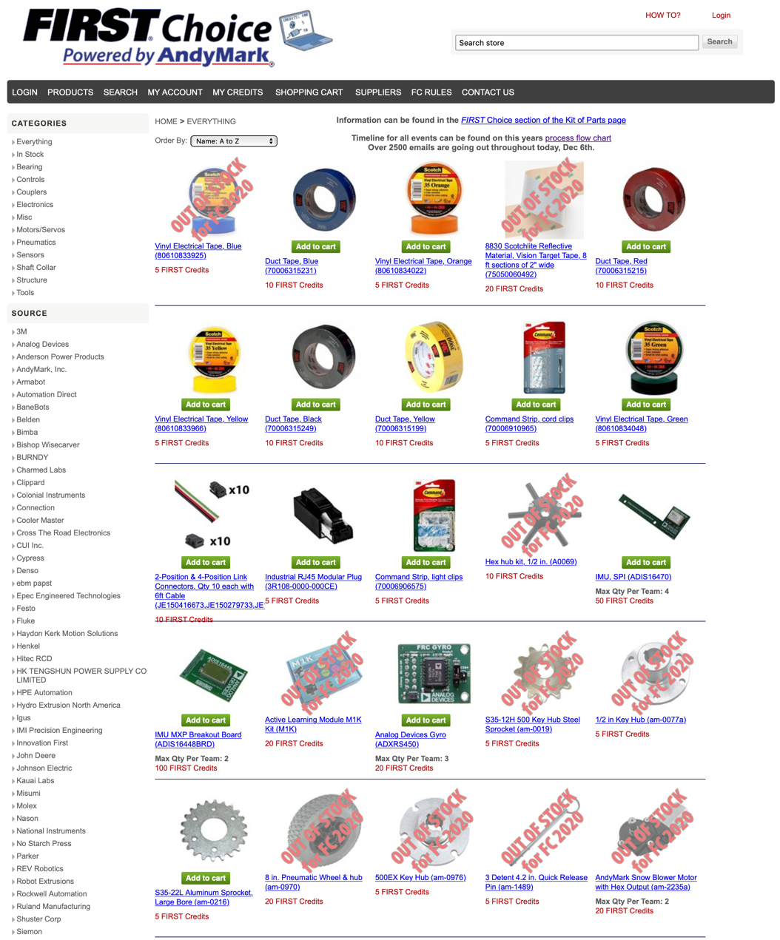
What is FIRST Choice?
FIRST Choice Kit of Parts (KOP) is basically a special storefront for FIRST Robotics Competition Teams (https://www.firstchoicebyandymark.com/everything)
Every FRC team is given credits to spend at the FIRST Choice store
Credits are given in two rounds. Round 1 deadline is usually early December and Round 2 is in early January.
If you don’t use up all your credits in the first round, you can use them in the second round. You get additional credits for Round 2
[Rookie Tip] It’s free other than shipping. Spend it and stock up for future years.

Slide 3
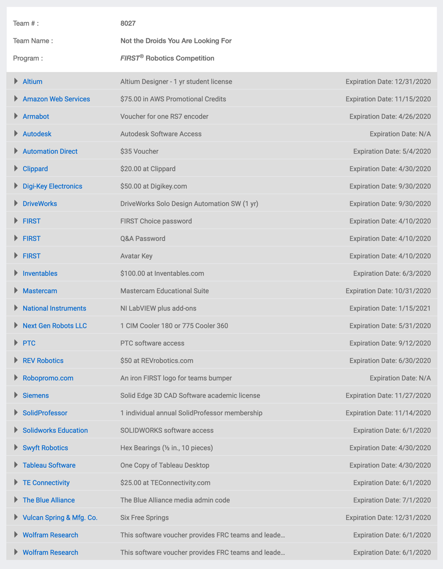
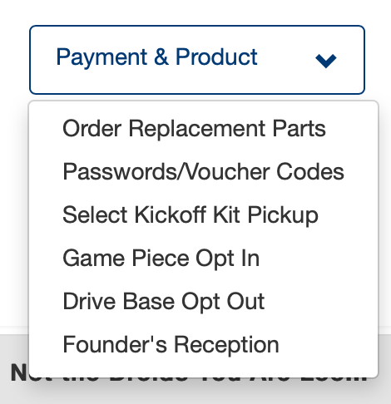
Voucher Codes
Every team is given a list of coupon codes to use at particular stores
These codes are unique to your team
These can be found from your FIRST Inspires Dashboard under Payment & Product
The codes and the deadlines to use them are clearly indicated
Your FIRST Choice password can be found on this page
[Rookie Tip] This is all free, so make sure you use it. Even if you do not use the item this season, it might be useful for next year

Slide 4
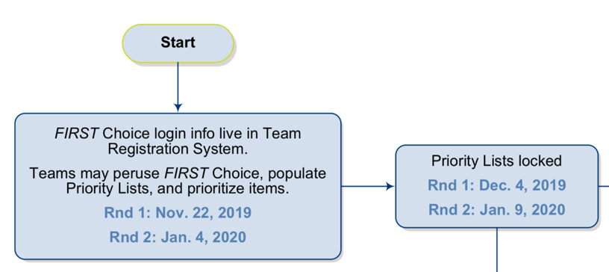
How many credits do we get?
In 2020, teams were given 580 credits in Round 1 + 275 credits in Round 2
You can visit the FIRST Choice Store to see how many credits typical items cost.
[Rookie Tip] Sometimes the cost to pay for the item in dollars is less than the cost in credits. Show wisely if your team is on a budget
[Rookie Tip] Not every item in the FIRST Choice is useful. For example, there is a LEGO building book listed and even some FTC game elements from past years!
Note that items obtained through FIRST Choice credits are considered to be KOP and may be accounted at $0 in your Bill of Materials (BOM)

Slide 5
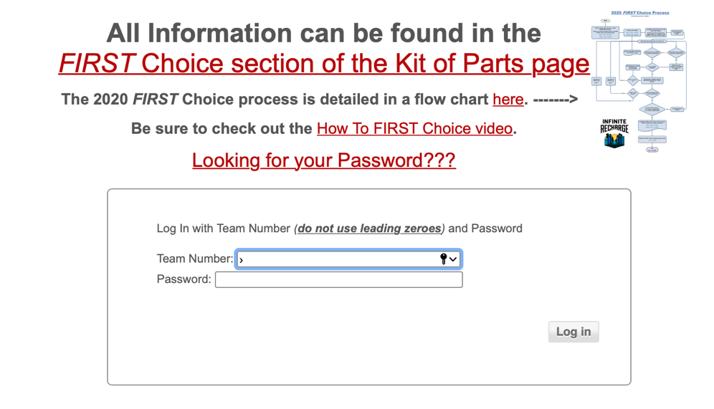
Step 1: Make an Account
Make an account and Login (https://firstchoicebyandymark.com/login)
You will need to know your team password for FIRST Choice

Slide 6
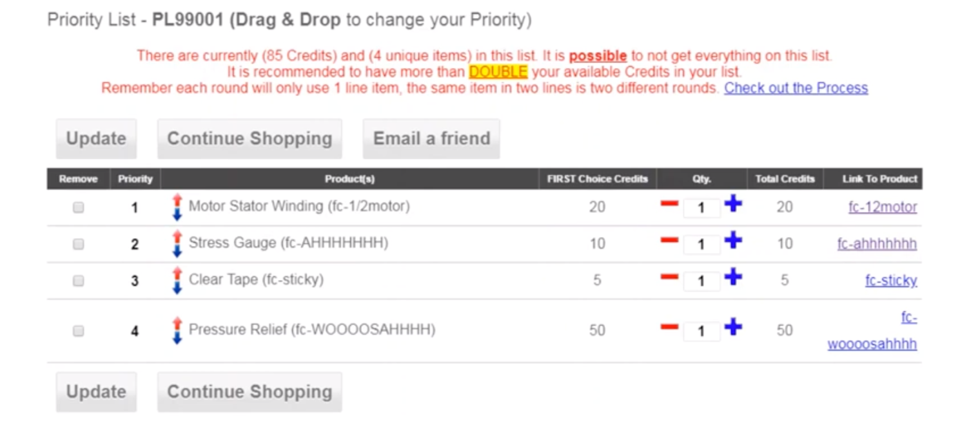
Step 2: Create a Priority List
FIRST and AndyMark use a priority list system
Teams indicate what items the like and then put them in an ordered list
You may not get all the items in your list. FIRST recommends that you list double the items you might have Credits for
If you don’t end up spending the Credits, you will get a chance to use them up after the two rounds are over on a first-come-first-served basis

Slide 7
Priority List Processing
The priority list is processed in “rounds”. In each round, a team is given the highest entry on their priority list that they have enough credits for and is still available. Note that multiple items still count as a single entry (e.g. you may get all 20 shaft collars that are 1st on your list in a single round).
[Rookie Tip] Carefully choose your priority order to maximize the value of FIRST Choice
Popular items (e.g. NEO motors, Spark Max controllers) will go out of stock quickly. If you really want these put them high on your list
In each round, you only get a single “entry” satisfied. So, make sure that your high priority entries have significant value (i.e. avoid putting a single roll of tape as high priority). You are better off getting something more valuable and buying the cheap item from the store.
New items (e.g. game pieces) are added to the store in the second round. While you get more credits, you may want to save some from the first round for these items.

Slide 8
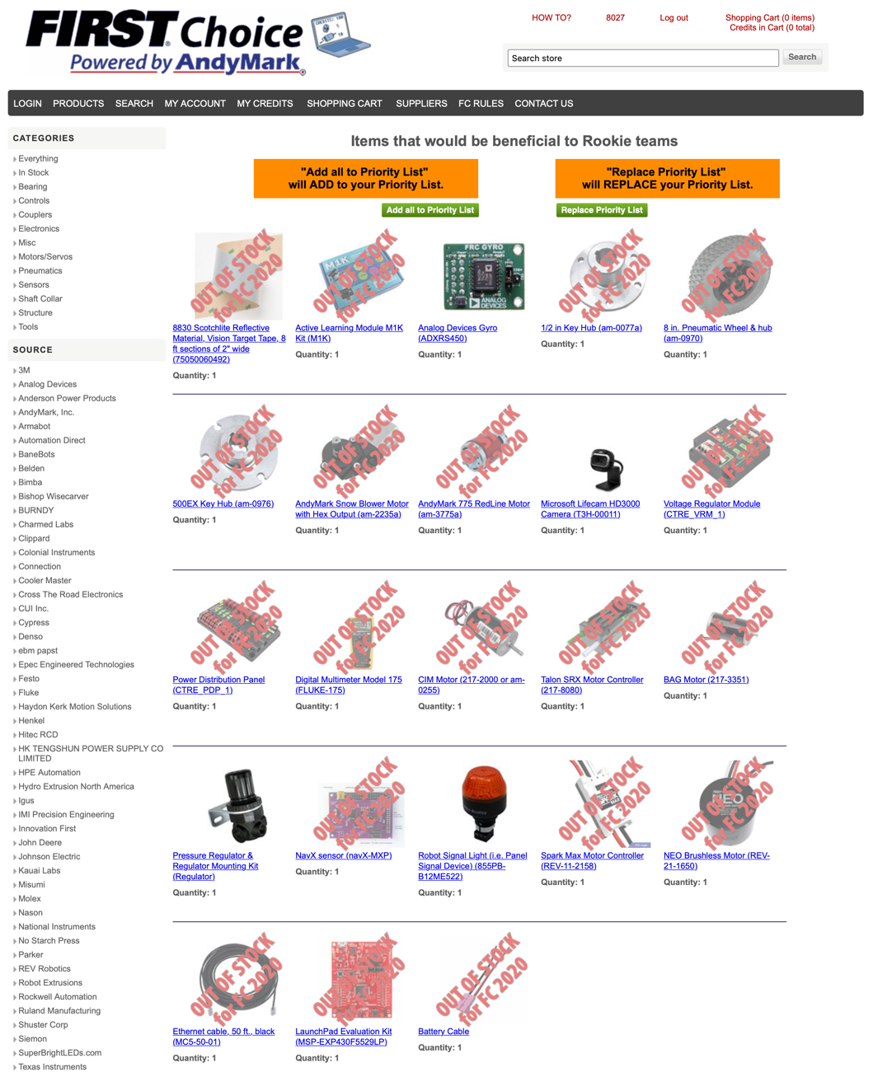
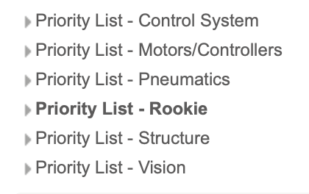
What should rookies get?
There are recommended lists on the FIRST Choice website. This is a good place to start (https://www.firstchoicebyandymark.com/priority-list-rookie)

Slide 9

Credits
This lesson was written by FRC 8027 for FRCTutorials.com
You can contact the author at team@droidsrobotics.org
More lessons for FIRST Robotics Competition are available at www.FRCtutorials.com
This work is licensed under a
Creative Commons Attribution-NonCommercial-ShareAlike 4.0 International License.

